Slide 1
CS231A Matlab Tutorial
Philip Lee
Winter 2015

Slide 2
Overview
Goals
Introduction to Matlab
Matlab Snippets
Basic image manipulations
Helpful Matlab tips and tricks

Slide 3

What is Matlab?
MAtrix LABratory
Scientific Tool
Good for:
Numerical analysis
Prototyping
Scientific computations
Not good for
Symbolic analysis
Large Systems
Computational efficiency

Slide 4
How to Get Matlab
Buy through Stanford
https://itservices.stanford.edu/service/softwarelic/matlab
Use the corn cluster
SSH into corn and use the following commands
ssh <suid>@corn.stanford.edu
module load matlab
matlab &

Slide 5
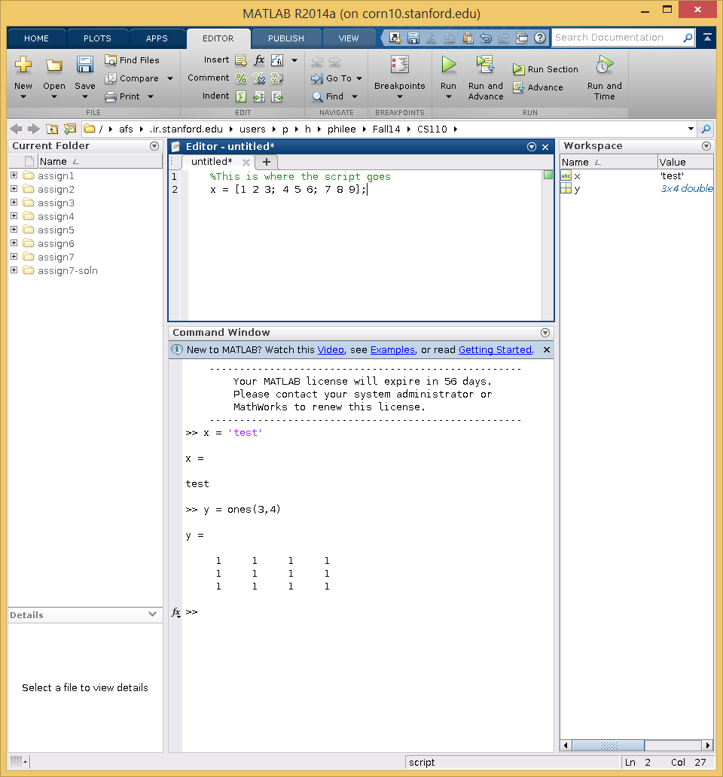
Matlab Screenshot
Workspace
Files in directory
“.m” files
Publish

Slide 6
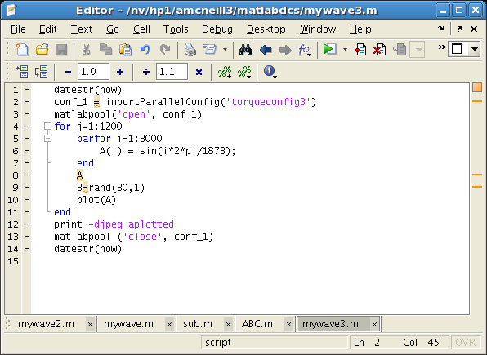
Small Matlab Snippets

Slide 7
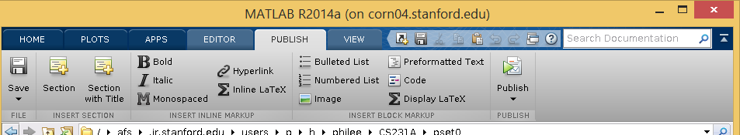
Publishing Scripts
Publish your scripts!
This makes it readable and inlines all of your plots/images

Slide 8
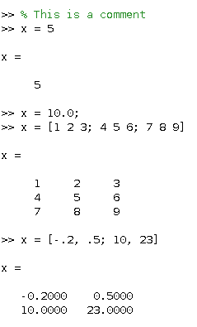
Small Matlab Snippets – Matrices / Vector Definitions
All variables in Matlab are matrices
Vectors are special cases of matrices
Case sensitive
Int, float, double, char, logical data types
Variations of these, i.e. uint8
Semicolons suppress outputs
Surround chars with single quotes (e.g. ‘c’)
Use spaces or colons to delineate values horizontally
Use semicolons to delineate values vertically

Slide 9
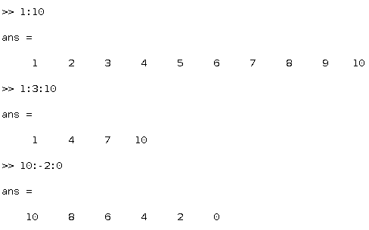
Small Matlab Snippets – Sequences
You can make row vectors of sequences very easily
Forward
Backward
Skipping

Slide 10
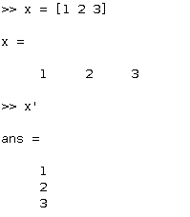
Small Matlab Snippets – Matrix Manipulations
Tranpose
Use single quote
Indexing
Starts at 1!
Can specify individual or group of values
Can use with multi-dimensional arrays
Can use end to denote end index

Slide 11
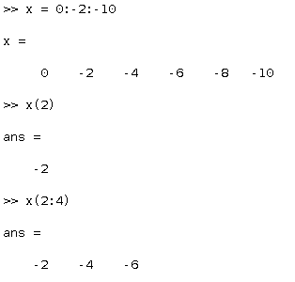
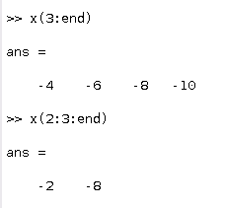
Small Matlab Snippets – Vector Indexing Examples

Slide 12
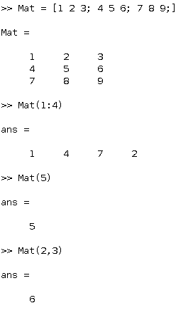
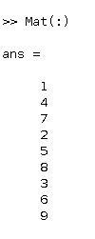
Small Matlab Snippets – Matrix Indexing Examples

Slide 13
Matrix Operations vs Element-wise Operations
Default operators are Matrix operations
+
-
*
/
^
Matrix-Matrix OR Matrix-vector operations
There are analogous element-wise operators
+
-
.*
./
.^
Scalar-Scalar operations

Slide 14
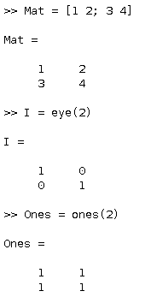
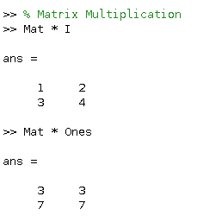
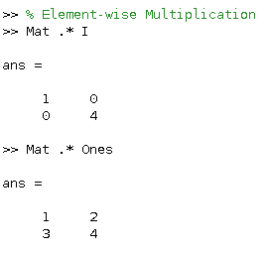
Matrix Operations vs Element-wise Operations Examples

Slide 15
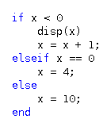


Control Flow
Comparison operators
>, >=, <, <=, ==, !=
If-elseif-else statements
While statements
For loops
Can use logical values

Slide 16
Functions
Function example
ones(M,N) or ones([M,N]) is an M-by-N matrix of ones.
Function definitions
Use a separate file
Generally not needed for homework assignments
Help command is your friend!
The following two syntaxes are equivalent
Function(‘arg’)
Function arg

Slide 17
Useful Functions
Ones / zeros
Create a matrix of ones or zeros
Size
Dimensions of the matrix
Diag (overloaded)
Diagonal elements of a matrix
create a diagonal matrix from a vector
Rand / randi / randn
Random generators
Max / min / sum / mean / median
Sort
Svd, eig,
Much more…

Slide 18
Plotting
Figures
Hold individual image / plot
Plots will overwrite each other unless you specify otherwise
Use the ‘hold’ command to lay plots on top of each other
Use the ‘figure’ command to specify which figure to use or if you should open a new figure
Title
Use ‘title’ command
Label axes
xlabel
ylabel

Slide 19
Plotting (cont.)
Various displaying functions
Plot
Scatter
Stem
Imshow
Shows an image (see next section)

Slide 20
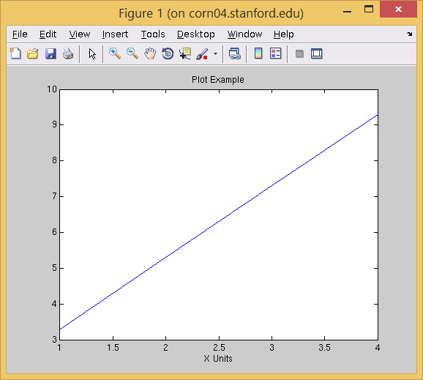
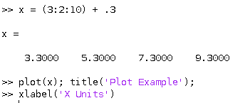
Plotting Examples
Can plot a vector as a sequence

Slide 21
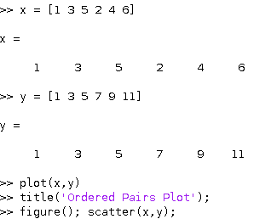
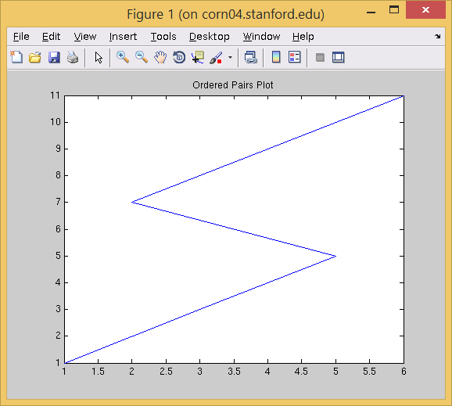
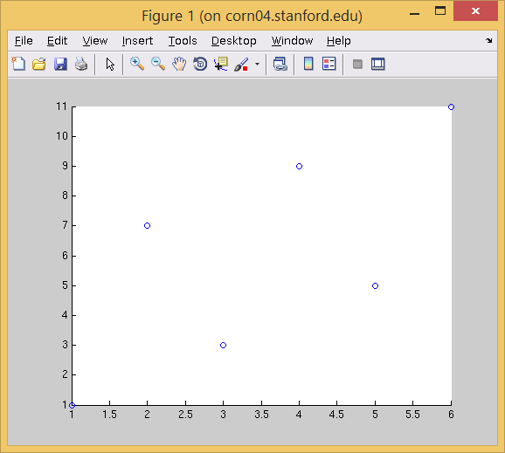
Plotting Examples (cont.)
Can plot two vector as ordered pairs

Slide 22
Images
Representation
Data type
Float / Double
0 is black
1 is white (or saturated)
Int
0 is black
255 is white (or saturated)
Can manipulate an image like any other matrix (after it’s read in)
Format
RGB
M x N x 3
Can think of as R,G, and B images laid on top of each other
Can be floats or ints
Grayscale
M x N
Can be floats or ints
Binary
M x N
Logical values

Slide 23
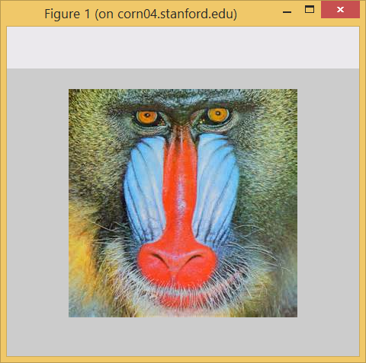
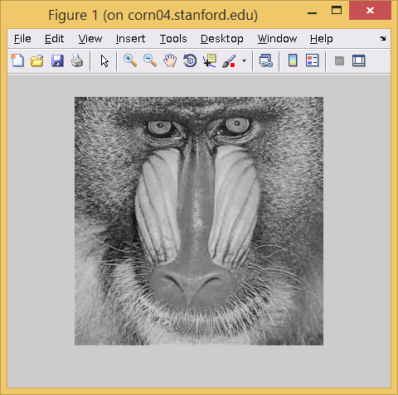
Image functions
Imread(‘filename’)
Reads in image as an RGB image
Saves image as a matrix representation (m x n x 3)
Imshow(matrix)
Displays matrix as if it were an image
Interprets scale (0 to 1 or 0 to 255) based on data type
Interprets RGB vs Grayscale based on dimensionality
Can convert between image types
Rgb2gray, gray2rgb
Cast data
May need to scale

Slide 24
Image functions
Imread(‘filename’)
Reads in image as an RGB image
Saves image as a matrix representation (m x n x 3)
Imshow(matrix)
Displays matrix as if it were an image
Interprets scale (0 to 1 or 0 to 255) based on data type
Interprets RGB vs Grayscale based on dimensionality
Can convert between image types
Rgb2gray, gray2rgb
Cast data
May need to scale

Slide 25
Tips and Tricks
Use the publish command to submit your work!
We will expect work to be published when you submit to Scoryst
Make sure your dimensions are right.
Element-wise vs matrix operators are the most common mistake by beginners
Use matrix operations instead of for loops. That’s what Matlab is for!
Use comments
Functions when necessary
May be needed for your project

Slide 26
More Text
http://web.stanford.edu/~wfsharpe/mia/mat/mia_mat3.htm

Slide 27
Questions?
Please feel free to ask questions in
Class
Discussion sections
Prof. Office Hours
TA Office hours
Piazza
Email
cs231a-win1415-staff@lists.stanford.edu
RIGHT NOW

