Slide 1
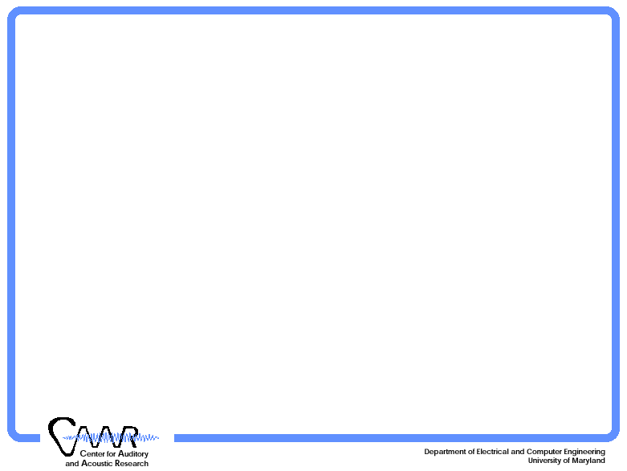
Computational Spectro-temporal Auditory Model
Taishih Chi
June 29, 2003

Slide 2
Auditory Model
Overview – two stage processing
Model description and formulation
Examples of representations
Reconstruction from model output representations
Discussions
Early Auditory
Primary Cortex (A1)
Spectral
Estimation
Auditory
Spectrum
Spectral
Analysis
Cortical
Representation
Sound

Slide 3







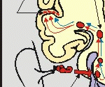
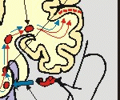




Auditory Model
Overview
Temporal dynamics reduction
Monaural model
Two stage functional model
  Early stage (spectrum estimation)
  Cortical stage (spectrum analysis)

Slide 4
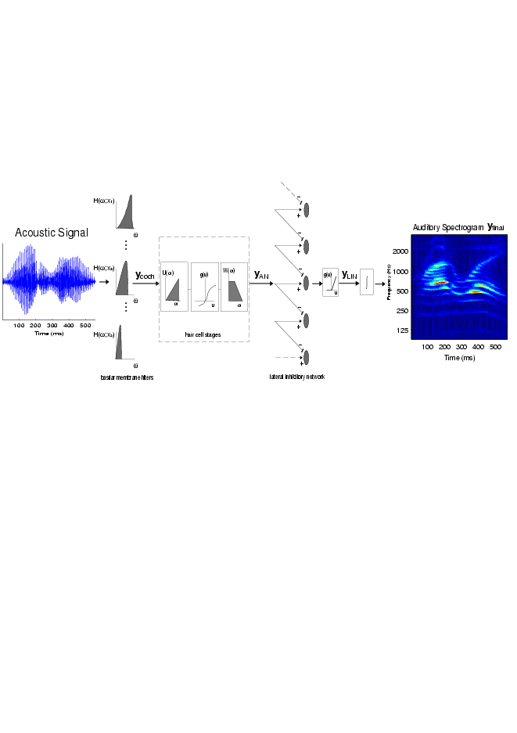
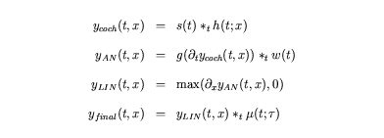
Early stage
Mathematical Formulation

Slide 5
Early Stage MATLAB Implementation
Matlab ToolBox Usage:
yfinal = wav2aud(s, [frmlen, tc, fac, shft], filt);
s : acoustic input signal
yfinal: auditory spectrogram; N(time) x M(freq.)
CF = 440 * 2 .^ ((-31:97)/24 + shft);

Slide 6

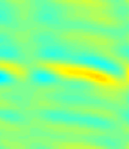




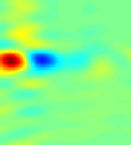
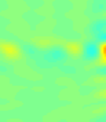
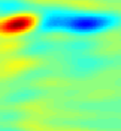
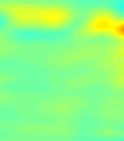

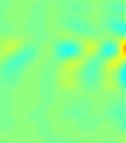
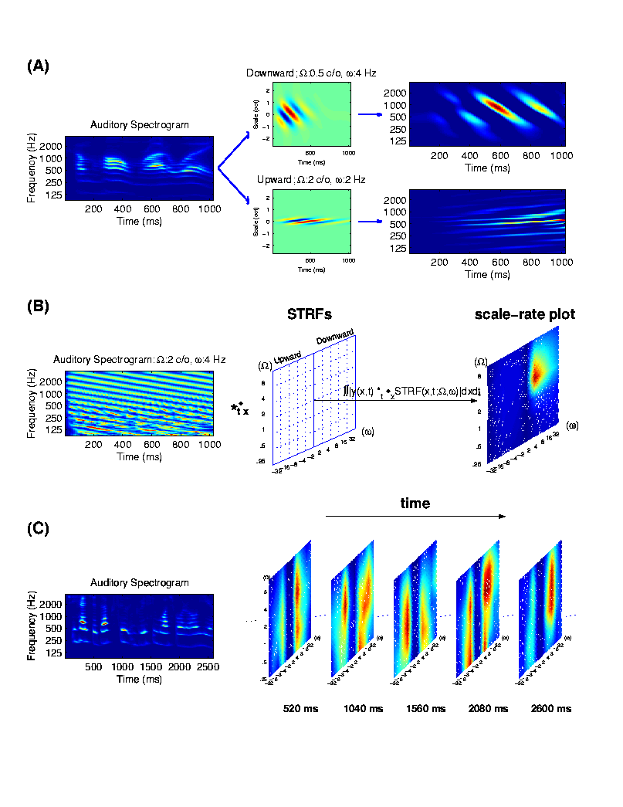
Cortical stage
Spectrotemporal Receptive Field
4
A
4
B
4
C
Frequency (kHz)
Frequency (kHz)
Frequency (kHz)
0
.
1
2
5
0
.
1
2
5
0
.
1
2
5
0
Time (ms)
250
0
Time (ms)
250
0
Time (ms)
250
4
D
4
E
4
F
Frequency (kHz)
Frequency (kHz)
Frequency (kHz)
0
.
1
2
5
0
.
1
2
5
0
.
1
2
5
0
Time (ms)
250
0
Time (ms)
250
0
Time (ms)
250

Slide 7
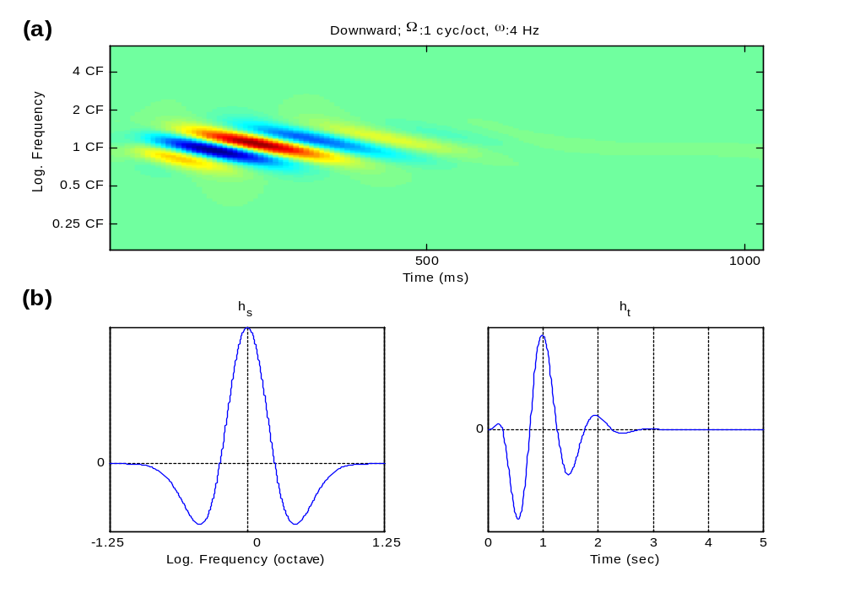

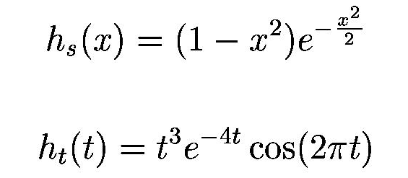
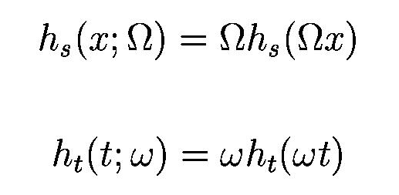
Cortical stage
Model Implementation

Slide 8
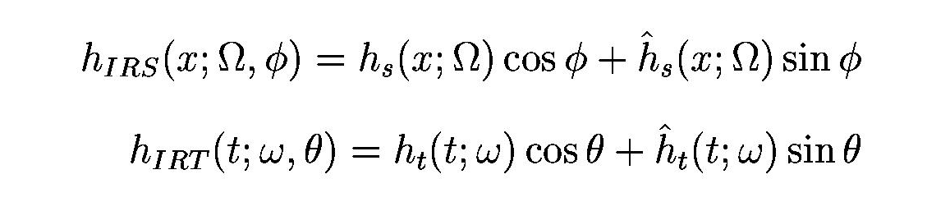
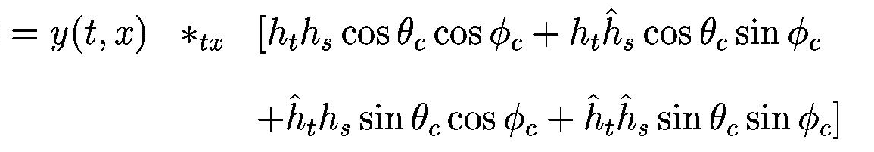
Cortical stage
Mathematical Formulation
where
then the spectrotemporal cortical response:

Slide 9
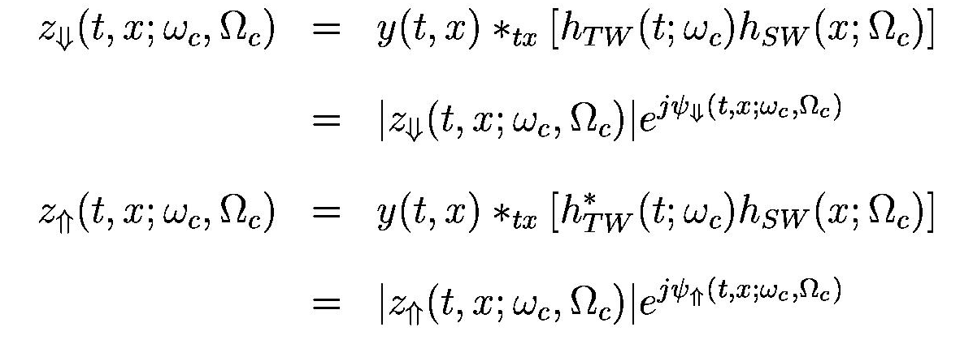
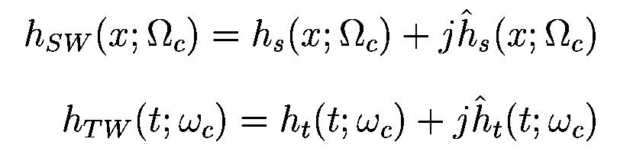
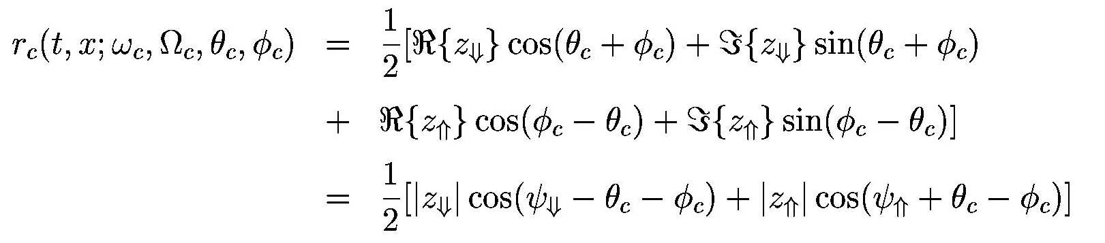
Cortical stage
Mathematical Formulation (cont’d)
Consider the complex wavelet transform
where
then

Slide 10
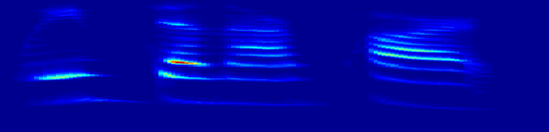
















Cortical stage
Cortical Representation of Speech
2000
1000
Frequency (Hz)
500
250
125
100
200
300
400
500
600
700
800
900
1000
Time (ms)
Multiresolution Cortical Filters and Outputs
Fast Rate
Slow Rate
Slow Rate
Fast Rate
Fine Scale
Fine Scale
Fine Scale
Fine Scale
Upward
Downward
Fast Rate
Slow Rate
Slow Rate
Fast Rate
Coarse Scale
Coarse Scale
Coarse Scale
Coarse Scale

Slide 11
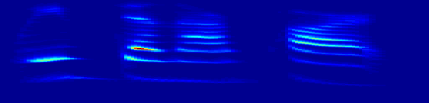















Cortical Magnitude Representation of Speech
Auditory Spectrogram
2000
1000
Frequency (Hz)
500
250
125
100
200
300
400
500
600
700
800
900
1000
Time (ms)
Multiresolution Cortical Filters and Outputs
Fast Rate
Slow Rate
Slow Rate
Fast Rate
Fine Scale
Fine Scale
Fine Scale
Fine Scale
Upward
Downward
Fast Rate
Slow Rate
Slow Rate
Fast Rate
Coarse Scale
Coarse Scale
Coarse Scale
Coarse Scale

Slide 12
Cortical Stage MATLAB Implementation
Matlab ToolBox Usage:
cr = aud2cor(y, para1, rv, sv, fname, DISP);
cr : 4D cortical representation (scale-rate(up-down)-time-freq.)
y : auditory spectrogram, N(time) x M(freq.)
para1 = [paras FULLT FULLX BP],paras:see WAV2AUD
FULLT (FULLX): fullness of temporal (spectral) margin.
BP : pure bandpass indicator.
rv : rate vector in Hz, e.g., 2.^(1:.5:5).
sv : scale vector in cyc/oct, e.g., 2.^(-2:.5:3).

