Slide 1
COMP2711H-Tutorial-Permutation and Combination
Chengbo Zheng

Slide 3
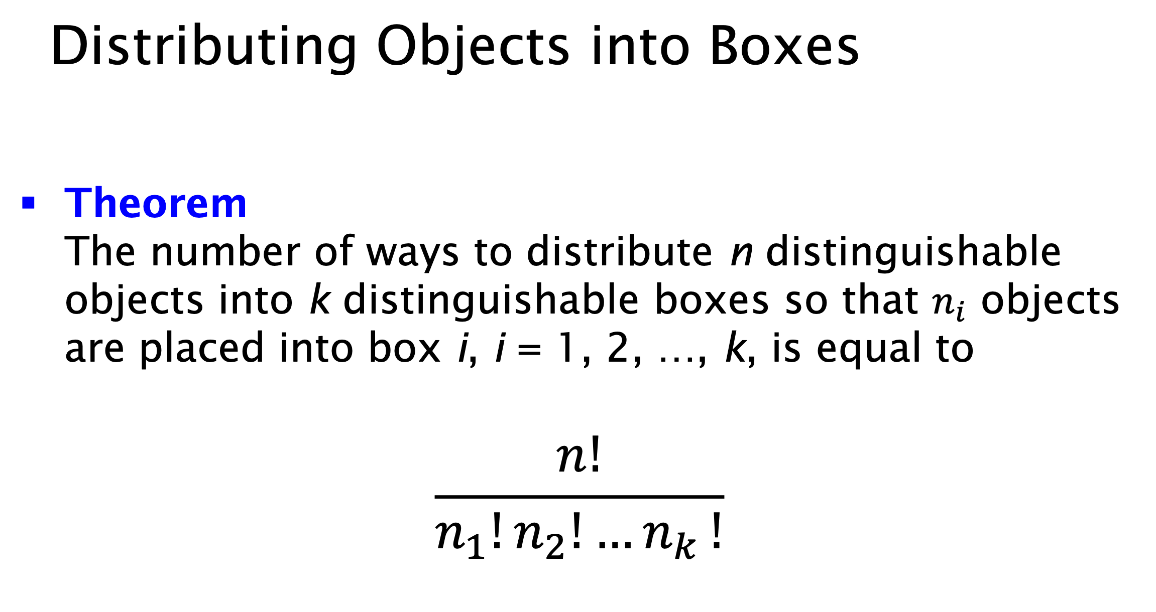

Slide 4



Slide 5



Slide 6

Ann
Bob

Slide 7

Ann
Bob

Slide 8


Slide 9


