Slide 1
Combining Worked Example and Problem Solving in a Data-driven Logic Tutor
Zhongxiu Liu, Behrooz Mostafavi, Tiffany Barnes
Presenter: Chen Lin

Slide 2
Motivation
A Pedagogical decision in a complex data-driven logic proof tutor:
When to provide a problem to solve (PS) or worked example (WE)
Introduction
Notes:
The motivation of this study is a pedagogical decision in a complex data-driven logic proof tutor: either to provide a problem for students to solve, or a complete solution for students to review during the tutoring session

Slide 3
Related Work - Worked Example (WE)
Inexperienced learners benefit most from worked example (Kalyuga, 2001)
Interleaving WE and PS helps solve problem faster and more accurate than blocked PS WE (trafton, 1993)
Introduction
Notes:
To establish a base ground, i’m going to first introduce some related work on worked example. Decades of studies have shown that work example is pedagogically benefitcial. Among them, Kalyuga found inexperienced learners benefit most from worked example. Trafton found that interleaving worked example and problem solving helped students solve post test problem faster and more accurate, compared with presenting problem solving and worked example in blocks

Slide 4
Related Work - Worked Example (WE)
In tutor: replacing PS with WE increases learning efficiency but not learning gain (Mclaren, 2008)
However, when to present and how to design WE in tutor is still not clear (Najar, 2007)
In our tutor: previously, worked example reduces time spent by 27%, increases completion by 14% and retention by 35% (Mostafavi, 2015)
- however, this comparison is between classes taught at different years.
Introduction
Notes:
In intelligent tutor. McLaren has found that replacing problem solving with worked example does not increase learning gain, but significantly increase learning efficiency. However, a recent literature review by Najar 2007 concludes that research on when to present worked example is still inconclusive.
Additionally, WE has shown its potential in Deep thought. our prior work with the same tutor in the study, we found WE reduce time spent by 27%, increase completion by 14% and increased retention by 35%. However, this analyses compared classes taught at different years, which show the potential of worked example, but the analyses are not scientifically strict.

Slide 5
This study
Evaluate the impact of WE and PS in a logic proof tutor, in authentic classroom settings.
H1: WE reduces problem-solving time and hint usage, but will not impact other observation of students responses (solution length/logic rule application accuracy)
H2: The number of WEs and their ordering with PS matters. Interleaving WE and PS results in better performance
Introduction
Notes:
In this study, we evaluate the impact of worked example and problem solving in Deep thought - a logic proof tutor, in an authentic college classroom settings. Based on previous study, our first hypothesize is that worked example will reduce problem solving time, decrease students hint usage, but may not have impact on other performance measurements. Our second hypothesize is that the number and ordering of WE/PS matters. Based on previous work, Interleaving WE and PS result in better performance then presenting WE and PS in blocks

Slide 6
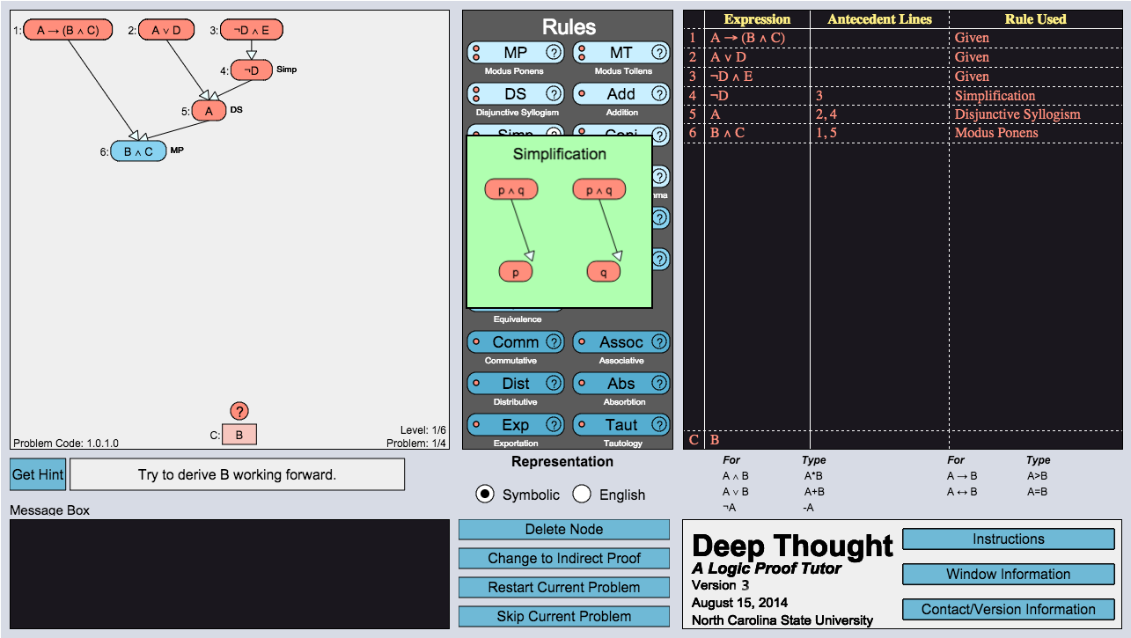
Deep Thought - PS
II. Students solve problem by highlighting existing clauses, and applying logic rules to derive new clauses
I. The problem: Derive B from the three given clauses
III. Students can request next step hint
Deep Thought Tutor
Notes:
Now we understood the research questions, let’s proceed to the content of this study. This study is conducted in Deep Thought - a data-driven logic proof tutor.
Here is an example of problem in deep thought(PS). The problem is to derive clause B from the three given Clause. Students solve the problem through highlighting existing clauses, and apply logic rules to derive new clauses. Students can click on logic rules and see a graphical description on the rules. Student can also request next step hints, which are automatically generated from past student’s solutions.

Slide 7
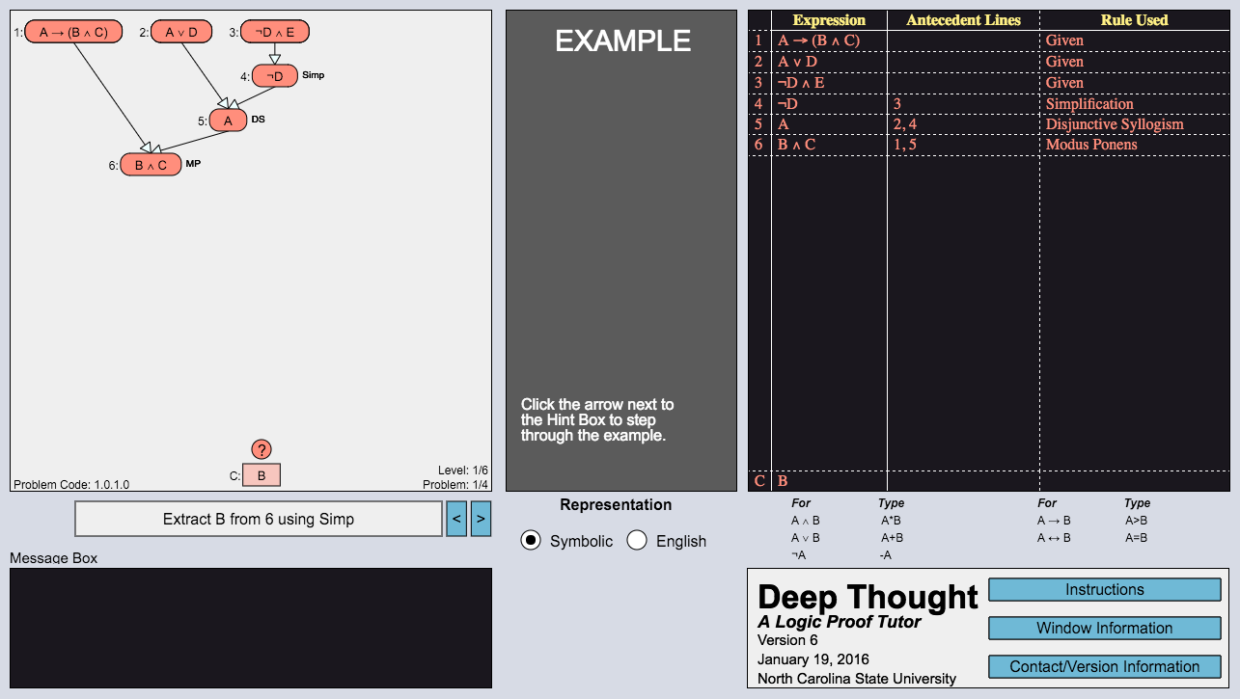
Deep Thought - Worked Example
Step-by-step worked Example
Deep Thought Tutor
Notes:
here is an example of worked example in Deep Thought. The interface is very similar to problem solving in deep thought. However, instead of requesting hints, students click to see how logic clauses are derived step by step. These worked example are also automatically generated from past students solutions, and has been examined by expert.

Slide 8
Deep Thought – Key Concepts
Proficiency Track
Proficiency track: DT assigns students to harder/easier problem paths based on their BKT scores, at the end of each level.(Behrooz, 2014)
6 problem levels.
Lvl1: single track (don’t know their BKT yet)
Lvl2-6: high&low proficiency tracks
Proficiency Track is controlled in this study
Deep Thought Tutor
Notes:
Now we’ve seen the deep thought interface, let me introduce one key concepts in deep thought that is related to this study - proficiency track. At the end of each level, Deep Thought assign students to easier or harder problems paths based on their BKT scores on logic rules.
Deep thought has 6 problem levels, with the upper levels requires longer solution and applying more logic rules to solve the problem.Thus,all students start from the same problems on level1, and are divided into high or low proficiency tracks in level 2-6
Because proficiency tracks have different problems difficulties, they are controlled in our analysis. We only compared between students on the same proficiency tracks.
You asked if BKT Is this the P(S_t=correct) for pretest? ------- Yes

Slide 9
Experiment - authentic classroom setting
Participants: undergraduates from Fall 2015 computer science class @ NC State
Control group (n=24) solve all problems
WE group (n=51): randomly assigned WE at each level
High track & lvl1: 3 harder problems - EES, ESS, SES
Low track: 4 easier problems - EESS, ESES, SEES, ESSS, SESS, SSES
The last problem at each level is a problem solving without hints
Experiment
Notes:
Our participants are undergraduates from Fall 2015 Computer Science class at nc state. Control group has 24 students who are supposed to solve all the problems. Experimental group contains 51 students. The number is a little higher because it was designed to contain two groups distinguished by another feature, but the designers failed to complete the other feature in time. In the experimental group, worked example is randomly assigned at each level. High proficiency track and level1 have 3 problems each level, and 3 possible orders of worked example and problem solving. Low proficiency track has 4 problems each level, with 6 possible orders of worked example and problem solving. Remind that the last problem at each level is designed to be problem solving without hints.
Possible Q: if levels are of different ‘difficulties’, why you combine them. A: its is a limitation, but almost all students finished the tutor. So the result won’t be too affected by unbalanced number of data in different levels. Also, higher levels are not necessarily more difficult, they just request more rules when students are already gain more proficiency with logic proofs.

Slide 10
Method
H1: WE & performance
Compared control and WE group on level1
H2: number and order of worked example
Compared different numbers of worked examples and their ordering on levels 2-6, with proficiency track controlled
For ordering: throw away low track because too few students
Method
Notes:
To answer our first hypothesis, whether presenting worked example will affect performance, we compared between control and WE group on level1, where there is no proficiency track assigned and all students do the exact same problems.
To answer our second hypothesis, we compared different numbers worked example and their orderings on level 2-6, with proficiency tracks controlled. Unfortunately, for ordering, we have to throw away low track because we have too few students with each order.

Slide 11
Method
Performance Measurements (per problem solved):
Time cost
logic rule’s application accuracy
solution length difference: #steps students used over the shortest recorded proof
#hints requested
Compared performance using Kruskal Wallis Test
Method
Notes:
We have four performance measurements: time cost to solve a problem. The accuracy: percentage of logic rule correctly applied out of all rules applied. The solution length difference, the number of steps students used over the shortest possible proof. And number of hint requested. We then compared performance with kruskal wallis Test, because performance measurements do not follow normal distributions.

Slide 12
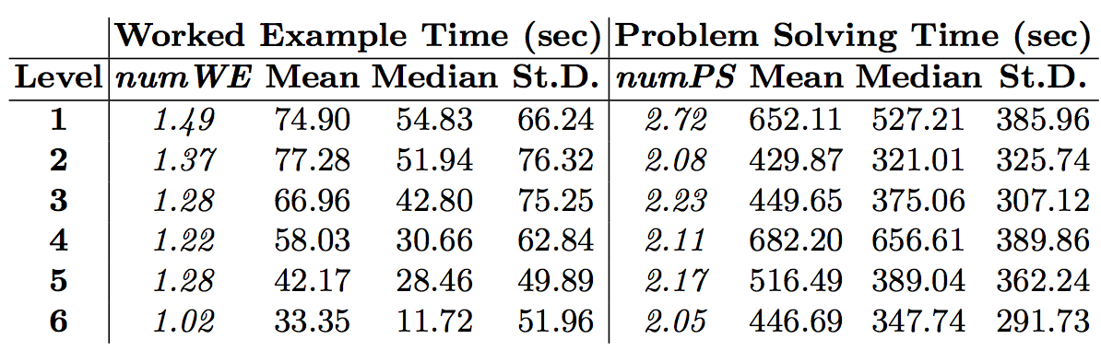
Result
# WE: 7.5 WEs for 6 levels, account for 38.2% of PS+WE
Time spent: 10.02% of tutoring time, 5-10 second each step
=> Students were actually reading the WEs in this tutor, especially at earlier levels
Result
Notes:
Now on understanding the experiment and method, lets proceed to result. First I would like to report the number and time cost of worked example and problem solving at each level. students on average received 7.5 worked examples on 6 levels, which accounts of 38.2% of problem solving and worked example. Students spent an average of 10.02% tutoring time on worked example, with 5-10 second each step in worked example. These statistics show that students are actually reading the worked example, especially in earlier levels. This fact allows us to proceed to further analysis on the effect of worked example

Slide 13
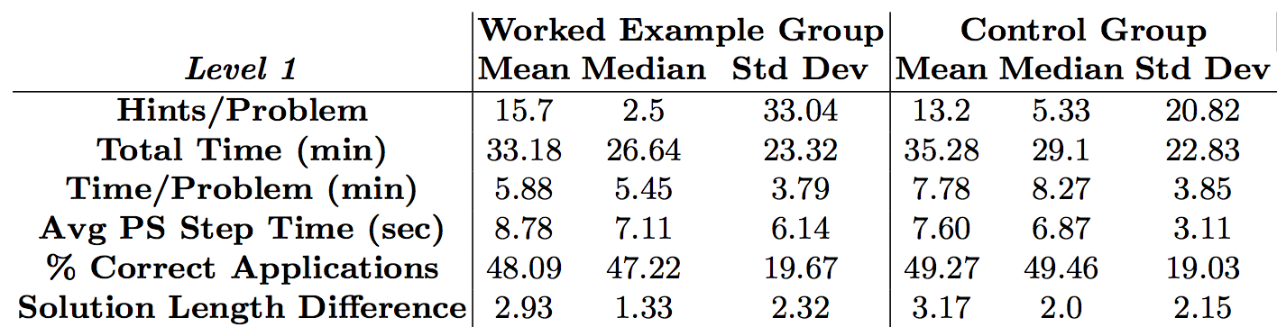
Result I: WE & PS
=>Learning may be more efficient for some students (less hints, shorter time, shorter solution), but the variance were too high for this effect to be significant
Result
Notes:
For the first analysis, we compared performance between worked example group and control group on level1, where all students solve the same problems. We found students with worked example tend to used less hint, took shorter time, and had shorter solutions. However, the values are not significant. We conclude that learning may be more efficicent for some students, but the variance were too high to this effect to be significant.

Slide 14
Result I: WE & PS
Result may due to the availability of hints, students may use hint to generate step-by-step examples.
=> Students benefited from either hints or WE at the beginning of using the tutor
Result
Notes:
This result may due to the availability of hints. As we see the median hint requested per problem is 3 hints more in control group than in experimental group. This may because students use hint to generate step-by-step worked examples. Thus, we conclude that at the beigning of using the tutor, students benefited from either hints of worked example at the beginning of using the tutor

Slide 15
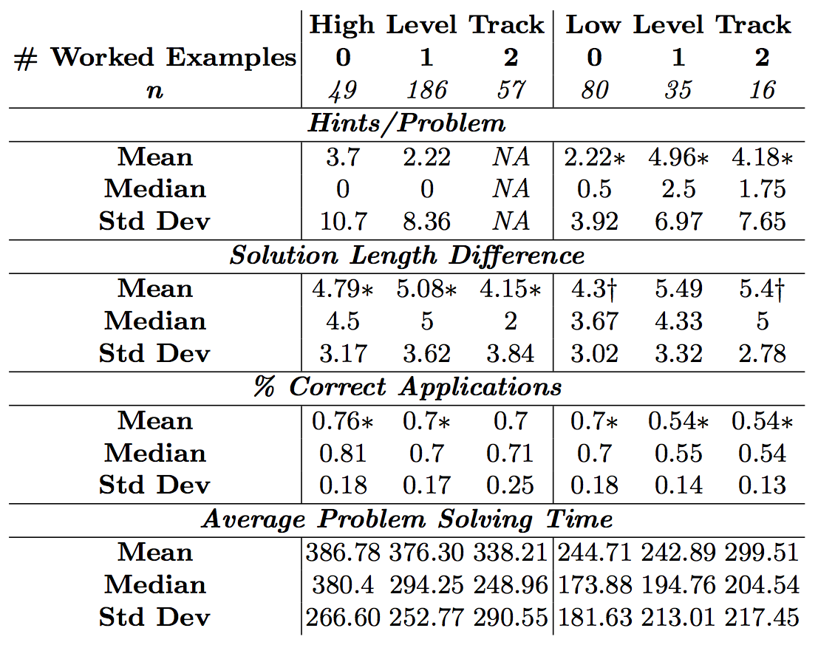
Result II: Number of Worked Example
High track: 1 WE used less hint per problem compared to no WE
Result
Notes:
Next we investigate into the effect of number of worked examples. This table report performance measurements of high and low tracks, with different number of worked example. The number n are not the number of students, but number of problems. High track with two worked example has hints/problem NA because the last problem at each level does not have hint, so it there’s two worked example, there’s no hint at that level. Significant values are makred with *, and marginal significant are marked with +. Here significance is result of comparing between 0,1 and 2 worked example, within each proficiency track.
We can see that for high track, worked example decreases the hint usage compared to no worked example, but the result is not significant.

Slide 16
Result II: Number of Worked Example
Low track with WE asked more hints, had longer solution and lower percentage of correct application
=> WE decreases self-regulation for low-proficiency students solving simpler problems
Result
Notes:
On the contrary, in low track, students with worked example asked for more hint. Student with more worked examples also had longer solution, and lower percentage of correct rule application. This implies that worked example may decrease self-regulation for low proficiency students solving simpler problem, in later levels (level 2-6).

Slide 17
Result III: Order of Worked Example
Compare performance on the last problem (has no hint) of orders EES, ESS, SES on high proficiency track (low proficiency track has too small sample size)
No significant differences in the performance => WE work as well as PS for learning on later levels
Result
Notes:
Last we compared the order or worked example and problem solving on high proficiency tracks. We found no significant differences on any performance measurements. We conclude that worked example works as well as problem solving in later levels on high proficiency track.

Slide 18
Conclusion
WE may be complex and individual in environments for open-ended complex problem solving
Early on, WE seems to be valuable for students, to learn how to use interface and apply logic rules
Hint can provide same scaffolding
Later, WE reduces needed practice in PS, but had negative impact on low-proficiency students.
Conclusion
Notes:
In conclusion, this study found that WE may be complex and individual in environments for open-ended problem solving. Early on, worked example seems to be valuable for students to learn how to use interface and apply logic rules, but hints may provide the same scaffolding. Later, worked example reduced the needed practice in problem solving, but had negative impact on low-proficiency students.

Slide 19
Limitation
BKT assigns same score to viewing/using rules, WE group are more likely to be assigned to higher proficiency track at lvl2-6 with more difficult problems
Drawback: small sample size on low proficiency track to compare WE, PS ordering; same ability students are more likely to do harder problems in WE group
Future work: Need better design to integrate worked example with BKT
No pretest, unreliable posttest
Limitation
Notes:
This result has several limitations. First, BKT assigns same scores to viewing/using rules, so worked example group are more likely to be assigned to higher proficiency track at lvl2-6 with more difficult problems. This result in small sample size in low proficiency track students, so we failed to compare how the order of worked example affect them. This also result in same ability students in WE group compared to control group are more likely to be assigned to high proficiency path, and thus did harder problems. To integrate worked example, we need better design to integrate worked example with BKT
Another limitation is that this study does not have pretest and reliable posttest. Students test score is related to course grade so they may not be the result of this tutor only. Future work involves integrate pre/post test into the real classroom setting. The last problem at each level without hint, but different proficiency track make it an unfair post test comparing between students.

Slide 20



Thank you!

