Slide 1
Animal classification

Slide 2
Dataset
Use animal 151 Dataset from Kaggle. Dataset link: https://www.kaggle.com/datasets/sharansmenon/animals141
Each class has a maximum of 60 images, with some classes having only 30 images; images are 224x224 RGB data.

Slide 3
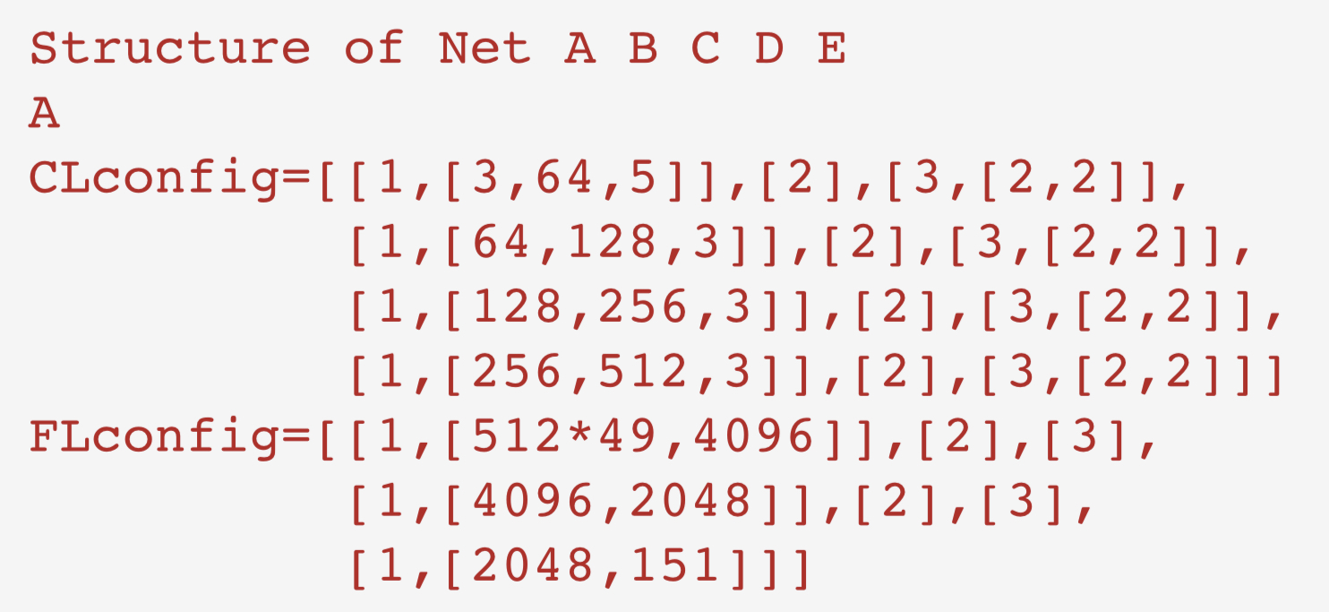
Model and Training
Use functions to build the class of CNN. CNN has a deep structure and layers have similarity. Define a function to build layers by taking array of configuration parameter. For training,The data is preprocessed by randomized flip to increase the variety.To optimize model, use crossentropyloss and SGD method(set up with lr=0.01 and apply weight decay(L2 regularization) method. Apply a scheduler for adjusting learning rate during epochs. Trained models have different configurations of layers of convolution, output channels, kernel sizes. Try dropout2d in convolution stage.

Slide 4
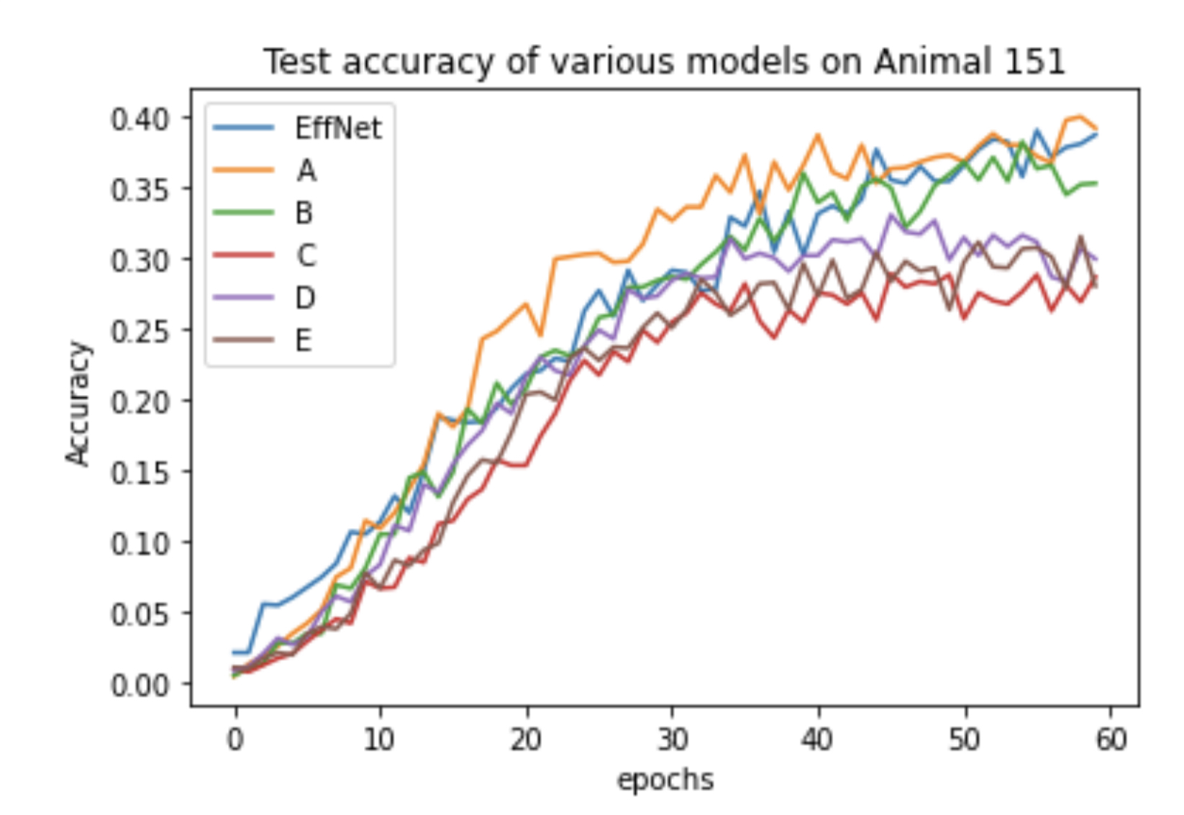
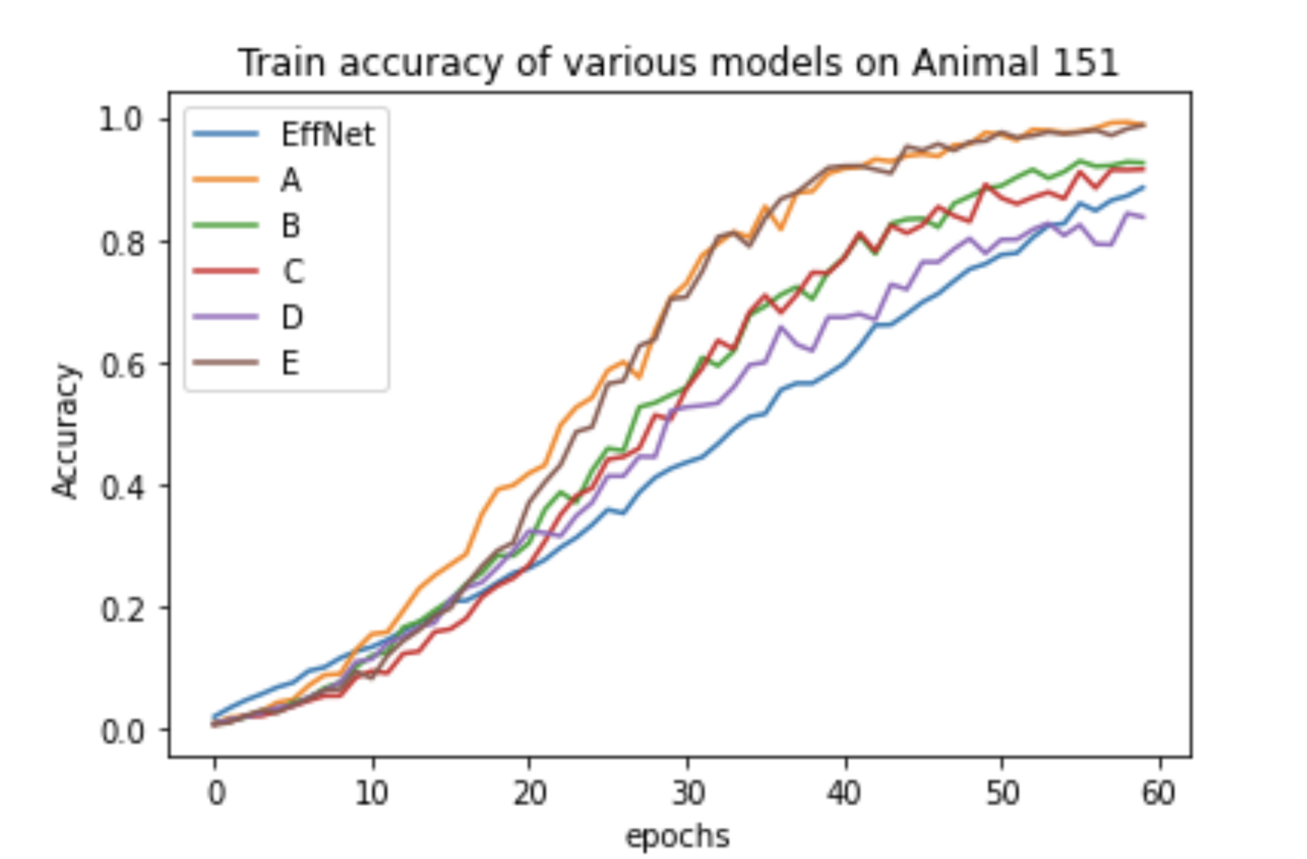
Results

Slide 5
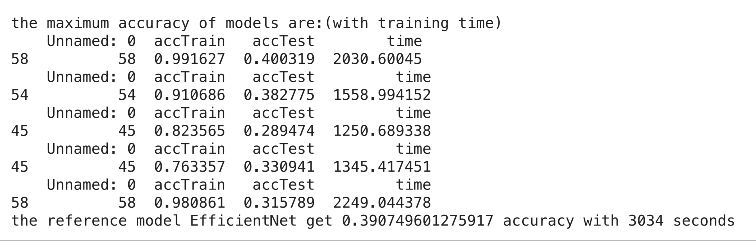
Results

Slide 6
Conclusion
All the models show the trend of overfitting after 30 epochs. Apply with scheduler, weight decay and dropout in convolution cannot improve the result significantly. And the model A is the structure which earned the highest accuracy. It has only around 2 percent advantage compared with model B. However, it costs 30% more time for training and extra 300MB for saving the model; the model B only requires 120MB storage.

Slide 7
Conclusion
Training the conventional CNN
Advantage: compare with the new generation model, it is easy to implement. It's class only have two blocks. Can be adjusted for training data conveniently.With limited number of layers and parameters per layer, it may be trained faster.Conventional CNN
Disadvantage:Amount of training parameter increases significantly with more layer. The size of parameter can increase by times; and the performance increment may not be significant. It could occupy large storage.Cannot update weights effectively. In very deep conventional CNN, this problem is severe and training these models requires more epochs. And the training time could be long.

