Slide 1
CS261 Data Structures
Dynamic Array Queue and Deque

Slide 2

Queues
int isEmpty();
void addBack(TYPE val); // Add value at end of queue.
TYPE front(); // Get value at front of queue.
void removeFront(); // Remove value at front.
remove from the front
add to the back

Slide 3

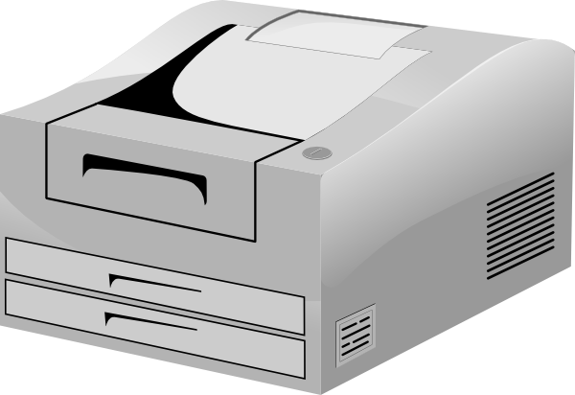
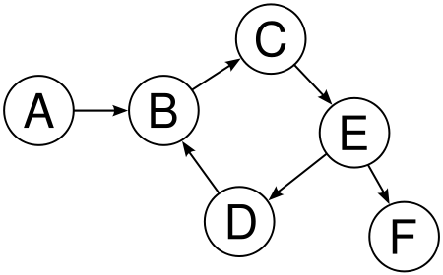
Queue Applications
Printer Queue
What nodes are
reachable from A?
Notes:
DES: Use a queue to represent the simulated stations. Say, a factory with conveyer belts and parts that are moved from one belt to the next. These are typically simulated as DES where time is not represented explicitly as clock time, but as events that are created, arrive and leave at designated times. Simulation, therefore is about queuing up events, processing them one at a time.
Operating Systems make heavy use of queues as buffers to hold jobs waiting to be serviced. A perfect example is the print queue.
Generally: Good for situations where need to store things in order they arrived!

Slide 4
Queue with Dynamic Array
Removal from front is expensive!
front
back
int isEmpty();
void addBack(TYPE val); // Add value at end of queue.
TYPE front(); // Get value at front of queue.
void removeFront(); // Remove value at front.
Notes:
Stack grew down and was O(1)
Implementing queue requires remove from front – O(n)

Slide 5
Deque (Double Ended Queue) ADT
void addFront(TYPE val);
void removeFront();
TYPE front();
void addBack(TYPE val);
void removeBack ()
TYPE back();
removeBack
addFront
front
back
5
22
8
removeFront
addBack
Notes:
We’re not going to implement a queue with the dynamic array, but will introduce and implement a new ADT, the DEQUE
Now let’s introduce a new ADT – the Deque.
Both the stack and queue interfaces combined.

Slide 6
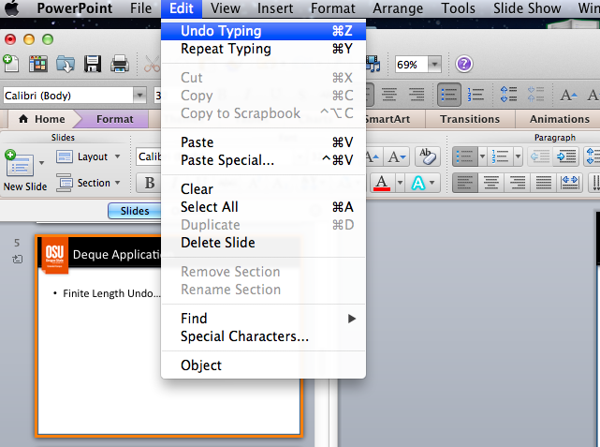
Deque Application
Finite Length Undo
Palindrome Checker ( e.g. radar)
Notes:
Could use a STACK, but don’t’ really want to keep them all around indefinitely. So, which do you get rid of and when?
Can’t really keep ALL operations
Want to throw out old…or allow user to determine their undo buffer
Add to end
Throw out of the front (add/remove back…remove front)
Also: A-Steal Job scheduling algorithm

Slide 7

Let the partially filled block “float” & “wrap”
Allow the starting index, beg, to “float” around the underlying array! It’s no longer confined to index 0
Logicalindex
beg=3
beg=5
size
size
0 1 2 3
3 4
0 1 2
0 1 2 3 4 5 6 7
0 1 2 3 4 5 6 7
Absolute index
How??
Keep track of the data, arranged circularly and convert all indices into proper indices for the actual array!
Circular
Buffer
Notes:
Just some additional bookkeeping to track beg and additional logic as you’ll see shortly.
See Java ArrayDeque for an example.

Slide 8
ArrayDeque Structure
struct ArrDeque {
TYPE *data; /* Pointer to data array. */
int size; /* Number of elements in collection. */
int beg; /* Index of first element. */
int cap; /* Capacity of array. */
};
void initArrDeque(struct ArrDeque *d, int cap) {
d->data = malloc(cap * sizeof(TYPE)));
assert(d->data != 0);
d->size = d->beg = 0;
d->cap = cap;
}

Slide 9
Adding/Removing from Back
Add
Remove
beg
beg
size
size
beg
beg
size
size

Slide 10
Adding/Removing from Front
Add
Remove
beg
beg
size
size
beg
beg
size
size
Notes:
decrement beg
Increase size
increment beg
decrease size
beg must be wrapped around though!

Slide 11
Wrapping Around – Circular Buffer
Elements can wrap around from beg to end
beg
size

Slide 12
Wrapping Around
Calculate offset: add logical (element) index to start (beg)
offset = beg + logicalIndex; /* logIndex = 3, offset = 9 */
If larger than or eq to capacity, subtract capacity
if (offset >= cap)
absoluteIndex = offset – cap;
Alternatively, use mod:
/* Convert logical index to absolute index. */
absIdx = (logicalIdx + beg) % cap;
beg = 6
cap = 8
beg
size
0 1 2 3 4 5 6 7
beg = 0
cap = 8
beg
size
0 1 2 3 4 5 6 7
Notes:
Say beg = 15, logical = 0, abso = (0+15) % 8 = 7
With offset: offset = 15 + 0; its > cap so abs = 15 – 8 = 7
Say beg = 23; offset = 23+0; it’s > cap, so abs = 23 – 8 = 15 !!!!!! Does NOT WORK!!! [could modify to abs = offset – cap*(beg/cap) because beg/cap tells you how many tiems to subtract off capacity (in this case == 2)
Alterantively, you can write your code to make sure beg always falls in the bounds: e.g. wrap beg as well ! In my solution, beg can go well beyond the bounds and float in either direction
Alternatively (this is my current version!): Wrap beg around so that it’s always within capacity!

Slide 13
Resizing?
Can we simply copy the elements to a larger array?
Have to be careful because the wrapping is dependent on the ‘capacity’

Slide 14
Key Changes from Dynamic Array
Keep track of floating data with beg & size
Wrap beg as necessary
Whenever accessing a logical index, convert to absolute first
On resize, copy to start of the new array and reset beg

Slide 15
Let’s look at some code…
void addFrontDynArr(DynArr *v, TYPE val){
if (v->size >= v->capacity)
_dynArrSetCapacity(v, 2*v->capacity);
v->beg = v->beg - 1;
if(v->beg < 0)
v->beg = v->capacity-1;
v->data[_absoluteIndex(v, 0)] = val;
v->size++;
}
Always make sure you have space
Update beg
Wrap beg as necessary
Don’t forget to increment size
convert to proper absolute index
front is at logical index = 0

Slide 16
Let’s look at some code…
Full implementation is in dynamicArrayDeque.c
void addFrontDynArr(DynArr *v, TYPE val){
if (v->size >= v->capacity)
_dynArrSetCapacity(v, 2*v->capacity);
v->beg = v->beg - 1;
if(v->beg < 0)
v->beg = v->capacity-1;
v->data[_absoluteIndex(v, 0)] = val;
v->size++;
}
Always make sure you have space
Update beg
Wrap beg as necessary
Don’t forget to increment size
convert to proper absolute index
front is at logical index = 0

Slide 17
Operations Analysis
Operation | Best | Worst | Ave
AddBack | 1 | n | 1+
RemoveBack | 1 | 1 | 1
AddFront | 1 | n | 1+
RemoveFront | 1 | 1 | 1
Notes:
Worksheet Time – worksheet #20
Finish the implementation…
1+ is amortized constant time
As you’re seeing in your homework, keepin

