Slide 1
CS 261 – Data Structures
C – Compilation Process
Notes:
RAM: Redo and tie to gcc with actual gcc commands!
Hello.
In this lecture, we’re going to discuss the C compiling process. Our goal is to help you better understand what’s really going on when we invoke the compiler and talk about how we write programs within this process.

Slide 2
Compilation Process
source .h, .c
Remove Comments
Replace Pre-processor directives (#).
For example, #include gets replaced with the include file
Conditional compilation
Pre-Processor
source .h, .c
Compiler
assembly .s
Assembler
#include<stdio.h>
int main(void) {
printf("Hello world!\n");
}
machine .o
Linker
executable .exe
Notes:
C programs go through a 4-step compilation process. The stages are the pre-processer, the compiler, the assembler, and the linker.
[click]
We’ll start with the Pre-Processor. The pre-processor does a few important things. It takes source files as input (those are your .c and .h files …more on these later) and strips out comments and replaces pre-processor directives (marked with the # sign). For example, in this case, the pre-processor will remove the #include line and replace it with the contents of the stdio.h file.
The pre-processor also allows for conditional compilation – meaning, we can write code that compiles based on some condition – we’ll see how this can be useful later.

Slide 3
Compilation Process
Take resulting source code and compiles to assembly code (.s)
Machine level code that manipulates memory and processor
source .h, .c
Pre-Processor
gcc -g -S -Wall -std=c99 -c main.c
source .h, .c
Compiler
assembly .s
.section __TEXT,__text,regular,pure_instructions
.globl _main
.align 4, 0x90
_main:
Leh_func_begin1:
pushq %rbp
Ltmp0:
movq %rsp, %rbp
Ltmp1:
subq $16, %rsp
Ltmp2:
movl %edi, %eax
movl %eax, -4(%rbp)
movq %rsi, -16(%rbp)
leaq L_.str(%rip), %rax
movq %rax, %rdi
callq _puts
addq $16, %rsp
popq %rbp
ret
Leh_func_end1:
.section __TEXT,__cstring,cstring_literals
L_.str:
.asciz "Hello World”
Assembler
machine .o
Linker
executable .exe
Notes:
The output of the Pre-processor are modified source files. These are then fed into the compiler which translates the source code into assembly code (these have a .s extension, but are typically not seen because they are used as a temporary file then discarded). Assembly is a machine level (but still human readable) code that manipulates memory and the processor directly. Here’s a snippet of the assembly produced from the simple HelloWorld example on the previous slide.

Slide 4
Compilation Process
Assembler generates object code (.o) from the assembly code.
Object code is in binary and can’t be viewed with a text reader
source .h, .c
Pre-Processor
source .h, .c
Compiler
assembly .s
Assembler
gcc –c main.c
gcc – c dynArr.c
Pre-process, compile, assemble
machine .o
Linker
executable .exe
Notes:
The next stage is the assembler. The assembler takes the assembly code as input and generates object code (.o files) which are binary files that cannot be viewed by a simple text reader. These are sometimes called machine code.

Slide 5
Compilation Process
The Linker pulls together your object code with libraries that you’re using in your program.
In this case, we use ‘printf’, so it will pull in the c standard library
The result is the executable
source .h, .c
Pre-Processor
source .h, .c
Compiler
assembly .s
Assembler
#include<stdio.h>
int main(void) {
printf("Hello world!\n");
}
machine .o
other libs
and
.o files
Linker
executable .exe
gcc –o prog main.o dynArr.o
Notes:
RAM: May want to, at a high level, describe how linking puts the code in system memory, and replaces offsets for symbols with actual addresses [or maybe that’s too much right now!]
Finally, the machine code is fed to the linker which combines it with any ‘other’ precompiled code (.o , libraries) that your program uses to produce the final executable file that you can then run!
In this particular example, we use the ‘printf’ function which is in the glibc library. The compiler will automatically pull this library into the linker, however, most libraries are not automatically pulled so you have to tell the compiler which libraries to pull. The math library is one example. For all assignments in this class, we’ll provide the compiling rules in a ‘makefile’, which we’ll discuss shortly.
[NOTE: In reality each function has an address relative to beginning of .o code called offsets that are generated by the assembler. When multiple .os are loated into memory, those addresses resolved into absolutes by the linke/loader, code that refers to addresses is resolved, and references to external symbols are resolved]

Slide 6
Separation of Interface and Implementation
Header files (*.h) have declarations and function prototypes (ie. interfaces)
Implementation files (*.c) have implementation source
A prototype is a function signature but no body (promise that the code will be linked in later)
int max(int a, int b);/* Function prototype */
Allows us to ‘hide’ implementation in pre-compiled .o files
Function prototypes must be terminated with a semicolon.
Notes:
So, now that we’ve covered the compiling process, let’s revisit the C source code files (those are the files with the .c and .h extensions).
In C, we will typically put declarations and function prototypes [click] in Header files with the extension .h. Function prototypes are essentially function signtures such as the one here, but with no actual implementation.
The implemention goes in the source file (.c) and will have the same signature, but include the full implementation code.
So why do this? This allows us to separate the interface to our code from the implementation. This is nice because we can then precompile implementation code, for example, into .o files or libraries that are not readable by users of our code. However, in order to use those libraries, they simply have to #include our header file for that implementation. The function prototypes in the header are essentially promises to the compiler that “Yes, this function exists, so treat it as so…and it will be linked in later, during the linker stage”. So, if you run code that compiles without error, however, produces a ‘link error’, that means you have not ‘linked’ to the proper .o files. The linker must make good on your promises!

Slide 7
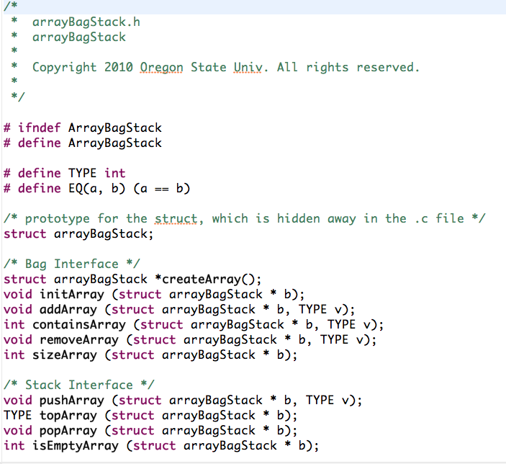
Source Files - arrayBagStack.h

Slide 8
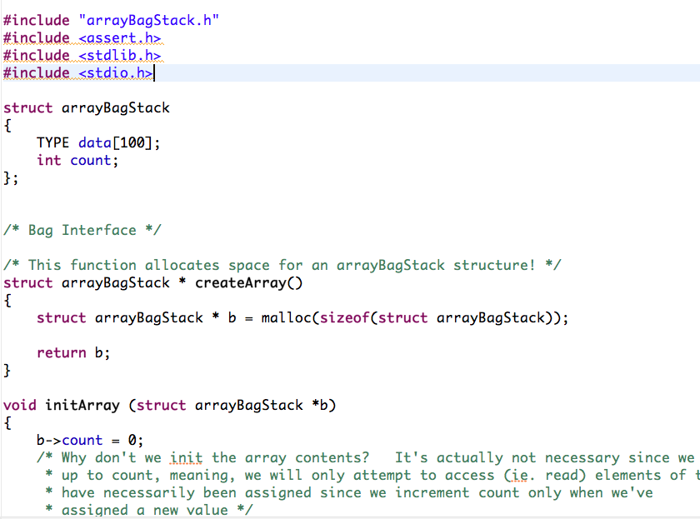
Source Files - arrayBagStack.c

Slide 9
.c and .h files
not visible to client developer
your data structure code (.o)
visible to client developer
your data structure headers (.h)
.o file with implementation of header 1
.h file 1
.h file 2
linker pulls in the promised code
.o file with implementation of header 2
client’s program
(.c file)
Notes:
For example, let’s say you have built a useful data structure that someone else (the client) wants to use in their code. You provide your data structures as precompiled libraries (.o files) that the client cannot see, and you give them the headers as well.

Slide 10
Tips: Ensuring Declarations Seen only Once
/* Header file for foo.h */
#ifndef BIG_COMPLEX_NAME
#define BIG_COMPLEX_NAME
…
/* Rest of foo.h file. */
#endif
If foo.h is included more than once (e.g., through other included files), it only gets inserted into the source (.c) file once
Conditionally
compiled code!!!
Notes:
RAM: Remove BIG_COMPLEX_NAME and replace ith FOO_H
We will often use code that looks like this in your header files. This is an example of conditional compilation.
The #ifndef is read “If not defined”, BIG_COMPLEX_NAME
then let’s do everything between it and the #endif
We use this to make sure that header files are only included in source files once. This is useful because you may include multiple different header files that include the same header file in them, resulting in multiply declared variables and function prototypes.
If you use this tip, however, then we can ensure that this does not happen.
When the preprocessor sees the #ifndef for the first time, if evals to true since BIG COMPLEX NAME IS NOT DEFINED, so it continues on and immediately defines BIG_COMPLEX_NAME, as well as include any other code between the #ifndef and the #endif [click]…this code is the conditionally compiled code
The next time the preprocessor sees this #ifndef (say this header is included more than once), then this will evaluate to false and the code in-between will not be included!

Slide 11

GCC And Make
Also, see the class website for much more on gcc, make and c-programming in general
Managing Projects with make, 2nd Edition
The Power of GNU make for Building Anything
By Andy Oram, Steve Talbott
Publisher: O'Reilly Media
Released: October 1991
Pages: 168
Notes:
Ok, so we’ve talked a lot about compiling. There’s a lot more you can learn by actually learning how to use a compiler explicitly. In this class, we’ll be turning in code that ultimately must compile with the GCC compiler.
Compilers can be fairly complex and so there are other tools to aid in setting up compile steps for code. One such tool is the Make utility.
We’ll provide Makefiles for all assignments and those makefiles will include all compile commands necessary to compile your code. You can take a look inside them to see how things work. You will find lots of
information about GCC and the Make utility online and there are also good books out there such as the Make book by O-Reilly.

