Slide 1

单周期32位MIPS处理器
支持汇编指令：
add, sub, and, or, slt, lw, sw, beq, addi, j
Branch
pcSrc
控制单元
[31:26]
Jump
Op
MemtoReg
[5:0]
MemWrite
Funct
ALUControl
zero
RegDst
RegWrite
ALUSrc
3
zero
pcbrmux
clk
clk
clk
pcnextbr
aluout / dataadr
0
寄存器文件
0
0
pcnext
pc
[7:2]
ROM
instr
[25:21]
WE3
srca
A
Z
1
32 x 64
指令存储器
A1
RD1
数据存储器
1
PC’
PC
A
RD
5
ALU
WE
1
reset
32
6
32
writedata
S
readdata
pcreg
[20:16]
A2
RD2
B
A
RD
resmux
pcmux
5
imem
alu
RAM
writereg
A3
WD
5
RAM
0
srcb
dmem
result
WD3
1
[20:16]
rf
srcbmux
pcadd1
0
wrmux
A
[15:11]
$$+$$
1
S
immsh
pcadd2
4
B
[15:0]
se
32
signimmsh
pcplus4
符号扩展
<<2
A
$$+$$
16
signimm
pcplus4
S
B
pcbranch
result
[25:0]
{pcplus4[31:28], instr[25:0], 2’b00}
<<2

Slide 2
单周期 (扩展)
add, sub, and, or, slt, lw, sw, beq, addi, j
andi, ori, bne
控制单元
Branch
pcSrc
[31:26]
Jump
MemtoReg
Op
nBranch
(bne)
[5:0]
Funct
MemWrite
zero
ALUControl
ImmExt
RegDst
RegWrite
ALUSrc
3
zero
clk
clk
rf
aluout / dataadr
0
pcplus4
pcnextbr
clk
0
寄存器文件
1
0
pcnext
pc
[7:2]
ROM
instr
[25:21]
WE3
srca
A
Z
readdata
1
32 x 64
指令存储器
A1
RD1
数据存储器
PC’
PC
A
RD
5
ALU
WE
resmux
pcbrmux
1
reset
32
6
32
writedata
S
[20:16]
A2
RD2
B
A
RD
pcmux
pcreg
5
imem
alu
RAM
A3
WD
result
RAM
0
srcb
dmem
WD3
1
[20:16]
5
srcbmux
[15:11]
0
writereg
A
pcplus4
1
zeroimm
imm
$$+$$
wrmux
1
S
4
B
ie0
ze
0
pcadd2
pcadd1
0扩展
extmux
signimmsh
[15:0]
1
<<2
A
0
符号扩展
immsh
$$+$$
ies
se
signimm
pcplus4
S
B
pcbranch
result
[25:0]
{pcplus4[31:28], instr[25:0], 2’b00}
<<2

Slide 3
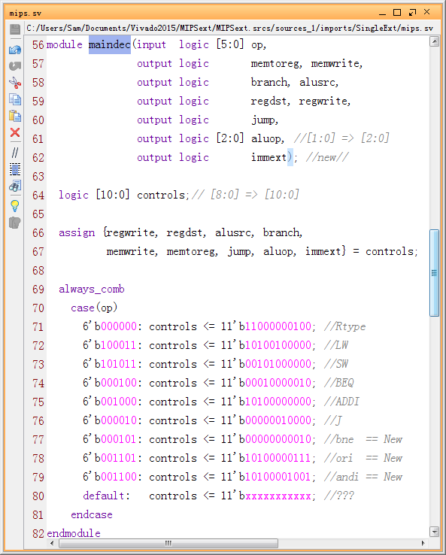
主译码器真值表+ 代码
指令 | Opcode | RegWrite | RegDst | ALUSrc | Branch | MemWrite | MemtoReg | Jump | ALUOp | ImmExt
R类型 | 000000 | 1 | 1 | 0 | 0 | 0 | 0 | 0 | 010 | 0
lw | 100011 | 1 | 0 | 1 | 0 | 0 | 1 | 0 | 000 | 0
sw | 101011 | 0 | x | 1 | 0 | 1 | x | 0 | 000 | 0
beq | 000100 | 0 | x | 0 | 1 | 0 | x | 0 | 001 | 0
addi | 001000 | 1 | 0 | 1 | 0 | 0 | 0 | 0 | 000 | 0
j | 000010 | 0 | x | x | x | 0 | x | 1 | xxx | 0
bne | 000101 | 0 | 0 | 0 | 0 | 0 | 0 | 0 | 001 | 0
ori | 001101 | 1 | 0 | 1 | 0 | 0 | 0 | 0 | 011 | 1
andi | 001100 | 1 | 0 | 1 | 0 | 0 | 0 | 0 | 100 | 1

Slide 4
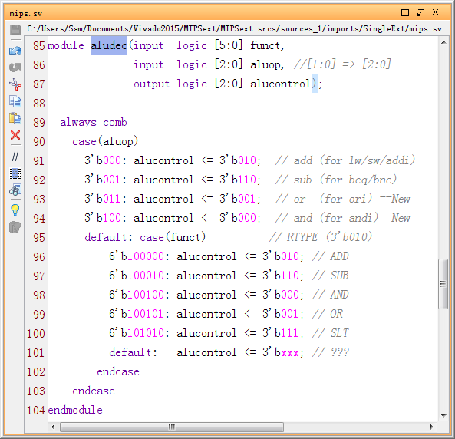
ALU译码器真值表+ 代码
ALUOp | Funct | ALUControl
00 | X | 010 (加)
X1 | X | 110 (减)
1X | 100000 (add) | 010 (加)
1X | 100010 (sub) | 110 (减)
1X | 100100 (and) | 000 (与)
1X | 100101 (or) | 001 (或)
1X | 101010 (slt) | 111(SLT)
ALUOp | 含义
00 | 加法
01 | 减法
10 | 依赖funct字段
11

