Slide 1

map reduce关键：
map, reduce, partition, combine函数是怎么写的
partition, combine函数是用来优化的，是怎么优化的？
Text Retrieval Algorithms
Data-Intensive Information Processing Applications ― Session #4
Jimmy Lin
University of Maryland
Tuesday, February 23, 2010
This work is licensed under a Creative Commons Attribution-Noncommercial-Share Alike 3.0 United States See http://creativecommons.org/licenses/by-nc-sa/3.0/us/ for details

Slide 2
Today’s Agenda
Introduction to information retrieval
Basics of indexing and retrieval
Inverted indexing in MapReduce
Retrieval at scale

Slide 3
First, nomenclature…
Information retrieval (IR)
Focus on textual information (= text/document retrieval)
Other possibilities include image, video, music, …（通过image的标题/附近的文字来找image）
What do we search?
Generically, “collections”
Less-frequently used, “corpora”
What do we find?
Generically, “documents”
Even though we may be referring to web pages, PDFs, PowerPoint slides, paragraphs, etc.

Slide 4
Information Retrieval Cycle
什么source，多久爬一次
Source
Selection
Resource
Query
Formulation
Query
Search
Results
Selection
Documents
System discovery
Vocabulary discovery
Concept discovery
Document discovery
Examination
learning to learn
Information
source reselection
Delivery

Slide 5
The Central Problem in Search
Author
Searcher
Concepts
Concepts
搜索人的关键词
作者的关键词
Query Terms
Document Terms
“tragic love story”
“fateful star-crossed romance”
Do these represent the same concepts?
怎么样把含有同样concepts的不同terms对应起来？
如何定义语义相似性？
怎么
Notes:
Why is IR hard? Because language is hard!

Slide 6
Abstract IR Architecture
Documents
Query
document acquisition (e.g., web crawling)
online
offline
Representation
Function
快速反馈
（0.3s以内）
计算速度没有要求
Representation
Function
获得文档表征的方程
Query Representation
Document Representation
比如bag of words
Index
Comparison
Function
查询
Hits

Slide 7
How do we represent text?
Remember: computers don’t “understand” anything!
“Bag of words”
Treat all the words in a document as index terms
Assign a “weight” to each term based on “importance” (or, in simplest case, presence/absence of word)
Disregard order, structure, meaning, etc. of the words
Simple, yet effective!
表征向量只看每个词是否出现、对应的重要程度，不考虑先后关系
Assumptions
Term occurrence is independent 词间关系独立
Document relevance is independent 文档间关系独立
“Words” are well-defined

Slide 8
What’s a word?
欧洲语言本身有空格来分开词语
但是亚洲的语言没有，怎么获得词？
欧洲的也有可能几个词合成一个词，比如new york
天主教教宗若望保祿二世因感冒再度住進醫院。這是他今年第二度因同樣的病因住院。
وقال مارك ريجيف - الناطق باسم
الخارجية الإسرائيلية - إن شارون قبل
الدعوة وسيقوم للمرة الأولى بزيارة
تونس، التي كانت لفترة طويلة المقر
الرسمي لمنظمة التحرير الفلسطينية بعد خروجها من لبنان عام 1982.
Выступая в Мещанском суде Москвы экс-глава ЮКОСа заявил не совершал ничего противозаконного, в чем обвиняет его генпрокуратура России.
भारत सरकार ने आर्थिक सर्वेक्षण में वित्तीय वर्ष 2005-06 में सात फ़ीसदी विकास दर हासिल करने का आकलन किया है और कर सुधार पर ज़ोर दिया है
日米連合で台頭中国に対処…アーミテージ前副長官提言
조재영 기자= 서울시는 25일 이명박 시장이 `행정중심복합도시'' 건설안에 대해 `군대라도 동원해 막고싶은 심정''이라고 말했다는 일부 언론의 보도를 부인했다.

Slide 9
Sample Document
McDonald's slims down spuds
Fast-food chain to reduce certain types of fat in its french fries with new cooking oil.
NEW YORK (CNN/Money) - McDonald's Corp. is cutting the amount of "bad" fat in its french fries nearly in half, the fast-food chain said Tuesday as it moves to make all its fried menu items healthier.
But does that mean the popular shoestring fries won't taste the same? The company says no. "It's a win-win for our customers because they are getting the same great french-fry taste along with an even healthier nutrition profile," said Mike Roberts, president of McDonald's USA.
But others are not so sure. McDonald's will not specifically discuss the kind of oil it plans to use, but at least one nutrition expert says playing with the formula could mean a different taste.
Shares of Oak Brook, Ill.-based McDonald's (MCD: down $0.54 to $23.22, Research, Estimates) were lower Tuesday afternoon. It was unclear Tuesday whether competitors Burger King and Wendy's International (WEN: down $0.80 to $34.91, Research, Estimates) would follow suit. Neither company could immediately be reached for comment.
…
“Bag of Words”
14 × McDonalds出现了14词
12 × fat
11 × fries
8 × new
7 × french
6 × company, said, nutrition
5 × food, oil, percent, reduce, taste, Tuesday
…

Slide 10
Counting Words…
Documents
case folding, tokenization, stopword removal, stemming
Bag of Words
syntax, semantics, word knowledge, etc.
Inverted
Index

Slide 11
Boolean Retrieval
Users express queries as a Boolean expression
AND, OR, NOT
Can be arbitrarily nested
Retrieval is based on the notion of sets
Any given query divides the collection into two sets: retrieved, not-retrieved
Pure Boolean systems do not define an ordering of the results

Slide 12
Inverted Index: Boolean Retrieval
Doc 1
Doc 2
Doc 3
Doc 4
one fish, two fish
red fish, blue fish
cat in the hat
green eggs and ham
1
2
3
4
blue
1
blue
2
cat
1
cat
3
egg
1
egg
4
fish
1
1
fish
1
2
green
1
green
4
ham
1
ham
4
hat
1
hat
3
one
1
one
1
red
1
red
2
two
1
two
1

Slide 13
Boolean Retrieval
To execute a Boolean query:
Build query syntax tree
For each clause, look up postings
Traverse postings and apply Boolean operator
Efficiency analysis
Postings traversal is linear (assuming sorted postings)
Start with shortest posting first 从短的链表开始
OR
( blue AND fish ) OR ham
ham
AND
blue
fish
blue
2
fish
1
2

Slide 14
Strengths and Weaknesses
Strengths
Precise, if you know the right strategies
Precise, if you have an idea of what you’re looking for
Implementations are fast and efficient
Weaknesses
Users must learn Boolean logic
Boolean logic insufficient to capture the richness of language
No control over size of result set: either too many hits or none
When do you stop reading? All documents in the result set are considered “equally good”（不给出分数，都是平等的）
What about partial matches? Documents that “don’t quite match” the query may be useful also（不产生部分match的query）

Slide 15
Ranked Retrieval
Order documents by how likely they are to be relevant（相关的程度） to the information need
Estimate relevance(q, d_{i})
Sort documents by relevance
Display sorted results
User model
Present hits one screen at a time, best results first
At any point, users can decide to stop looking
How do we estimate relevance?
Assume document is relevant if it has a lot of query terms
Replace relevance(q, d_{i}) with sim(q, d_{i})相似度！！！
Compute similarity of vector representations计算向量间的相似度

Slide 16
Vector Space Model
t₃
d₂
d₃
d₁
θ
φ
t₁
d₅
t₂
d₄
Assumption: Documents that are “close together” in vector space “talk about” the same things
Therefore, retrieve documents based on how close the document is to the query (i.e., similarity ~ “closeness”)

Slide 17
Similarity Metric
Use “angle” between the vectors:
Or, more generally, inner products:

Slide 18
Term Weighting
Term weights consist of two components
Local: how important is the term in this document（文档）?
文档里出现的多，重要
Global: how important is the term in the collection（文档的集合）?
不同的文档里都出现，则不重要
Here’s the intuition:
Terms that appear often in a document should get high weights
Terms that appear in many documents should get low weights
How do we capture this mathematically?
Term frequency (local)
Inverse document frequency (global)

Slide 19
TF.IDF Term Weighting
越大越重要
weight assigned to term i in document j
number of occurrence of term i in document j
number of documents in entire collection
number of documents with term i

Slide 20
Inverted Index: TF.IDF
Doc 1
Doc 2
Doc 3
Doc 4
one fish, two fish
red fish, blue fish
cat in the hat
green eggs and ham
多少个document中出现了
文档编号、对应文档中出现次数
tf
1
2
3
4
df
blue
1
1
blue
1
2
1
cat
1
1
cat
1
3
1
egg
1
1
egg
1
4
1
fish
2
2
2
fish
2
1
2
2
2
green
1
1
green
1
4
1
ham
1
1
ham
1
4
1
hat
1
1
hat
1
3
1
one
1
1
one
1
1
1
red
1
1
red
1
2
1
two
1
1
two
1
1
1

Slide 21
Positional Indexes
Store term position in postings
Supports richer queries (e.g., proximity)
Naturally, leads to larger indexes…

Slide 22
Inverted Index: Positional Information
Doc 1
Doc 2
Doc 3
Doc 4
one fish, two fish
red fish, blue fish
cat in the hat
green eggs and ham
加了position的信息后，index的总大小比原信息还要大了
词在文档中的出现位置
tf
1
2
3
4
df
blue
1
1
blue
1
2
1
[3]
cat
1
1
cat
1
3
1
[1]
egg
1
1
egg
1
4
1
[2]
fish
2
2
2
fish
2
1
2
[2,4]
2
2
[2,4]
green
1
1
green
1
4
1
[1]
ham
1
1
ham
1
4
1
[3]
hat
1
1
hat
1
3
1
[2]
one
1
1
one
1
1
1
[1]
red
1
1
red
1
2
1
[1]
two
1
1
two
1
1
1
[3]

Slide 23
Retrieval in a Nutshell
Look up postings lists corresponding to query terms
Traverse postings for each query term
Store partial query-document scores in accumulators
Select top k results to return

Slide 24
Retrieval: Document-at-a-Time
Evaluate documents one at a time (score all query terms)
Tradeoffs
Small memory footprint (good)
Must read through all postings (bad), but skipping possible
More disk seeks (bad), but blocking possible
blue
9
2
21
1
35
1
…
fish
1
2
9
1
21
3
34
1
35
2
80
3
…
Accumulators
(e.g. priority queue)
Document score in top k?
Yes: Insert document score, extract-min if queue too large
No: Do nothing

Slide 25
Retrieval: Query-At-A-Time
Evaluate documents one query term at a time
Usually, starting from most rare term (often with tf-sorted postings)
Tradeoffs
Early termination heuristics (good)
Large memory footprint (bad), but filtering heuristics possible
blue
9
2
21
1
35
1
…
Accumulators (e.g., hash)
Score_{{q=x}}(doc n) = s
fish
1
2
9
1
21
3
34
1
35
2
80
3
…

Slide 26
MapReduce it?
The indexing problem
Scalability is critical
Must be relatively fast, but need not be real time 不需要实时处理
Fundamentally a batch operation 批处理
Incremental updates may or may not be important
For the web, crawling is a challenge in itself
The retrieval problem
Must have sub-second response time
For the web, only need relatively few results
Perfect for MapReduce!
Uh… not so good…

Slide 27
Indexing: Performance Analysis
Fundamentally, a large sorting problem
Terms usually fit in memory
Postings usually don’t 词的链表很长，可能放不进内存
How is it done on a single machine?
How can it be done with MapReduce?
First, let’s characterize the problem size:
Size of vocabulary 词汇量大小
Size of postings 链表长度

Slide 28
Vocabulary Size: Heaps’ Law
Heaps’ Law: linear in log-log space 在log空间中是线性的
Vocabulary size grows unbounded! 指数级别增长
M is vocabulary size
T is collection size (number of documents)
k and b are constants
Typically, k is between 30 and 100, b is between 0.4 and 0.6
Notes:
22

Slide 29
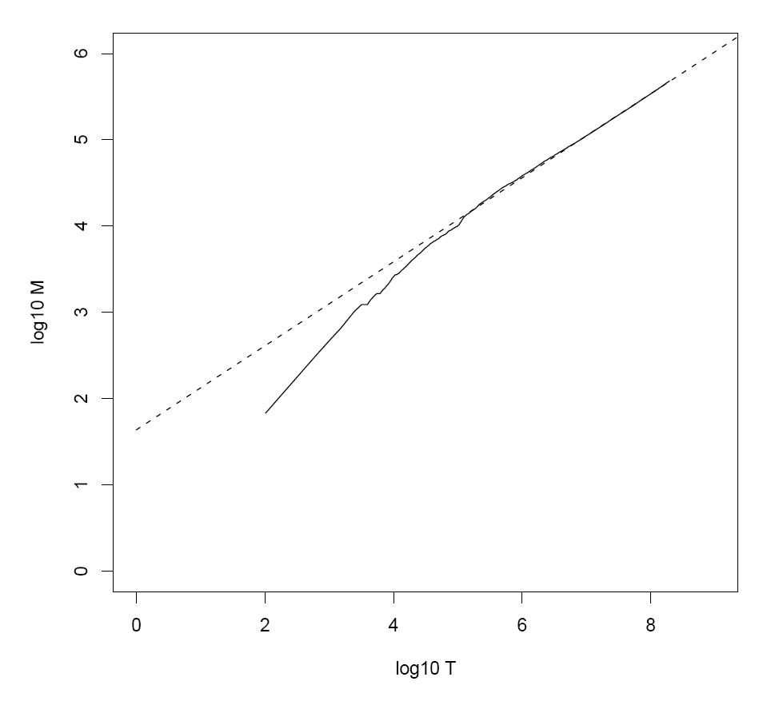
Heaps’ Law for RCV1
k = 44
b = 0.49
First 1,000,020 terms:
Predicted = 38,323
Actual = 38,365
Reuters-RCV1 collection: 806,791 newswire documents (Aug 20, 1996-August 19, 1997)
Manning, Raghavan, Schütze, Introduction to Information Retrieval (2008)

Slide 30
Postings Size: Zipf’s Law
Zipf’s Law: (also) linear in log-log space
Specific case of Power Law distributions
In other words:
A few elements occur very frequently
Many elements occur very infrequently
cf is the collection frequency of i-th common term
c is a constant
Notes:
22

Slide 31
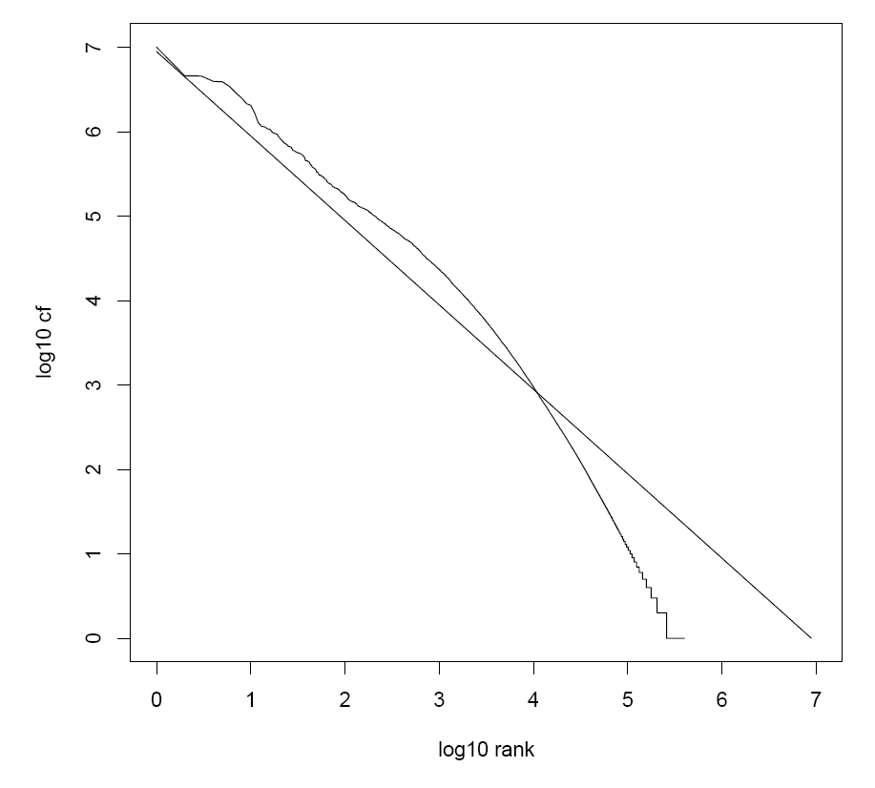
Zipf’s Law for RCV1
Fit isn’t that good… but good enough!
Reuters-RCV1 collection: 806,791 newswire documents (Aug 20, 1996-August 19, 1997)
Manning, Raghavan, Schütze, Introduction to Information Retrieval (2008)

Slide 32
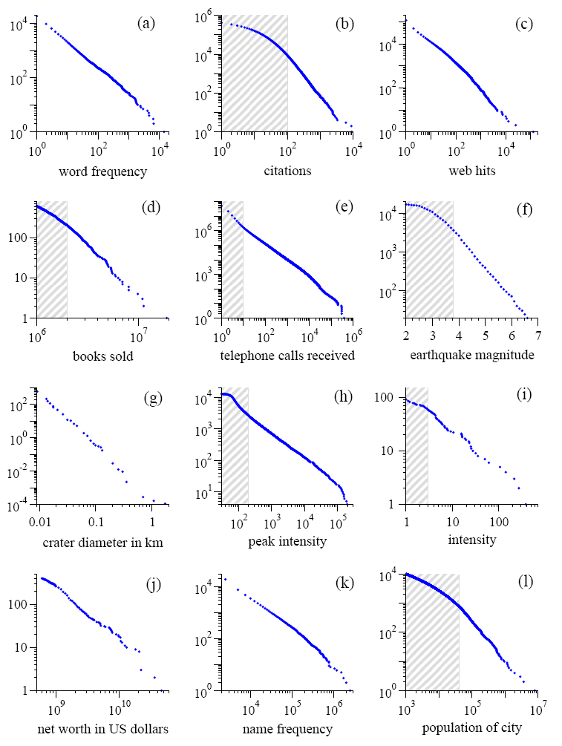
Power Laws are everywhere!
Figure from: Newman, M. E. J. (2005) “Power laws, Pareto distributions and Zipf's law.” Contemporary Physics 46:323–351.

Slide 33
MapReduce: Recap
Programmers must specify:
map (k, v) → <k’, v’>*
reduce (k’, v’) → <k’, v’>*
All values with the same key are reduced together
Optionally, also:
partition (k’, number of partitions) → partition for k’
Often a simple hash of the key, e.g., hash(k’) mod n
Divides up key space for parallel reduce operations
combine (k’, v’) → <k’, v’>*
Mini-reducers that run in memory after the map phase
Used as an optimization to reduce network traffic
The execution framework handles everything else…

Slide 34
word count的map reduce过程
k₁
v₁
k₂
v₂
k₃
v₃
k₄
v₄
k₅
v₅
k₆
v₆
map
map
map
map
a
1
b
2
c
3
c
6
a
5
c
2
b
7
c
8
combine
combine
combine
combine
a
1
b
2
c
9
a
5
c
2
b
7
c
8
partition
partition
partition
partition
Shuffle and Sort: aggregate values by keys
a
1
5
b
2
7
c
2
9
8
reduce
reduce
reduce
r₁
s₁
r₂
s₂
r₃
s₃

Slide 35
Inverted Index: TF.IDF
Doc 1
Doc 2
Doc 3
Doc 4
one fish, two fish
red fish, blue fish
cat in the hat
green eggs and ham
tf
1
2
3
4
df
blue
1
1
blue
1
2
1
cat
1
1
cat
1
3
1
egg
1
1
egg
1
4
1
fish
2
2
2
fish
2
1
2
2
2
green
1
1
green
1
4
1
ham
1
1
ham
1
4
1
hat
1
1
hat
1
3
1
one
1
1
one
1
1
1
red
1
1
red
1
2
1
two
1
1
two
1
1
1

Slide 36
Inverted Index: Positional Information
Doc 1
Doc 2
Doc 3
Doc 4
one fish, two fish
red fish, blue fish
cat in the hat
green eggs and ham
tf
1
2
3
4
df
blue
1
1
blue
1
2
1
[3]
cat
1
1
cat
1
3
1
[1]
egg
1
1
egg
1
4
1
[2]
fish
2
2
2
fish
2
1
2
[2,4]
2
2
[2,4]
green
1
1
green
1
4
1
[1]
ham
1
1
ham
1
4
1
[3]
hat
1
1
hat
1
3
1
[2]
one
1
1
one
1
1
1
[1]
red
1
1
red
1
2
1
[1]
two
1
1
two
1
1
1
[3]

Slide 37
MapReduce: Index Construction
Map over all documents
输入文档编号和文档内容
Emit term as key, (docno, tf) as value
Emit other information as necessary (e.g., term position)
Sort/shuffle: group postings by term
Reduce
Gather and sort the postings (e.g., by docno or tf)
Write postings to disk 输出各个term的posting
MapReduce does all the heavy lifting!

Slide 38
Inverted Indexing with MapReduce
Doc 1
Doc 2
Doc 3
one fish, two fish
red fish, blue fish
cat in the hat
one
1
1
red
2
1
cat
3
1
Map
two
blue
hat
1
1
2
1
3
1
fish
1
2
fish
2
2
文档编号、词出现次数
Shuffle and Sort: aggregate values by keys
cat
3
1
Reduce
blue
2
1
fish
1
2
2
2
posting链表
hat
3
1
one
1
1
two
1
1
red
2
1

Slide 39
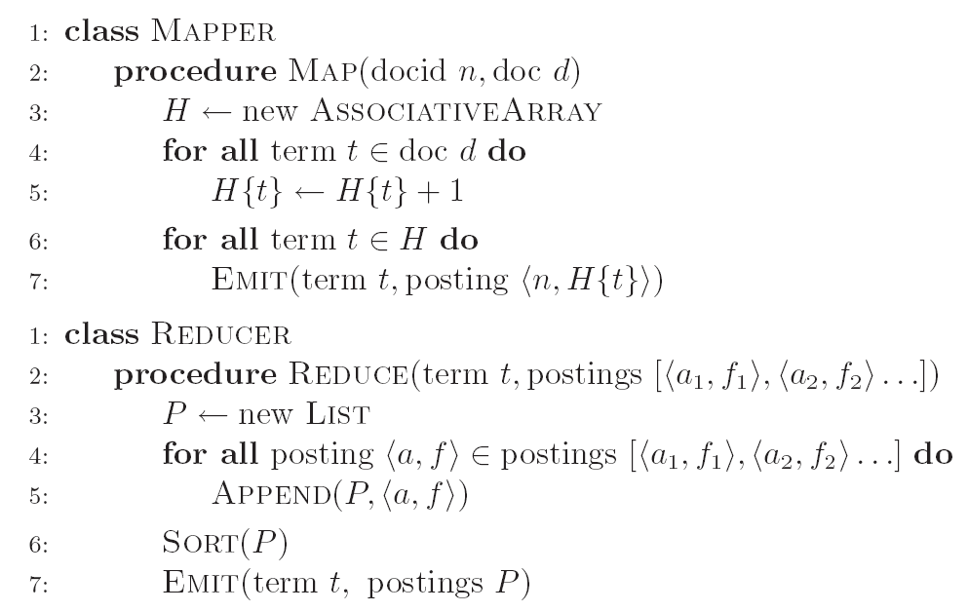
Inverted Indexing: Pseudo-Code
改key，key是会有排序的
对posting进行排序
term t为key，P为posting

Slide 40
Positional Indexes
Doc 1
Doc 2
Doc 3
one fish, two fish
red fish, blue fish
cat in the hat
one
1
1
[1]
red
2
1
[1]
cat
3
1
[1]
Map
two
blue
hat
1
1
[3]
2
1
[3]
3
1
[2]
fish
1
2
[2,4]
fish
2
2
[2,4]
Shuffle and Sort: aggregate values by keys
cat
3
1
[1]
Reduce
blue
2
1
[3]
fish
1
2
[2,4]
2
2
[2,4]
hat
3
1
[2]
one
1
1
[1]
two
1
1
[3]
red
2
1
[1]

Slide 41
Inverted Indexing: Pseudo-Code
What’s the problem?

Slide 42
Scalability Bottleneck
Initial implementation: terms as keys, postings as values
Reducers must buffer all postings associated with key (to sort)
What if we run out of memory to buffer postings?
Uh oh!
改key！key本身是有序的，自动排序

Slide 43
Another Try…
(key)
(values)
(keys)
(values)
fish
1
2
[2,4]
fish
1
[2,4]
34
1
[23]
fish
9
[9]
21
3
[1,8,22]
fish
21
[1,8,22]
35
2
[8,41]
fish
34
[23]
80
3
[2,9,76]
fish
35
[8,41]
9
1
[9]
fish
80
[2,9,76]
How is this different?
Let the framework do the sorting
Term frequency implicitly stored
Directly write postings to disk!
Where have we seen this before?

Slide 44
Postings Encoding
Conceptually:
fish
1
2
9
1
21
3
34
1
35
2
80
3
…
In Practice:
Don’t encode docnos, encode gaps (or d-gaps) 不存储文档id，存文档id的前后gap
But it’s not obvious that this save space… 可以很好的节省存储空间
fish
1
2
8
1
12
3
13
1
1
2
45
3
…

Slide 45
MapReduce it?
The indexing problem
Scalability is paramount
Must be relatively fast, but need not be real time
Fundamentally a batch operation
Incremental updates may or may not be important
For the web, crawling is a challenge in itself
The retrieval problem
Must have sub-second response time
For the web, only need relatively few results
Just covered
Now

Slide 46
Retrieval with MapReduce?
MapReduce is fundamentally batch-oriented
Optimized for throughput, not latency
Startup of mappers and reducers is expensive
MapReduce is not suitable for real-time queries!
Use separate infrastructure for retrieval…

Slide 47
Important Ideas
Partitioning (for scalability)
Replication (for redundancy)
Caching (for speed)
Routing (for load balancing)
The rest is just details!

Slide 48
Term vs. Document Partitioning
D
T₁
D
T₂
Term Partitioning
…
T₃
T
Document Partitioning
…
T
D₁
D₂
D₃

Slide 49
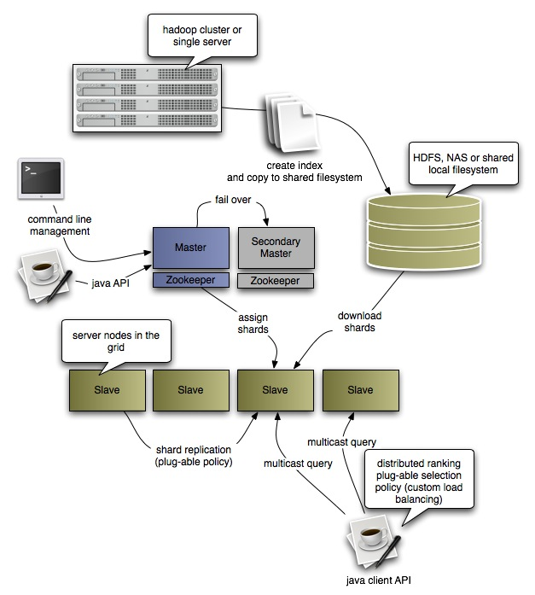
Katta Architecture (Distributed Lucene)
http://katta.sourceforge.net/

Slide 50

Questions?
Source: Wikipedia (Japanese rock garden)

Slide 51
Graph Algorithms
Data-Intensive Information Processing Applications ― Session #5
Jimmy Lin
University of Maryland
Tuesday, March 2, 2010
This work is licensed under a Creative Commons Attribution-Noncommercial-Share Alike 3.0 United States See http://creativecommons.org/licenses/by-nc-sa/3.0/us/ for details

Slide 52
Source: Wikipedia (Japanese rock garden)

Slide 53
Today’s Agenda
Graph problems and representations
Parallel breadth-first search
PageRank

Slide 54
What’s a graph?
G = (V,E), where
V represents the set of vertices (nodes)
E represents the set of edges (links)
Both vertices and edges may contain additional information
Different types of graphs:
Directed vs. undirected edges
Presence or absence of cycles
Graphs are everywhere:
Hyperlink structure of the Web
Physical structure of computers on the Internet
Interstate highway system
Social networks

Slide 55
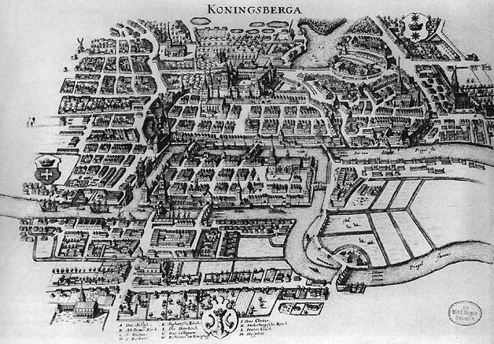
Source: Wikipedia (Königsberg)

Slide 56
Some Graph Problems
Finding shortest paths
Routing Internet traffic and UPS trucks
Finding minimum spanning trees
Telco laying down fiber
Finding Max Flow
Airline scheduling
Identify “special” nodes and communities
Breaking up terrorist cells, spread of avian flu
Bipartite matching （转换为最大流问题）
Monster.com, Match.com
And of course... PageRank

Slide 57
Graphs and MapReduce
Graph algorithms typically involve:
Performing computations at each node: based on node features, edge features, and local link structure
Propagating computations: “traversing” the graph
Key questions:
How do you represent graph data in MapReduce?
How do you traverse a graph in MapReduce?

Slide 58
Representing Graphs
G = (V, E)
Two common representations
Adjacency matrix
Adjacency list

Slide 59
Adjacency Matrices邻接矩阵
Represent a graph as an n x n square matrix M
n = |V|
M_{ij} = 1 means a link from node i to j
多数情况下是稀疏矩阵
出入度都容易求
占存储空间大
2
 | 1 | 2 | 3 | 4
1 | 0 | 1 | 0 | 1
2 | 1 | 0 | 1 | 1
3 | 1 | 0 | 0 | 0
4 | 1 | 0 | 1 | 0
1
3
4

Slide 60
Adjacency Matrices: Critique
Advantages:
Amenable to mathematical manipulation
Iteration over rows and columns corresponds to computations on outlinks and inlinks
Disadvantages:
Lots of zeros for sparse matrices
Lots of wasted space

Slide 61
Adjacency Lists
Take adjacency matrices… and throw away all the zeros
 | 1 | 2 | 3 | 4
1 | 0 | 1 | 0 | 1
2 | 1 | 0 | 1 | 1
3 | 1 | 0 | 0 | 0
4 | 1 | 0 | 1 | 0
1: 2, 4
2: 1, 3, 4
3: 1
4: 1, 3

Slide 62
Adjacency Lists: Critique
Advantages:
Much more compact representation 省空间
Easy to compute over outlinks 出度方便求
Disadvantages:
Much more difficult to compute over inlinks 入度难求

Slide 63
Single Source Shortest Path
Problem: find shortest path from a source node to one or more target nodes
Shortest might also mean lowest weight or cost
First, a refresher: Dijkstra’s Algorithm

Slide 64
Dijkstra’s Algorithm Example
∞
1
∞
10
0
2
3
9
4
6
5
7
∞
∞
2
Example from CLR

Slide 65
Dijkstra’s Algorithm Example
10
1
∞
10
0
2
3
9
4
6
5
7
5
∞
2
Example from CLR

Slide 66
Dijkstra’s Algorithm Example
8
1
14
10
0
2
3
9
4
6
5
7
5
7
2
Example from CLR

Slide 67
Dijkstra’s Algorithm Example
8
1
13
10
0
2
3
9
4
6
5
7
5
7
2
Example from CLR

Slide 68
Dijkstra’s Algorithm Example
8
1
9
1
10
0
2
3
9
4
6
5
7
5
7
2
Example from CLR

Slide 69
Dijkstra’s Algorithm Example
8
1
9
10
0
2
3
9
4
6
5
7
5
7
2
Example from CLR

Slide 70
Single Source Shortest Path
Problem: find shortest path from a source node to one or more target nodes
Shortest might also mean lowest weight or cost
Single processor machine: Dijkstra’s Algorithm
MapReduce: parallel Breadth-First Search (BFS)

Slide 71
Finding the Shortest Path
Consider simple case of equal edge weights
Solution to the problem can be defined inductively
Here’s the intuition: BFS的每一层都是并行运算的
Define: b is reachable from a if b is on adjacency list of a
DistanceTo(s) = 0
For all nodes p reachable from s, DistanceTo(p) = 1
For all nodes n reachable from some other set of nodes M, DistanceTo(n) = 1 + min(DistanceTo(m), m ∈ M)
d₁
m₁
…
d₂
s
…
n
m₂
…
d₃
m₃

Slide 72

Source: Wikipedia (Wave)

Slide 73
Visualizing Parallel BFS
n₇
n₀
n₁
n₃
n₂
n₆
n₅
n₄
n₈
n₉

Slide 74
From Intuition to Algorithm
Data representation:
Key: node n
Value: d (distance from start)哪一层, adjacency list (list of nodes reachable from n)领接链表
Initialization: for all nodes except for start node, d = ∞
Mapper:
∀m ∈ adjacency list: emit (m, d + 1)
Sort/Shuffle
Groups distances by reachable nodes
Reducer:
Selects minimum distance path for each reachable node
Additional bookkeeping needed to keep track of actual path

Slide 75
Multiple Iterations Needed
Each MapReduce iteration advances the “known frontier” by one hop
Subsequent iterations include more and more reachable nodes as frontier expands
Multiple iterations are needed to explore entire graph
Preserving graph structure:
Problem: Where did the adjacency list go?
Solution: mapper emits (n, adjacency list) as well

Slide 76
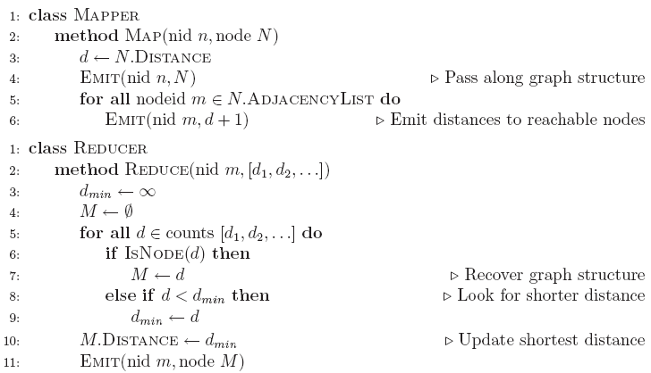
BFS Pseudo-Code

Slide 77
Stopping Criterion
How many iterations are needed in parallel BFS (equal edge weight case)?
Convince yourself: when a node is first “discovered”, we’ve found the shortest path
Now answer the question...
Six degrees of separation?
Practicalities of implementation in MapReduce

Slide 78
Comparison to Dijkstra
Dijkstra’s algorithm is more efficient
At any step it only pursues edges from the minimum-cost path inside the frontier
MapReduce explores all paths in parallel
Lots of “waste” 不在当前层的点，都在空转
Useful work is only done at the “frontier”
Why can’t we do better using MapReduce?

Slide 79
Weighted Edges
Now add positive weights to the edges
Why can’t edge weights be negative?
Simple change: adjacency list now includes a weight w for each edge
In mapper, emit (m, d + w_{p}) instead of (m, d + 1) for each node m
That’s it?

Slide 80
Stopping Criterion
How many iterations are needed in parallel BFS (positive edge weight case)?
Convince yourself: when a node is first “discovered”, we’ve found the shortest path
Not true!

Slide 81
Additional Complexities
search frontier
1
n₆
1
n₇
1
n₈
r
10
1
n₅
n₉
n₁
s
1
1
p
q
n₄
1
n₂
1
n₃

Slide 82
Stopping Criterion
How many iterations are needed in parallel BFS (positive edge weight case)? 什么时候可以结束？比之前更难结束了
Practicalities of implementation in MapReduce

Slide 83
Graphs and MapReduce
Graph algorithms typically involve:
Performing computations at each node: based on node features, edge features, and local link structure
Propagating computations: “traversing” the graph
Generic recipe:
Represent graphs as adjacency lists
Perform local computations in mapper
Pass along partial results via outlinks, keyed by destination node
Perform aggregation in reducer on inlinks to a node
Iterate until convergence: controlled by external “driver”
Don’t forget to pass the graph structure between iterations

Slide 84
Random Walks Over the Web
Random surfer model:
User starts at a random Web page
User randomly clicks on links, surfing from page to page
PageRank
Characterizes the amount of time spent on any given page
Mathematically, a probability distribution over pages
PageRank captures notions of page importance
Correspondence to human intuition?
One of thousands of features used in web search
Note: query-independent

Slide 85
PageRank: Defined
Given page x with inlinks t₁…t_{n}, where
C(t) is the out-degree of t
α is probability of random jump
N is the total number of nodes in the graph
t₁
X
t₂
…
t_{n}

Slide 86
Computing PageRank
Properties of PageRank
Can be computed iteratively
Effects at each iteration are local
Sketch of algorithm:
Start with seed PR_{i} values
Each page distributes PR_{i} “credit” to all pages it links to
Each target page adds up “credit” from multiple in-bound links to compute PR_{i+1}
Iterate until values converge

Slide 87
Simplified PageRank
First, tackle the simple case:
No random jump factor
No dangling links
Then, factor in these complexities…
Why do we need the random jump?
Where do dangling links come from?

Slide 88
Sample PageRank Iteration (1)
Iteration 1
n₂ (0.2)
n₂ (0.166)
n₁ (0.2)
0.1
0.1
0.1
n₁ (0.066)
0.1
节点重要性/出度
0.066
0.066
0.066
n₅ (0.2)
n₃ (0.2)
n₅ (0.3)
n₃ (0.166)
0.2
0.2
n₄ (0.2)
n₄ (0.3)
输入值 - 输出值

Slide 89
Sample PageRank Iteration (2)
Iteration 2
n₂ (0.166)
n₂ (0.133)
n₁ (0.066)
0.033
0.083
0.083
n₁ (0.1)
0.033
0.1
0.1
0.1
n₅ (0.3)
n₃ (0.166)
n₅ (0.383)
n₃ (0.183)
0.3
0.166
n₄ (0.3)
n₄ (0.2)

Slide 90
PageRank in MapReduce
n₁ [n₂, n₄]
n₂ [n₃, n₅]
n₃ [n₄]
n₄ [n₅]
n₅ [n₁, n₂, n₃]
Map
n₂
n₄
n₃
n₅
n₄
n₅
n₁
n₂
n₃
n₁
n₂
n₂
n₃
n₃
n₄
n₄
n₅
n₅
Reduce
n₁ [n₂, n₄]
n₂ [n₃, n₅]
n₃ [n₄]
n₄ [n₅]
n₅ [n₁, n₂, n₃]

Slide 91
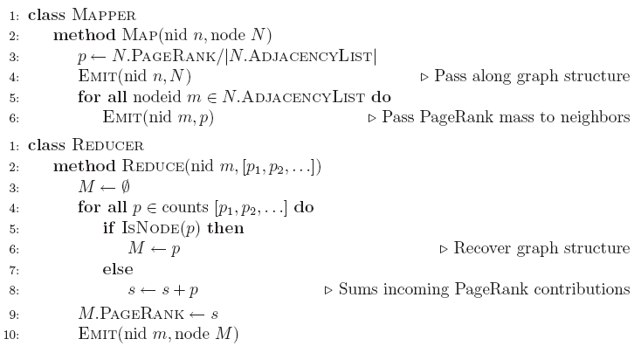
PageRank Pseudo-Code

Slide 92
Complete PageRank
Two additional complexities
What is the proper treatment of dangling nodes?
How do we factor in the random jump factor?
Solution:
Second pass to redistribute “missing PageRank mass” and account for random jumps 添加的第二部分是损失的PR值
p is PageRank value from before, p' is updated PageRank value
|G| is the number of nodes in the graph
m is the missing PageRank mass

Slide 93
PageRank Convergence
Alternative convergence criteria
Iterate until PageRank values 值 don’t change
Iterate until PageRank rankings 排序 don’t change
Fixed number of iterations 足够多的固定值更新次数就够了，就算值仍能继续变化，但是差别不会很大了
Convergence for web graphs?

Slide 94
Beyond PageRank
Link structure is important for web search
PageRank is one of many link-based features: HITS, SALSA, etc.
One of many thousands of features used in ranking…
Adversarial nature of web search
Link spamming 过滤垃圾连接？
Spider traps
Keyword stuffing
…

Slide 95
Efficient Graph Algorithms
Sparse vs. dense graphs
Graph topologies

Slide 96
Power Laws are everywhere!
Figure from: Newman, M. E. J. (2005) “Power laws, Pareto distributions and Zipf's law.” Contemporary Physics 46:323–351.

Slide 97
Local Aggregation
Use combiners!
In-mapper combining design pattern also applicable
Maximize opportunities for local aggregation
Simple tricks: sorting the dataset in specific ways

Slide 98
Questions?
Source: Wikipedia (Japanese rock garden)

Slide 99
MapReduce and databases
Data-Intensive Information Processing Applications ― Session #7
Jimmy Lin
University of Maryland
Tuesday, March 23, 2010
This work is licensed under a Creative Commons Attribution-Noncommercial-Share Alike 3.0 United States See http://creativecommons.org/licenses/by-nc-sa/3.0/us/ for details

Slide 100
Source: Wikipedia (Japanese rock garden)

Slide 101
Today’s Agenda
Role of relational databases in today’s organizations
Where does MapReduce fit in?
MapReduce algorithms for processing relational data
How do I perform a join, etc.?
Evolving roles of relational databases and MapReduce
What’s in store for the future?

Slide 102
Big Data Analysis
Peta-scale datasets are everywhere:
Facebook has 2.5 PB of user data + 15 TB/day (4/2009)
eBay has 6.5 PB of user data + 50 TB/day (5/2009)
…
A lot of these datasets are (mostly) structured
Query logs
Point-of-sale records
User data (e.g., demographics)
…
How do we perform data analysis at scale?
Relational databases and SQL
MapReduce (Hadoop)

Slide 103
Relational Databases vs. MapReduce
Relational databases:
Multipurpose: analysis and transactions; batch and interactive
Data integrity via ACID transactions
Lots of tools in software ecosystem (for ingesting, reporting, etc.)
Supports SQL (and SQL integration, e.g., JDBC)
Automatic SQL query optimization
MapReduce (Hadoop):
Designed for large clusters, fault tolerant
Data is accessed in “native format”
Supports many query languages
Programmers retain control over performance
Open source
Source: O’Reilly Blog post by Joseph Hellerstein (11/19/2008)

Slide 104
Database Workloads
OLTP (online transaction processing)
Typical applications: e-commerce, banking, airline reservations
User facing: real-time, low latency, highly-concurrent
Tasks: relatively small set of “standard” transactional queries
Data access pattern: random reads, updates, writes (involving relatively small amounts of data)
OLAP (online analytical processing)
Typical applications: business intelligence, data mining
Back-end processing: batch workloads, less concurrency
Tasks: complex analytical queries, often ad hoc
Data access pattern: table scans, large amounts of data involved per query

Slide 105
One Database or Two?
Downsides of co-existing OLTP and OLAP workloads
Poor memory management
Conflicting data access patterns
Variable latency
Solution: separate databases
User-facing OLTP database for high-volume transactions
Data warehouse for OLAP workloads
How do we connect the two?

Slide 106
OLTP/OLAP Architecture
OLTP
OLAP
ETL (Extract, Transform, and Load)

Slide 107
OLTP/OLAP Integration
OLTP database for user-facing transactions
Retain records of all activity
Periodic ETL (e.g., nightly)
Extract-Transform-Load (ETL)
Extract records from source
Transform: clean data, check integrity, aggregate, etc.
Load into OLAP database
OLAP database for data warehousing 数据仓库
Business intelligence: reporting, ad hoc queries, data mining, etc.
Feedback to improve OLTP services

Slide 108
Business Intelligence
Premise: more data leads to better business decisions
Periodic reporting as well as ad hoc queries
Analysts, not programmers (importance of tools and dashboards)
Examples:
Slicing-and-dicing activity by different dimensions to better understand the marketplace
Analyzing log data to improve OLTP experience
Analyzing log data to better optimize ad placement
Analyzing purchasing trends for better supply-chain management
Mining for correlations between otherwise unrelated activities

Slide 109
OLTP/OLAP Architecture: Hadoop?
OLTP
OLAP
What about here?
ETL (Extract, Transform, and Load)
Hadoop here?

Slide 110
OLTP/OLAP/Hadoop Architecture
OLTP
Hadoop
OLAP
ETL (Extract, Transform, and Load)
Why does this make sense?

Slide 111
ETL Bottleneck
Reporting is often a nightly task:
ETL is often slow: why?
What happens if processing 24 hours of data takes longer than 24 hours?
Hadoop is perfect:
Most likely, you already have some data warehousing solution
Ingest is limited by speed of HDFS
Scales out with more nodes
Massively parallel
Ability to use any processing tool
Much cheaper than parallel databases
ETL is a batch process anyway!

Slide 112
MapReduce algorithms for processing relational data

Slide 113
Design Pattern: Secondary Sorting
MapReduce sorts input to reducers by key
Values are arbitrarily ordered
What if want to sort value also?
E.g., k → (v₁, r), (v₃, r), (v₄, r), (v₈, r)…

Slide 114
Secondary Sorting: Solutions
Solution 1:
Buffer values in memory, then sort
Why is this a bad idea?
Solution 2:
“Value-to-key conversion” design pattern: form composite intermediate key, (k, v₁)
Let execution framework do the sorting
Preserve state across multiple key-value pairs to handle processing
Anything else we need to do?

Slide 115
Value-to-Key Conversion
Before
k → (v₁, r), (v₄, r), (v₈, r), (v₃, r)…
Values arrive in arbitrary order…
After
(k, v₁) → (v₁, r)
Values arrive in sorted order…
(k, v₃) → (v₃, r)
Process by preserving state across multiple keys
(k, v₄) → (v₄, r)
Remember to partition correctly!
(k, v₈) → (v₈, r)
…

Slide 116
Working Scenario
Two tables:
User demographics (gender, age, income, etc.)
User page visits (URL, time spent, etc.)
Analyses we might want to perform:
Statistics on demographic characteristics
Statistics on page visits
Statistics on page visits by URL
Statistics on page visits by demographic characteristic
…

Slide 117
Relational Algebra
Primitives
Projection (π)
Selection (σ)
Cartesian product (×)
Set union (∪)
Set difference (−)
Rename (ρ)
Other operations
Join (⋈)
Group by… aggregation
…

Slide 118
Projection
R₁
R₁
R₂
R₂
R₃
R₃
R₄
R₄
R₅
R₅

Slide 119
Projection in MapReduce
Easy!
Map over tuples, emit new tuples with appropriate attributes
No reducers, unless for regrouping or resorting tuples
Alternatively: perform in reducer, after some other processing
Basically limited by HDFS streaming speeds
Speed of encoding/decoding tuples becomes important
Relational databases take advantage of compression
Semistructured data? No problem!

Slide 120
Selection
R₁
R₂
R₁
R₃
R₃
R₄
R₅

Slide 121
Selection in MapReduce
Easy!
Map over tuples, emit only tuples that meet criteria
No reducers, unless for regrouping or resorting tuples
Alternatively: perform in reducer, after some other processing
Basically limited by HDFS streaming speeds
Speed of encoding/decoding tuples becomes important
Relational databases take advantage of compression
Semistructured data? No problem!

Slide 122
Group by… Aggregation
Example: What is the average time spent per URL?
In SQL:
SELECT url, AVG(time) FROM visits GROUP BY url
In MapReduce:
Map over tuples, emit time, keyed by url
Framework automatically groups values by keys
Compute average in reducer
Optimize with combiners

Slide 123

Relational Joins
Source: Microsoft Office Clip Art

Slide 124
Relational Joins
R₁
S₁
R₂
S₂
R₃
S₃
R₄
S₄
R₁
S₂
R₂
S₄
R₃
S₁
R₄
S₃

Slide 125
Types of Relationships
Many-to-Many
One-to-Many
One-to-One

Slide 126
Join Algorithms in MapReduce
Reduce-side join
Map-side join
In-memory join
Striped variant
Memcached variant

Slide 127
Reduce-side Join
Basic idea: group by join key
Map over both sets of tuples
Emit tuple as value with join key as the intermediate key
Execution framework brings together tuples sharing the same key
Perform actual join in reducer
Similar to a “sort-merge join” in database terminology
Two variants
1-to-1 joins
1-to-many and many-to-many joins

Slide 128
Reduce-side Join: 1-to-1
Map
keys
values
R₁
R₁
R₄
R₄
S₂
S₂
S₃
S₃
Reduce
keys
values
R₁
S₂
S₃
R₄
Note: no guarantee if R is going to come first or S

Slide 129
Reduce-side Join: 1-to-many
Map
keys
values
R₁
R₁
S₂
S₂
S₃
S₃
S₉
S₉
Reduce
keys
values
R₁
S₂
S₃
…
What’s the problem?

Slide 130
Reduce-side Join: V-to-K Conversion
In reducer…
keys
values
R₁
New key encountered: hold in memory
S₂
Cross with records from other set
S₃
S₉
R₄
New key encountered: hold in memory
S₃
Cross with records from other set
S₇

Slide 131
Reduce-side Join: many-to-many
In reducer…
keys
values
R₁
内存放不下全部？
R₅
Hold in memory
R₈
S₂
Cross with records from other set
S₃
S₉
What’s the problem?

Slide 132
Map-side Join: Basic Idea
Assume two datasets are sorted by the join key:
R₁
S₂
R₂
S₄
R₄
S₃
R₃
S₁
A sequential scan through both datasets to join (called a “merge join” in database terminology)

Slide 133
Map-side Join: Parallel Scans
If datasets are sorted by join key, join can be accomplished by a scan over both datasets
How can we accomplish this in parallel?
Partition and sort both datasets in the same manner
In MapReduce:
Map over one dataset, read from other corresponding partition
No reducers necessary (unless to repartition or resort)
Consistently partitioned datasets: realistic to expect?

Slide 134
In-Memory Join
Basic idea: load one dataset（放的进） into memory, stream over other dataset （放不进）
Works if R << S and R fits into memory
Called a “hash join” in database terminology
MapReduce implementation
Distribute R to all nodes
Map over S, each mapper loads R in memory, hashed by join key
For every tuple in S, look up join key in R
No reducers, unless for regrouping or resorting tuples

Slide 135
In-Memory Join: Variants
Striped variant:
R too big to fit into memory?
Divide R into R₁, R₂, R₃, … s.t. each R_{n} fits into memory
Perform in-memory join: ∀n, R_{n} ⋈ S
Take the union of all join results
Memcached join:
Load R into memcached
Replace in-memory hash lookup with memcached lookup

Slide 136
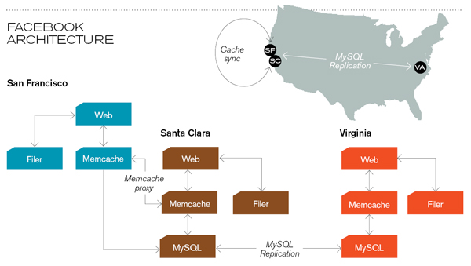
Memcached
Caching servers: 15 million requests per second, 95% handled by memcache (15 TB of RAM)
Database layer: 800 eight-core Linux servers running MySQL (40 TB user data)
Source: Technology Review (July/August, 2008)

Slide 137
Memcached Join
Memcached join:
Load R into memcached
Replace in-memory hash lookup with memcached lookup
Capacity and scalability?
Memcached capacity >> RAM of individual node
Memcached scales out with cluster
Latency?
Memcached is fast (basically, speed of network)
Batch requests to amortize latency costs
Source: See tech report by Lin et al. (2009)

Slide 138
Which join to use?
In-memory join（都放进内存） > map-side join（有序） > reduce-side join（无序，R、S都大）
Why?
速度顺序！
Limitations of each?
In-memory join: memory
Map-side join: sort order and partitioning
Reduce-side join: general purpose

Slide 139
Processing Relational Data: Summary
MapReduce algorithms for processing relational data:
Group by, sorting, partitioning are handled automatically by shuffle/sort in MapReduce
Selection, projection, and other computations (e.g., aggregation), are performed either in mapper or reducer
Multiple strategies for relational joins
Complex operations require multiple MapReduce jobs
Example: top ten URLs in terms of average time spent
Opportunities for automatic optimization

Slide 140
Evolving roles for relational database and MapReduce

Slide 141
OLTP/OLAP/Hadoop Architecture
OLTP
Hadoop
OLAP
ETL (Extract, Transform, and Load)
Why does this make sense?

Slide 142
Need for High-Level Languages
Hadoop is great for large-data processing!
But writing Java programs for everything is verbose and slow
Analysts don’t want to (or can’t) write Java
Solution: develop higher-level data processing languages
Hive: HQL is like SQL
Pig: Pig Latin is a bit like Perl

Slide 143


Hive and Pig
Hive: data warehousing application in Hadoop
Query language is HQL, variant of SQL
Tables stored on HDFS as flat files
Developed by Facebook, now open source
Pig: large-scale data processing system
Scripts are written in Pig Latin, a dataflow language
Developed by Yahoo!, now open source
Roughly 1/3 of all Yahoo! internal jobs
Common idea:
Provide higher-level language to facilitate large-data processing
Higher-level language “compiles down” to Hadoop jobs

Slide 144
Hive: Example
Hive looks similar to an SQL database
Relational join on two tables:
Table of word counts from Shakespeare collection
Table of word counts from the bible
SELECT s.word, s.freq, k.freq FROM shakespeare s
JOIN bible k ON (s.word = k.word) WHERE s.freq >= 1 AND k.freq >= 1 ORDER BY s.freq DESC LIMIT 10;
the 25848 62394
I 23031 8854
and 19671 38985
to 18038 13526
of 16700 34654
a 14170 8057
you 12702 2720
my 11297 4135
in 10797 12445
is 8882 6884
Source: Material drawn from Cloudera training VM

Slide 145
Hive: Behind the Scenes
SELECT s.word, s.freq, k.freq FROM shakespeare s
JOIN bible k ON (s.word = k.word) WHERE s.freq >= 1 AND k.freq >= 1 ORDER BY s.freq DESC LIMIT 10;
(Abstract Syntax Tree)
(TOK_QUERY (TOK_FROM (TOK_JOIN (TOK_TABREF shakespeare s) (TOK_TABREF bible k) (= (. (TOK_TABLE_OR_COL s) word) (. (TOK_TABLE_OR_COL k) word)))) (TOK_INSERT (TOK_DESTINATION (TOK_DIR TOK_TMP_FILE)) (TOK_SELECT (TOK_SELEXPR (. (TOK_TABLE_OR_COL s) word)) (TOK_SELEXPR (. (TOK_TABLE_OR_COL s) freq)) (TOK_SELEXPR (. (TOK_TABLE_OR_COL k) freq))) (TOK_WHERE (AND (>= (. (TOK_TABLE_OR_COL s) freq) 1) (>= (. (TOK_TABLE_OR_COL k) freq) 1))) (TOK_ORDERBY (TOK_TABSORTCOLNAMEDESC (. (TOK_TABLE_OR_COL s) freq))) (TOK_LIMIT 10)))
(one or more of MapReduce jobs)

Slide 146
Hive: Behind the Scenes
cong
把SQL自动变成分布式map reduce的代码
STAGE DEPENDENCIES:
Stage-1 is a root stage
Stage-2 depends on stages: Stage-1
Stage-0 is a root stage
STAGE PLANS:
Stage: Stage-1
Map Reduce
Alias -> Map Operator Tree:
s
TableScan
alias: s
Filter Operator
predicate:
expr: (freq >= 1)
type: boolean
Reduce Output Operator
key expressions:
expr: word
type: string
sort order: +
Map-reduce partition columns:
expr: word
type: string
tag: 0
value expressions:
expr: freq
type: int
expr: word
type: string
k
TableScan
alias: k
Filter Operator
predicate:
expr: (freq >= 1)
type: boolean
Reduce Output Operator
key expressions:
expr: word
type: string
sort order: +
Map-reduce partition columns:
expr: word
type: string
tag: 1
value expressions:
expr: freq
type: int
Stage: Stage-2
Map Reduce
Alias -> Map Operator Tree:
hdfs://localhost:8022/tmp/hive-training/364214370/10002
Reduce Output Operator
key expressions:
expr: _col1
type: int
sort order: -
tag: -1
value expressions:
expr: _col0
type: string
expr: _col1
type: int
expr: _col2
type: int
Reduce Operator Tree:
Extract
Limit
File Output Operator
compressed: false
GlobalTableId: 0
table:
input format: org.apache.hadoop.mapred.TextInputFormat
output format: org.apache.hadoop.hive.ql.io.HiveIgnoreKeyTextOutputFormat
Stage: Stage-0
Fetch Operator
limit: 10
Reduce Operator Tree:
Join Operator
condition map:
Inner Join 0 to 1
condition expressions:
0 {VALUE._col0} {VALUE._col1}
1 {VALUE._col0}
outputColumnNames: _col0, _col1, _col2
Filter Operator
predicate:
expr: ((_col0 >= 1) and (_col2 >= 1))
type: boolean
Select Operator
expressions:
expr: _col1
type: string
expr: _col0
type: int
expr: _col2
type: int
outputColumnNames: _col0, _col1, _col2
File Output Operator
compressed: false
GlobalTableId: 0
table:
input format: org.apache.hadoop.mapred.SequenceFileInputFormat
output format: org.apache.hadoop.hive.ql.io.HiveSequenceFileOutputFormat

Slide 147
Pig: Example
Task: Find the top 10 most visited pages in each category
Visits
Url Info
User | Url | Time
Amy | cnn.com | 8:00
Amy | bbc.com | 10:00
Amy | flickr.com | 10:05
Fred | cnn.com | 12:00
Url | Category | PageRank
cnn.com | News | 0.9
bbc.com | News | 0.8
flickr.com | Photos | 0.7
espn.com | Sports | 0.9
Pig Slides adapted from Olston et al. (SIGMOD 2008)

Slide 148
Pig Query Plan
Load Visits
Group by url
Foreach url
generate count
Load Url Info
Join on url
Group by category
Foreach category
generate top10(urls)
Pig Slides adapted from Olston et al. (SIGMOD 2008)

Slide 149
Pig Script
visits = load ‘/data/visits’ as (user, url, time);
gVisits = group visits by url;
visitCounts = foreach gVisits generate url, count(visits);
urlInfo = load ‘/data/urlInfo’ as (url, category, pRank);
visitCounts = join visitCounts by url, urlInfo by url;
gCategories = group visitCounts by category;
topUrls = foreach gCategories generate top(visitCounts,10);
store topUrls into ‘/data/topUrls’;
Pig Slides adapted from Olston et al. (SIGMOD 2008)

Slide 150
Pig Script in Hadoop
Map₁
Load Visits
Group by url
Reduce₁
Map₂
Foreach url
generate count
Load Url Info
Join on url
Reduce₂
Map₃
Group by category
Reduce₃
Foreach category
generate top10(urls)
Pig Slides adapted from Olston et al. (SIGMOD 2008)

Slide 151
Parallel Databases ↔ MapReduce
Lots of synergy between parallel databases and MapReduce
Communities have much to learn from each other
Bottom line: use the right tool for the job!

Slide 152
Questions?
Source: Wikipedia (Japanese rock garden)

