Slide 1
Does childhood trauma really affects pleasantness of self-referential criticism?
汇报人：罗霄，唐晨烨，刘正浩，李仁轩

Slide 2
CONTENTS
Introduction
Research method
Results
Discussion

Slide 3

Introduction Research Field
Introduction
Childhood trauma have a significant impact on psycho-logical development and are closely related to mental and psychological disorders in adulthood. Children who have lived in a traumatic environment for a long time are emotionally deprived and unsatisfied due to the insecurity, hostility and threat of their environment. Therefore, it is difficult for children to develop well-adapted personality struc-tures and functions.
Research method
Results
Discussion
Ref：Bernstein, D. P., Fink, L., Handelsman, L., Foote, J., Lovejoy, M., Wenzel, K., ... & Ruggiero, J. (1994). Initial reliability and validity of a new retrospective measure of child abuse and neglect. The American journal of psychiatry..

Slide 4

Introduction CTQ
Introduction
Five types:
emotional abuse,
physical abuse,
sexual abuse,
emotional neglect,
physical neglect.
from “Never true” to ‘Very often true.”
Research method
Results
Discussion
Ref：Bernstein, D. P., Fink, L., Handelsman, L., & Foote, J. (1998). Childhood trauma questionnaire. Assessment of family violence: A handbook for researchers and practitioners.

Slide 5
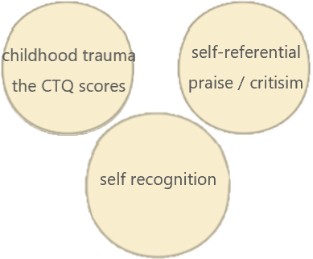
Introduction Main Problem & Purpose
Main problem: Whether and to what extent childhood trauma can have an impact on self-recognition.
Introduction
Research method
Research purpose: By studying the relationship between CTQ score and the plea-santness of self-referential praise and criticism, we can get the influence of child-hood trauma on self-recognition
Results
Discussion

Slide 6
CONTENTS
Research method
Introduction
Results
Discussion

Slide 7
Research method
Introduction
Research method
Participants
Questionnaire
Stimuli
Results
100healthy undergraduates and postgraduate students;
50 men 50 women;
from 18 to 26 years old
(M = 23.66, SD = 1.43);
all participants are Chinese natives
Childhood Trauma
Questionnaire (CTQ)
100 praising and criticizing
sentences
(50 in each category)
Discussion

Slide 8
Research method
Introduction
Research method
Procedure
Data analysis
Results
completed CTQ first rate each sentence for pleasantness
e.g.
“你充满激情”in English “You are passionate!”
“你优柔寡断!”in English “You are indecisive!”
a paired t test (two-tailed) for pleasantness ratings;
Pearson correlation
(two-tailed) analysis for the association between
pleasantness and CTQ
scores
Discussion

Slide 9
CONTENTS
Results
Introduction
Research method
Discussion

Slide 10
Results
Introduction
Paired T-test
The difference between pleasantness of self-referential criticism and self referential praise
Pearson correlation
The correlation between pleasantness of self-referential criticism and the CTQ score.
Research method
Results
Discussion

Slide 11
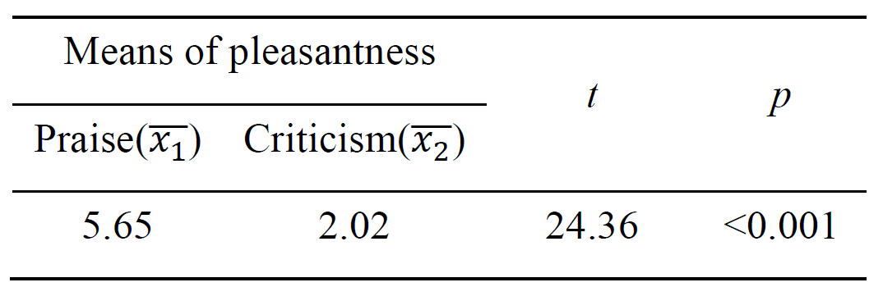

Results Paired T-test
1. hypothesis
2. calculate
3. evaluate
Introduction
Research method
Results
Discussion
Assume that $d=x_{1i}−x_{2i}$, using the equation $t=\frac{\overline{d}−μ_{0}}{\frac{s}{\sqrt{n}}}$ ,
we could calculate the t value.
Ref: David, H. A., & Gunnink, J. L. (1997). The paired t test under artificial pairing. The American Statistician, 51(1), 9-12.

Slide 12
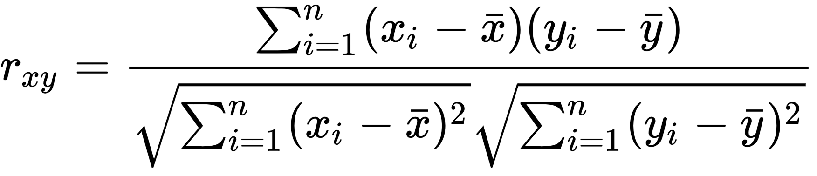
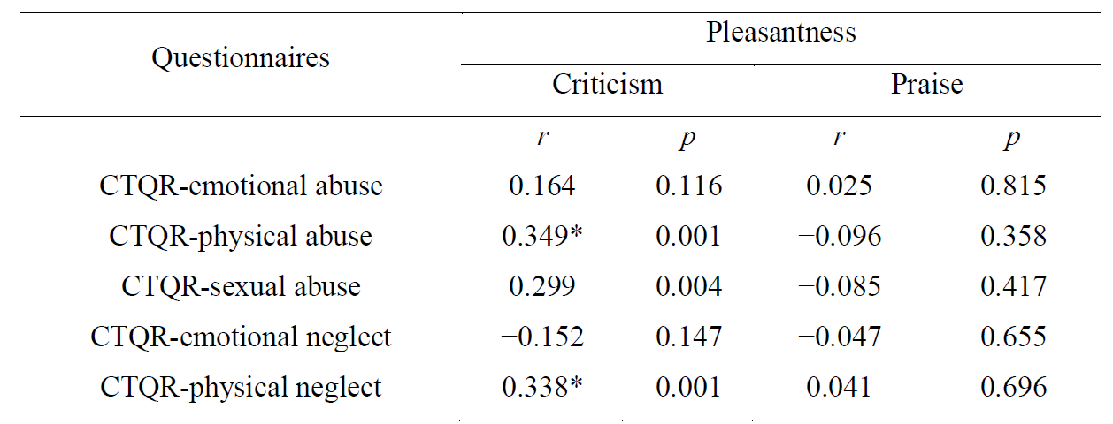
Results Pearson correlation
Introduction
Research method
Results
Discussion
Ref: “Pearson correlation coefficient”, en.wikipedia.org/wiki/Pearson_correlation_coefficient

Slide 13
CONTENTS
Discussion
Introduction
Research method
Results

Slide 14
Discussion
Introduction
This experiment primarily aimed to reveal the connection between childhood trauma and pleasantness of self-referential criticism and praise.
Participants were presented with the CTQ and a pleasantness evaluation test.
When the participants were provided with sentence of different types, the average figures of pleasantness were largely changed, which means that the pleasantness evaluation tests carried out is reasonable and valid.
Research method
Results
Discussion

Slide 15
Discussion
Introduction
There are three groups of data (r=0.349, p=0.001; r=0.299, p=0.004; r=0.338, p=0.001) have small chances to get wrong conclusion in Table 2, and they all belong to the column of “criticism”.
The pleasantness of criticism may has positives correlation with Childhood Trauma.
Meanwhile, the pleasantness of praise may have no correlation with Childhood Trauma.
Research method
Results
Discussion

Slide 16
Discussion
Introduction
If someone have childhood trauma, he or she may be less sensitive to criticism than others. It might be reasonable based on our life experience.
The correlation between childhood trauma and pleasantness of criticism has rarely been researched. This article proves the existence of correlation between Childhood Trauma and pleasantness, and complements some new viewpoint to present references.
Research method
Results
Discussion

Slide 17
THANK YOU

