Slide 1
Titanic
BY BOLARINWA OREOLUWA SEUN.

Slide 2
contents
ABOUT
PROCEDURES
Data analysis ,data wrangling and data manipulation
Data visualization
Machine learning modelling
TESTING

Slide 3
ABOUT

Slide 4
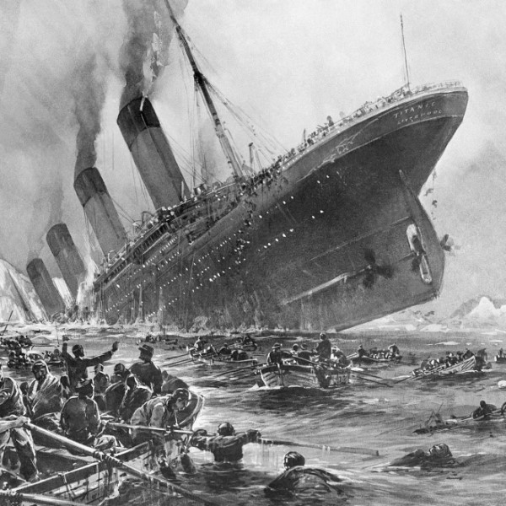
WHAT THIS PROJECT IS ABOUT.
A Machine Learning classification model that predicts whether a passenger of the titanic ship survived or not based on the data features of the given data set.
In this project, survived outputs the value 1, and the opposite outputs the value 0.

Slide 5
PROCEDURES

Slide 6
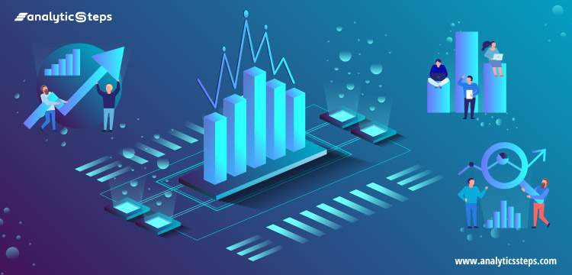
Data Analysis , Wrangling and Manipulation.
Data wrangling, sometimes referred to as data munging, is the process of transforming and mapping data from one "raw" data form into another format with the intent of making it more appropriate and valuable for a variety of downstream purposes such as analytics.
Data manipulation refers to the process of adjusting data to make it organised and easier to read.

Slide 7
Data Analysis , Wrangling and Manipulation.
IN THIS SECTION:
I performed various and numerous analytical , wrangling and manipulation activities on my dataset to keep it in the best possible format for efficient usage. Data cleaning is not left out
I GAINED SOME INSIGHTS ON the dataset using some data visualization tools and this will be dwelt upon shortly.

Slide 8
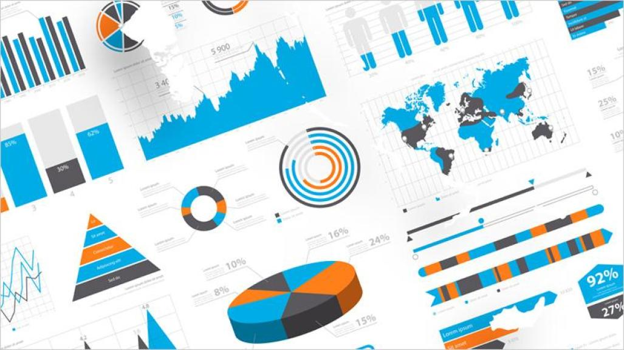
Data Visualization.
Data visualization is the graphical representation of information and data. By using visual elements like charts, graphs, and maps, data visualization tools provide an accessible way to see and understand trends, outliers, and patterns in data.
The main idea behind all the data visualizations is to give insights on the data…

Slide 9
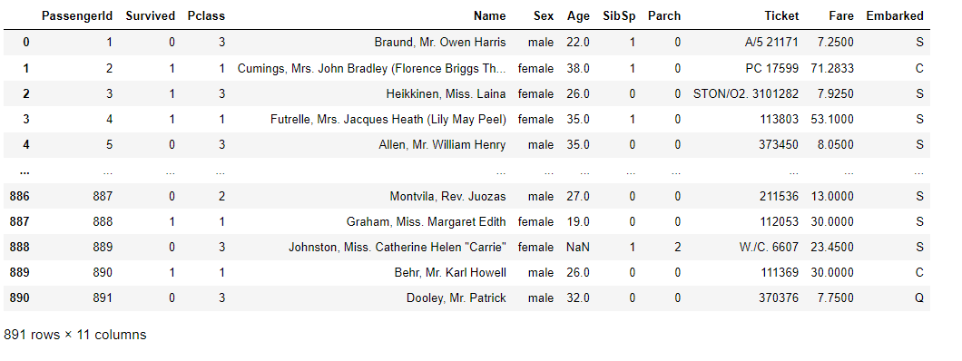
An overview of the dataset used.

Slide 10
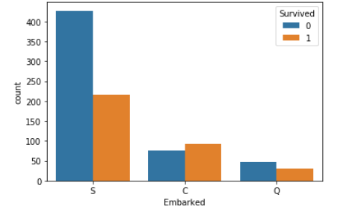
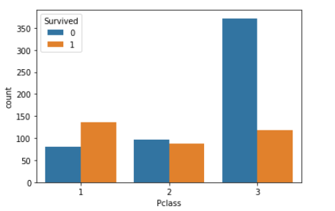
Data visualization.

Slide 11
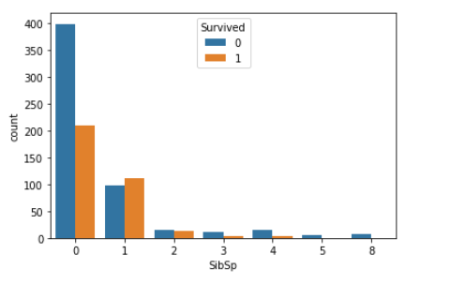
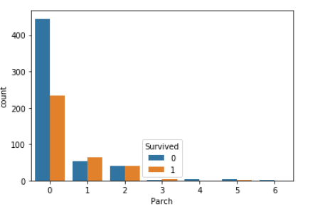
Data visualizations

Slide 12
Data Visualization Tools.
Data visualization tools include
Matplotlib
Seaborn
pyplot

Slide 13
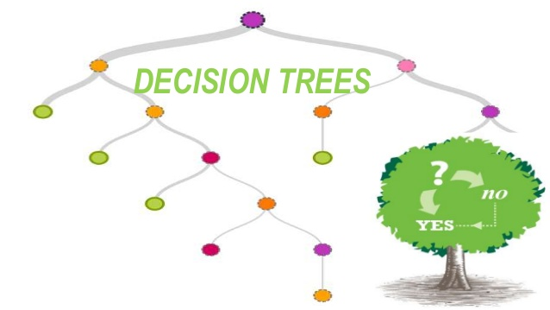
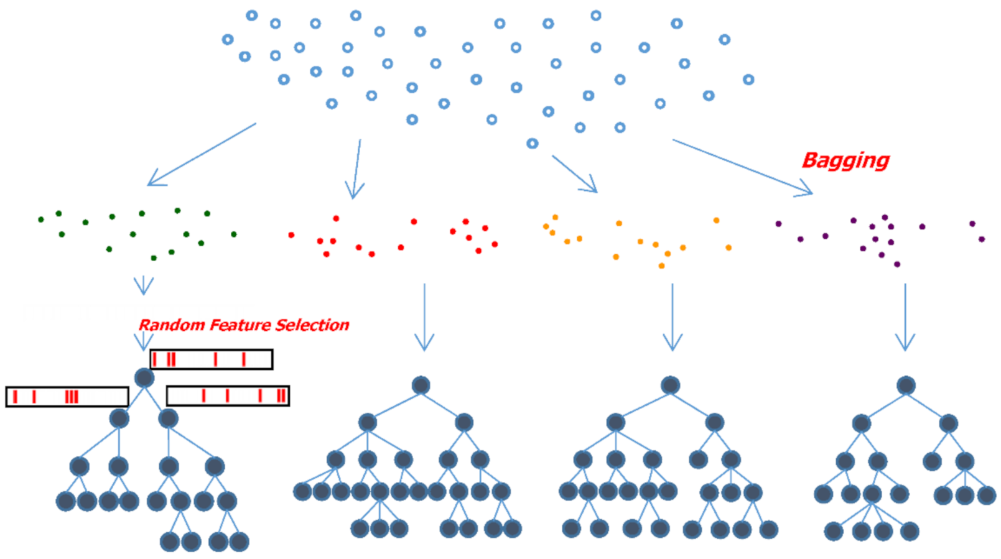
Machine Learning Modelling.

Slide 14
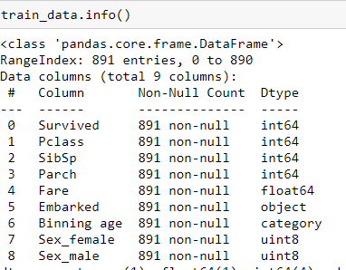
Machine learning modelling.
I performed feature engineering on the datasets, removed un-needed data features and created new ones
Eventually my original datasets got modified to this features by the right

Slide 15
Machine Learning Modelling.
From sklearn, a machine learning framework I imported logistic regression , random forest regressor and decision tree regressor
I fitted the train dataset with the different machine learning algorithms
Then I approached the testing phase

Slide 16
Testing

Slide 17
Testing
After creating the different machine learning models… I achieved an accuracy of about 79% for the logistic regression model, about 81% for the random forest model and a accuracy of 85% for the decision trees model..
Hence taking the model with the highest accuracy… the decision tress model is used in predicting if a ship passenger survived or not.

