Slide 1
Instrumental Variables
Professor Susan Athey
Machine Learning and Causal Inference

Slide 2
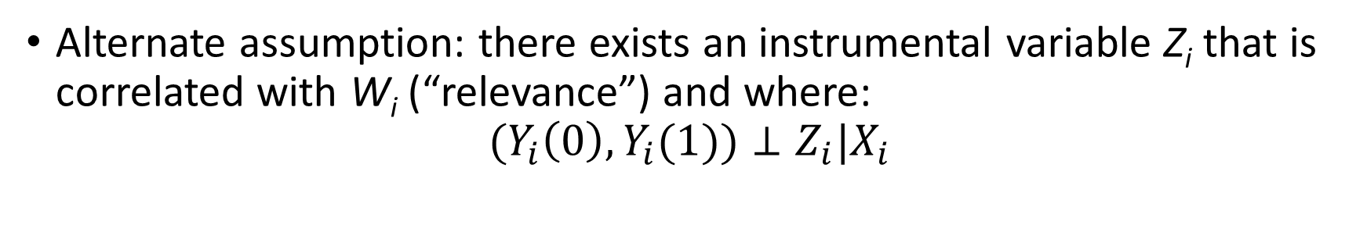
What if unconfoundedness fails?
Alternate assumption: there exists an instrumental variable Z_{i} that is correlated with W_{i} (“relevance”) and where:
$$(Y_{i}\left(0\right),Y_{i}(1))⊥Z_{i}|X_{i}$$
Treatment W_{i} | Instrument Z_{i} | Outcome Y_{i}
Military service | Draft Lottery Number | Earnings
Price | Fuel cost | Sales
Having 3 or more kids | First 2 kids same sex | Mom’s wages
Education | Quarter of birth | Wage
Taking a drug | Assigned to treatment group | Health
Seeing an ad | Assigned to group of users advertiser bids on in experiment | Purchases at advertiser’s web site

Slide 3
Instrumental Variables: Binary Experiment Case
 | Assigned to Treatment | Not Assigned to Treatment
Compliers | Treated | Not treated
Always-Takers | Treated | Treated
Never-Takers | Not treated | Not treated
Defiers | Not treated | Treated

Slide 4
Different Estimands
Why not look at who was actually treated?
Those who complied or defied were probably not random
Intention-to-treat (ITT)
Compare average outcomes of those assigned to treatment with those assigned to control
This may be interesting object if compliance will be similar when you actually implement the treatment, e.g. recommend patients for a drug
Local Average Treatment Effect (effect of treatment on compliers)
Calculated as ITT/Pr(treat|assigned treatment)=ITT/Pr(W_{i}=1|Z_{i}=1)
This clearly works if you can’t get the treatment without being assigned to treatment group (no always-takers, no defiers)
This also works as long as there are no defiers
LATE is always larger than ITT

Slide 5
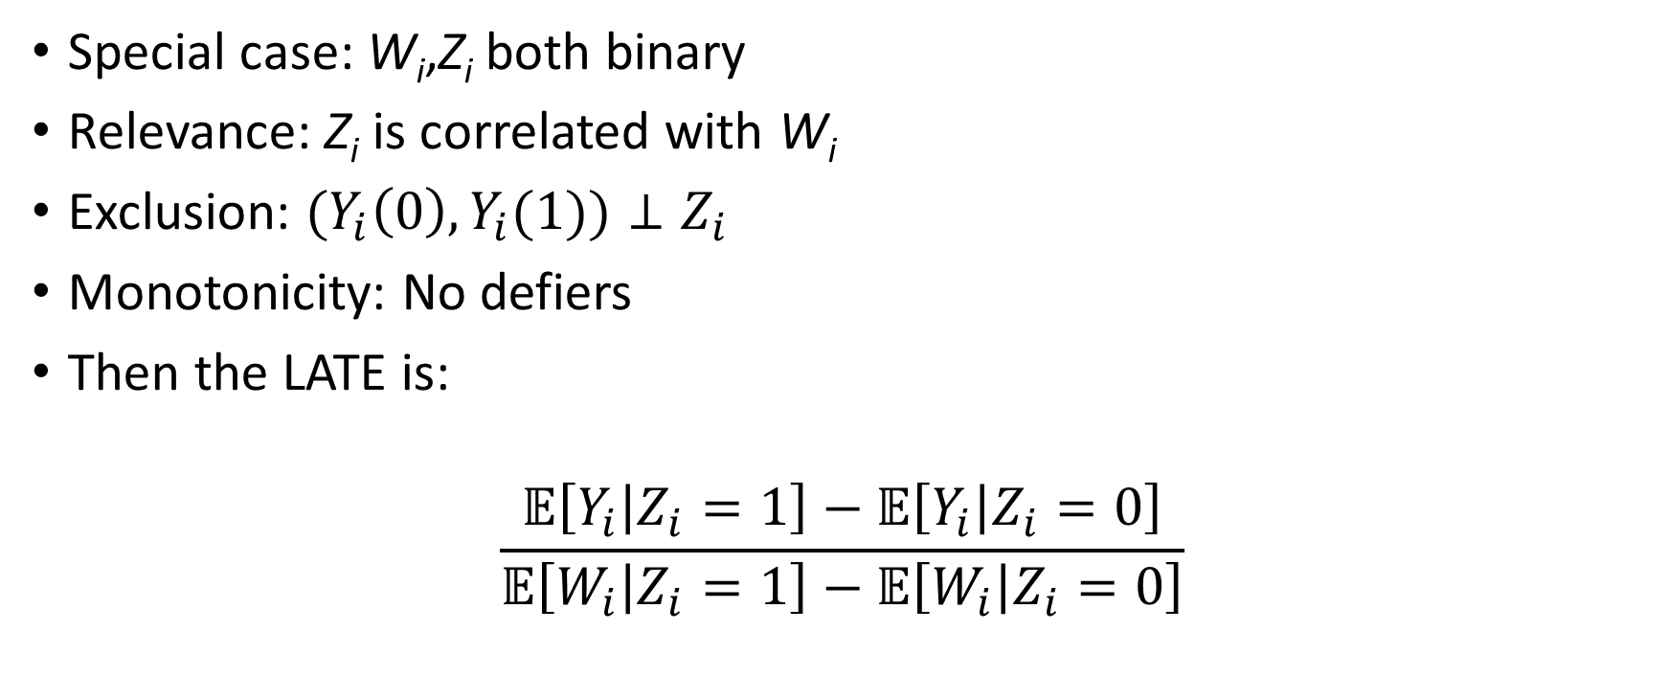
Local Average Treatment Effects
Special case: W_{i},Z_{i} both binary
Relevance: Z_{i} is correlated with W_{i}
Exclusion: $(Y_{i}\left(0\right),Y_{i}(1))⊥Z_{i}$
Monotonicity: No defiers
Then the LATE is:
$$\frac{𝔼\left[Y_{i} | Z_{i}=1\right]−𝔼\left[Y_{i} | Z_{i}=0\right]}{𝔼\left[W_{i} | Z_{i}=1\right]−𝔼\left[W_{i} | Z_{i}=0\right]}$$

Slide 6
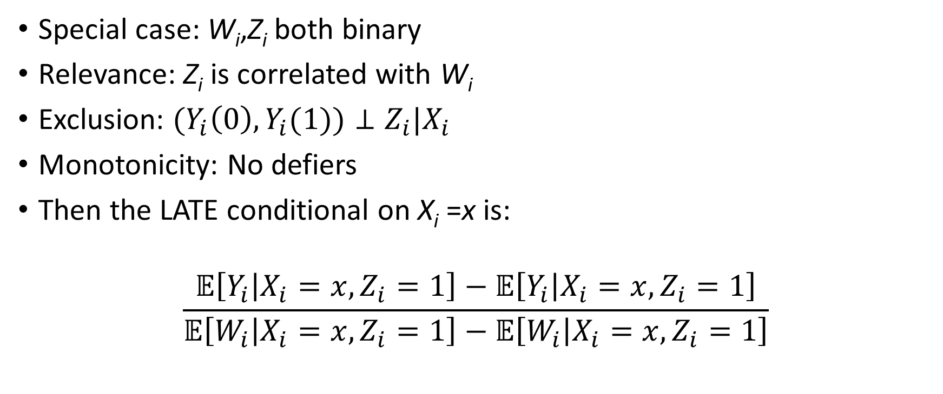
Local Average Treatment Effects: Including Covariates
Special case: W_{i},Z_{i} both binary
Relevance: Z_{i} is correlated with W_{i}
Exclusion: $(Y_{i}\left(0\right),Y_{i}(1))⊥Z_{i}|X_{i}$
Monotonicity: No defiers
Then the LATE conditional on X_{i} =x is:
$$\frac{𝔼\left[Y_{i} | X_{i}=x,Z_{i}=1\right]−𝔼\left[Y_{i} | X_{i}=x,Z_{i}=1\right]}{𝔼\left[W_{i} | X_{i}=x,Z_{i}=1\right]−𝔼\left[W_{i} | X_{i}=x,Z_{i}=1\right]}$$

Slide 7
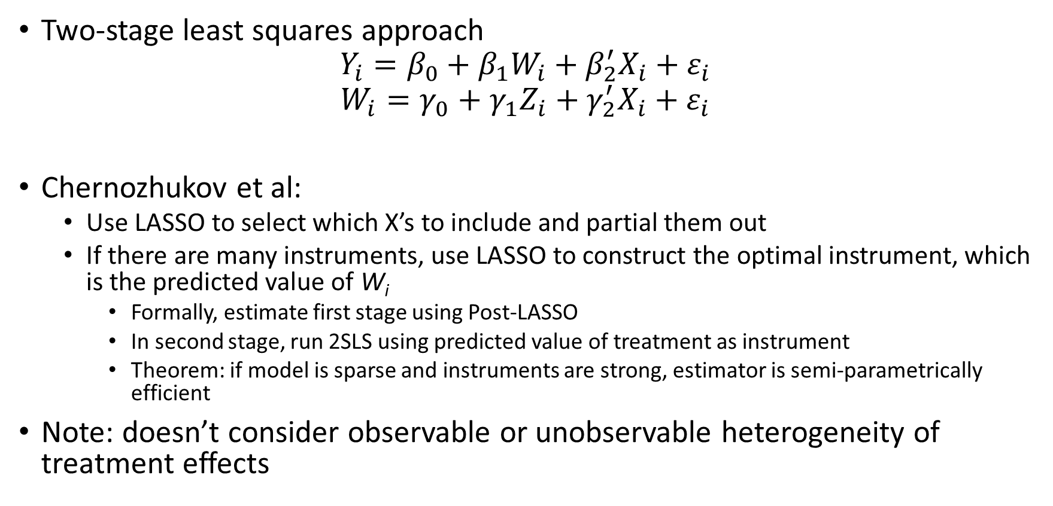
IV Approaches: Including Covariates
Two-stage least squares approach
$$Y_{i}=β_{0}+β_{1}W_{i}+β_{2}^{′}X_{i}+ε_{i}$$
$$W_{i}=γ_{0}+{γ_{1}Z}_{i}+γ_{2}^{′}X_{i}+ε_{i}$$
Chernozhukov et al:
Use LASSO to select which X’s to include and partial them out
If there are many instruments, use LASSO to construct the optimal instrument, which is the predicted value of W_{i}
Formally, estimate first stage using Post-LASSO
In second stage, run 2SLS using predicted value of treatment as instrument
Theorem: if model is sparse and instruments are strong, estimator is semi-parametrically efficient
Note: doesn’t consider observable or unobservable heterogeneity of treatment effects

Slide 8
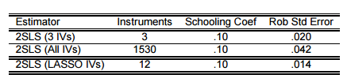
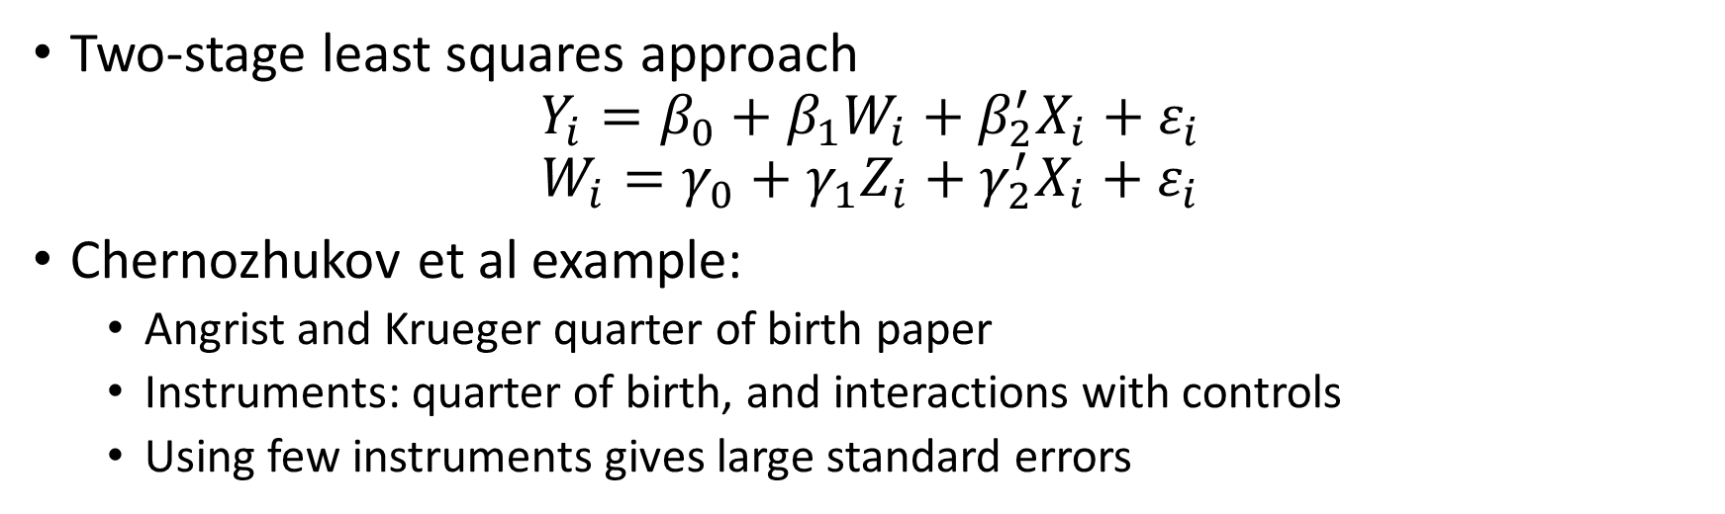
IV Approaches: Including Covariates
Two-stage least squares approach
$$Y_{i}=β_{0}+β_{1}W_{i}+β_{2}^{′}X_{i}+ε_{i}$$
$$W_{i}=γ_{0}+{γ_{1}Z}_{i}+γ_{2}^{′}X_{i}+ε_{i}$$
Chernozhukov et al example:
Angrist and Krueger quarter of birth paper
Instruments: quarter of birth, and interactions with controls
Using few instruments gives large standard errors

