Slide 1
Counterfactuals via Deep IV
Matt Taddy (Chicago + MSR) Greg Lewis (MSR)
Jason Hartford (UBC) Kevin Leyton-Brown (UBC)

Slide 2
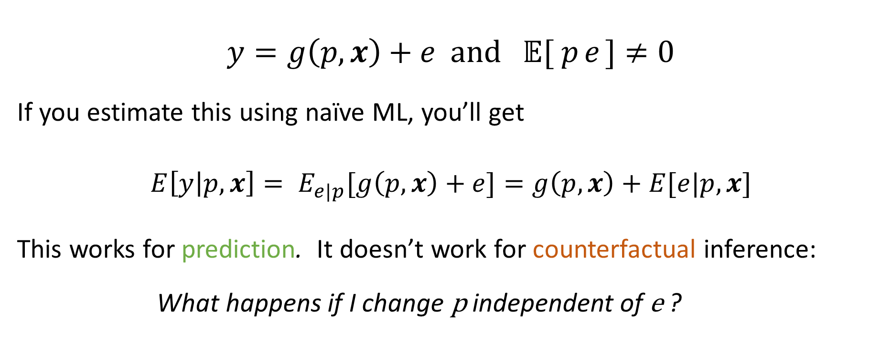
Endogenous Errors
$$y=g\left(p,x\right)+e and 𝔼[{ p}_{ }e_{ }]≠0$$
If you estimate this using naïve ML, you’ll get
$$E\left[y | p,x\right]= E_{e|p}[g\left(p,x\right)+e]=g\left(p,x\right)+E[e|p,x]$$
This works for prediction. It doesn’t work for counterfactual inference:
What happens if I change p independent of e ?

Slide 3
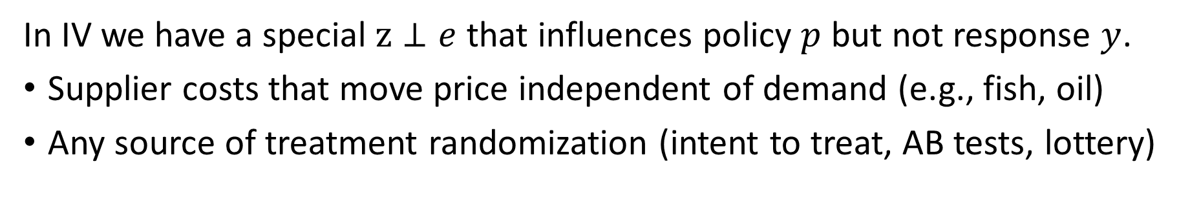
Instrumental Variables (IV)
y
p
x
z
e
In IV we have a special $z⊥e$ that influences policy $p$ but not response $y$.
Supplier costs that move price independent of demand (e.g., fish, oil)
Any source of treatment randomization (intent to treat, AB tests, lottery)

Slide 4
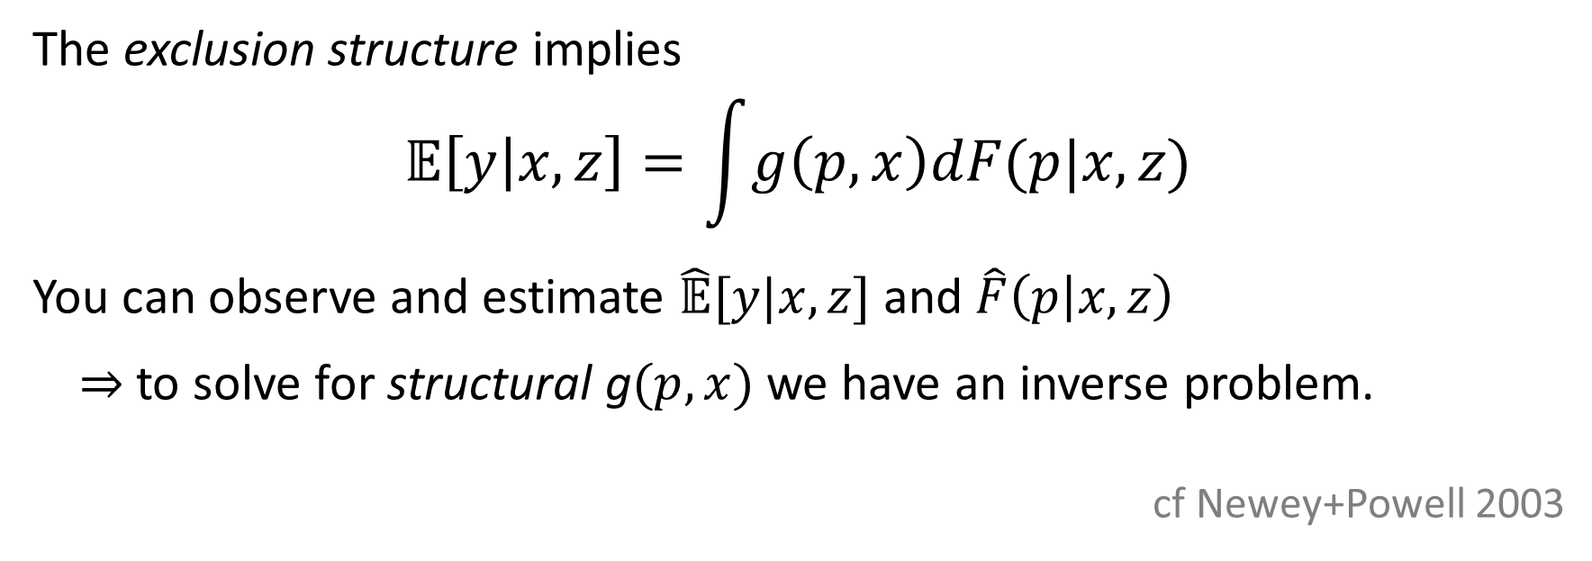
Instrumental Variables (IV)
y
p
x
z
e
The exclusion structure implies
$$\text{𝔼}\left[y | x,z\right]=\int{g\left(p,x\right)dF(p|x,z)}$$
You can observe and estimate $\hat{\text{𝔼}}[y|x,z]$ and $\hat{F}\left(p | x,z\right)$
$⇒$ to solve for structural g$(p,x)$ we have an inverse problem.
cf Newey+Powell 2003

Slide 5


$$\min_{g∈G}{ ∑} {\left(y_{i} −\int{g\left(p,x_{i}\right)dF(p|x_{i},z_{i})} \right)}^{2}$$
2SLS: $p=βz+ν$ and $g\left(p\right)=τp$ so that $\int{g\left(p\right)dF\left(p | z\right)}=τ𝔼[p|z]$
So you first regress $p$ on $z$ then regress $y$ on $\hat{p}$ to recover $\hat{τ}$.

Slide 6
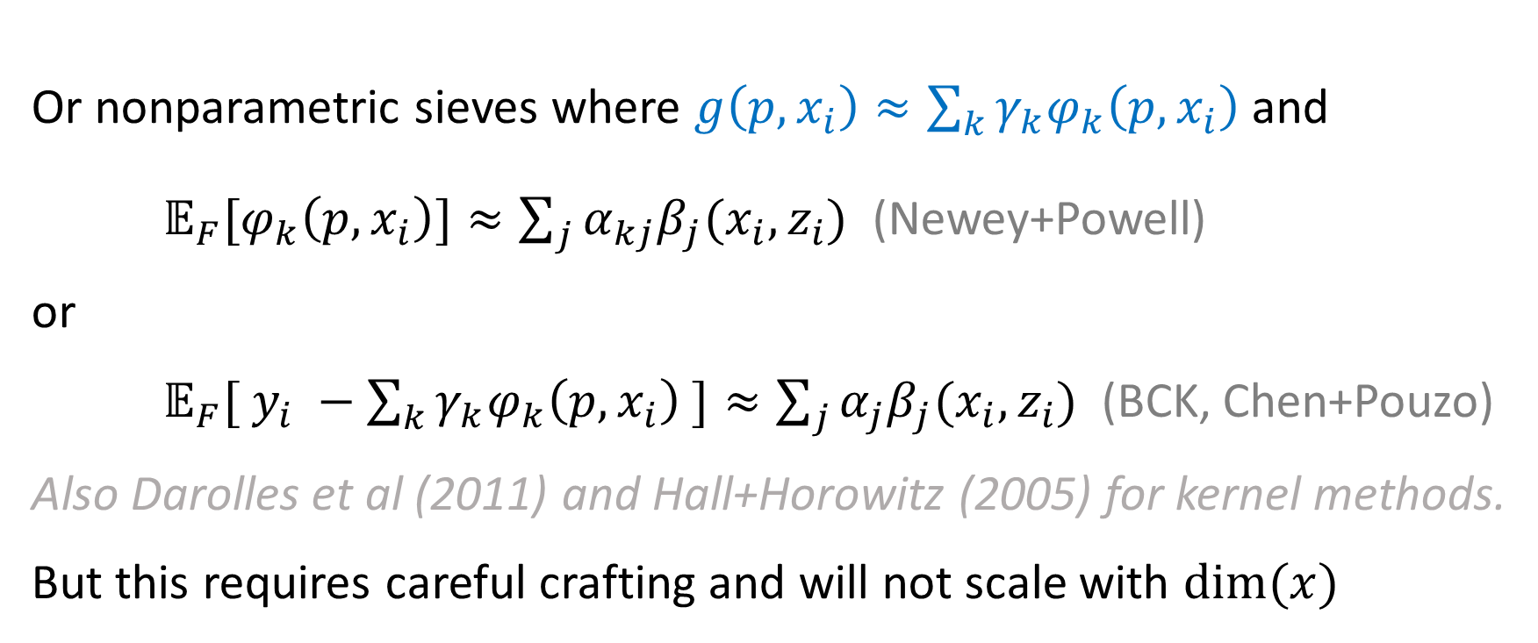

$$\min_{g∈G}{ ∑} {\left(y_{i} −\int{g\left(p,x_{i}\right)dF(p|x_{i},z_{i})} \right)}^{2}$$
Or nonparametric sieves where $g\left(p,x_{i}\right)≈\sum_{k}{γ_{k}φ_{k}\left(p, x_{i}\right) }$and
${𝔼_{F}[φ}_{k}\left(p, x_{i}\right)]≈\sum_{j}{{α_{kj}β}_{j}(x_{i}, z_{i})}$ (Newey+Powell)
or
${𝔼_{F}[ y_{i} −\sum_{k}{γ_{k}φ_{k}\left(p, x_{i}\right)}}_{ }]≈\sum_{j}{{α_{j}β}_{j}(x_{i}, z_{i})}$ (BCK, Chen+Pouzo)
Also Darolles et al (2011) and Hall+Horowitz (2005) for kernel methods.
But this requires careful crafting and will not scale with $dim(x)$

Slide 7
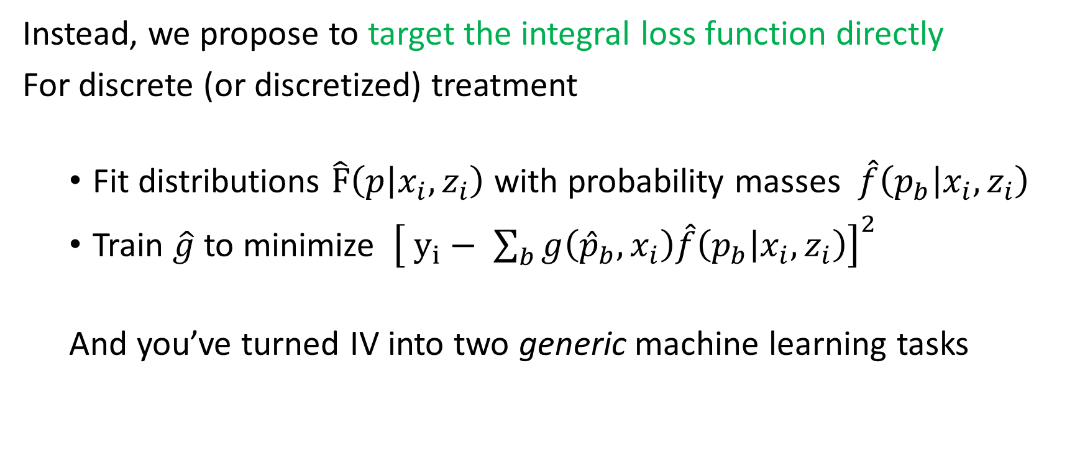

$$\min_{g∈G}{ ∑} {\left(y_{i} −\int{g\left(p,x_{i}\right)dF(p|x_{i},z_{i})} \right)}^{2}$$
Instead, we propose to target the integral loss function directly
For discrete (or discretized) treatment
Fit distributions $\hat{F}\left(p | x_{i},z_{i}\right)$ with probability masses $\hat{f}\left(p_{b} | x_{i},z_{i}\right)$
Train $\hat{g}$ to minimize ${\left[ y_{i}− \sum_{b}{g\left({\hat{p}}_{b},x_{i}\right)\hat{f}\left(p_{b} | x_{i},z_{i}\right)}\right]}^{2}$
And you’ve turned IV into two generic machine learning tasks

Slide 8
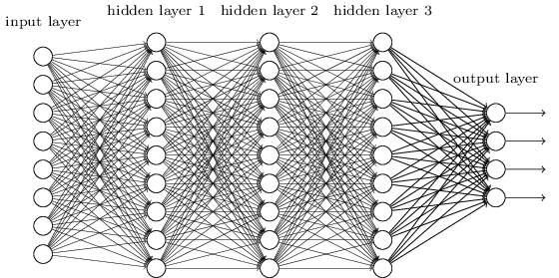
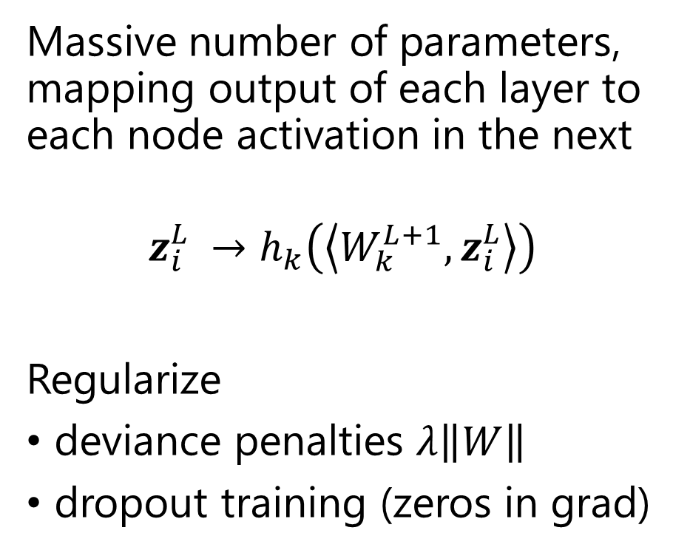
Deep Neural Networks
Massive number of parameters, mapping output of each layer to each node activation in the next
$${z_{i}^{L}}_{ }^{ }→{h_{k}\left(\left\langle W_{k}^{L+1},z_{i}^{L}\right\rangle \right)}_{ }^{ }$$
Regularize
deviance penalties $λ\left\|W\right\|$
dropout training (zeros in grad)
activation

Slide 9
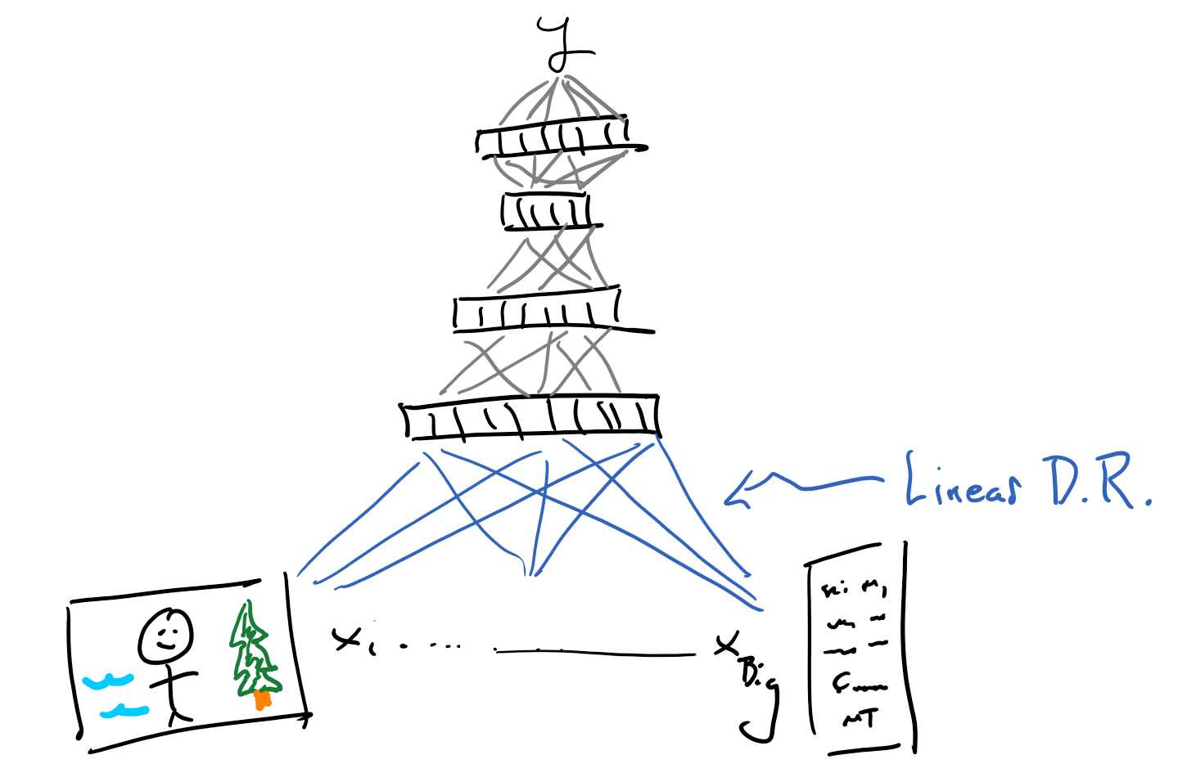
Deep nets are not really sieves
1st layer is a big dimension reduction
e.g.,
word embedding for text
matrix convolution for images
We need to study these…

Slide 10
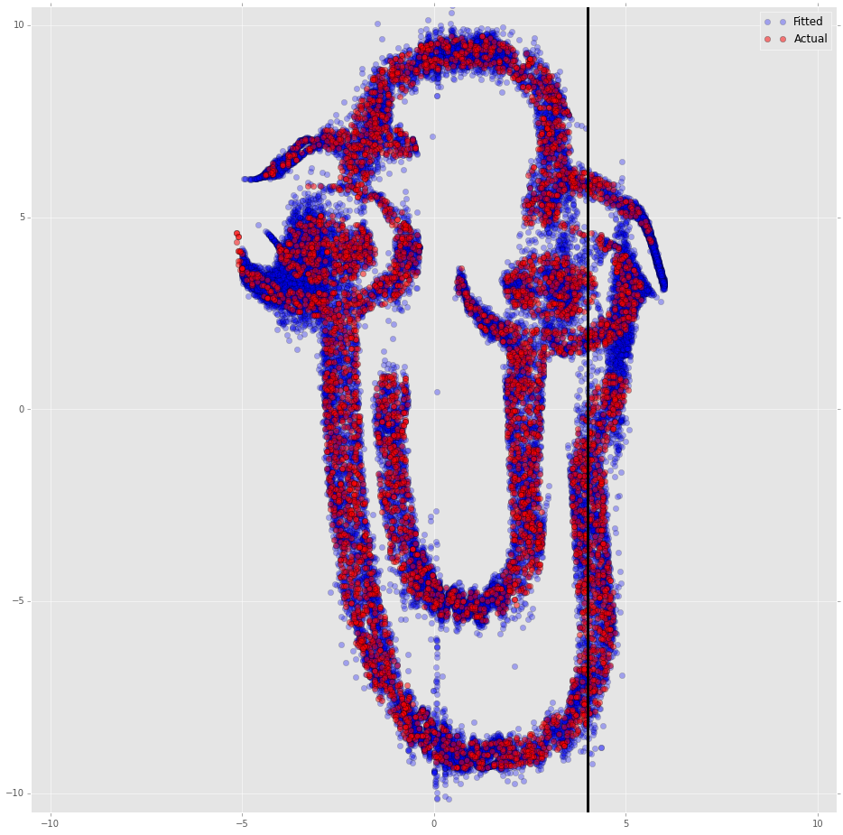
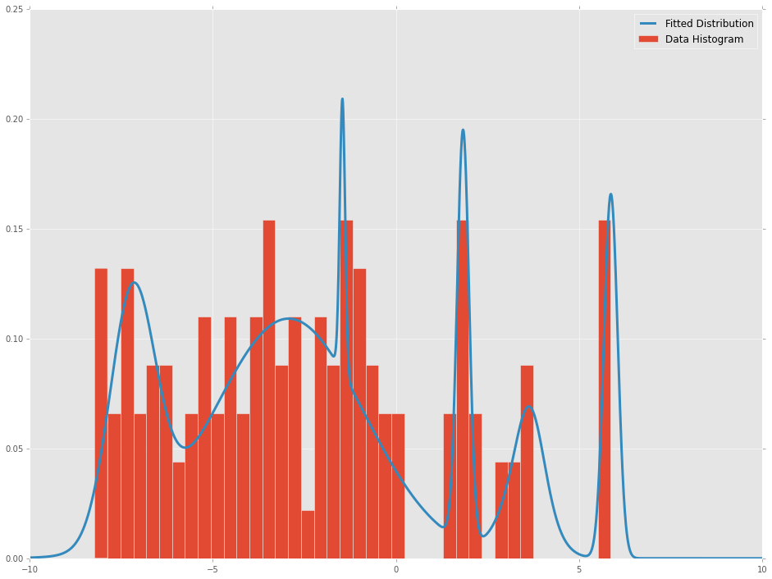
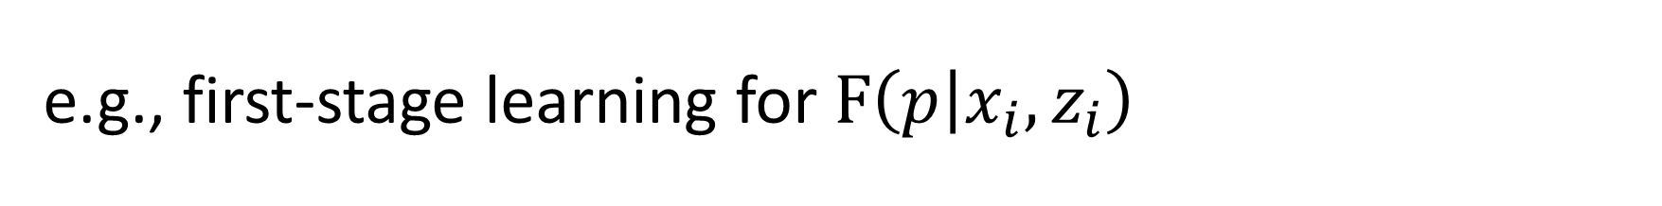
e.g., first-stage learning for $F\left(p | x_{i},z_{i}\right)$
Bishop 96: Final layer of network parametrizes a mixture of Gaussians

Slide 11
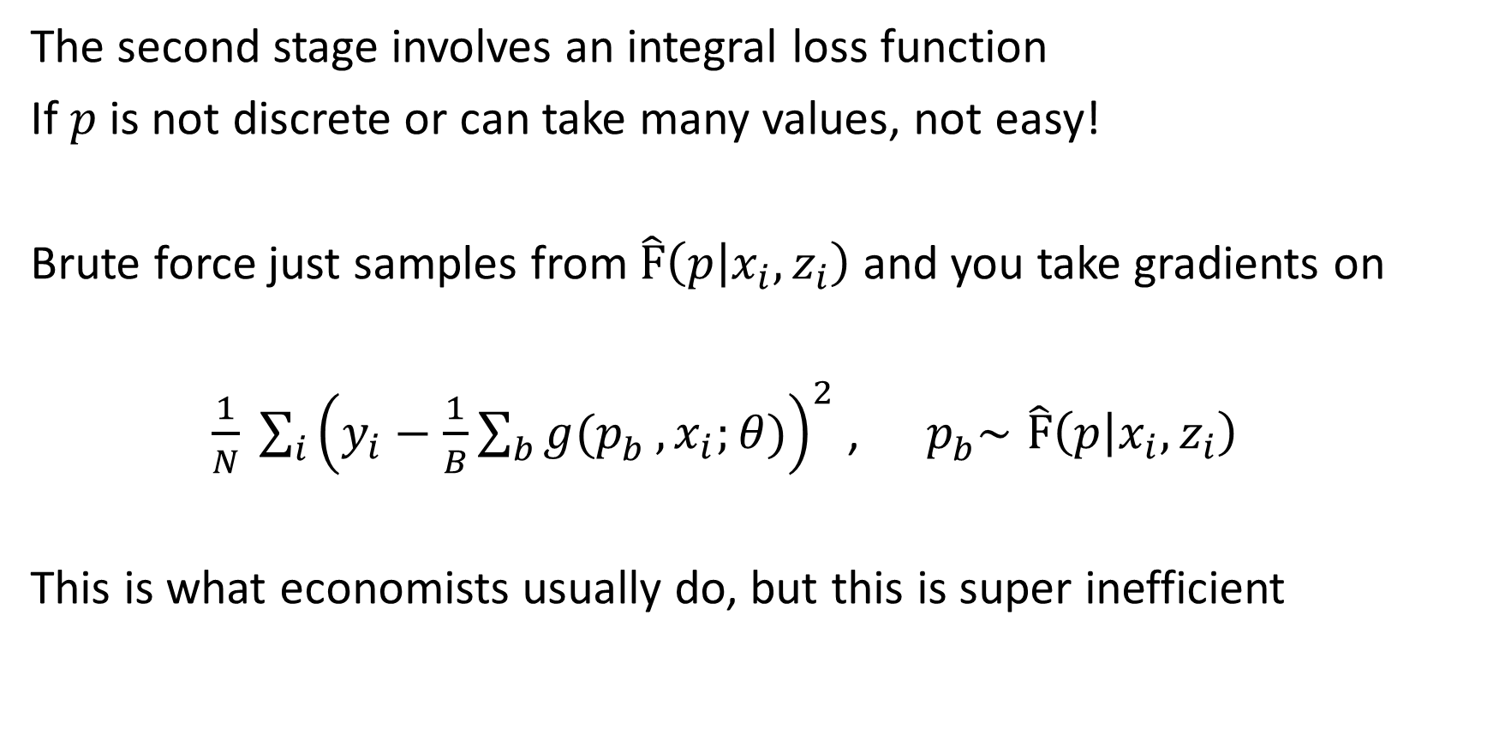
Stage 2: Integral Loss
The second stage involves an integral loss function
If $p$ is not discrete or can take many values, not easy!
Brute force just samples from$\hat{F}\left(p | x_{i},z_{i}\right)$ and you take gradients on
${ \frac{1}{N} \sum_{i}^{ }{{\left(y_{i}−\frac{1}{B}\sum_{b}{g(p_{b}^{ }}, x_{i};θ)\right)}^{2}}}$ , ${ p}_{b}^{ }∼\hat{F}\left(p | x_{i},z_{i}\right)$
This is what economists usually do, but this is super inefficient

Slide 12
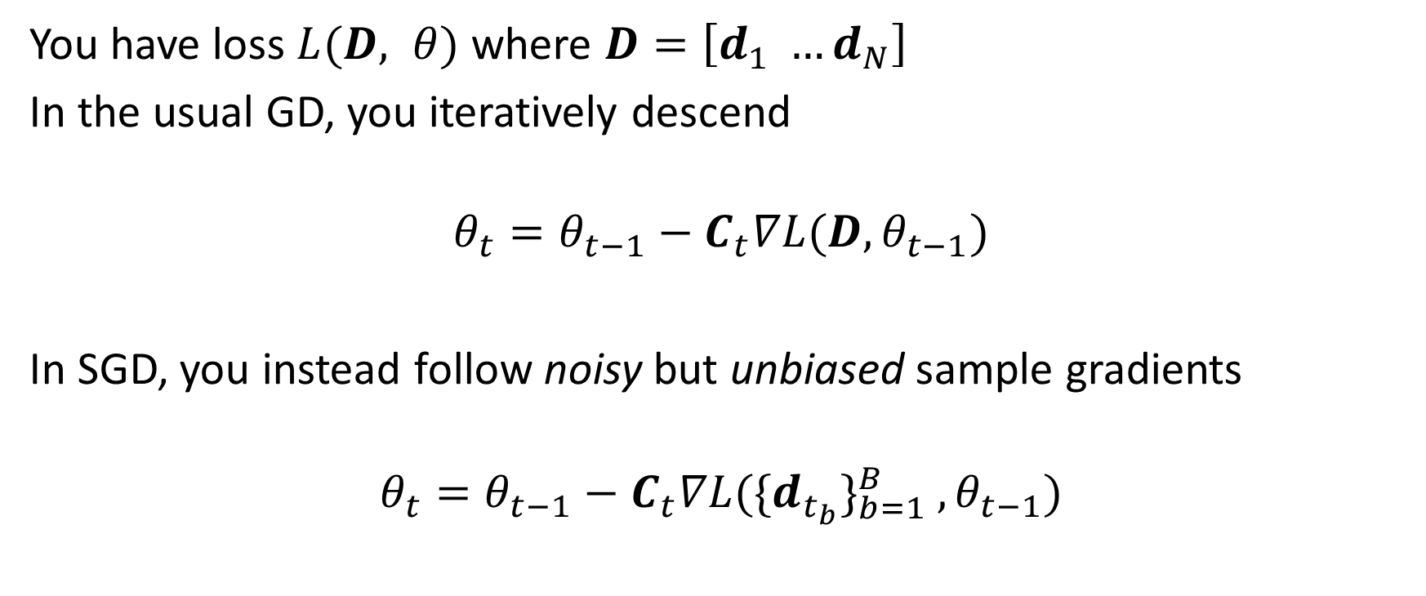
Stochastic Gradient Descent
You have loss $L(D, θ)$ where $D=\left[d_{1} …d_{N}\right]$
In the usual GD, you iteratively descend
$$θ_{t}=θ_{t−1}−C_{t}∇L(D, θ_{t−1})$$
In SGD, you instead follow noisy but unbiased sample gradients
$$θ_{t}=θ_{t−1}−C_{t}∇L{({\{d_{t_{b}}\}}_{b=1}^{B}}_{ }, θ_{t−1})$$
Notes:
First order vs second order

Slide 13
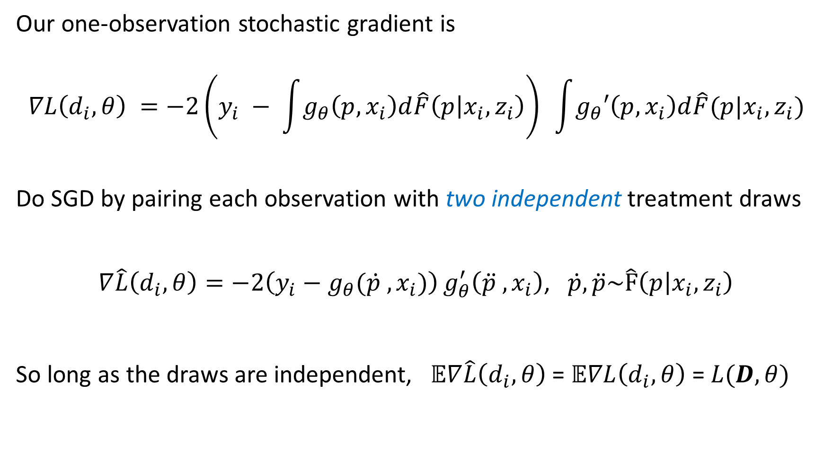
SGD for integral loss functions
Our one-observation stochastic gradient is
$$∇L\left(d_{i}, θ\right) =−2\left(y_{i} − \int{g_{θ}\left(p,x_{i}\right)d\hat{F}\left(p | x_{i},z_{i}\right)}\right){ }\int{g_{θ}′\left(p,x_{i}\right)d\hat{F}(p|x_{i},z_{i})}$$
Do SGD by pairing each observation with two independent treatment draws
$∇\hat{L}\left(d_{i},θ\right)=−2\left(y_{i}−g_{θ}({\dot{p}}_{ }^{ }, x_{i})\right)g_{θ}^{′}\left({\ddot{p}}_{ }^{ }, x_{i}\right)$, $\dot{p}, \ddot{p}\sim \hat{F}\left(p | x_{i},z_{i}\right)$
So long as the draws are independent, $𝔼∇\hat{L}\left(d_{i},θ\right)$ = $𝔼∇L\left(d_{i},θ\right)$ = $L(D, θ)$

Slide 14
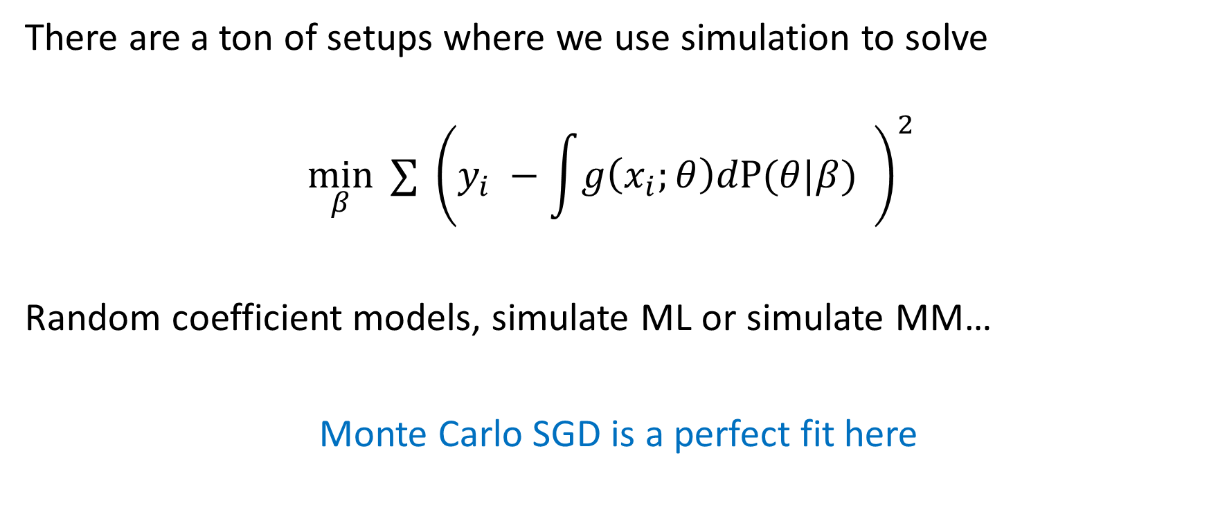
Aside: we can use SGD more in econ …
There are a ton of setups where we use simulation to solve
$$\min_{β}{ ∑} {\left(y_{i} −\int{g\left(x_{i};θ\right)dP(θ|β)} \right)}^{2}$$
Random coefficient models, simulate ML or simulate MM…
Monte Carlo SGD is a perfect fit here

Slide 15
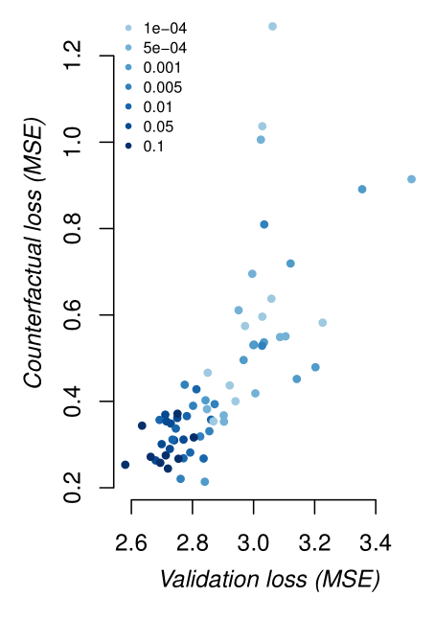
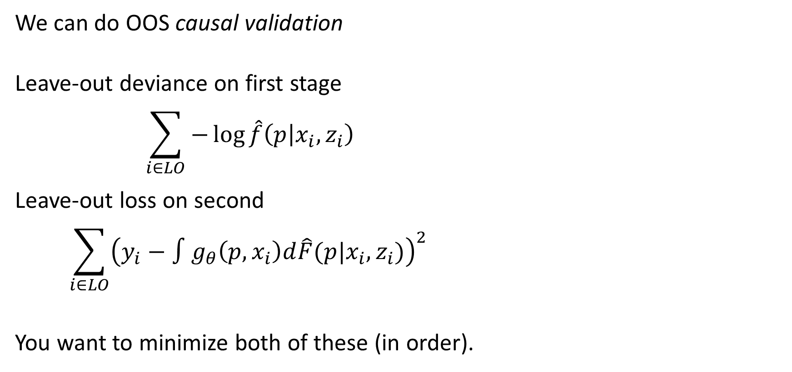
Validation and model tuning
We can do OOS causal validation
Leave-out deviance on first stage
$$\sum_{i∈LO}{−\log{\hat{f}\left(p | x_{i},z_{i}\right)}}$$
Leave-out loss on second
$$\sum_{i∈LO}{{\left(y_{i}−∫g_{θ}\left(p, x_{i}\right)d\hat{F}(p|x_{i}, z_{i})\right)}^{2}}{ }$$
You want to minimize both of these (in order).

Slide 16
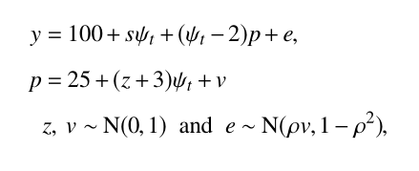
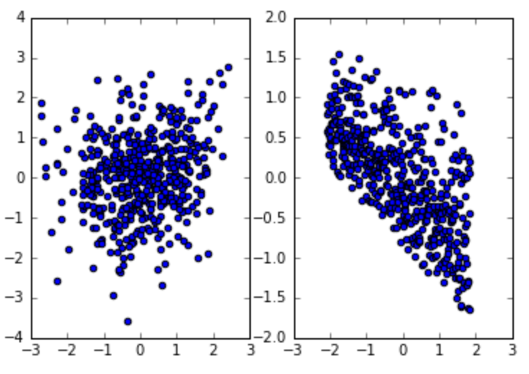
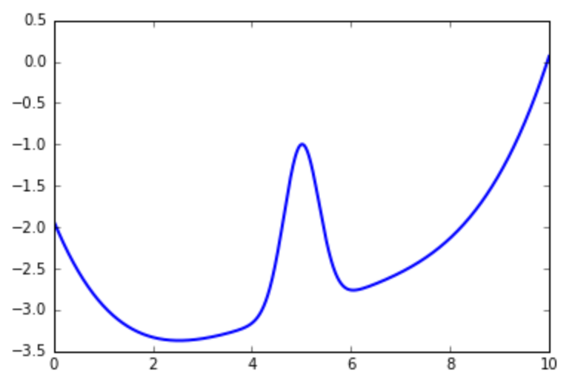
heterogeneous price effects
‘time’ dependent prices, sensitivity, utility
Customer ‘type’ 1-7 impacts demand
observed
structural
normalized sales
normalized price

Slide 17
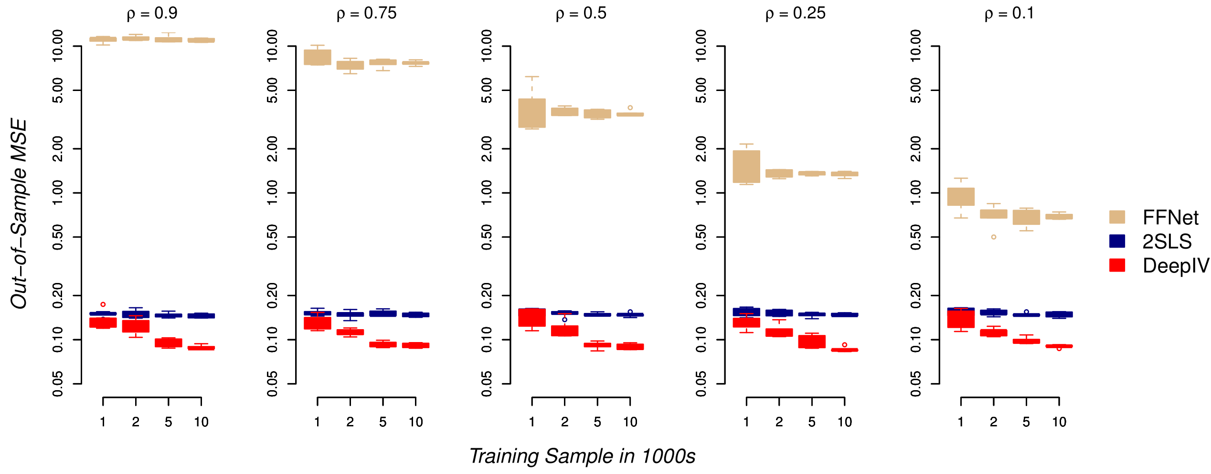

Slide 18
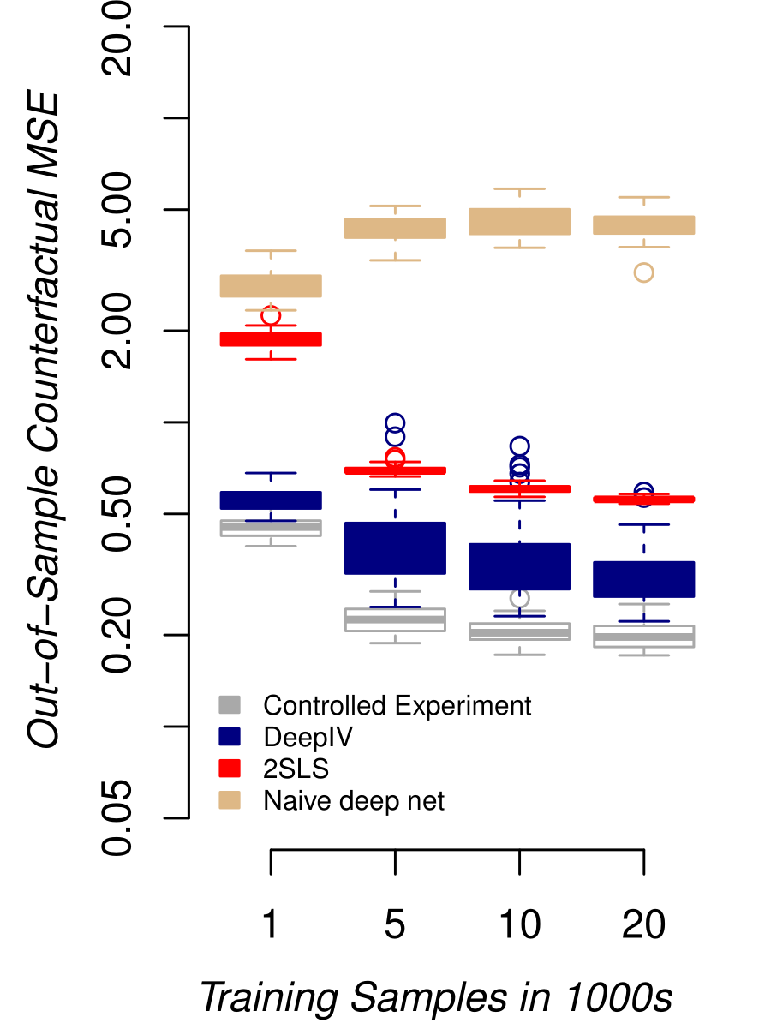
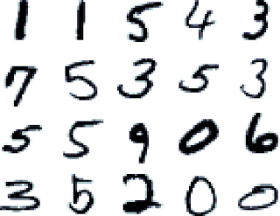
Make it harder…

Slide 19
Inference? Good question

Slide 20
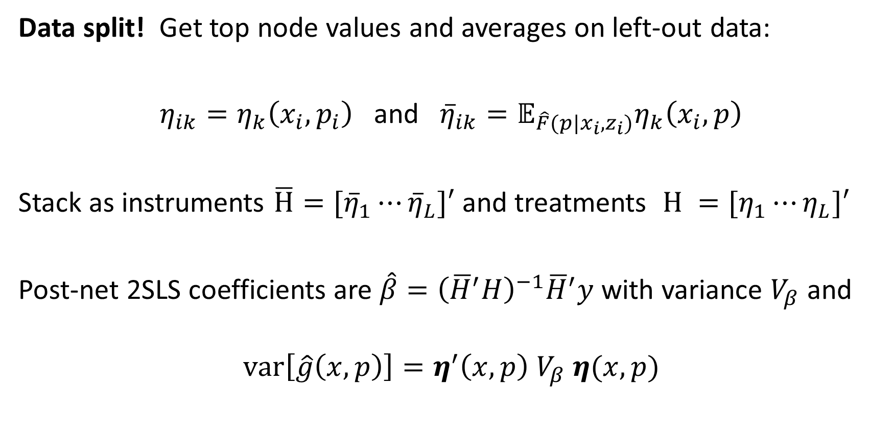
Data split! Get top node values and averages on left-out data:
$η_{ik}=η_{k}\left(x_{i},p_{i}\right)$ and ${\overline{η}}_{ik}=𝔼_{\hat{F}(p|x_{i},z_{i})}η_{k}\left(x_{i}, p\right)$
Stack as instruments $\overline{H}=[{\overline{η}}_{1}⋯{\overline{η}}_{L}]′$ and treatments $H =[η_{1}⋯η_{L}]′$
Post-net 2SLS coefficients are $\hat{β}={\left({\overline{H}}^{′}H\right)}^{−1}{\overline{H}}^{′}y$ with variance $V_{β}$ and
$$var\left[\hat{g}\left(x,p\right)\right]=η^{′}\left(x,p\right) V_{β} η(x,p)$$

Slide 21
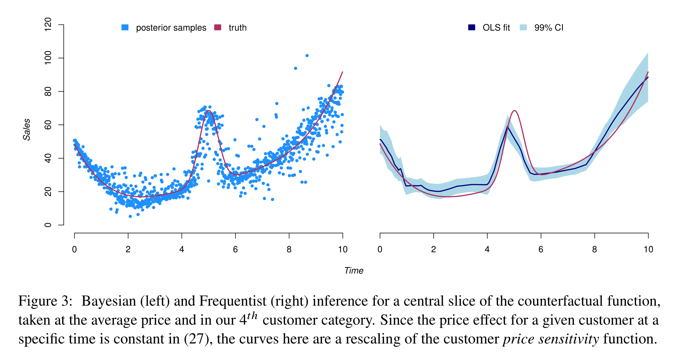

Slide 22
Ads Application
Taken from Goldman and Rao (2014)
We have 74 mil click-rates over 4 hour increments for 10k search terms
Treatment: ad position 1-3
Instrument: background AB testing (bench of ~ 100 tests)
Covariates: advertiser id and ad properties, search text, time period

Slide 23
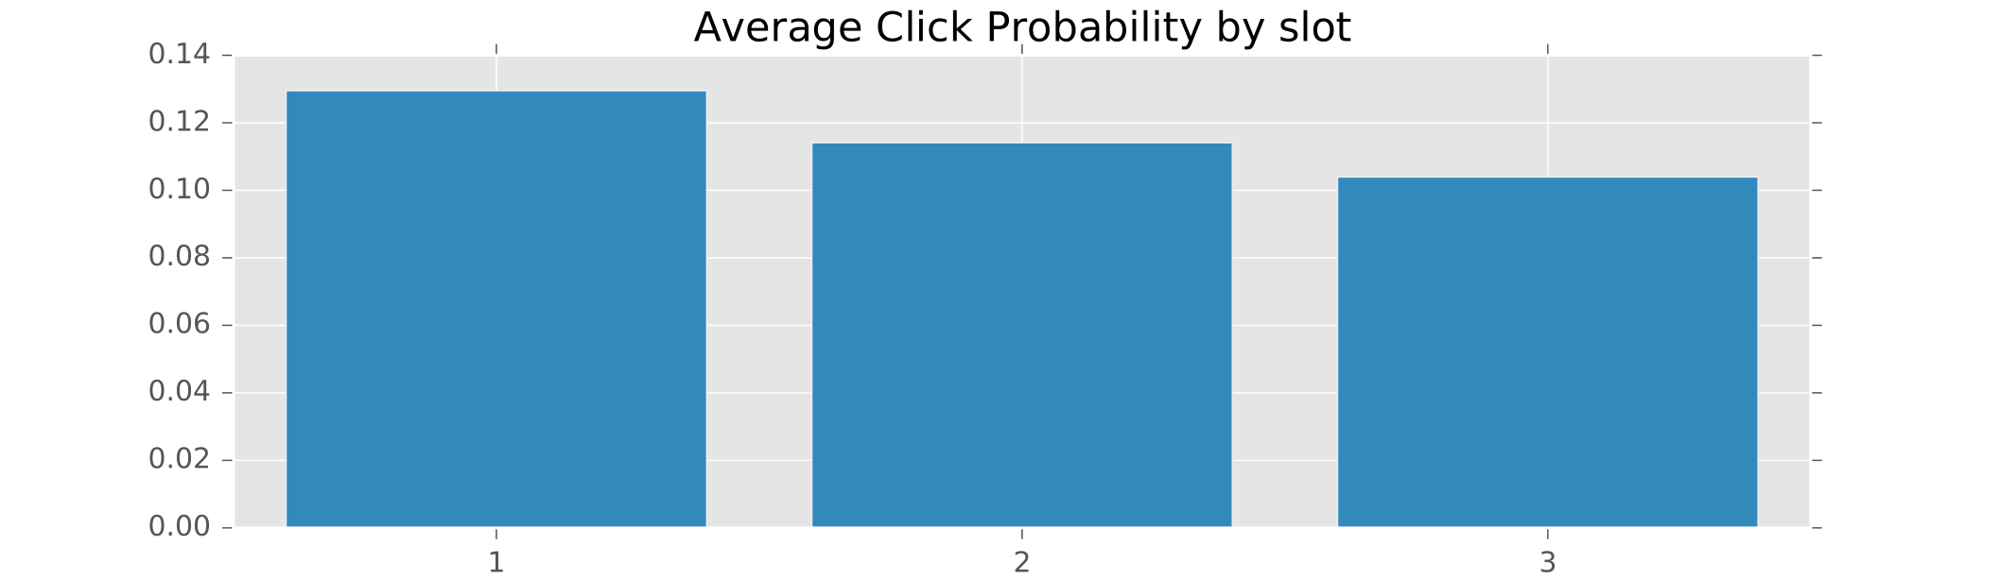
Average Treatment Effects
These compare to observed click probabilities of 0.33, 0.1, and 0.05.

Slide 24
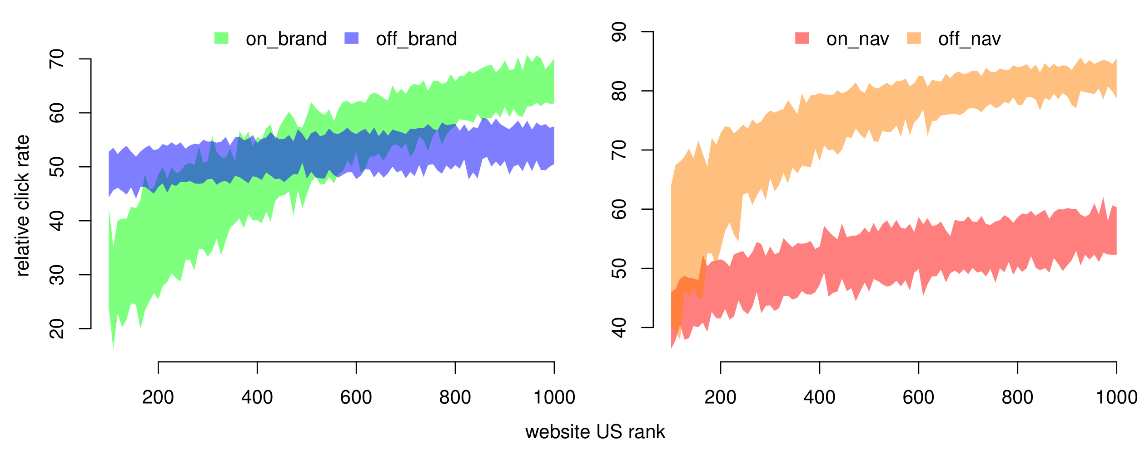
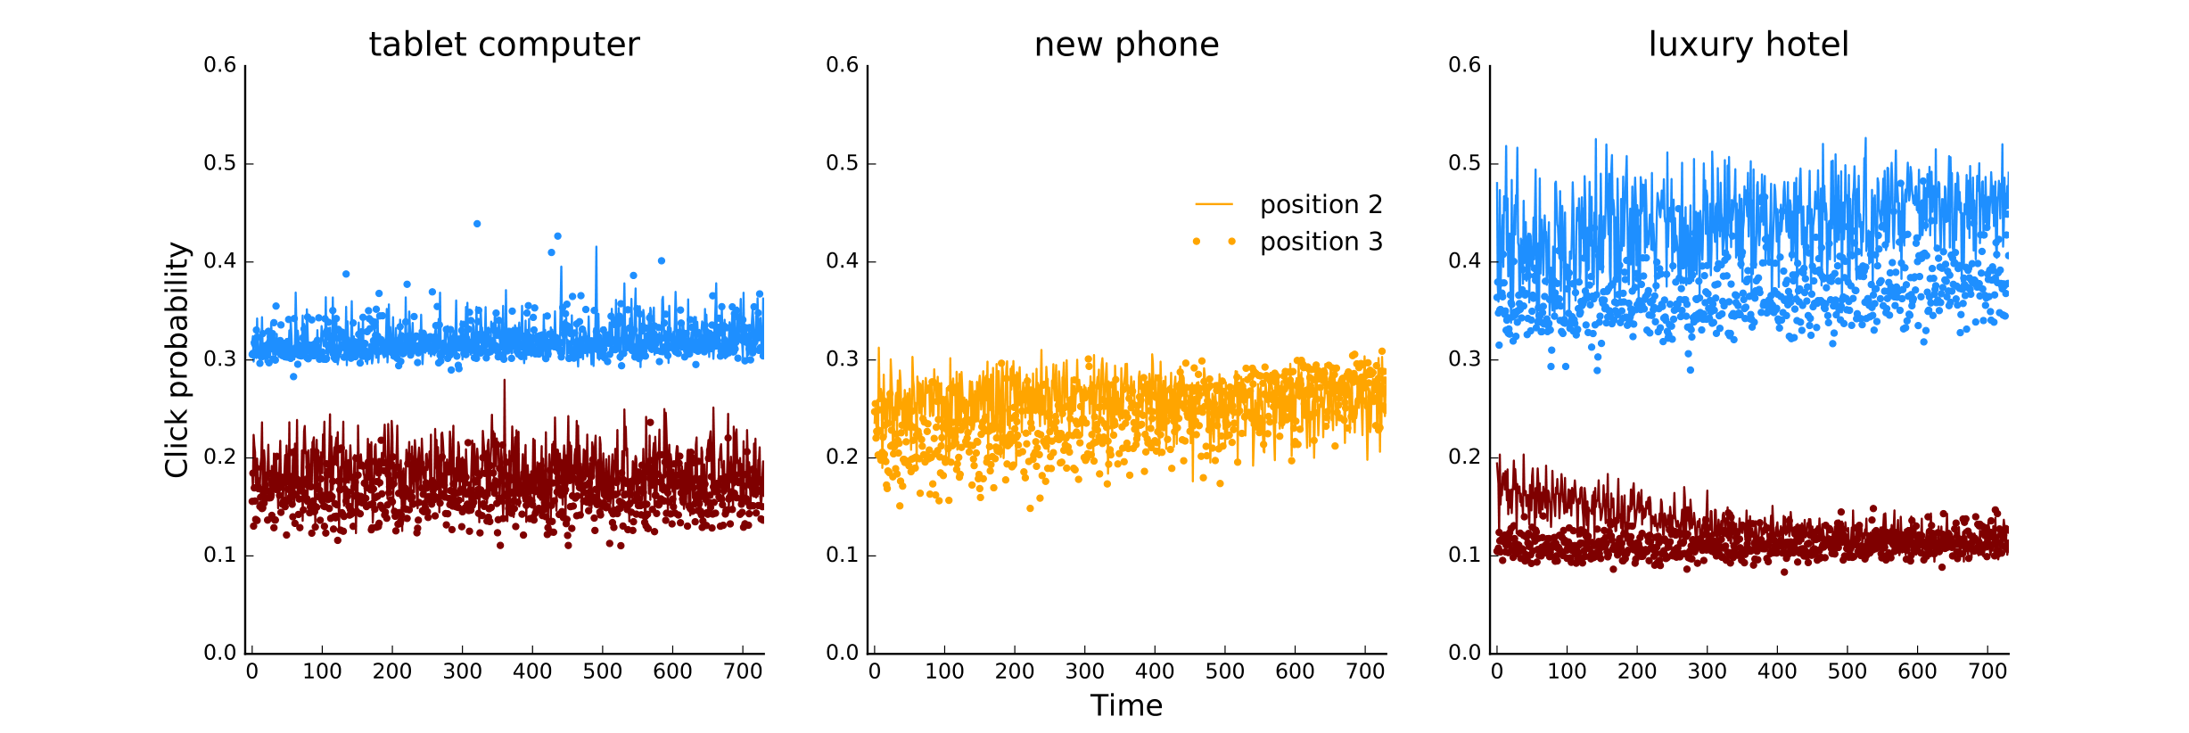
Heterogeneity across advertiser and search

Slide 25

Automated Learning and Intelligence for Causation and Economics
We use economic theory to build systems of tasks that can be
addressed with deep nets and other state-of-the-art ML.
This is the construction of systems for Economic AI

