Slide 1

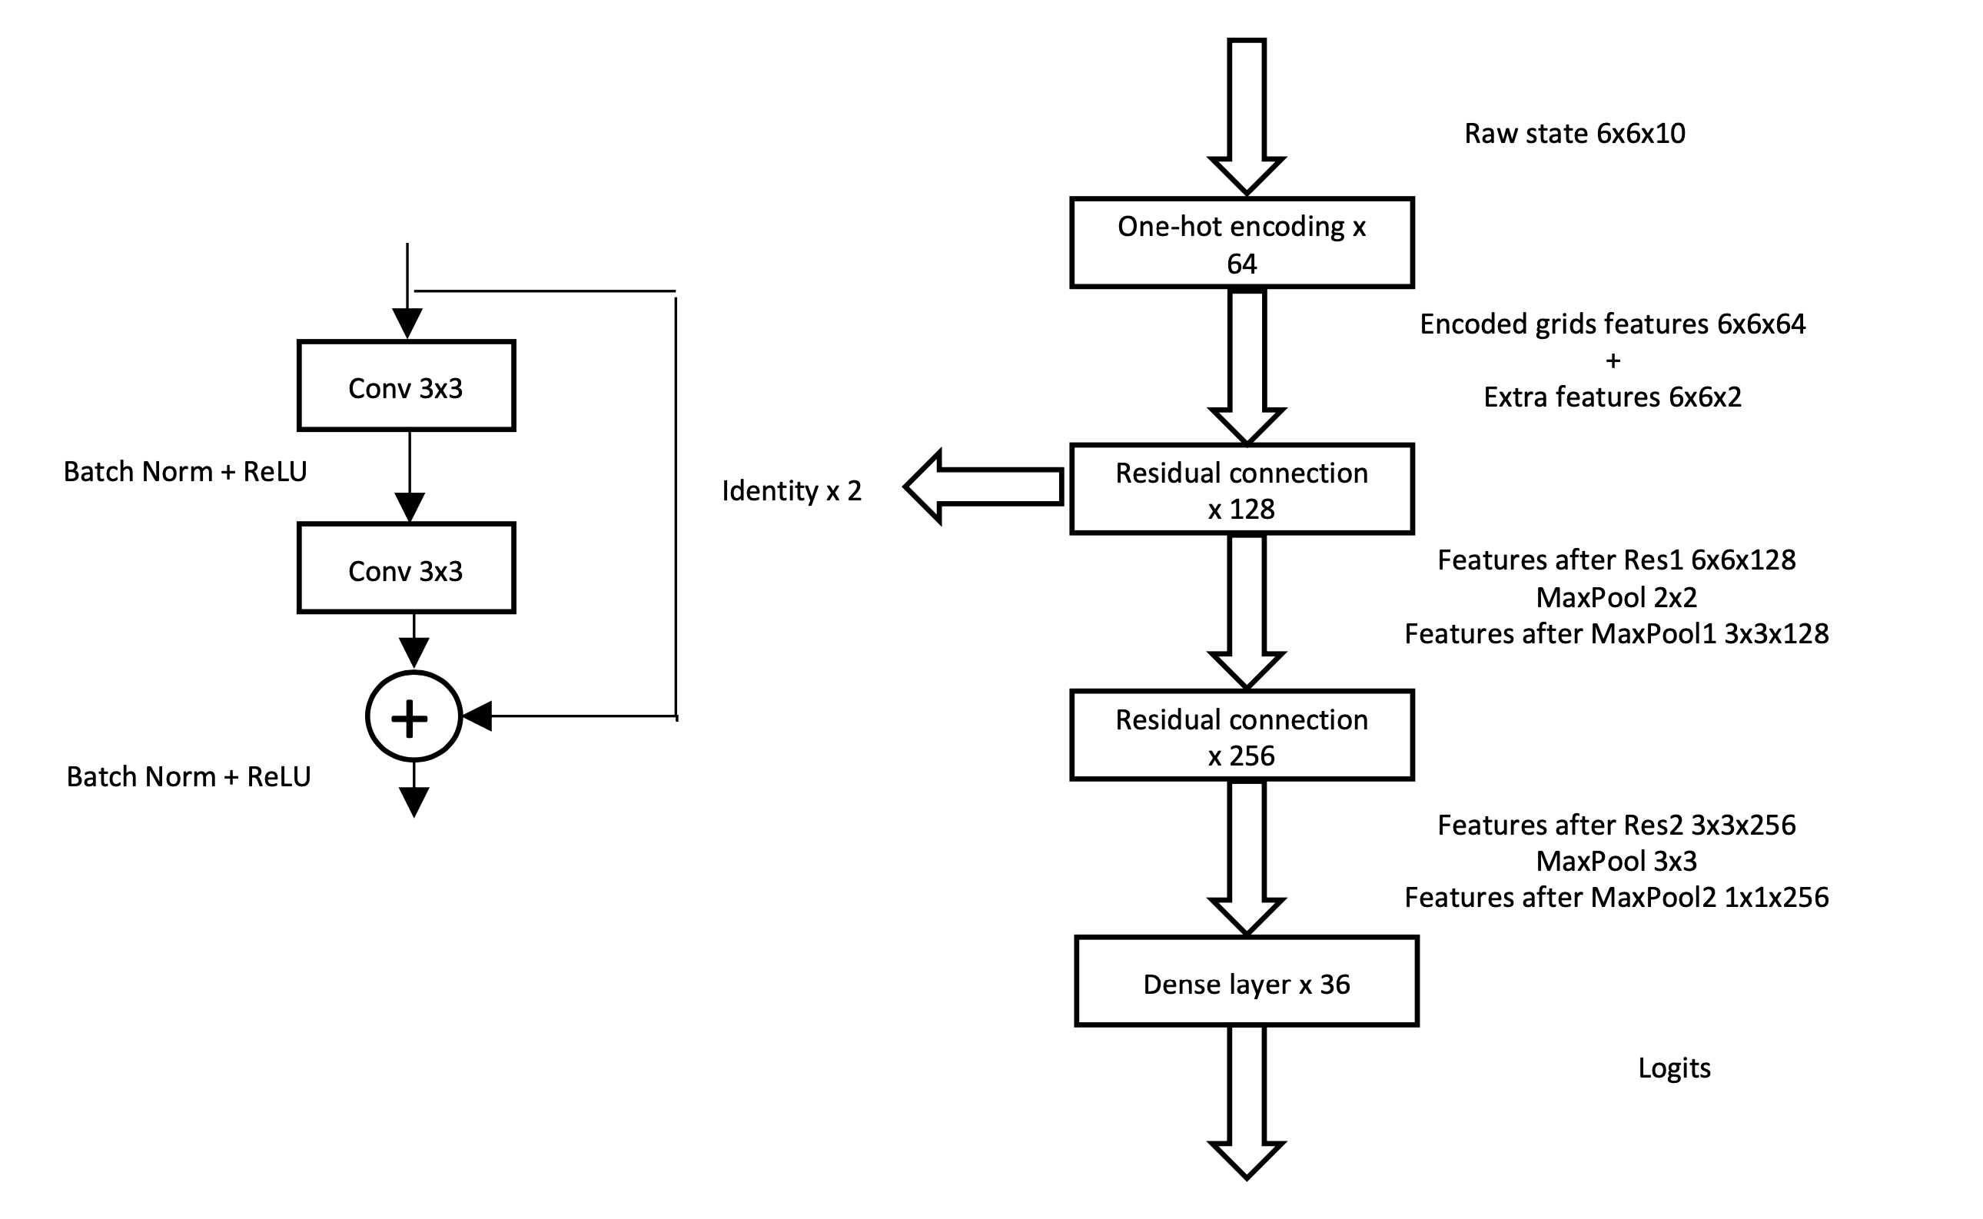
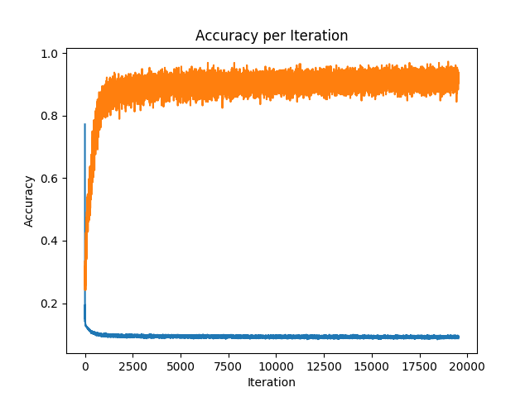
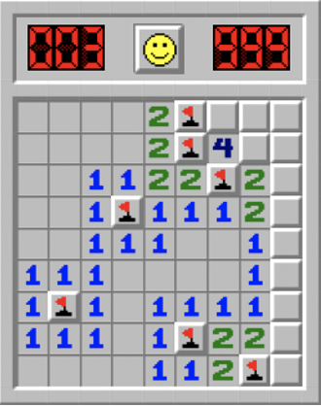
Minesweeper Solver Yuchen Zhou, Wei Li
Introduction
Methodology
Results
We trained a Minesweeper agent in a supervised learning fashion with DNN.
Why Minesweeper: Fully estimating the probability distribution belong to a class of #P-complete problems [1]. DNN gives an estimation with lower the time complexity.
Why Supervised Learning: Supervised Learning has a more stable loss decrement. For Minesweeper game, an early local optimum would not lead to bad state, therefore, we do not need to estimate the state value as did in reinforcement learning.
Model: We used convolutional layer with Residual connection, Batch Normalization, and ReLU. Figure 2.1 shows the model architecture.
Loss function: A cross entropy target function is used as the loss for the model. A uniform distribution of all correct next step actions is provided as the label for the cross entropy. The accuracy per action is used to evaluate the validation of the loss.
Extra Feature encoding: We encoded global feature of ratio of the number of mines to grid size and local feature of scaler of quantity of mines as a two-dimensional vector of each grid.
Datasets: In order to supervise train the model, 1 million different Minesweeper game states with corresponding correct next move labels has been generated by approximately 330,000 different game initializations.
Testing: The model is finally being tested by playing the Minesweeper game with 6x6 grid size and 6 mines.
To maximize local optimum decisions for every single action, cross entropy with uniformed correct next move probably distribution is used to gradient descend the parameters. Figure 3.1 shows the validity of the model.
The model is finally being tested by playing the Minesweeper game with 6x6 grid size and 6 mines. We report a 62% winning rate with approximately 20,000 update iterations over a batch size of 256 and a 58% winning rate with approximately 12,000 update iterations over a batch of the same size.
Figure 2.1 Supervised training Minesweeper prediction model architecture
Challenges & Reflection
We asked each of the question in the final reflection on Devpost. The biggest challenges we had was that we changed the major component from Reinforcement Learning to Supervised Learning. We have also talked a bit about some future could be done in the report.
Challenges & Reflection
[1] Nakov, P., & Wei, Z. (2003). MINESWEEPER, #MINESWEEPER
Figure 3.1 Loss and accuracy versus gradient updates iterations

