Slide 1
Presidential Newspaper Endorsements
Angela Zhou

Slide 2
Datasets
Main source:Noah Veltman
108 newspapers
1980 – 2020, 11 elections
1k records
Second source: Wikipedia
Daily newspaper, weekly newspaper, magazine, college and university newspaper, scientific journals, foreign periodicals and Online news outlets
Only 6 elections
More data need to scrape online to cover 80% of total 1297 daily newspaper.
Notes:
a panel dataset with presidential endorsement of top 100 newspapers in US based on circulation.
with more data in much broader coverage
Both source add up to roughly 15% - 20% out of total 1297 daily newspapers. My goal: is to have at least 80% with last 15 elections.
Challenge facing:
training dataset may not representative enough
may contain too much noises, deviation, such as 2016 election to fit a meaningful model

Slide 3
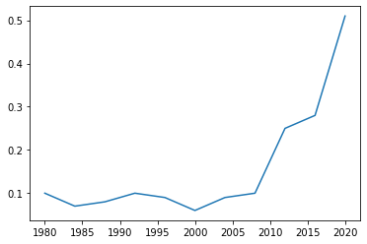
Question 1: Do more newspapers stop giving endorsement?
“A survey by Editor & Publisher showed that by 1996, almost 70% of newspapers weren't endorsing presidential candidates as opposed to just 13.4% during the 1940 election cycle.” - A Brief History of Newspaper Endorsement, 2008
Notes:
Two reasons:
the decline of the newspaper as a central aspect of Americans' lives
a reluctance to engage in partisan politics
It kind of give me a whole picture of this traditional event, a backdrop to help me to analyze further on any possible trend with it.
The plot shown on right is based on Noah’s dataset with only top 100 newspapers.

Slide 4
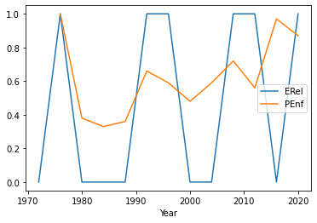
Question 2: Do the total newspapers endorsement align with national election outcome?
“In most elections since 1940, the candidate with the strongest newspaper support has won, but there are notable exceptions.” - A Brief History of Newspaper Endorsements,2008
Notes:
Outlier: 2016, the correlation between the total endorsement and election outcome
from 1980 through 2020 is 0.19
and 0.60 without 2016
To better reflect the alignment, could change the outcome from Boolean value 0: Republic, 1: Democratic, to the fraction based on percentage of total electoral votes received by the winner party.
Sort of like transform a classification problem to continuous probability values, a possible logistic regression modal might be a fit, but it is served to solve the classification problem.

Slide 5
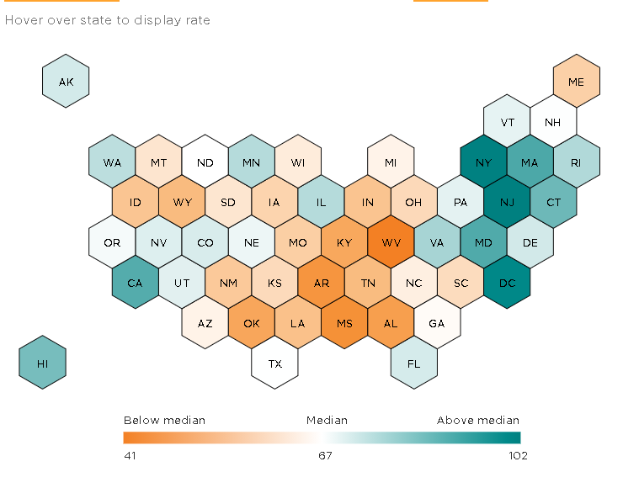
Question 3: Are local newspapers endorsement more consistent with state electoral votes?
Add categorical attributes: such as state, circulation no.
Group by state, get probability of alignment with state electoral votes outcome
Build an interactive map to display
Further more, at individual newspaper level, calculate similar correlation
Notes:
Introduce more categorical attributes such as state and circulation number.
Group newspapers by state, and get probability of alignment with state electoral votes outcome. For a state with multiple publication data, we calculate a local newspaper endorsements fraction (either based on percentage of circulation or equal share)
Planning to create an interactive state map, looks like right, with a color scheme to display how each state newspaper endorsement get align with their state’s electoral outcome for each election and overall 11 election. Hopefully it will help us to identify some reginal pattern on the local alignment.
To further suffice my personal curiosity, a similar correlation on each individual newspaper could be calculated and a distribution of probability plot might help to see if there is any underlying relationship between the two across the nation.

Slide 6
Question 4 Is there an underlying relationship between endorsement switching and election outcome?
A special behavior : switching
From one party to another (realignment)
Between endorsement and no endorsement (ex. USA Today 2016 ; Los Angeles Times 1976 dealignment )
preceded by 3 or 4 successive
Could a high frequency of switching during a election have some indication on the national election outcome?
Could switches on endorsement have some impact on the process of flipping a state?
Notes:
By observing the dataset, notice a special behavior happened in the event of newspaper endorsement, which is switching. It means switching from one party to another, or switching between endorsing one party and not endorsing at all.
Also, such a switch must be preceded by at least 3 or 4 successive opposite actions.
And so my question is when I add up all the switch in one election to get a probability of total incidents, if there is a correlation with the election result.
Basically, what I am trying to find out here if such this kind of single switching incident not just represent its individual opinion change, but once add up could indicate something bigger and related to the final election outcome.
And at state level, for example, in those battle states, this year, if there was a switch happening at local newspaper as well. In other words, if those newspaper endorsement take part in the process of flipping a state.

Slide 7
Concerns:
Challenges:
Not representative: scrape more data online to cover non-mainstream
May contain noises: ex. 2016
Sensitivity:
Politic topic
Notes:
In other words, there may not have any underlying relationship general enough to make a prediction on unseen.
Limited training dataset with noise may not be fitted to any potential modal to generalize the

