Slide 1
Presidential Newspaper Endorsements
Angela Zhou
11/19/2020

Slide 2
Datasets
Main source:Noah Veltman
108 newspapers
1980 – 2020, 11 elections
1k records
Second source: Wikipedia
Daily newspaper, weekly newspaper, magazine, college and university newspaper, scientific journals, foreign periodicals and Online news outlets
Only 6 elections
More data need to scrape online to cover 80% of total 1297 daily newspaper.
Notes:
a panel dataset with presidential endorsement of top 100 newspapers in US based on circulation.
with more data in much broader coverage
Both source add up to roughly 15% - 20% out of total 1297 daily newspapers. My goal: is to have at least 80% with last 15 elections.

Slide 3
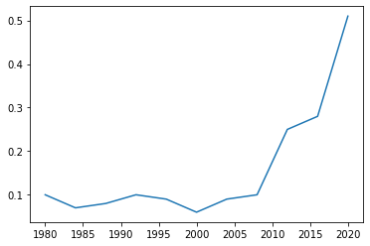
Question No. 1: Do more newspapers stop giving endorsement?
“A survey by Editor & Publisher showed that by 1996, almost 70% of newspapers weren't endorsing presidential candidates as opposed to just 13.4% during the 1940 election cycle.” - A Brief History of Newspaper Endorsement, 2008
Notes:
Two reasons:
the decline of the newspaper as a central aspect of Americans' lives
a reluctance to engage in partisan politics
The plot shown on right is based on Noah’s dataset with only top 100 newspapers.

Slide 4
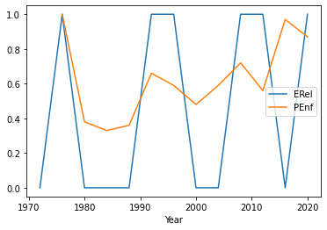
Question No. 2: Do the newspapers endorsement in total align with national election outcome?
“In most elections since 1940, the candidate with the strongest newspaper support has won, but there are notable exceptions.” - A Brief History of Newspaper Endorsements,2008
Notes:
To better reflect the alignment, could change the outcome from Boolean value 0: Republic, 1: Democratic, to the fraction based on percentage of total electoral votes received by the winner party.
Sort of like transform a classification problem to continuous probability values, a possible logistic regression modal might be a fit, but it is served to solve the classification problem.

Slide 5
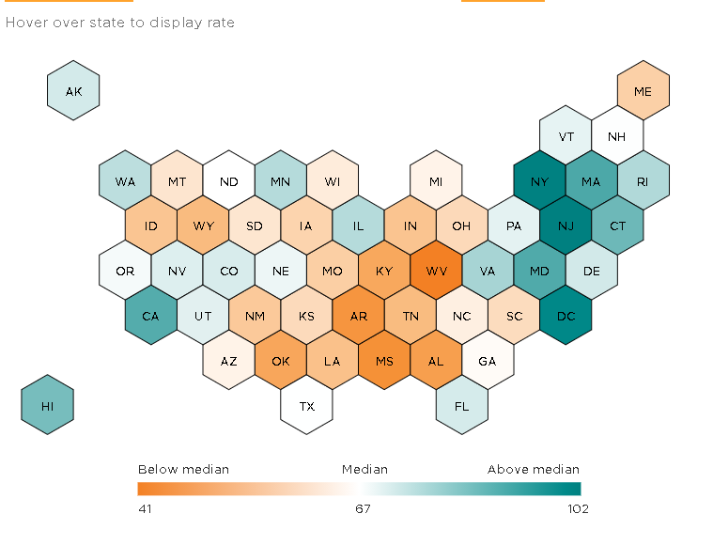
Question No. 3: Are local newspapers endorsement more consistent with state electoral votes?
Add categorical attributes: such as state, circulation no.
Group by state, get probability of alignment with state electoral votes outcome
Build an interactive map to display
Further more, at individual newspaper level, create a distribution of probability of plot

Slide 6
Question No. 4 Is there an underlying relationship between endorsement switching and election outcome?
A special behavior : switching
From one party to another (realignment)
Between endorsement and no endorsement (ex. USA Today 2016 ; Los Angeles Times 1976 dealignment )
preceded by 3 or 4 successive
Could a high frequency of switching during a election have some indication on the national election outcome?
Could switches on endorsement have some impact on the process of flipping a state?

Slide 7
Concerns:
Challenges:
Not representative: to cover non-mainstream
May contain noises: ex. 2016
Sensitivity:
Politic topic

