Slide 1
Knitter: Fast, Resilient Single-User Indoor Floor Plan Construction
Ruipeng Gao, Beijing Jiaotong University, China
Bing Zhou, Stony Brook University, USA
Fan Ye, Stony Brook University, USA
Yizhou Wang, Peking University, China
IEEE INFOCOM 2017
Atlanta, GA, USA

Slide 2

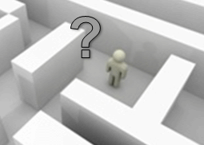

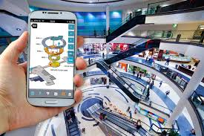
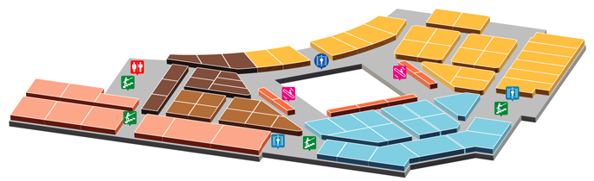
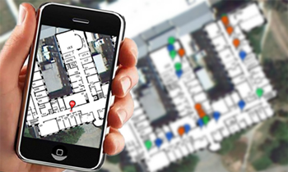
Indoor Location-based Services
Localization/navigation of users in a complex building
  Office building, shopping malls, train stations, airports
Finding nearby products/stores/services
Notes:
Indoor localization is the basis for many location based services, e.g. navigating in a shopping mall, finding nearby products.

Slide 3
More than a decade of research
Special hardware to measure distance
  Ultrasound (Cricket 00’, WALRUS 05’)
  Infrared (ActiveBadge 99’)
  RFID (LANDMARC 04’, Tagoram 14’)
Main stream technology: RF signature based
  WiFi: Radar 00’, Horus 05’, Modellet’14
  + other signatures: cellular tower (Otsason et. al 05’), Bluetooth (Centaur 12’), magnetism (Chung et. al. 11’)
Where are we now?
Notes:
As GPS signal is not available indoors, there are more than a decade of research for indoor localization.

Slide 4
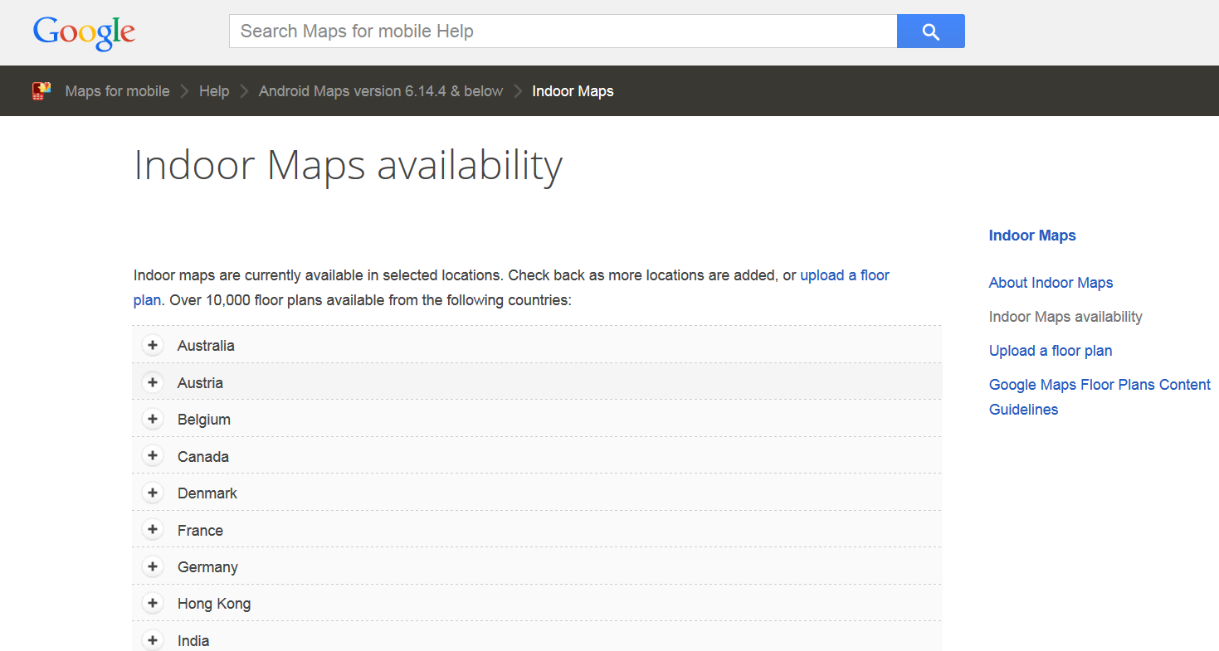
  The Service Availability is far from Ubiquitous
Indoor location service still sporadic
  Google Indoor Maps availability*
    Selected locations in 24 countries
    Only in some airports/ malls/ museums
One major obstacle: lacking of floor maps
  Need effort-intensive and time-consuming business negotiations
  Hire dedicated personnel
Background: crowdsourcing based
  Mobile traces & WiFi signatures: noisy
  Images: large amounts
* source: https://www.google.com/maps/about/partners/indoormaps
Notes:
After more than a decade of research, it is still not yet pervasive.
The industry state-of-the-art, Google Indoor Maps, covers about 10,000 locations in 18 countries, which are only a fraction of indoor environments around the world.
One major obstacle is that mainstream indoor localization technologies rely on RF signature maps from IT infrastructures, e.g. WiFi access points and cellular towers, and their signature maps require intensive human efforts to build and periodically calibrate, e.g. 2m a grid point.

Slide 5
Limitations
Time cost
  CrowdSourcing requires weeks’, even months’ data collection
Human efforts
  Hundreds, even thousands of images (Intensive human effort)
Data quality and amount
  Varies among individuals
Knitter:
Fast, Resilient Single-User Indoor Floor Plan Construction
Cut down time cost
Robust to data quality & amount
Cut down human effort

Slide 6
Motivation
Knitter: Fast, Resilient, Single-User Indoor Floor Plan Construction
  One man-hour’s effort vs weeks/months data collection
  Single user vs crowdsourced random users
  Novice users vs well-trained users
  Different types of buildings (malls, offices, labs)
Inspirations
  Leveraging environmental landmarks (POIs)
    Stores logos, paintings on the wall, entrances, ATM machines
  Combine Lightweight Vision + Mobile techniques
  Design probabilistic formulations for robustness

Slide 7
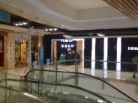

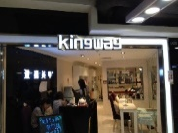
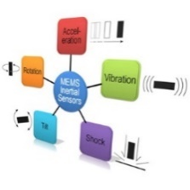
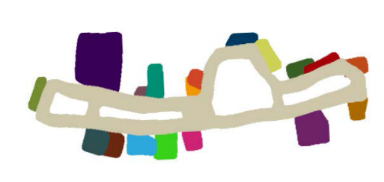

Knitter Overview
Three stages
Single image localization
Map fusion framework
Compartment estimation
Images
Inertial sensors
Landmark recognition
Trajectory calibration
& cleaning
Final map
WiFi

Slide 8
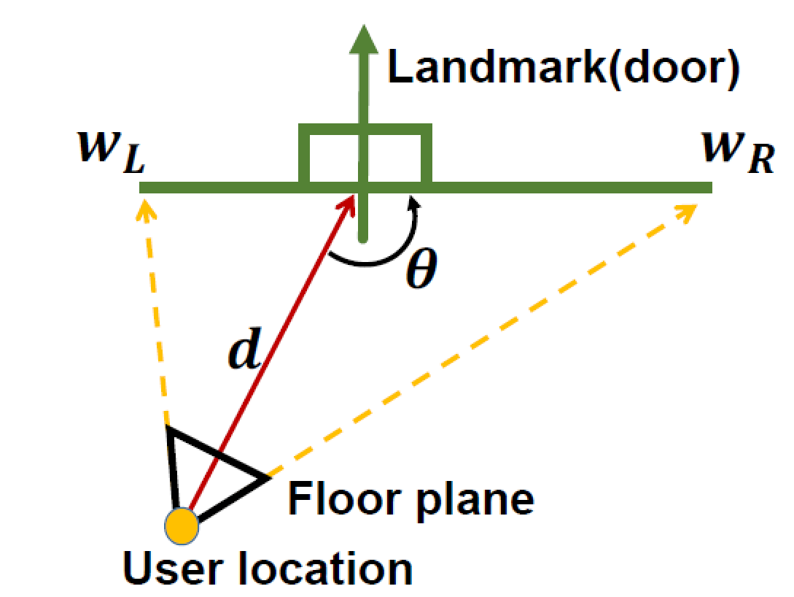
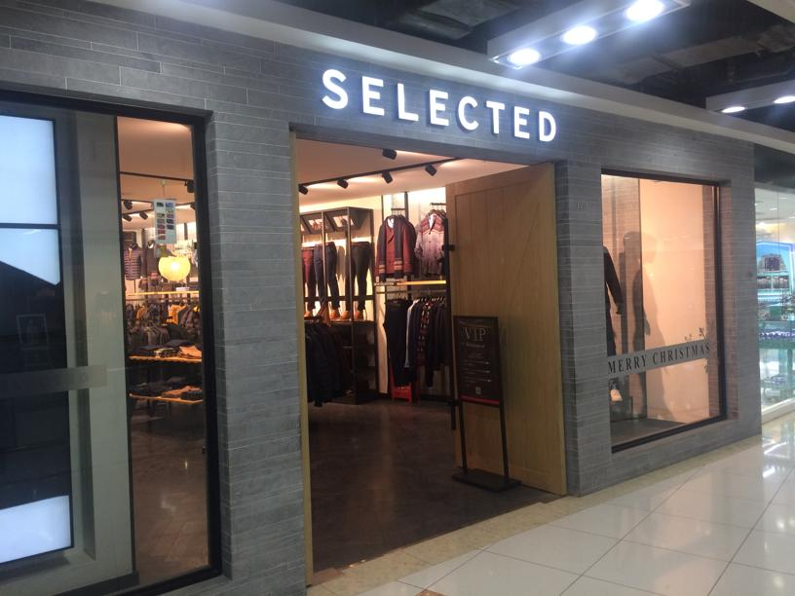
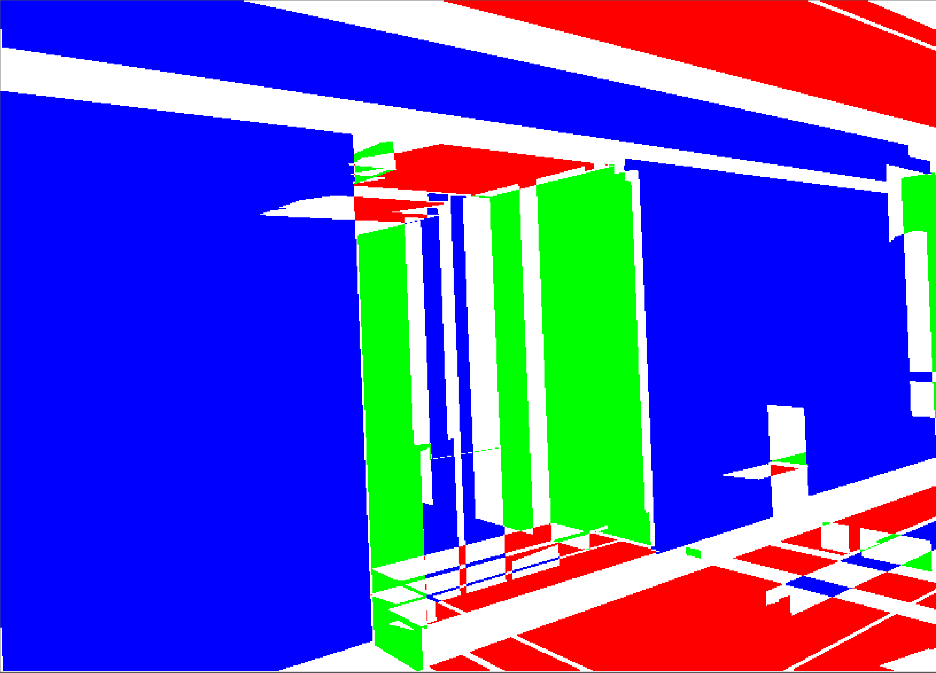
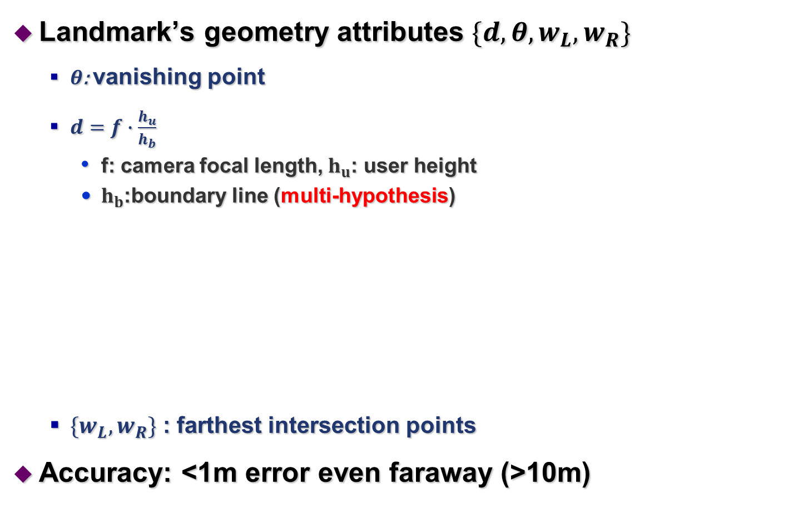

Localization via a Single Image
Landmark’s geometry attributes $\{d,θ,w_{L},w_{R}\}$
  $θ$: vanishing point
  $d=f∙\frac{h_{u}}{h_{b}}$
    f: camera focal length, $h_{u}$: user height
    $h_{b}$:boundary line (multi-hypothesis)
  $\{w_{L},w_{R}\}$: farthest intersection points
Accuracy: <1m error even faraway (>10m)
Vanishing point
VP(u,v)
Horizon line
$$h_{b}$$
Boundary line

Slide 9
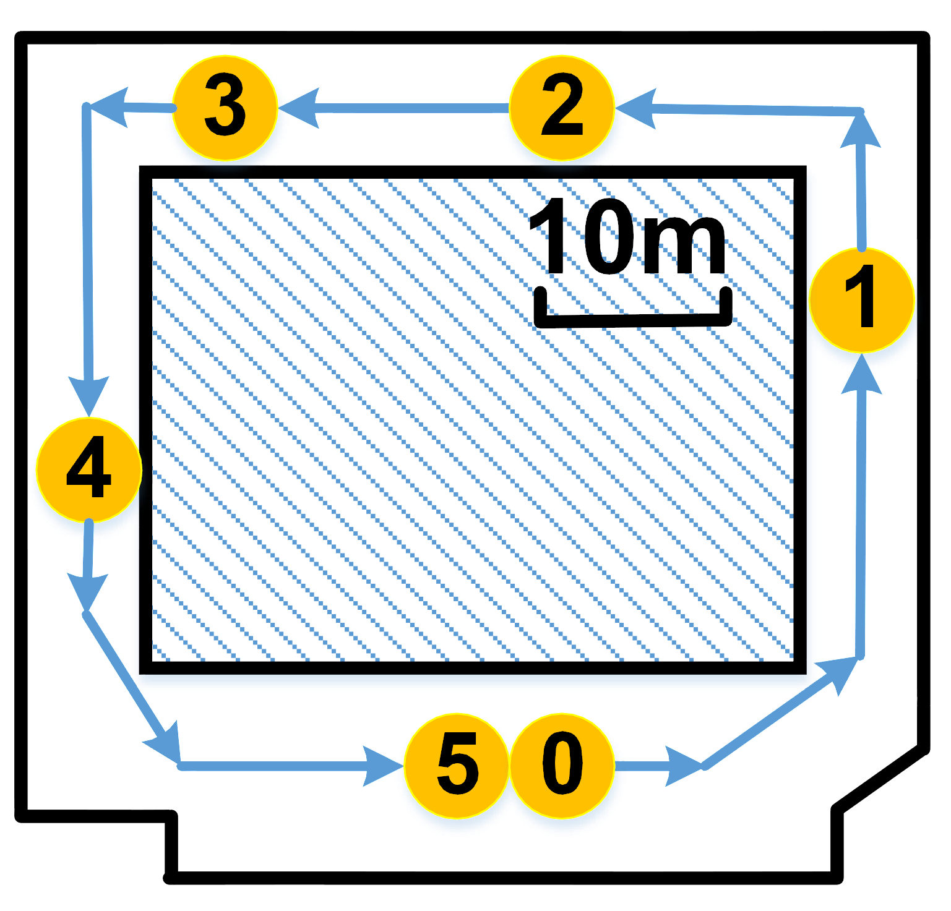
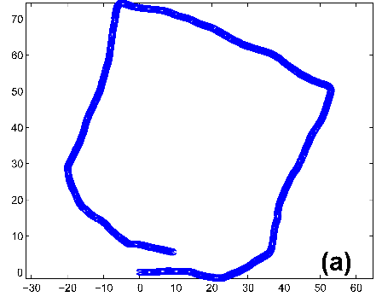
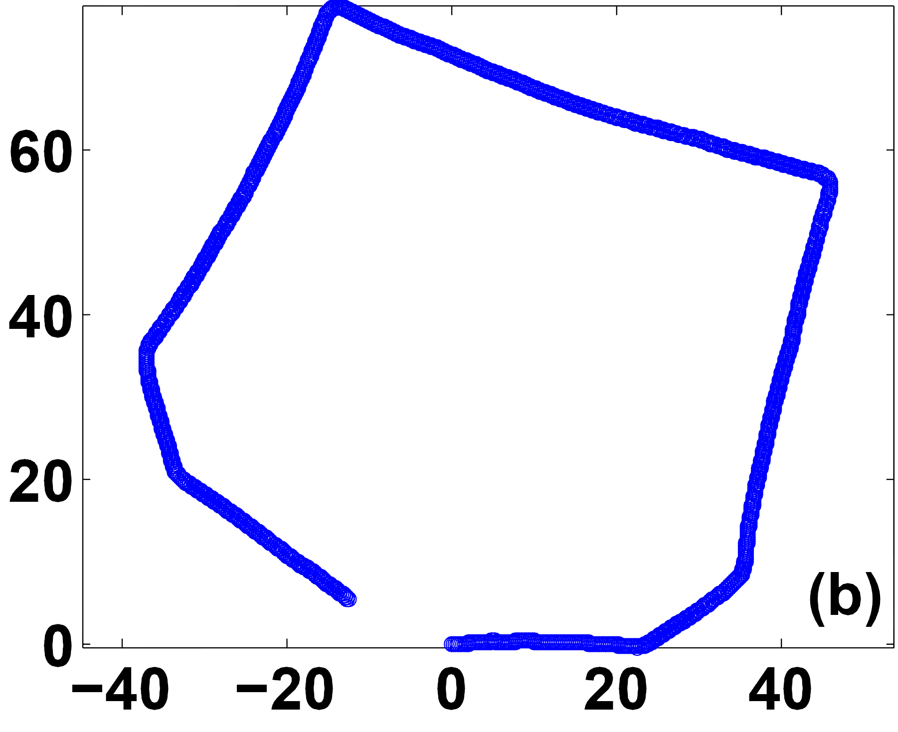
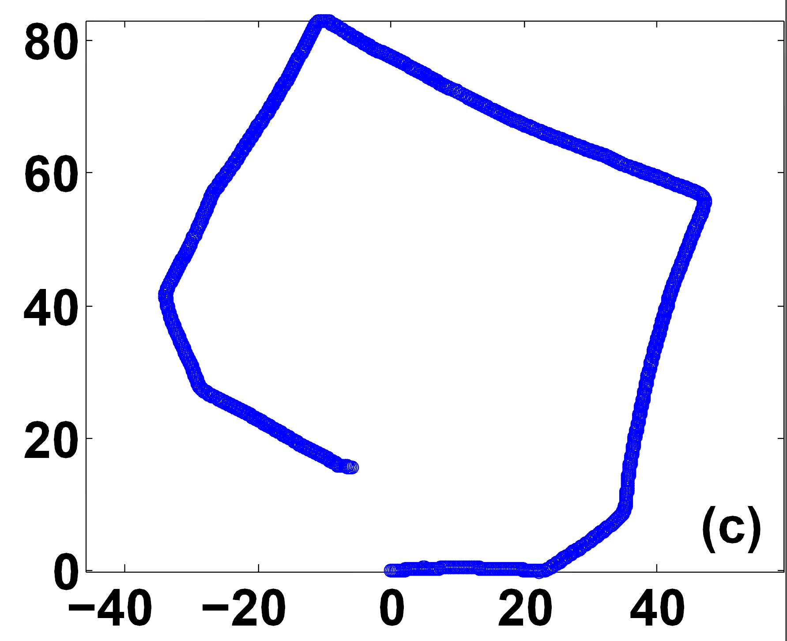
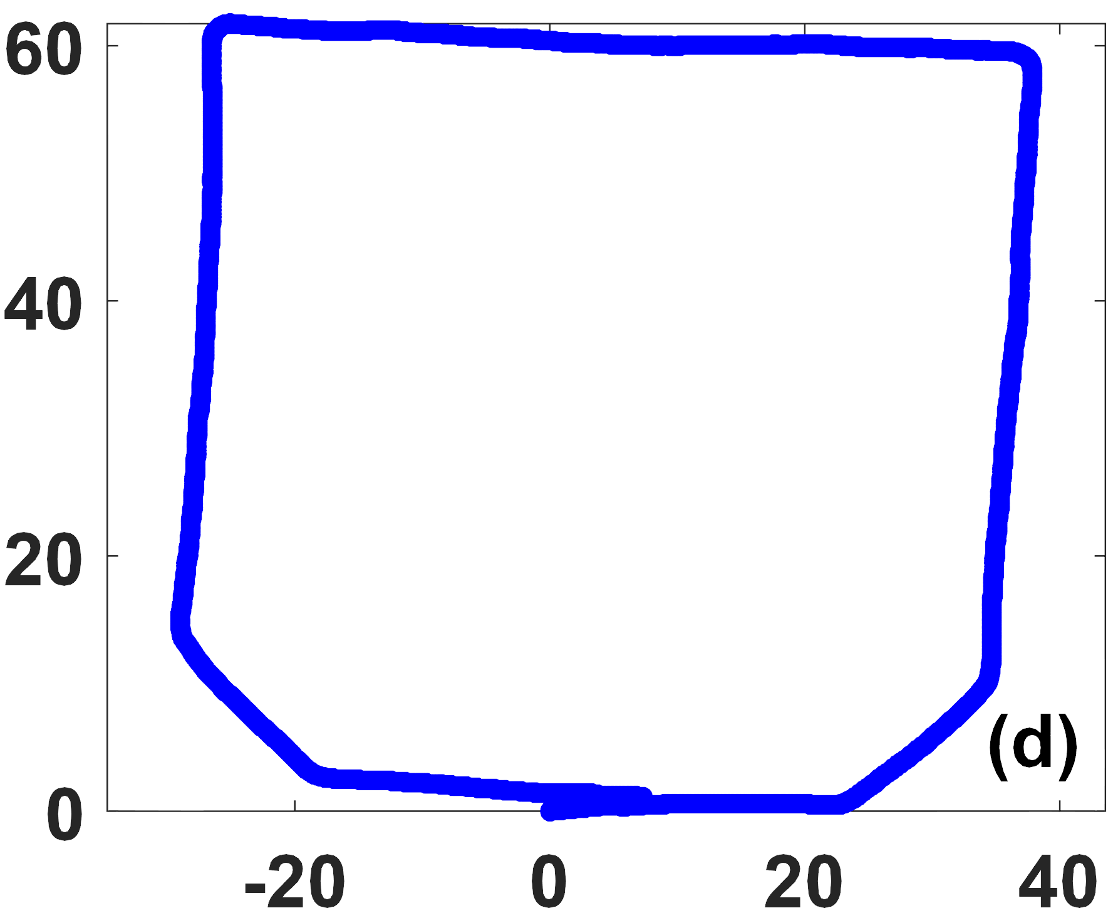
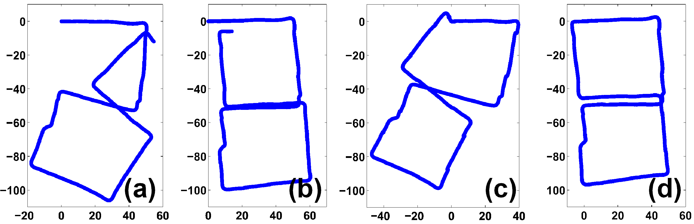
Trajectory Calibration
Angle calibration
  Compass/gyro
  Compass + gyro
  Image + gyro
Stride length calibration
  Image + loop closure
Ground truth
Compass only
Gyroscope only
Gyro + compass*
Gyro + image
Raw data Angle calibration only Stride length calibration only Both
[*] P. Zhou, M. Li, and G. Shen. Use it free: Instantly knowing your phone attitude. In ACM MobiCom, 2014.

Slide 10
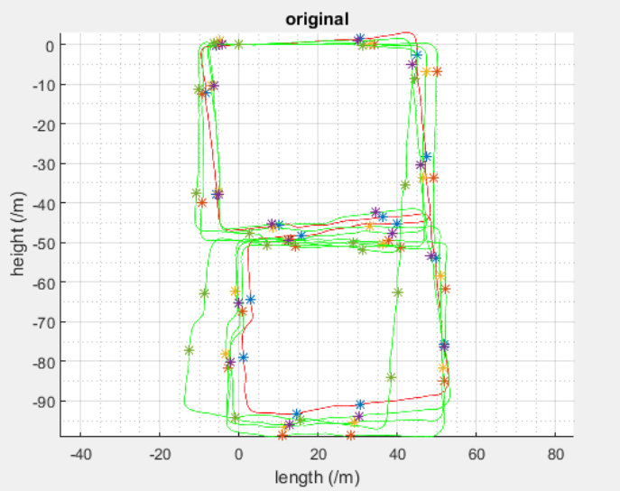
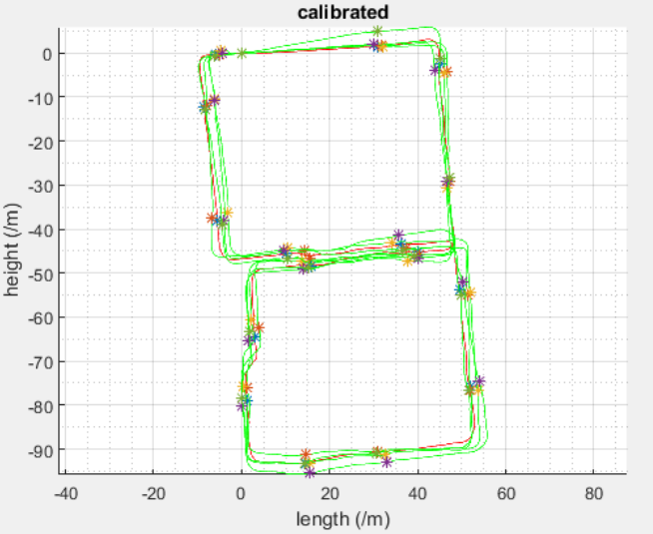
Trajectory Cleaning
Motivation
  Calibration only rectify small errors, but not outliers
Three steps
  Loop screening
    Remove traces with large distance “gap”
  Loop alignment
    Translate, rotate and scale the second loop to the existing one
    Objective: maximum overlap
    Greedy search + iterative perturbation
  Outlier removal
    Compute Euclidian distance for landmark vectors among loops
    DBSCAN
Outlier!
Alignment

Slide 11
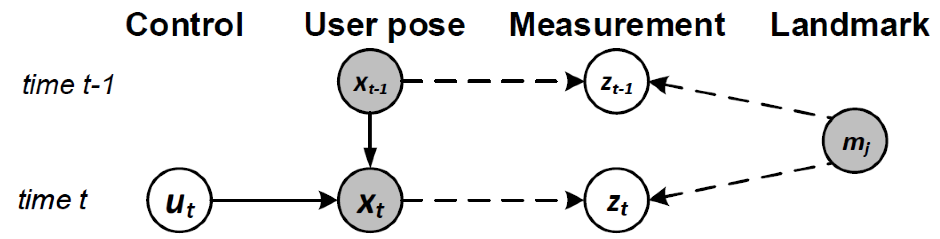
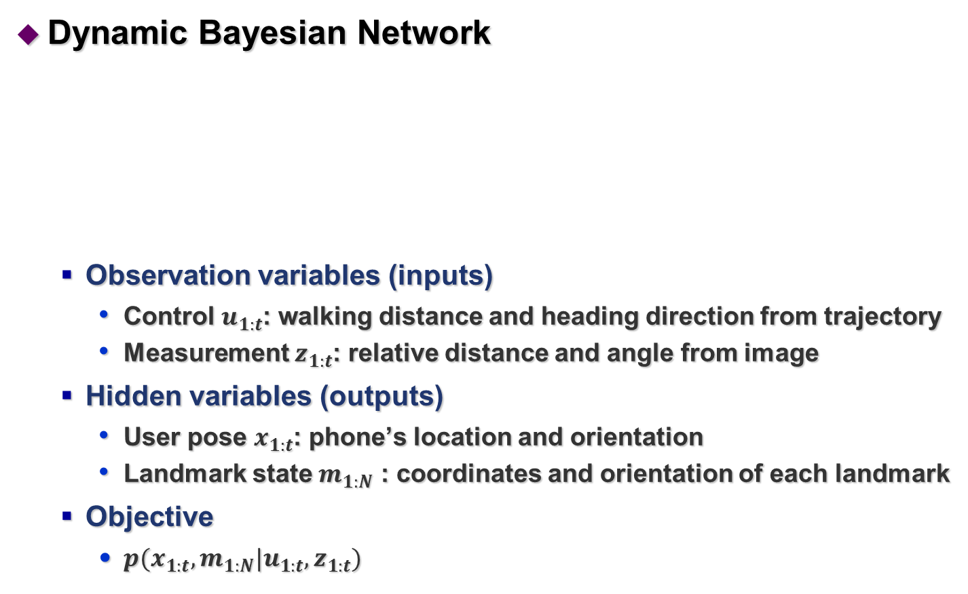
Map Fusion Framework
Dynamic Bayesian Network
  Observation variables (inputs)
    Control $u_{1:t}$: walking distance and heading direction from trajectory
    Measurement $z_{1:t}$: relative distance and angle from image
  Hidden variables (outputs)
    User pose $x_{1:t}$: phone’s location and orientation
    Landmark state $m_{1:N}$ : coordinates and orientation of each landmark
  Objective
    $p(x_{1:t},m_{1:N}|u_{1:t},z_{1:t})$
Observation
Hidden

Slide 12
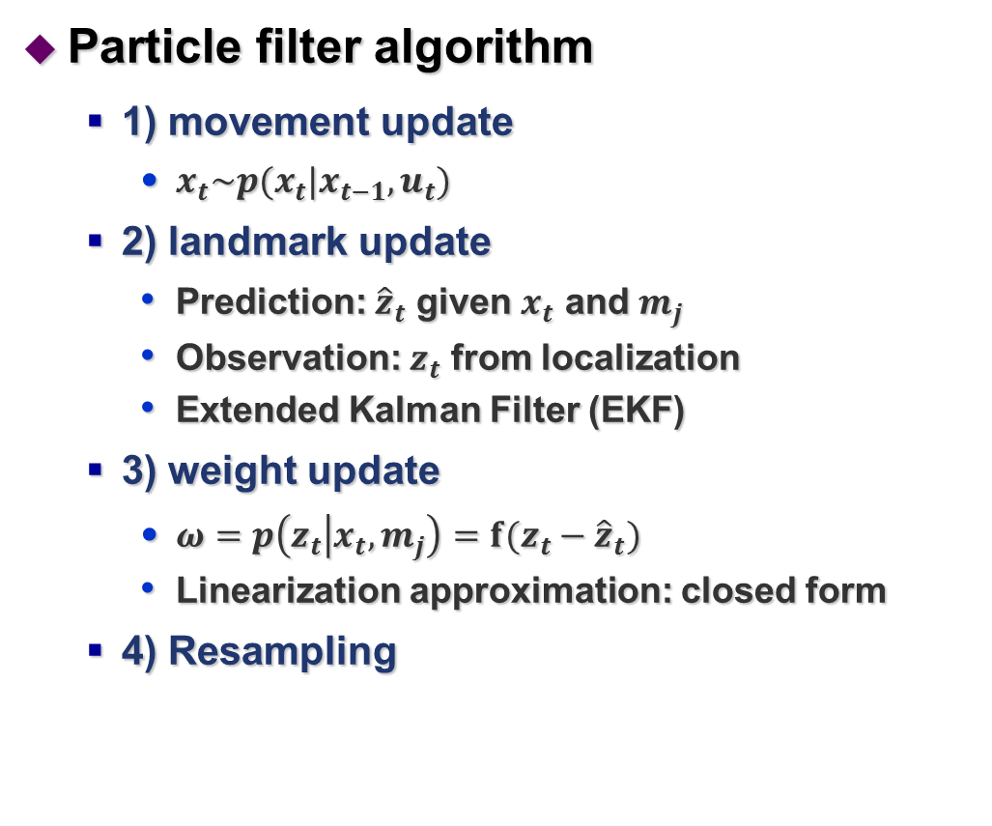


Map Fusion Framework
Particle filter algorithm
  1) movement update
    $x_{t}\sim p(x_{t}|x_{t−1},u_{t})$
  2) landmark update
    Prediction: ${\hat{z}}_{t}$ given $x_{t}$ and $m_{j}$
    Observation: $z_{t}$ from localization
    Extended Kalman Filter (EKF)
  3) weight update
    $ω=p\left(z_{t} | x_{t},m_{j}\right)=f(z_{t}−{\hat{z}}_{t})$
    Linearization approximation: closed form
  4) Resampling
Movement update
Current user pose
Previous user pose
Observation $z_{t}$
Prediction ${\hat{z}}_{t}$
Current landmark state
Previous landmark state

Slide 13

Issues in Practice
Landmark recognition
  Image-based
  WiFi-based
  Pose-based
Compartment estimation vs data sparsity
WiFi-based
Pose-based
Existing
landmarks
Image-based
Camera
Reconstructed
Landmark
Landmark
p=0
p=1
Camera
(a) Mobile trace
(b) External boundary of hallway
(c) Real wall segment

Slide 14
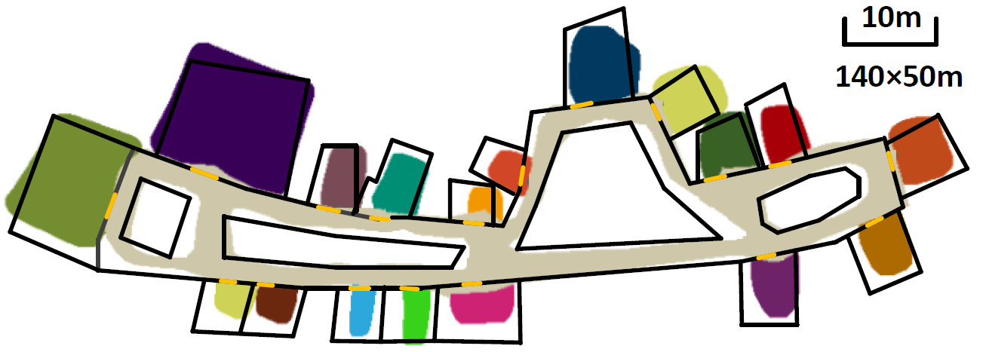
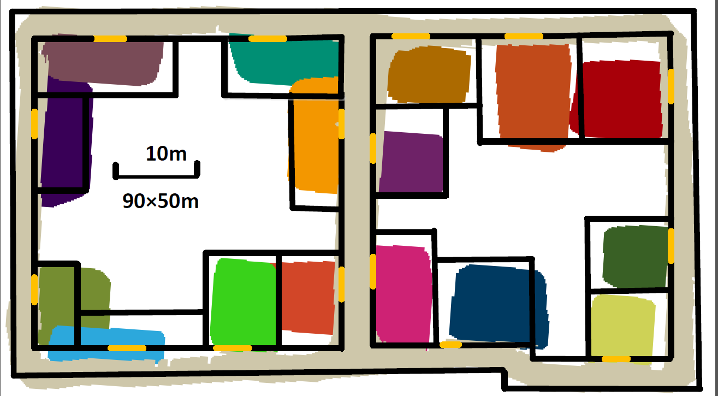
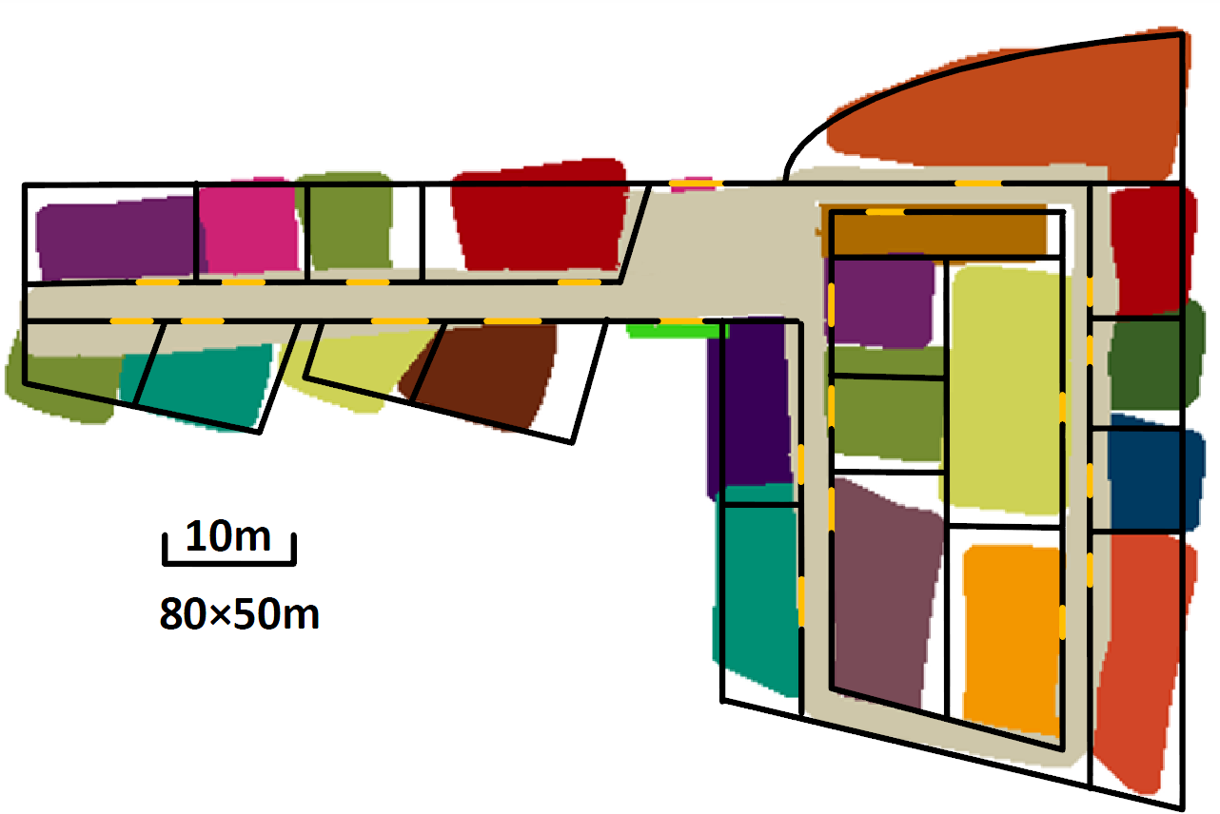
Evaluation
Methodology
  3 types of buildings
    shopping mall, office, lab
  30+ users
    Dedicated users (ourselves)
    15 novice users (5 min practicing)
    15 untrained users
  Data collection guidelines
    Images with medium distances & angles (~5 meters, ~45º)
    Hold the phone steady during walking

Slide 15
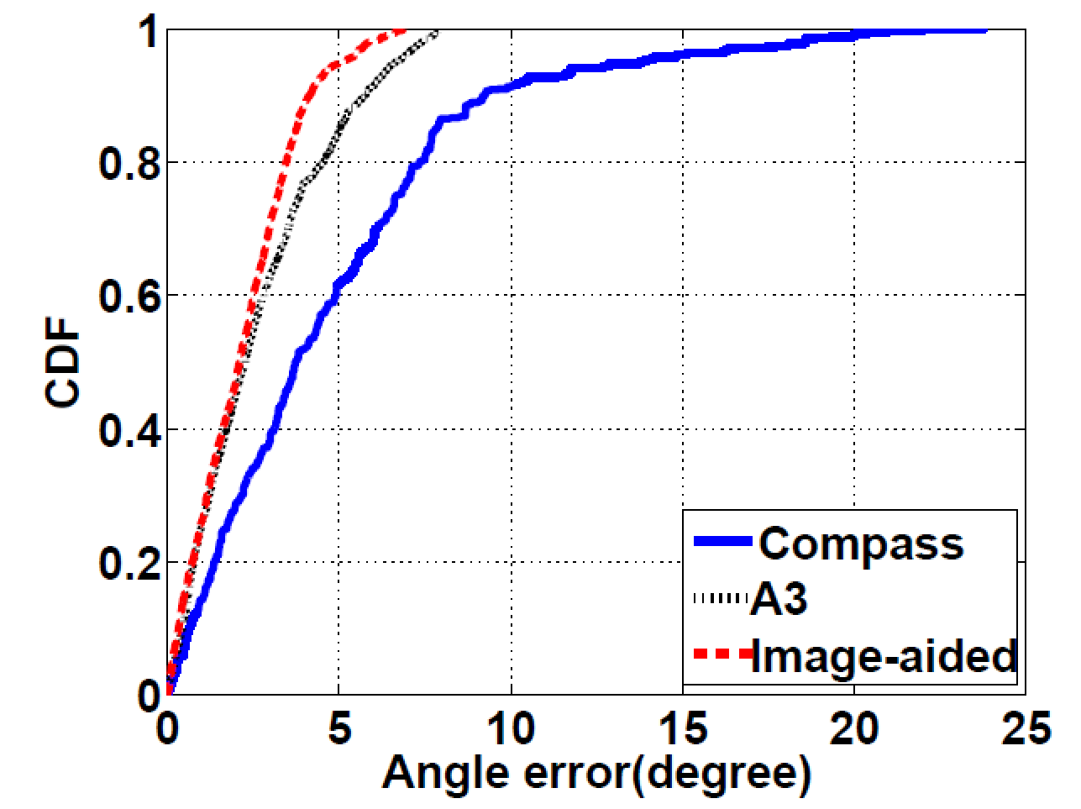
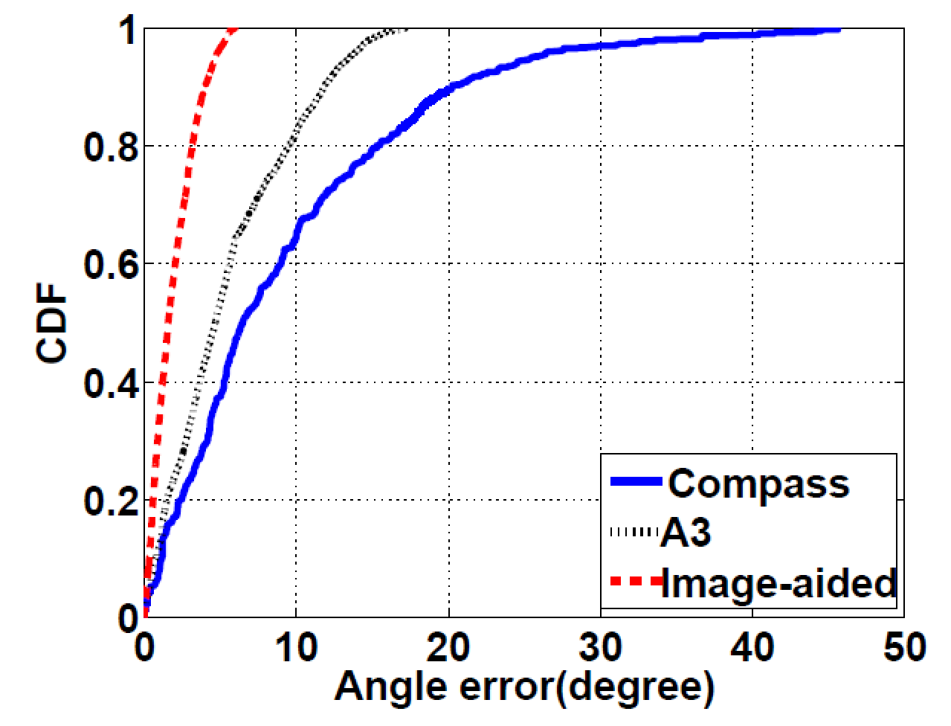
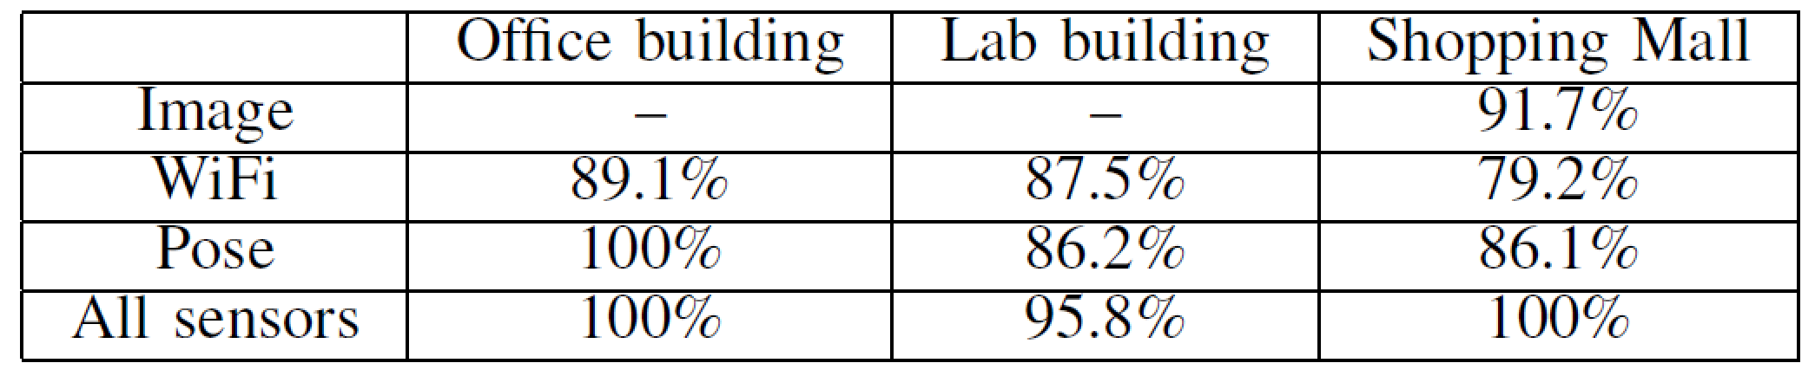
Evaluation
Inputs accuracy
  Image measurements
    80-percentile errors: 1m and 5º
    Maximum errors: 2.2m and 94º
  Trajectory angle calibration
    90-percentile error: 5º
    Robustness
  Landmark recognition
(a) Without strong magnetic disturbances
(b) With strong magnetic disturbances

Slide 16
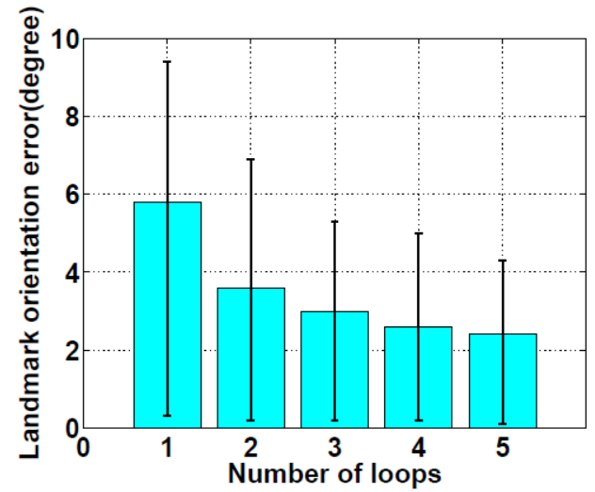
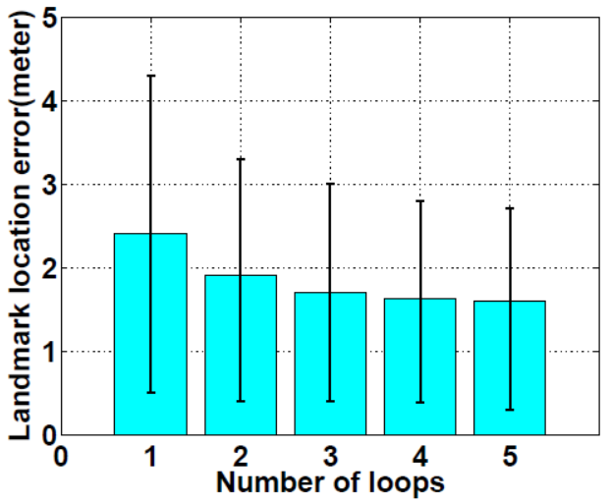
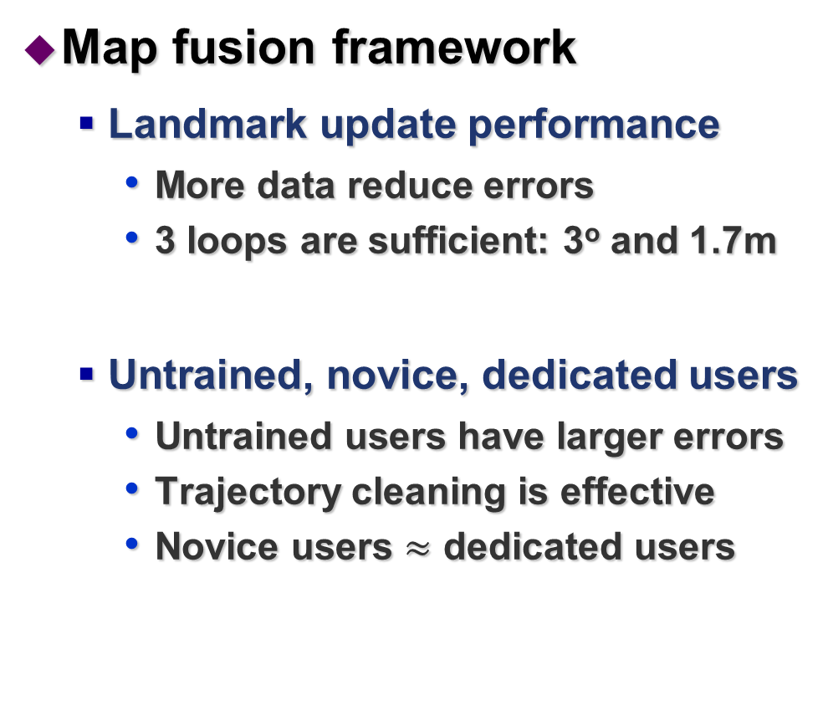
Evaluation
Map fusion framework
  Landmark update performance
    More data reduce errors
    3 loops are sufficient: 3º and 1.7m
  Untrained, novice, dedicated users
    Untrained users have larger errors
    Trajectory cleaning is effective
    Novice users $≈$ dedicated users
(a) Orientation errors
(b) Location errors

Slide 17
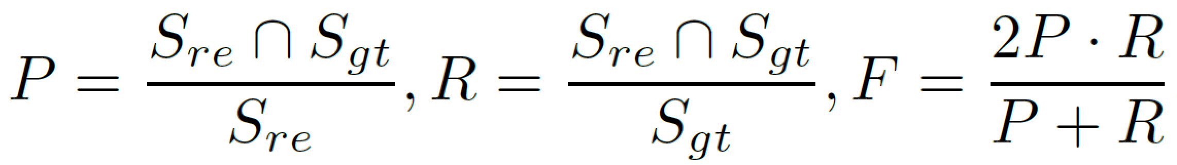
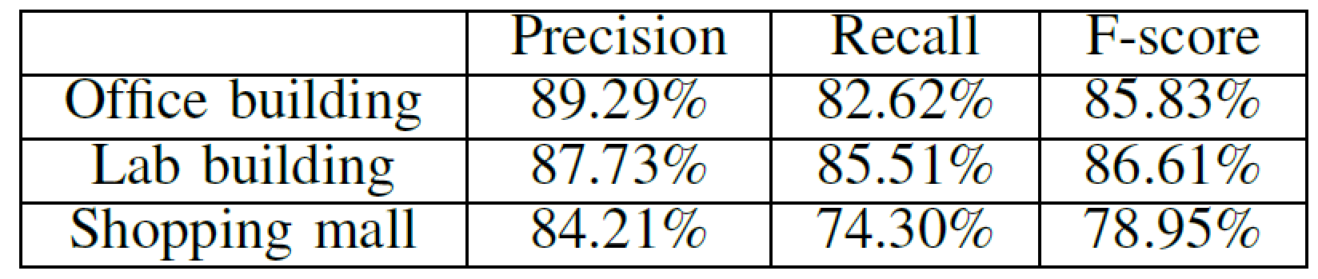
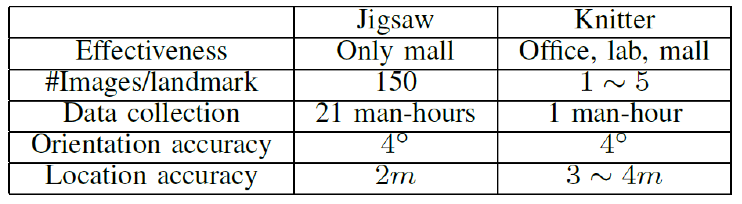
Evaluation
Map overall shapes
  Metric
    Overlay the reconstructed map with GT
  Results
Comparison with Jigsaw [MobiCom’14]
  Comparable accuracy, 20x speed up, effectiveness

Slide 18
Related work
Proposal | Device | Inputs | Limitation
MapGenie | Smartphone +IMU | Inertial | Dedicated device
Tango | Tablet | Inertial + visual + infrared
Walkie-Markie | Smartphone | Inertial + WiFi | Hallway-only
SmartSLAM | Smartphone | Inertial + WiFi
Y. Jiang et al | Smartphone | Inertial + WiFi | Rectangle rooms
A. Sankar et al | Smartphone | Inertial + visual | Manhattan
CrowdInside | Smartphone | Inertial+WiFi+GPS | GPS in rooms
Jigsaw | Smartphone | Inertial + visual | Mall only, large image amount
iMoon | Smartphone | Inertial + visual
Knitter | Smartphone | Inertial + visual

Slide 19
  Summary
Knitter
  Comparable quality with state-of-the-art
  More than 20x speed up
Enable techniques
  Single image localization
  Multi-hypothesis inputs
  Trajectory calibration and cleaning
  Data fusion
  Incremental map construction framework

Slide 20
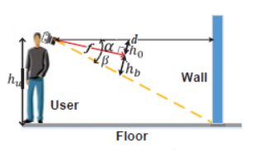


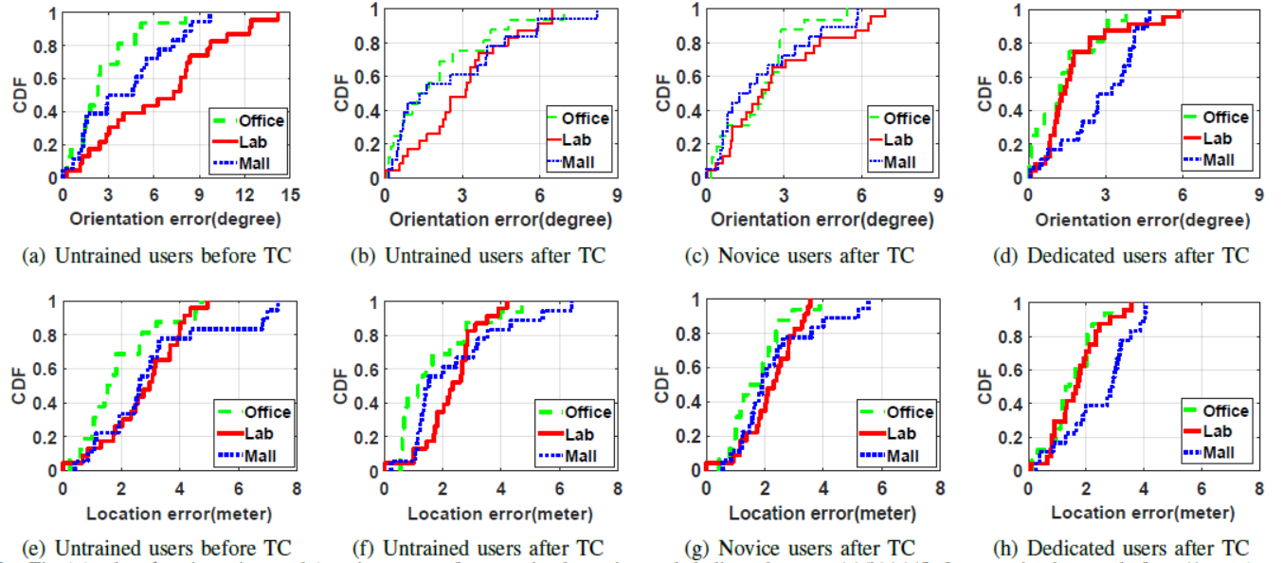
Backup

