Slide 1


Micro DB
Presentation By:
Lulu (lz2761)
Chengrui(cz2664)
Shubham(sp3895)

Slide 2
Acknowledgement
We want to convey our heartfelt gratitude to Prof Stroustrup as well as our TAs David and Luiz for providing us with a chance to work on this project and for helping us and guiding us along the way.

Slide 3

Abstract
There are many C++ based SQL database frameworks like SQLAPI++, SOCI etc
These need other dependent libraries to function properly.
We were inspired by Redis and initially set out to built a replica using C++.
Redis uses in-memory data storage but due to time constraints and scope of this project, we opted to provide similar functionalities by file-storage based implementation.
Our goal is to develop an easy to use self-contained library that can support key-value pair storage into filesystem.
The program uses idx and DAT files to store and retrieve data

Slide 4

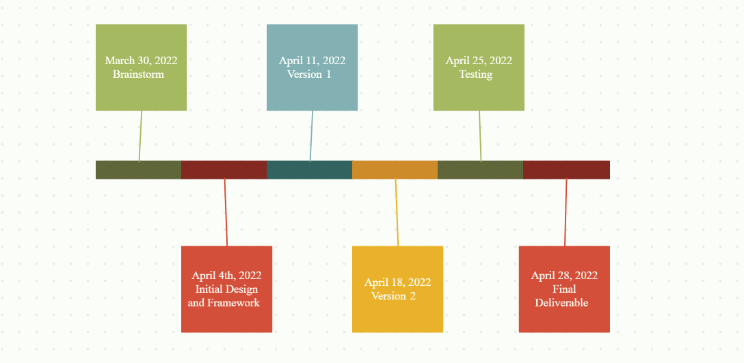
Development Timeline

Slide 5


A little detail about each of these steps
Brainstorm: March 30th to 4th April : Narrowed down set of functionalities that the project will support based on the needs of users and their pain points.
Initial Design and Framework: April 4th to April 11th :Decided the hashing function and storage architecture
Version 1: April 4th to April 11th : Developed the insert, find, delete and create database functionality
Version 2: April 11th to April 18th: Added support to insert values into database on file uploads. Added support for query functionality
Testing: April 18th to April 25th: Added performance test application and tested with datasets from IMDB
Final Deliverables: April 25th to April 28th : Created tutorial, demo and sample docs.

Slide 6
Commands we support
INSERT : to add a key-value pair into the database
FIND : to get value of any key passed
DELETE : to delete a key-value pair from the database
QUERY : to search through database based on condition of key or value at particular index
IMPORT : import data from a csv or tsv file into database
Control Flow for each can be referred in the design document here.
Moreover, we added a test application in the project which also acts as a tutorial sample on how to use the library. The test application captures time taken for each of the above command and also does a sanity test of the database by testing random string inserts.

Slide 7
FileList
File Name | Purpose
CMakeLists.txt | CMake file to build the project
Manual | Instruction Manual
data.tsv | Test dataset from IMDB
db.cpp | Function definitions
db.h | Function declarations
exception.h | Exception declarations
idx.h | Index file declarations
main.cpp | Application file which provides command line interface to test
test.cpp | Test application
tutorial.cpp | Tutorial file
It's a simple directory structure and each file is named to be self- explanatory of what it does

Slide 8
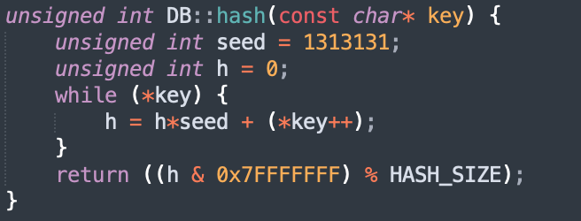

Design Approach
Hash Function
BKDR hash function (comes from Brian Kernighan and Dennis Ritchie):
Hash value of string s = seed^(n-1)* s[n-1] + seed^(n-2)*s[n-1] + …… + seed^0*s[0]

Slide 9
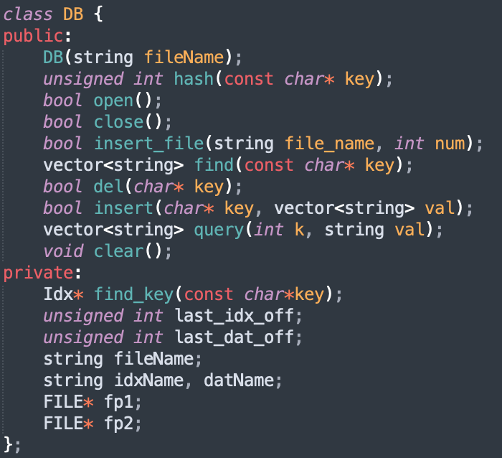
Design Approach
DB class

Slide 10
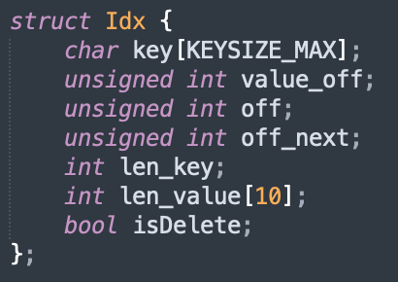
Design Approach
Index struct
Solve hash value conflicts
value:support single string/multiple strings(<=10)

Slide 11
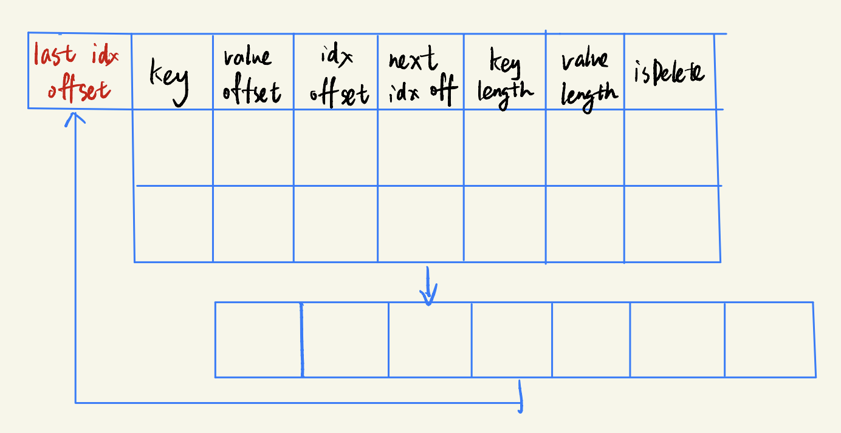
How we organize the index file
When key value conflicts happens, append the new idx struct to the end of the file.
Set the next_idx_off of the last conflict key’s idx struct as the offset of the new idx struct. Thus, the hash table is organised as a Linked list.
When a key’s idx struct is deleted, we do not truly delete it. Only set “isDelete” to be true. We can directly insert a new idx struct to the position where “isDelete” == true.

Slide 12
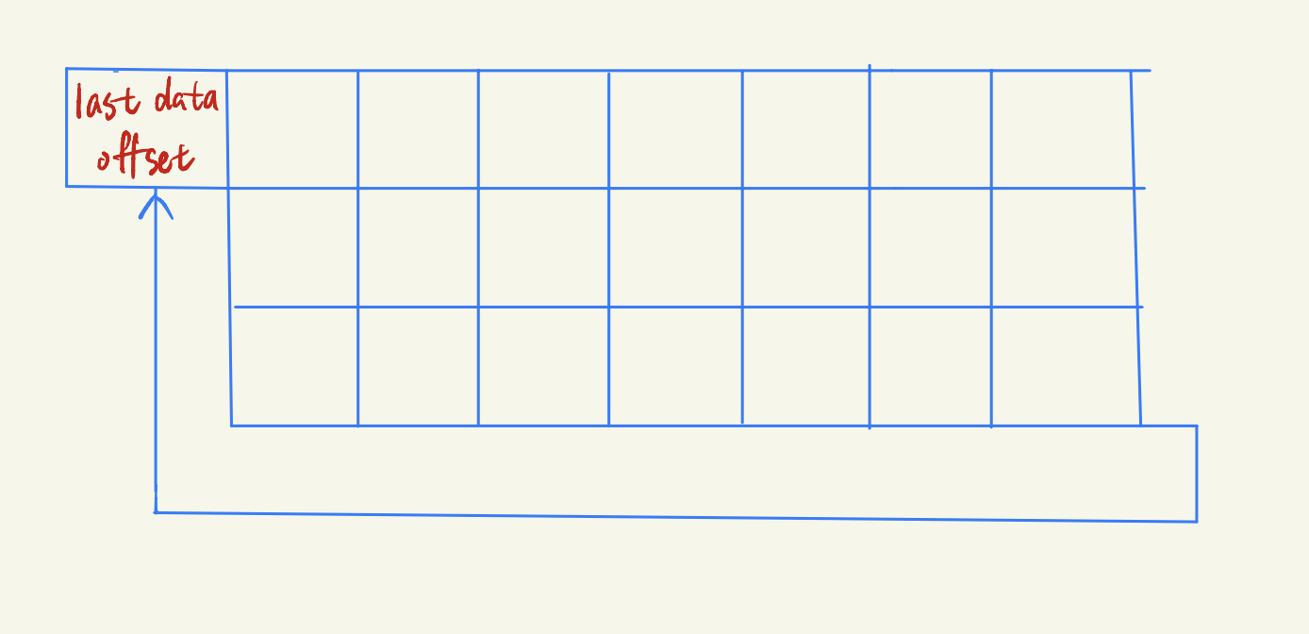
How we organize the data file
The value data of each key is stored sequentially in the dat file.

Slide 13
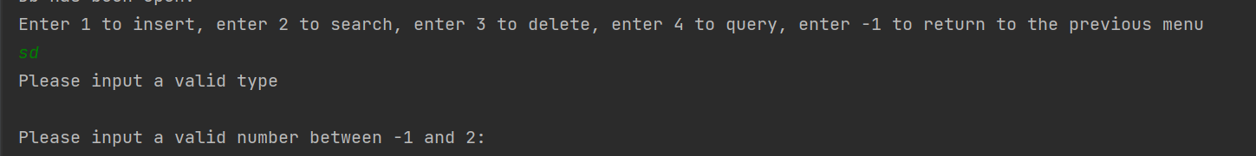
Exception Handling
We wrote a exception class to handle some potential problems. We take some cases in consideration that
there may be some incorrect input like strings or characters when the system wants us to input a number.
Or we input the wrong number which is not valid for it to work. Like it requires us to input numbers between 1 ~ 4, but we input 8.

Slide 14
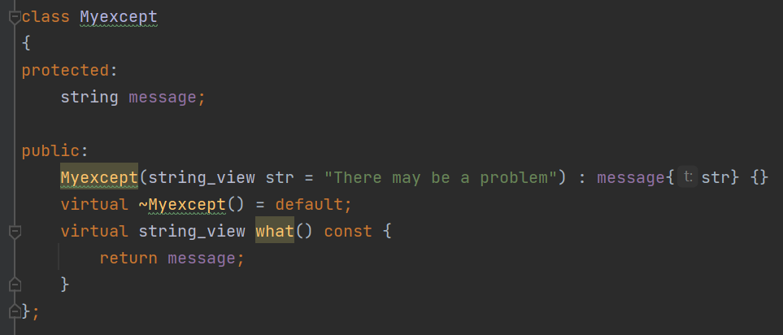
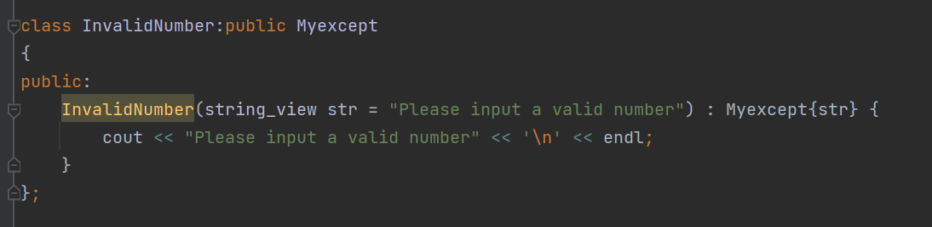
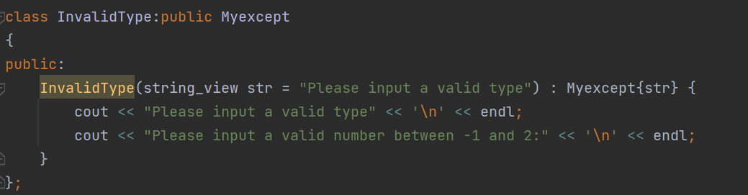
Exception Handling
This is the exception class we defined.
These are the subclasses of Myexcept for some specific cases.

Slide 15
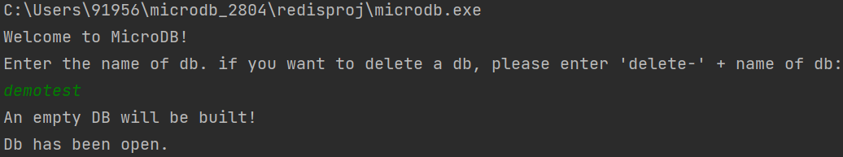
Sample
For Creating database file : On running the executable file, it asks the user for a database name, if a dat and idx file with same name is present in the directory it will connect to that database else it will create new set of dat and idx file.

Slide 16
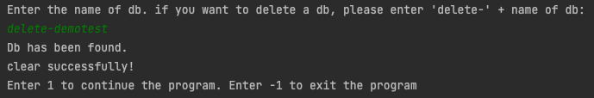
Sample
Delete database: User would enter the name of the database to be deleted. if the database is found, then the idx file and dat file of this database would be deleted. Otherwise, the program would warn that the database is not found and return to the menu.

Slide 17
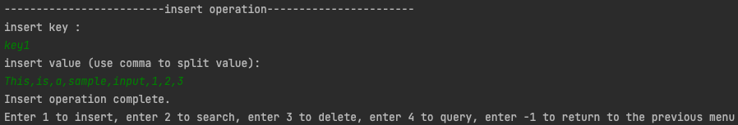
Sample
Insert: This command adds a key-value pair to the database file(Notice: in the current system, input of more than 10 values is not allowed. We can insert as many as we want, but it could only read 10 values.)

Slide 18
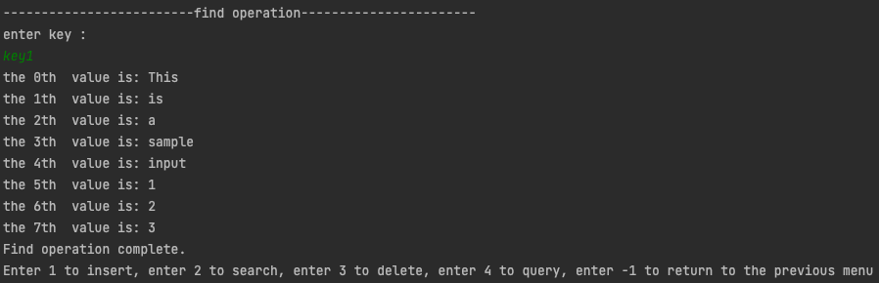
Sample
Find: This function searches through the database for the specific key value and returns the value vector

Slide 19
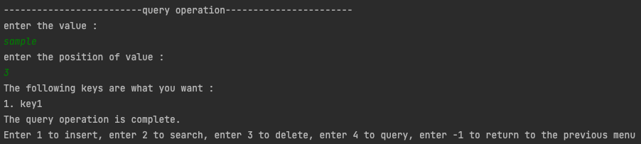
Sample
Query: This function returns all keys that fulfill the query requirement. Specifically, it iterators through all keys in the database and check if the kth value of each key equals to what the user query.

Slide 20
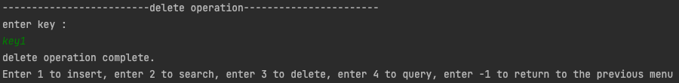
Sample
Delete: This function deletes a key-value data.. The program would first check if the key-value pair exists. If exists, it would delete it. Otherwise, it would warn the user that the key is not found.

Slide 21
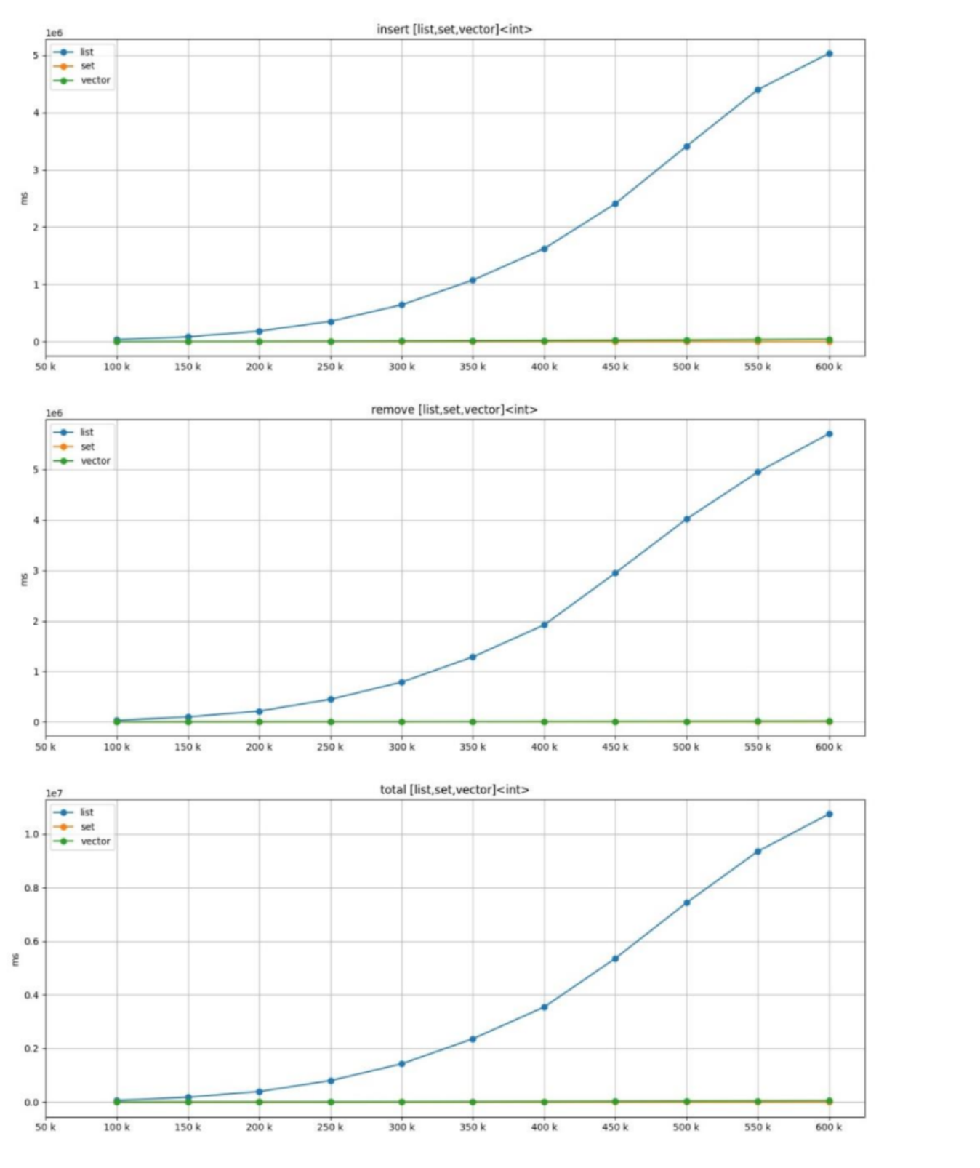
Performance Measurement
Inserting performance:

Slide 22
Performance Measurement
We used the data we grabbed from IMDB and imported them into the CSV file. We set the names as the keys and all the attributes as the values of the keys. The maximum data that the database can read now is less than 300,000 lines. We tested csv files that contains 1000, 10000, 100,000 and 200,000 lines.

Slide 23
Performance Measurement
Function | Operations | Measure
Insert | 6.7 | millisecond/Insert
Find | 0.8 | millisecond/Read
Query | 1.85337 | Seconds for 100000 rows in Database
Delete | 1.1 | millisecond/Delete
Import csv | 56,139 | Inserts/Second

Slide 24
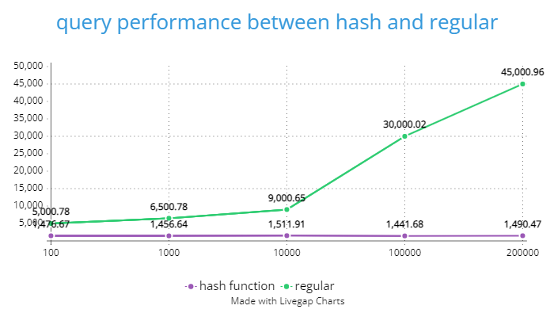
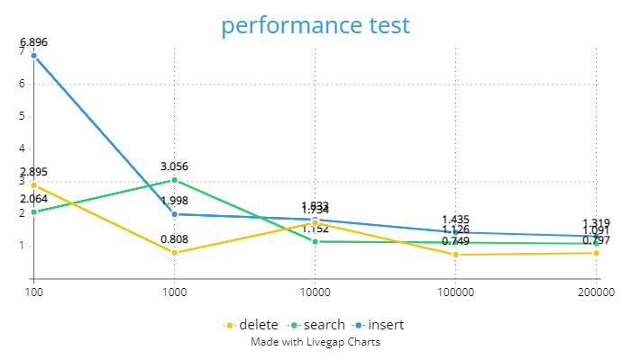
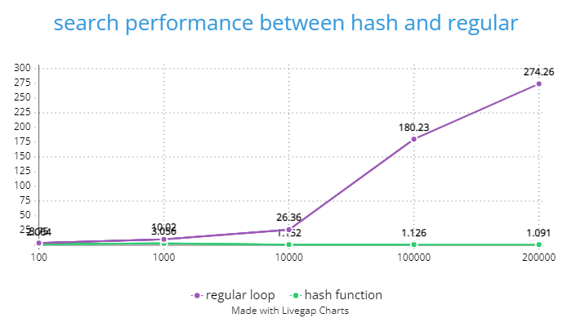
Performance Measurement
Performance between hash function
and normal reading function:

Slide 25
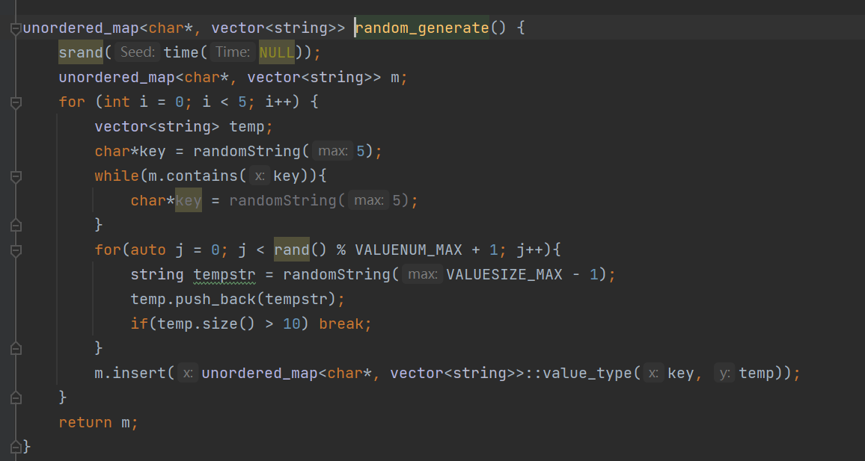
Correctness Measurement
We defined the max num of key string and single data value, and we randomly generated some value according to the given length.

Slide 26
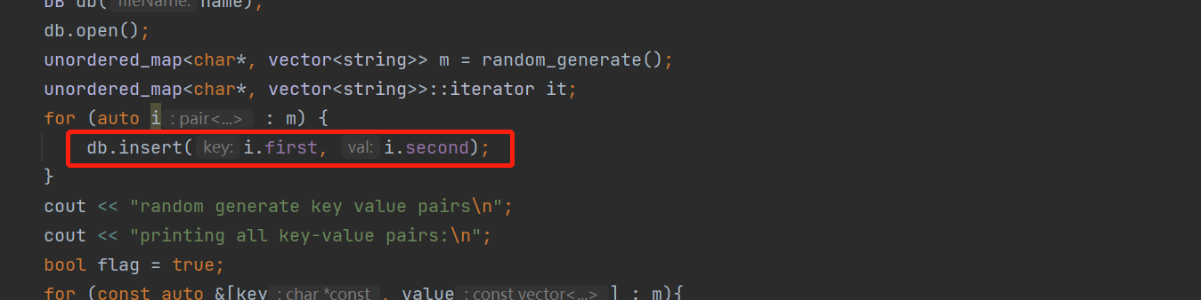
Correctness Measurement
We stored the data we generated into a map and insert them into the database.

Slide 27
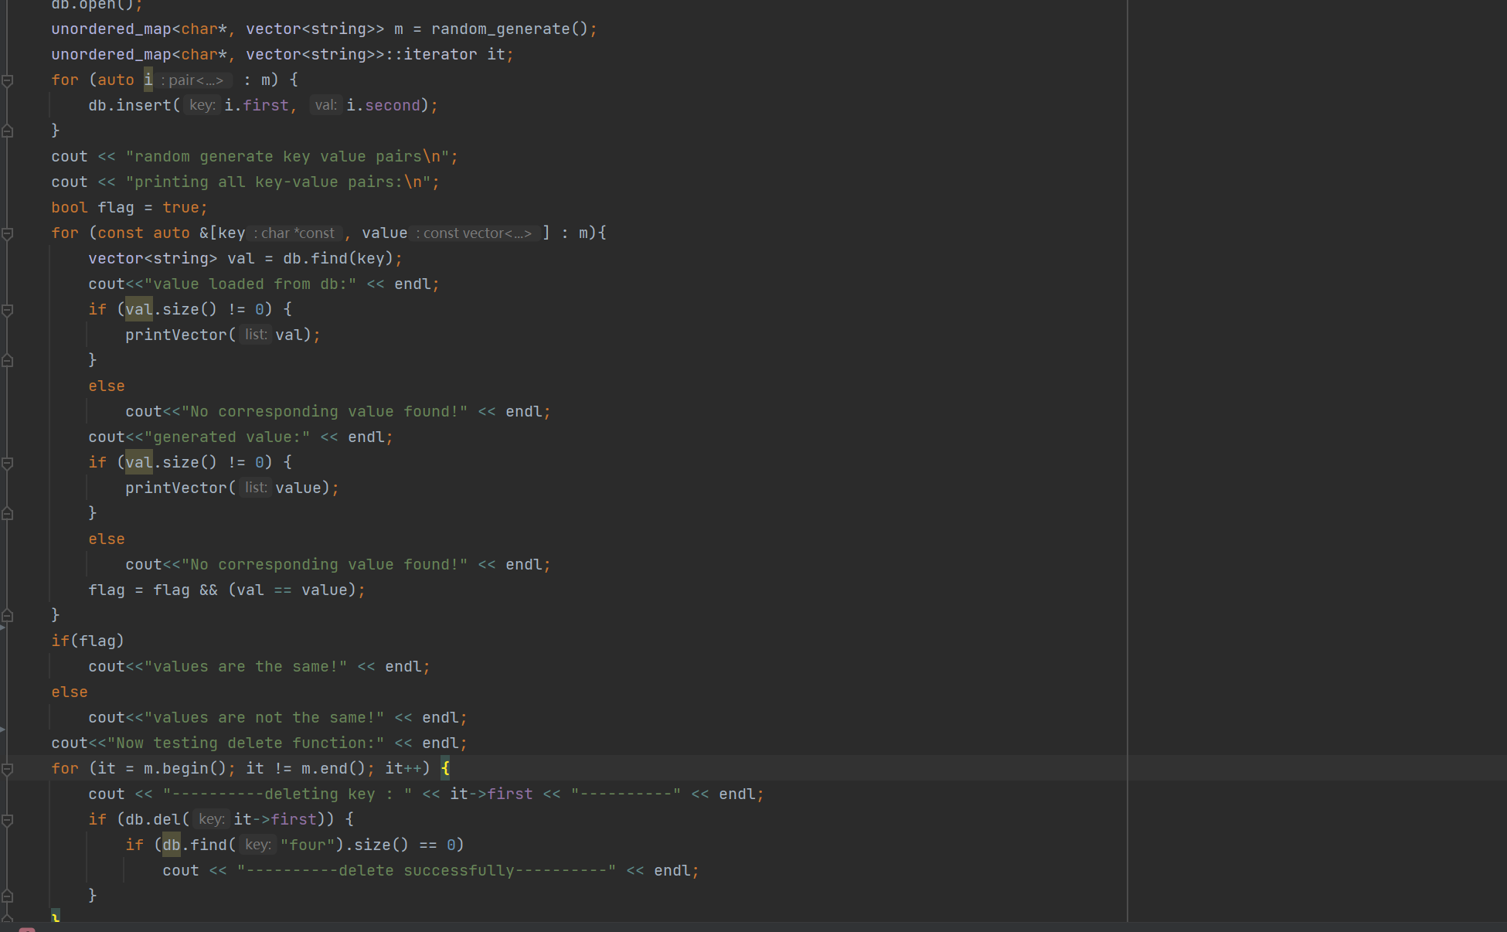
Correctness Measurement
Then we read the value from both the database and the unordered_map, we compared them, then we delete them and see whether they were existed in the database.

Slide 28
Testing Mechanism
We tested with two mechanism
First, through command line interface
User can perform operations on any database file through this interface
Sample log from command line interface Link
Second, through test_performance application
Test app benchmarks all operations for different size of input file and prints log
Test checks correctness of the database by generating random string and testing read/write values based on it.
Sample test_performance log file Link.
Databases Used for testing:
https://datasets.imdbws.com/
Title.ratings.tsv.gz
title.akas.tsv.gz

Slide 29
Problems faced:
An ideal size of hash table: time cost v.s. space cost
If the hash size is very large:
the idx file would be very big and takes lots of space.
If the hash size is very small:
It would suffer from key value conflict issue. We need to go through the linked list for conflicting keys in find and delete function, thus very time consuming.

Slide 30
Problems faced:
Fix the value length or not?
For single value, it is better to fix the value length.
So that we can implement update function without wasting much space.

Slide 31
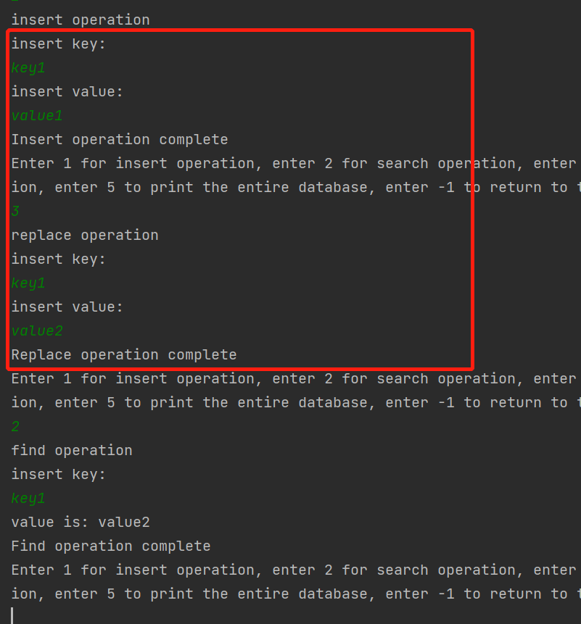
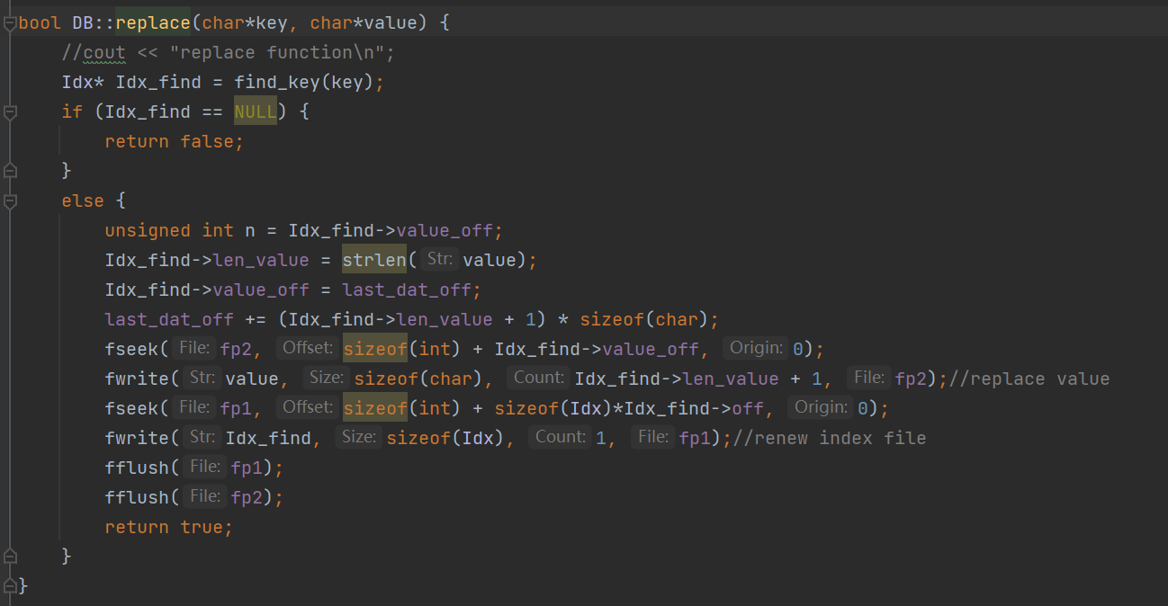
Fix the value length or not?
This is our original update function.
Original output

Slide 32
Problems faced:
Fix the value length or not?
For multiple values, it is not easy to handle.
Now we only restrict the total number of values for each key to be less than 10.
If we fix the value length, it would be a waste of space for short length value..
If we do not fix the value length, we have trouble implementing update function. Because the data is stored in sequence. If the new value we try to update is longer than the previous one, it would cover the data stored next to it.
I think we can use dynamic hash function to expand or shrink the length of the hash table to some space.

Slide 33
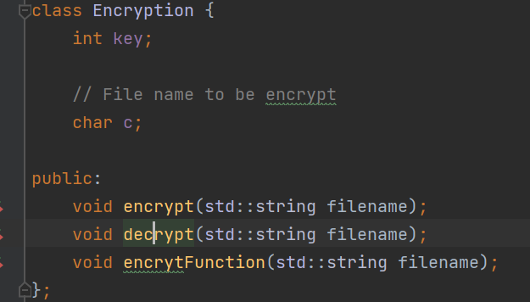
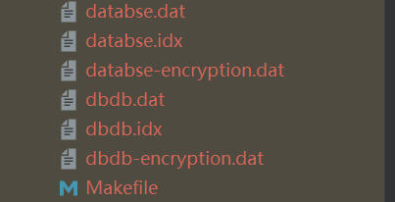
Problems faced:
Encrypt and decrypt functions and class
Encryption and decryption functions:
At first we designed an algorithm based on MD5 and RSA and tried to realize the encryption and decryption functions of the dat files. And we made it. We successfully used password to realize that. However, even though we could decrypt the content of the file which was totally same as the previous content, yet we couldn’t successfully search the value in the database, which may generate some garbled text when we search the key.

Slide 34
Further tasks:
This implementation is file system based, in future we would like to add function like in-memory based implementation similar to Redis in design, we would need to add functions to maintain concurrency control and persistence.

Slide 35
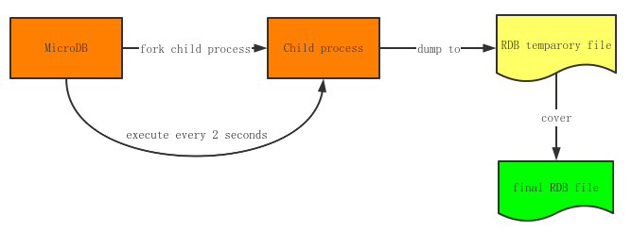
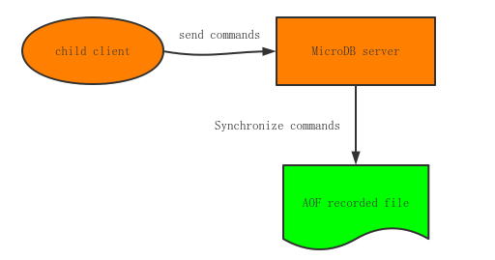
Further tasks:
Now our product is just a simple version of the NoSQL database. There are still a lot of things for us to do:
About persistence now we only store all the data into the file on our local disk. In the future we will try to do some more persistence functions.

Slide 36
Further tasks:
Now our product is just a simple version of the NoSQL database. There are still a lot of things for us to do:
2. No we only have the version on our local computer. If we want to make our database more functional, we will introduced the distribution lock to this database to serve the scenario of huge amount of users.
3. Current implementation assumes that all keys and values vector are string, we want to try to move it to template based implementation so that the user can type of data while creating the database. This would provide better speed of operations when the user needs to use simple data types like int for values.
4. Convert to module(C++20) for easier integration with new applications

Slide 37
Further tasks:
Now our product is just a simple version of the NoSQL database. There are still a lot of things for us to do:
4. We also plan to add more functions on servers like master-slave synchronization, transactions and sentinel mechanism to make it more efficient and comprehensive.
5. When memory is low, we plan to free memory by evict some key according to LRU.
6. Convert to module(C++20) for easier integration with new applications

Slide 38
Thank you
Opening the floor to Q&A

