Slide 1
Python code
The method

Slide 2




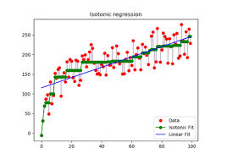

Tools used

Slide 3
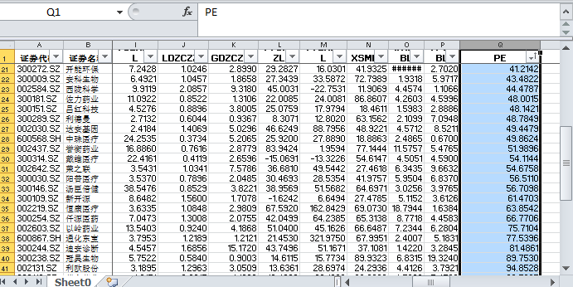

Fitting , The simple, the beautiful
X,y
lm = linear_model.LinearRegression()
lm.fit(X,y)
T = “test” , score = R2
The result is easily resulted

Slide 4
Improve it , To reduce noises
R² from fitting data
Initial result:
PE value of:
贝瑞基因
华大基因
Are these parameters(features) all contribute to PE value ?
New X data:
“0” for row, “1” for column
New Test data:
Numpy function

Slide 5
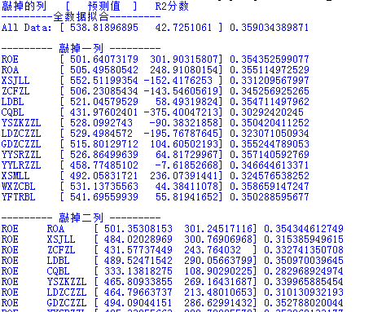


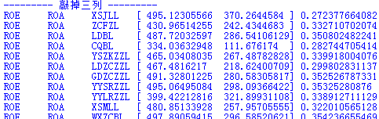
Improved results …, but…
Code, result
… …
R2 does not seem to improve

Slide 6
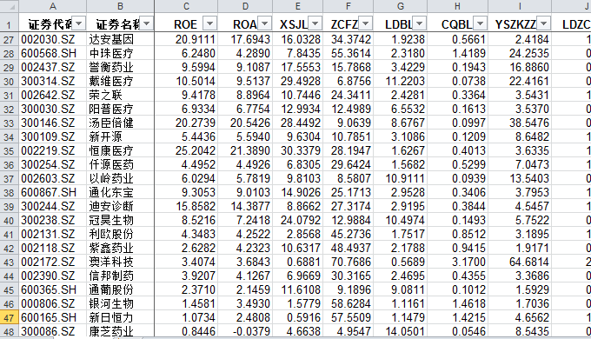
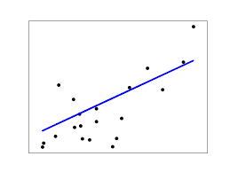
Improve it step2 , get rid of outliers
New X data:
0
0
“0” for row, “1” for column
New Test data:
Numpy function

Slide 7


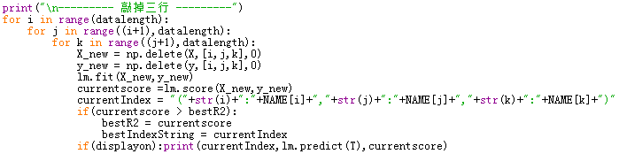
Machine way of learning: Method of exhaustion
… …
… …
>>> 最好R2：0.72669916063 （敲除企业）@( 36: 通化东宝, 45: 新日恒力, 48: 中源协和)

Slide 8
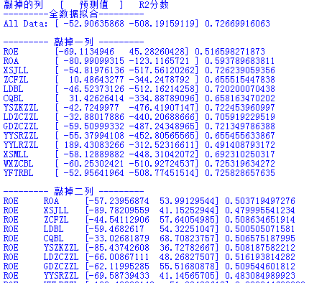
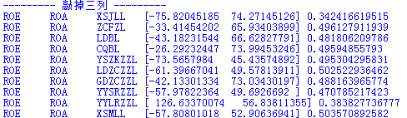
Then we are close to the truth
The best R2 is still achieved by
Full-feature data

