Slide 1
Automated tools
Explore & Output
TRIS
Round 2
2015.05.18

Slide 2
Project Progress
Simplify Selenium API
Screenshot & Highlight on Error
Design & Output Test Report Template
Test Cases on Product Specification

Slide 3
Simplify Selenium API
Selenium 2.0
TRIS
Hundreds of APIs
TRISWebDriver
Software Defects
TRISBrowser
APIs Updated

Slide 4
Design & Output Test Report Template
TestNG + ReportNG + Customized = TRIS Test Report
TRIS for upc-crm Example

Slide 5
Discussion Point
Test Report output
R&D rhythm control
Personnel division

Slide 6
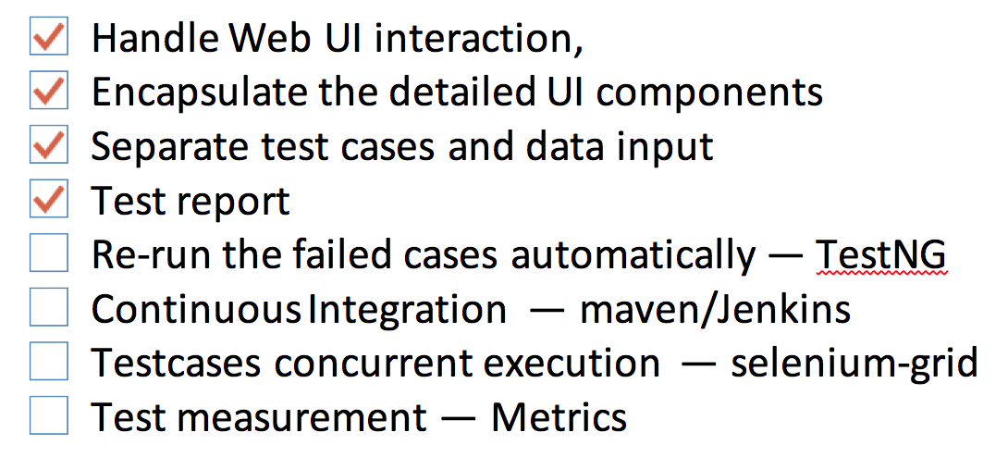
R&D rhythm control

Slide 7
Personnel division
Test Engineer — Design all cases and write manual cases
coding automated cases
Software Engineer in Test
maintain automated tools

