Slide 1
Automated tools
Explore & Output
TRIS
Round 4
2015.06.08

Slide 2
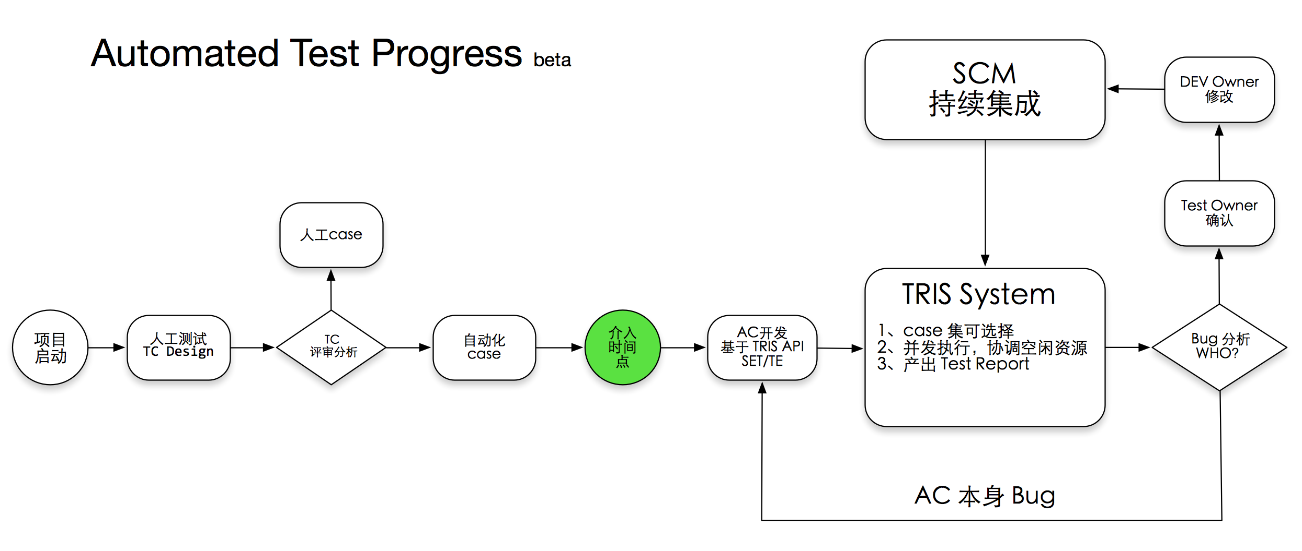

Slide 3
TRIS Platform beta
Right now ,
TRIS only focus on
Automated Testing Execution & Test Artifact Analysis,
which means TRIS is not a case management system.

Slide 4
TRIS Platformbeta Overview
TRIS_Web
TRIS_Server
TRIS_Core
Trigger
Test Artifact

Slide 5




Mobile
iOS/Android
DMP
Test Case Management
Proxy
Restful API
Trigger TC Execution
Manage Data collection
CRUD
Http/Https
Data format
JSON
Web Front-End
Back-End

Slide 6
Sorry, only Demo page Show this week…

Slide 7
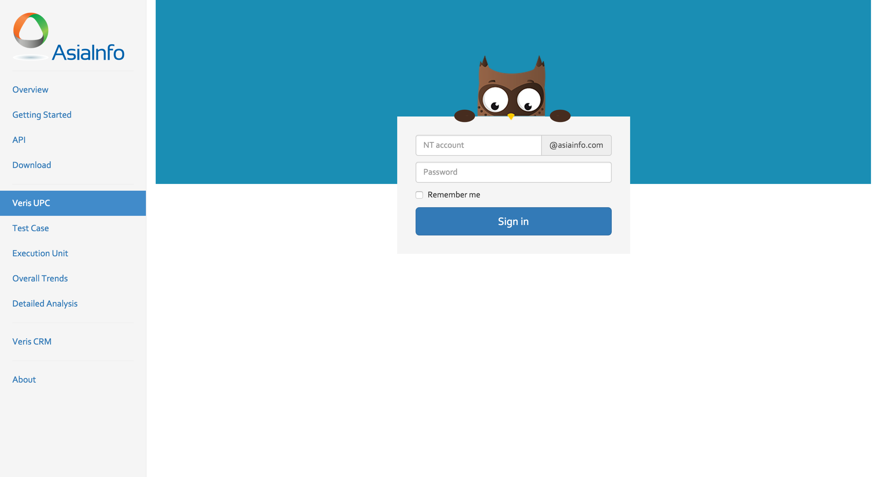

Slide 8
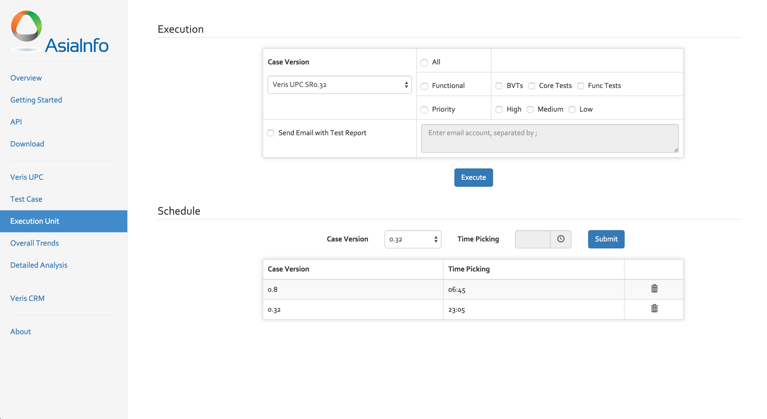

Slide 9
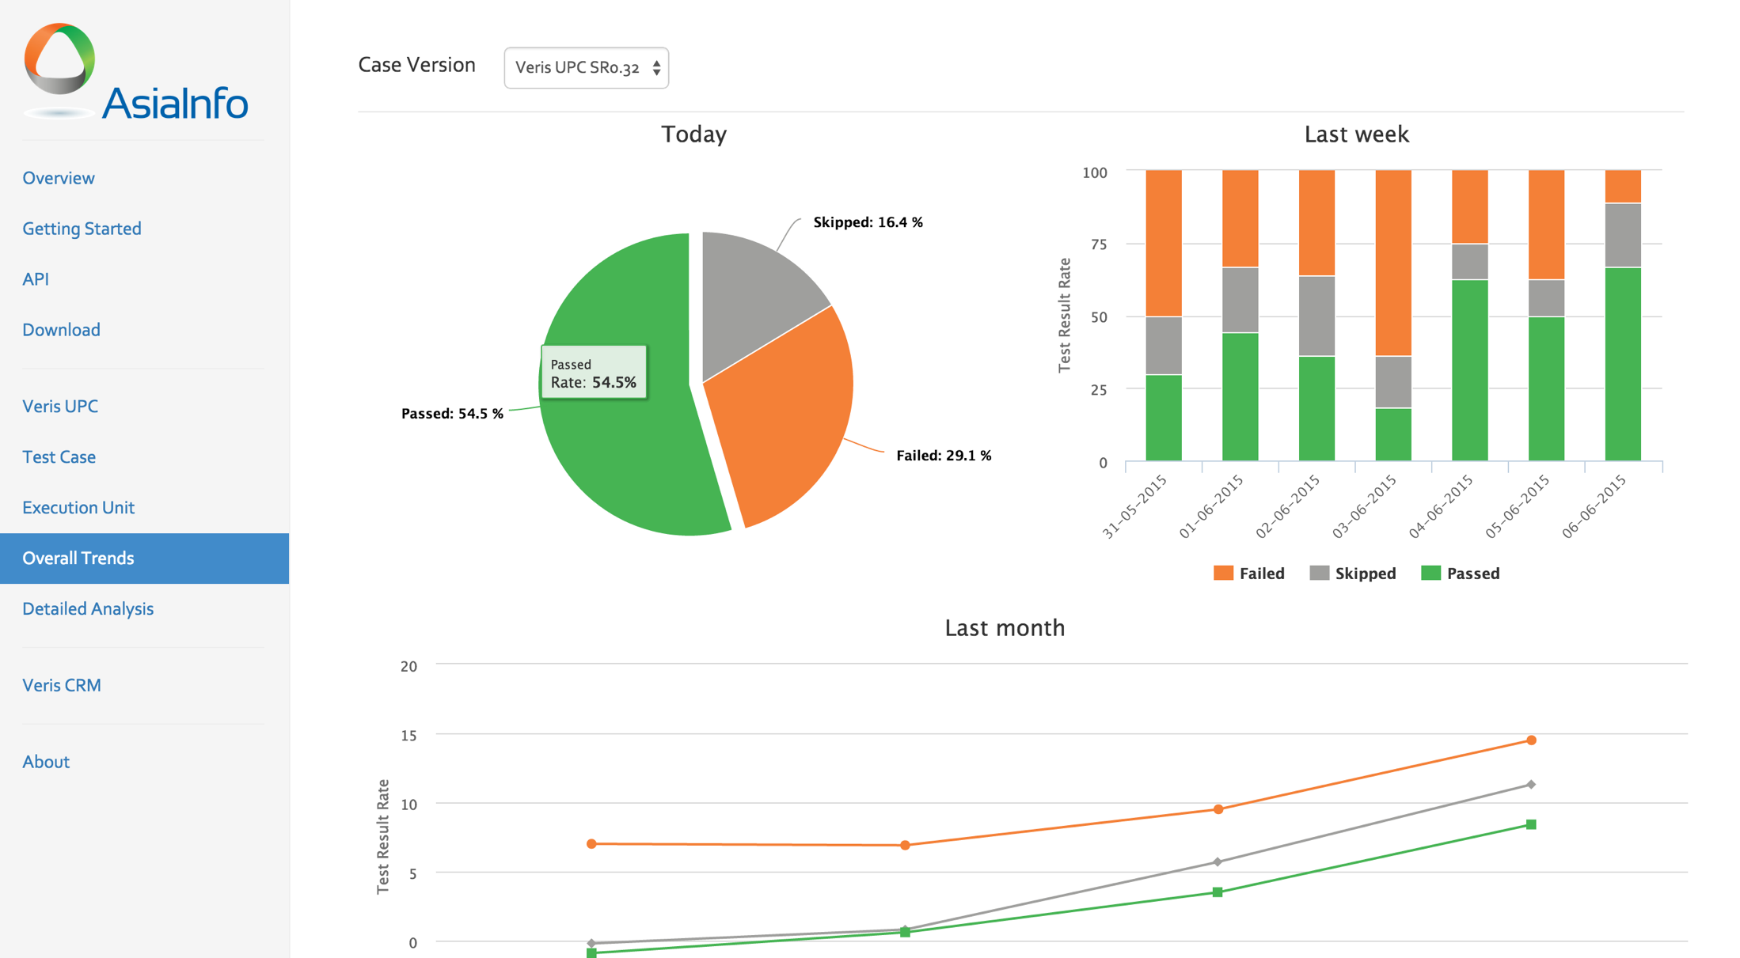

Slide 10
