Slide 1
Automated tools
Explore & Output
TRIS
Round 3
2015.05.26

Slide 2
Welcome Shi bin

Slide 3
Automated Test Progress beta
Concurrent execution of test cases based on Seleinum-Grid
Customized Test Report

Slide 4
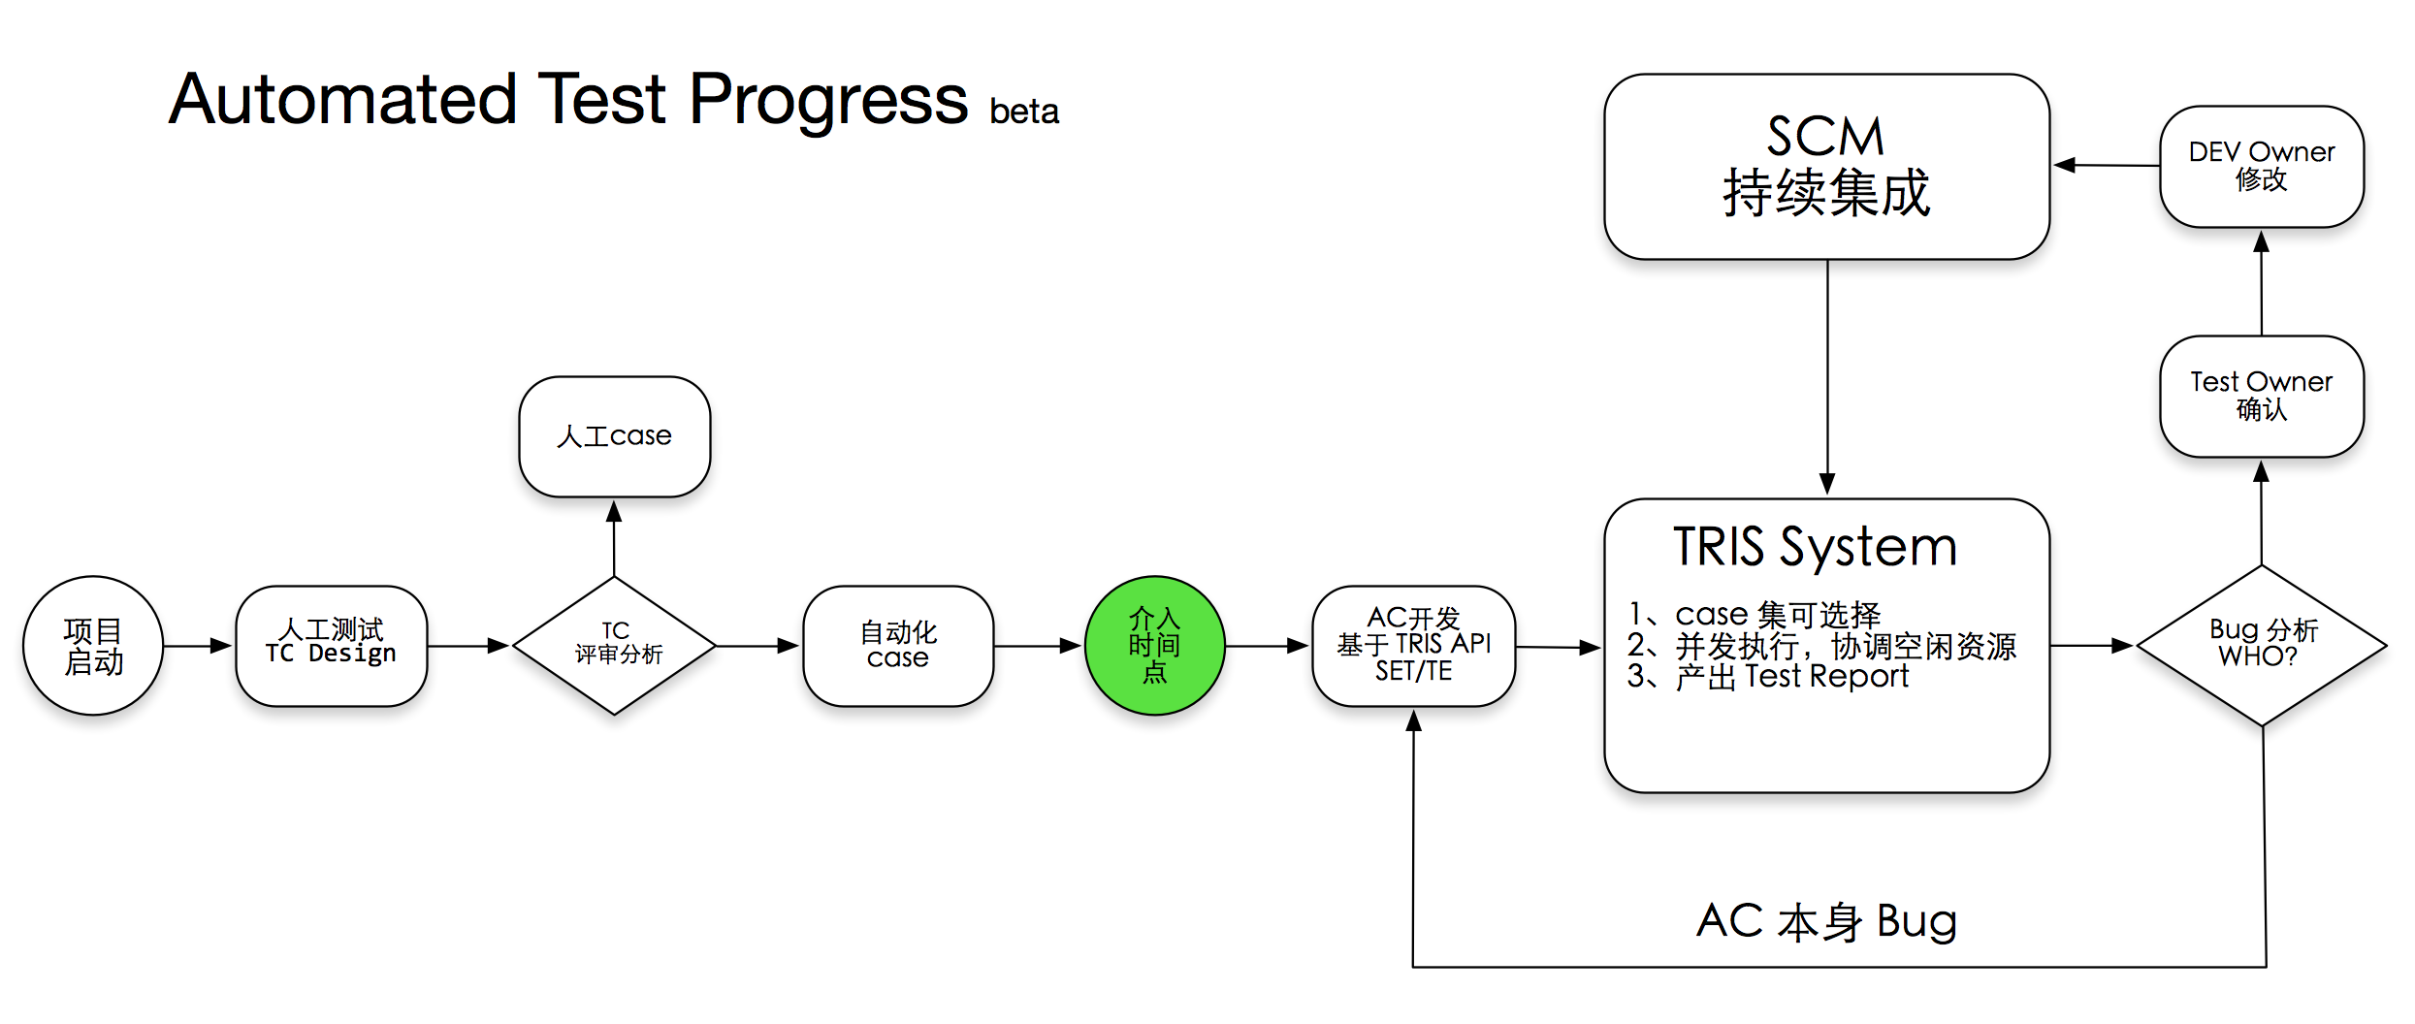

Slide 5
selenium-grid
Notes:
Selenium Grid是一种自动化的测试辅助工具，Grid通过利用现有的计算机基础设施，能加快Web-app的功能测试。利用Grid，可以很方便地同时在多台机器上和异构环境中并行运行多个测试事例。

Slide 8
Test Report
Web / Mail
Display Information
as-is
to-be
How to connect with Case Export

