Slide 1
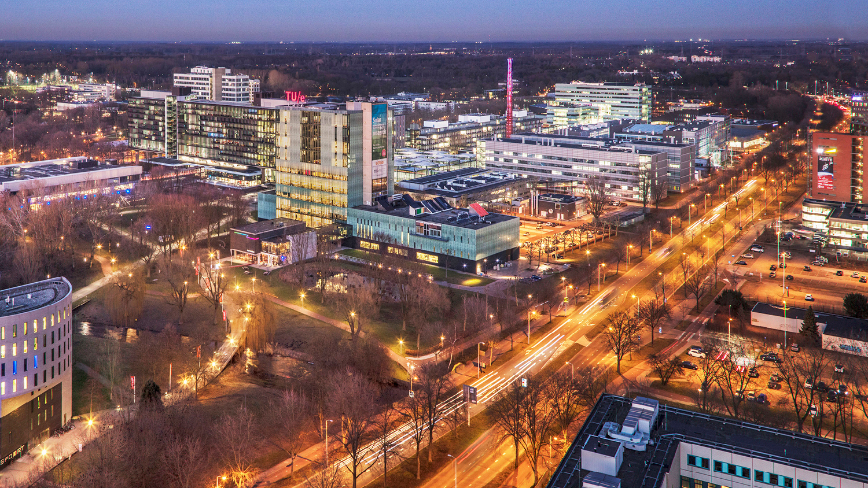
Locality-aware HSI classification
Fangqin Zhou Mert Kilickaya Joaquin Vanschoren

Slide 2
Introduction
Motivation: HyperSpectral Imaging (HSI) has been widely used in modern industries because it provides the opportunities to extract more detailed information from a number of wavebands in comparison to 3-channel RGB imaging. For instance, HSI has been used in agriculture to detect crop growing status changes according to their light abortion. More commonly, HSI has been applied in remote sensing to acquire information to distinguish different materials according to their light abortion. However, collecting hyperspectral data is challenging as it requires expensive hardware and time-consuming while good predicting models are usually data-hungry. Therefore, training a model with a small amount of hyperspectral data is desired. Convolutional Neural Networks (CNNs) have been proven to be powerful in extracting meaningful features from both spectral and spatial dimensions. However, due to the multi-band nature, hyperspectral data usually contains highly redundant information that requires a long-range reasoning and traditional CNNs usually fail in this continuous domain. To address this challenge, Vision Transformers (ViTs) have been widely used in vision tasks and have achieved remarkable outcomes. Hong et al have proved that ViT also outperforms CNNs in hyperspectral image classification task.

Slide 3
Related work
- Vision Transformer
- Hyperspectral Classification
- Locality in Computer Vision

Slide 4
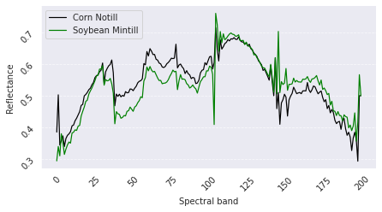
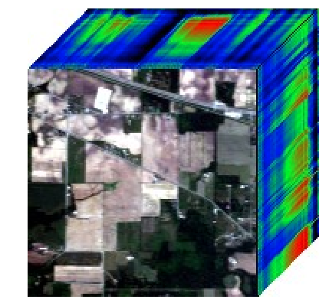
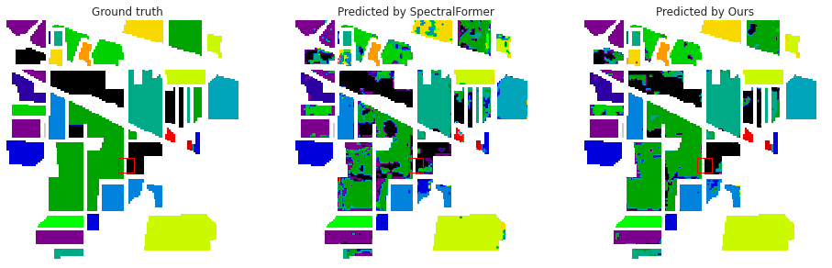
Motivation
(a)
(b)
True label: Soybean Mintill
Predicted as Corn Notill wrongly
Predicted as Soybean Mintill correctly

Slide 5
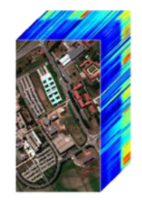

LAHIT
Local-Spectral Regularization
Spec_m
Embed
Class
MLP Head
Class Embed
Spec_1 Embed
…...
B x
Transformer Encoder with Cross-layer Adaptive Fusion (CAF)
FeedForward
CAF
LayerNorm
CAF
Block1
Block2
Block3
Block4
B x
…...
Spatial MHA
positional embedding
LayerNorm
m
class token
Linear Projection of Spatial Patches
Spectral MHA
LayerNorm
Patchify
1
2
3
m-2
m-1
m
…...
Each
patch
p*p
p*p
p*p
p*p
p*p
p*p
m * W * H
m * p * p

Slide 6
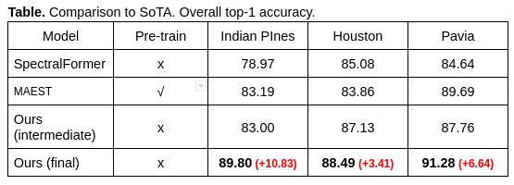
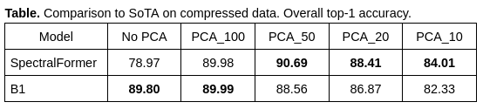
Experiment 1 - Comparison to SoTA
Our model has significant improvement for all three dataset.
Comparing to SoTA on compressed data.

Slide 7
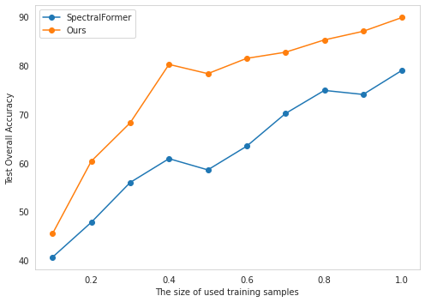
Experiment 1 - Comparison to SoTA
Comparison to SoTA on sub training samples.

Slide 8
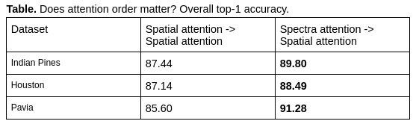
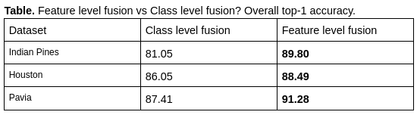
Experiment 2 – Ablation studies
Ablation 1: Does attention order matter? Yes, firstly performing spectra attention works better than firstly performing spatial attention.
Ablation 2: Does the stage of combing spatial and spectral features matter? Yes, early feature-level fusion which is our final model outperforms late class-level fusion which decomposes spatial and spectra features and combines their extracted embedding just before the final MLP head.

Slide 9
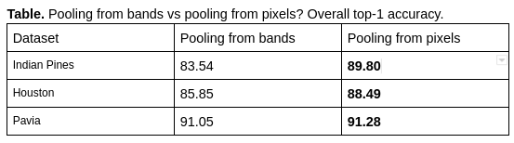
Experiment 2 – Ablation studies
Ablation 3: Pooling from spectral (band) dimension vs pooling from spatial (pixels) dimension.
- Pooling from pixels that is our final model works better than pooling from wavebands, which is reasonable because in the case of pooling from pixels, the global token aggregates information from all wavebands into patch embedding, while in the latter, the global token aggregates information from all pixels into band embedding.

Slide 10
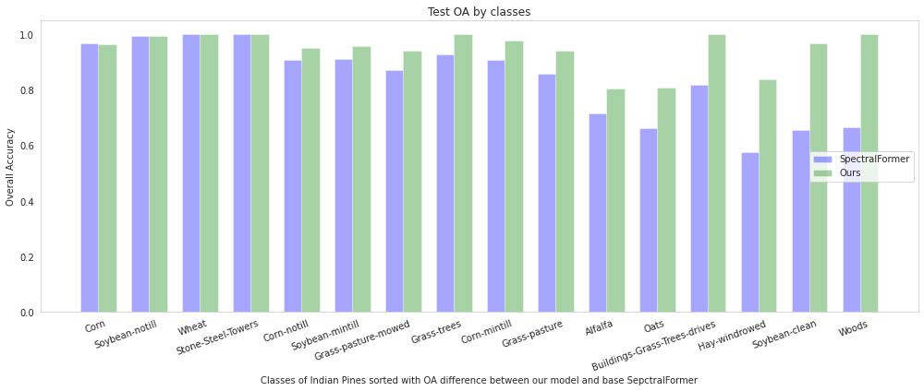
Experiment 3.1 – Improvement analysis
Comparing our model to SpectralFormer (SF) in predicting each class, except for ‘Corn’ that SF works slightly better, our model works better for other classes. Particularly, in terms of identifying woods, Soybean-clean and Hay-windrowed, our model reaches over 26% accuracy than SF.

Slide 11
Experiment 3.1 – Attention analysis
Attention maps

Slide 12
References
[1]. Detection of early blight and late blight diseases on tomato leaves using hyperspectral imaging.
[2]. Revisiting Deep Hyperspectral Feature Extraction Networks via Gradient Centralized Convolution. Roy et al. 2022.
[3]. Plant disease identification using explainable 3D deep learning on hyperspectral images. Nagasubramanian et al. 2019.
[4]. Residual Spectral–Spatial Attention Network for Hyperspectral Image Classification. Zhu et al. 2021.
[5]. Early Detection of Tomato Spotted Wilt Virus by Hyperspectral Imaging and Outlier Removal Auxiliary Classifier
Generative Adversarial Nets (OR-AC-GAN). 2019.
[6]. Wheat physiology predictor: predicting physiological traits in wheat from hyperspectralrefectance measurements using deep learning. Furbank et al.
[7]. Integrating Morphological and Physiological Responses of Tomato Plants to Light Quality to the Crop Level by 3D Modeling. J. Anja Dieleman et al. 2019.
[8]. Photosynthetic rate prediction model of newborn leaves verified by core fuorescence parameters. Zhang et al. 2020.
[9]. Improving GAN-based feature extraction for hyperspectral images classification. 2021.
[10]. Using hyperspectral leaf reflectance to estimate photosynthetic capacity and nitrogen content across eastern cottonwood and hybrid poplar taxa. 2022.
[11]. Multimodal GANs: Toward Crossmodal Hyperspectral–Multispectral Image Segmentation. 2021.
[12]. Spectral-Spatial Attention Networks for Hyperspectral Image Classification. Mei et al. 2019. https://github.com/EtPan/SSAN.
[13]. SpectralFormer: Rethinking Hyperspectral Image Classification With Transformers. 2021.
[14]. Learning A 3D-CNN and Transformer Prior for Hyperspectral Image Super-Resolution. 2021.
[15]. MST++: Multi-stage Spectral-wise Transformer for Efficient Spectral Reconstruction. 2022.
[16]. Summary: https://github.com/Yangzhangcst/Transformer-in-Computer-Vision
[17]. Attention-Based Adaptive Spectral-Spatial Kernel ResNet for Hyperspectral Image Classification 2021: https://github.com/suvojit-0x55aa/A2S2K-ResNet.
[18]. "FPGA: Fast Patch-Free Global Learning Framework for Fully End-to-End Hyperspectral Image Classification". 2020.
https://github.com/Z-Zheng/FreeNet.
[19]. Exploring Relationships between Canopy Architecture, Light Distribution, and Photosynthesis in Contrasting Rice Genotypes Using 3D Canopy Reconstruction. Alexandra J. Burgess et al. 2017.
[20]. Deep Learning and Hyperspectral Images Based Tomato Soluble Solids Content and Firmness Estimation. Xiang et al. 2022.
[21]. Hyperspectral Imaging Combined With Deep Transfer Learning for Rice Disease Detection. Feng et al. 2021.
[22]. Successive Projection Algorithm Robust to Outliers. Et al. 2019.
[23]. Using hyperspectral imaging to discriminate yellow leaf curl disease in tomato leaves. Zhu et al. 2018.
[24]. Generative adversarial networks for realistic synthesis of hyperspectral samples. Audebert et al. 2018.
[25]. Self-Attention Generative Adversarial Networks. Zhang et al. 2019.
[26]. Effective band selection of hyperspectral image by an attention mechanism-based convolutional network. Zheng et al. 2022
[27]. Spectral-Spatial Attention Network for Hyperspectral Image Classification. Sun et al. 2020.
[28]. Spectral–Spatial Self-Attention Networks for Hyperspectral Image Classification. Zhang et al. 2022.
TWINERGY

