Slide 1
Lahore Sewerage Pipeline and Terminal Discharge Station Project
Bid Initiation Report
Pakistan Branch
January 3, 2025

Slide 2
Reporting Content
(1) Project Introduction
(II) Bid Evaluation Rules and Bid Organization
(3) Competition and Risk Analysis

Slide 3
1
Project Introduction

Slide 4
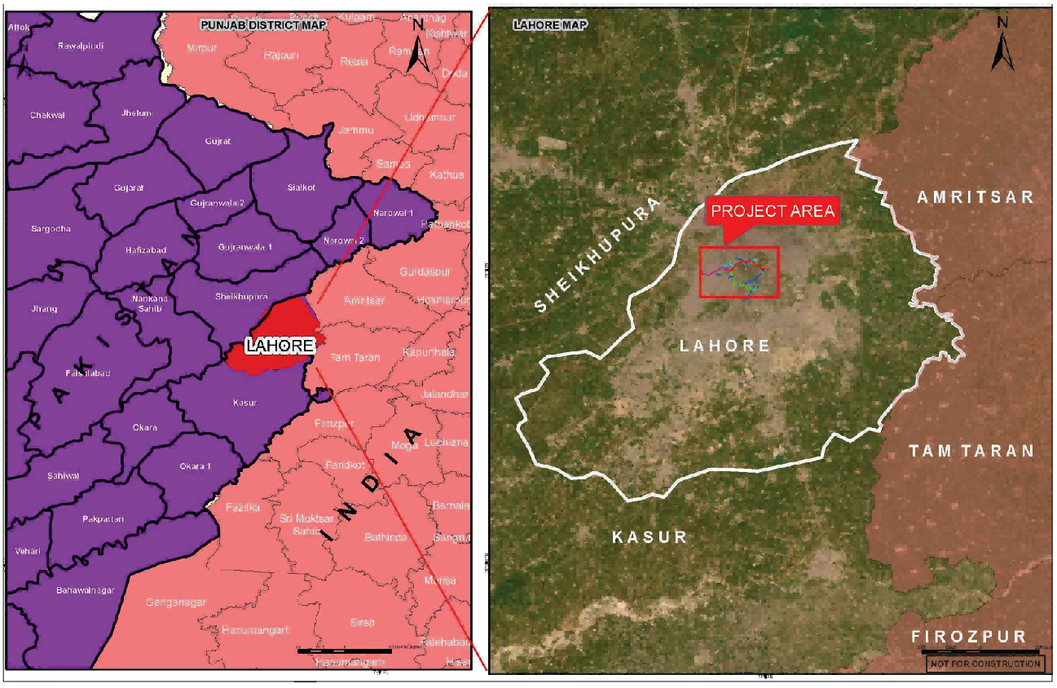
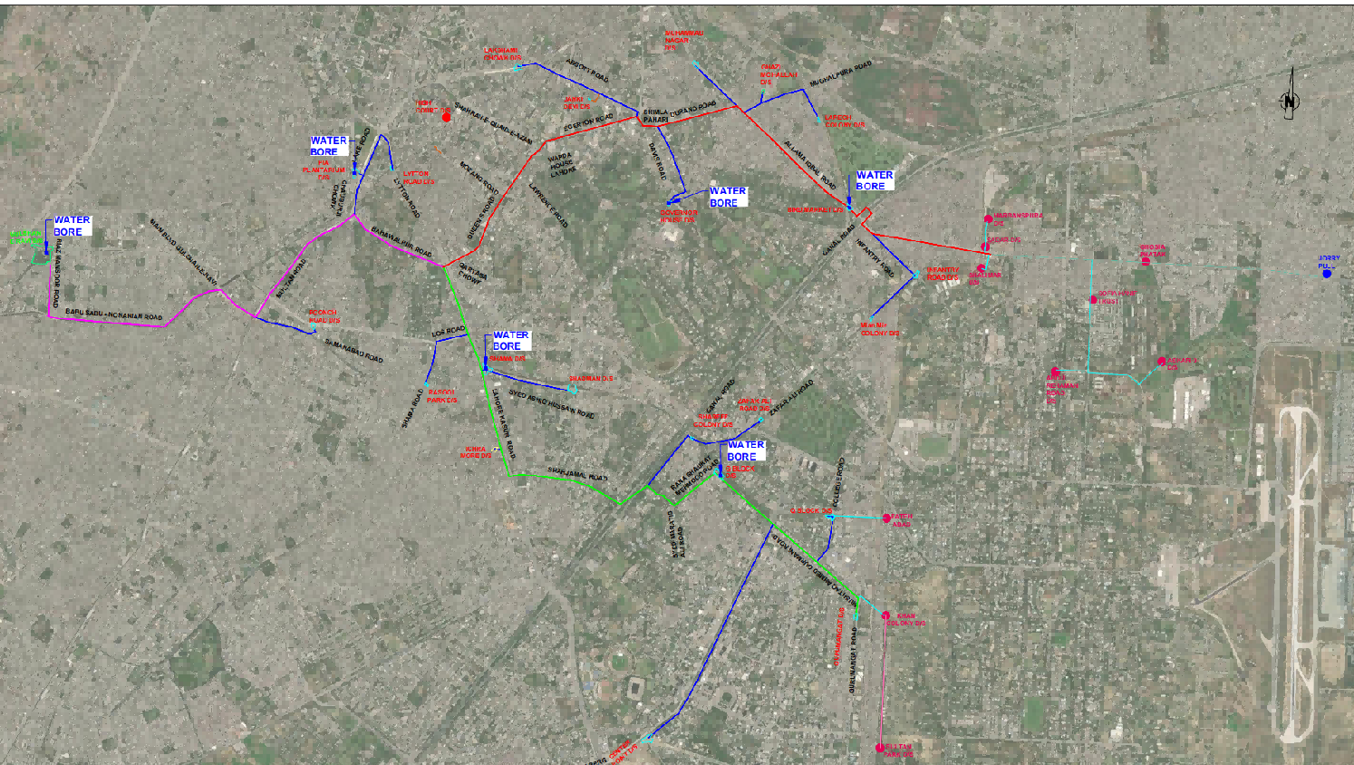
I. Project Overview - Basic Information
[Project Name] Lahore Sewer Pipeline and Terminal Discharge Station Project
[Project Owner] Lahore Water and Sanitation Authority (Government)
[Project Supervisor] Led by U.S.-based EBA Corporation, in consortium with three Pakistani companies.
[Project Location] Lahore, Punjab Province, Pakistan
[Estimated Contract Amount] USD 1.75 billion
[Source of Funds] Asian Infrastructure Investment Bank
[Scope of Work] Design and construction of a 32-kilometer concrete sewer pipeline, together with a terminal discharge station.
【Bidding Method】 International Open Bidding + Post-qualification Review
【Bid Submission Date】 January 29, 2026

Slide 5
I. Project Overview - Commercial Terms
Contract Type | EPC General Construction Contract
Use Contract | FIDIC EPC Silver Book 2017 Edition (Revised and Reissued in 2022)
Construction period | 30 months (including 6 months for design)
Bid Bond | 150 US dollars
Advance Payment Guarantee | 20%
Performance Bond | 10%
Warranty deposit ratio | 5%
Warranty Period | 365 days
Late Payment Penalty | Design phase: 1% per day; Construction phase: 0.05% per day, with a cap of 10%.
Foreign currency payment | Up to 50% of payments may be made in foreign currency.
Minimum Pricing Amount | 3% of the contract amount
Pricing Period | 56 days
Price Adjustment | Sixty percent of the rupee portion is adjustable (cement, reinforcing steel, diesel fuel, and labor). Thirty percent of the foreign currency portion is adjustable (foreign labor, stainless steel, HDPE lining).
Contingency Fund | 39 Rupees (equivalent to US$14 million)
DAAB | The International Chamber of Commerce Arbitration Rules shall apply. The arbitral tribunal shall consist of three members, and the seat of arbitration shall be Dubai or London.
Bid Qualification | International open tender, post-qualification review
Applicable Law | Pakistani Law

Slide 6
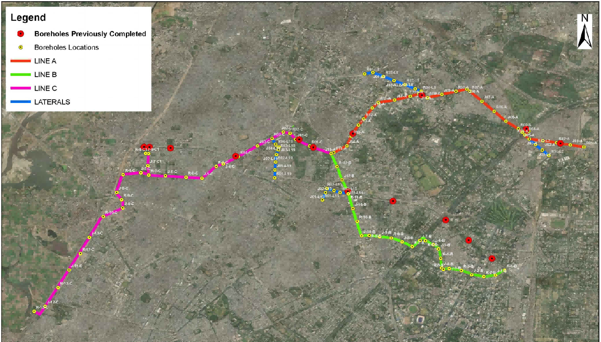
I. Project Overview - Major Scope of Works (Organized by Route)
Line | Start and end positions | Pipe diameter (mm) | Length (km)
Red Line | LARECHS Colony to Qartaba Chowk | 1050, 1500, 2400 | 12.14
Green Line | Gurumangat Road to Qartaba Chowk | 1050, 1500, 2400 | 12.82
Pink line | Qartaba Chowk to Gulshan-e-Ravi (Drainage Station) | 1050, 3500 | 7.25

Slide 7
I. Project Overview - Major Scope of Works (Categorized by Pipe Diameter)
Pipe inner diameter (mm) | Cumulative Mileage (m) | Maximum spacing of working shafts (m) | Pipe jacking machine
1050 | 9837 | 190 | 2 units
1500 | 5454 | 250 | 1 unit
2400 | 11582 | 350 | 2 units
3500 | 5337 | 500 | 1 unit
450-750 | 8480 | Adopt the open-cut method.
A total of 32.2 kilometers of pipe jacking, 8.48 kilometers of open-cut excavation, and 165 working shafts have been completed.

Slide 8
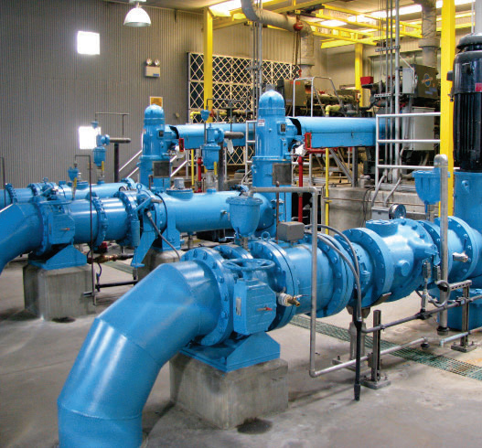
I. Project Overview - Main Scope of Works
Terminal Emission Station:
848 cusec (24 cubic meters per second)
The head regulating gates of the intake structures, filtration chambers, wet wells, dry wells, distribution wells, effluent pipelines, diversion channels, and discharge channels, as well as the associated ancillary works.
SCADA system
450kW photovoltaic system

Slide 9
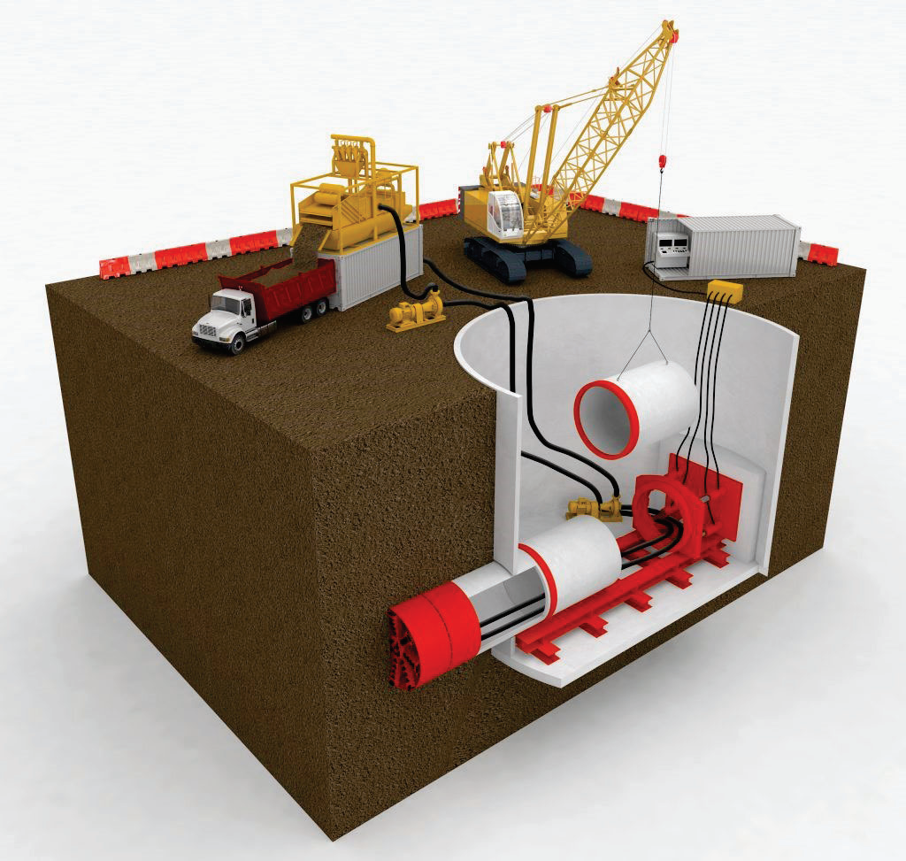
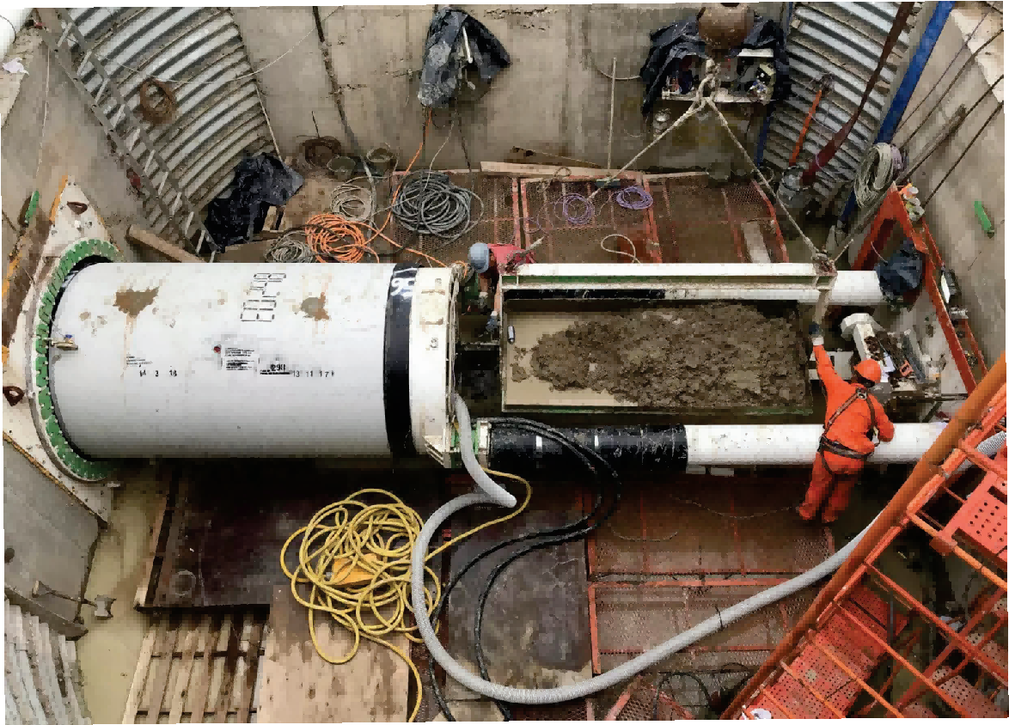
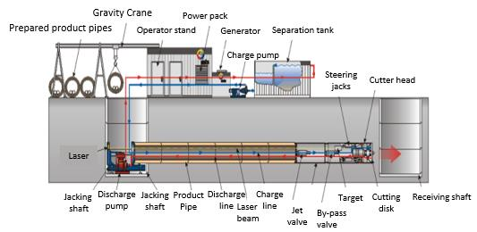
I. Project Overview - Construction Technology
Pakistan’s first municipal pipeline project to employ pipe-jacking construction:
【Working Shaft Depth】There are 165 working shafts, with depths ranging from 8 to 20 meters.
[Geological Conditions] The Indus River alluvial plain features a flat topography. The surface layer is predominantly silty clay and clay, ranging from soft plastic to hard plastic, with a thickness of 0–7m. The pipe-jacking working stratum is mainly composed of sandy soils, interbedded with some silt and a small amount of gravel, slightly wet to saturated, and ranging from medium dense to dense. No groundwater was observed along the red line and green line (25km); however, in certain sections along the pink line (7.2km), the groundwater depth ranges from 12 to 20 meters.
[Existing Facilities] The existing underground facilities have been clearly identified on the drawings; construction may result in traffic disruptions.

Slide 10
II
Evaluation Criteria and Bid Organization

Slide 11
II. Bid Evaluation Rules and Bid Organization
Evaluation Criteria:
Under the two-envelope, single-stage procedure, only those bidders whose technical proposals have been approved shall proceed to the financial proposal stage; in principle, the bidder submitting the lowest evaluated financial proposal shall be awarded the contract.
Technical Proposal Passing Criteria: The maximum score is 100 points; a total of 65 points or higher is required to pass, with scoring conducted in accordance with the tender’s established evaluation criteria.
Technical Proposal Scoring Method: Performance [Quantity Weight] multiplied by [Quality Weight]
The financial bid shall not be less than 20% of the Engineer’s budgeted price.

Slide 12
II. Bid Evaluation Rules and Bid Organization
Bidding Organization:
[Lead Partner of the Consortium] Bids in the name of the consortium; China State Construction Engineering Corporation serves as the lead partner, holding a 51% stake, and is responsible for organizing the bidding process, coordinating with embassies, consulates, and the employer, preparing the quotation, assembling and submitting the bid documents, and other related tasks.
[Consortium Partner] China Railway Long Engineering Group Co., Ltd., holding a 49% stake
[Design Specialty Subcontract] Shenzhen Municipal Design Institute Co., Ltd.
Shanghai Municipal Engineering Design & Research Institute (Group) Co., Ltd.
[Equipment Supplier] China Railway Construction Heavy Industry Co., Ltd. (tentative; subject to price comparison)

Slide 13



II. Bid Evaluation Rules and Bid Organization
China Railway Long Engineering Group
Shenzhen Municipal Institute
Shanghai Municipal Institute
Founded in 1998, this engineering general contractor specializes in rail transit, water environment management, and urban renewal. It holds Grade-I municipal general contracting qualifications and is a subsidiary of Shandong High-Speed Group.
Form a joint venture with China Railway Construction Corporation, with China Railway Construction Corporation holding 51% and China Railway Longyuan Engineering Group Co., Ltd. holding 49%, and issue an equal-amount performance bond.
Primarily responsible for providing construction performance records, preparing technical proposals, and supplying quotation references.
Founded in 1984, the company specializes in design, survey, and consulting services for transportation infrastructure, municipal projects, landscaping, and underground spaces. It holds a Class-A comprehensive qualification for engineering surveys and is a subsidiary of Shenzhen Metro Group.
As a design specialist subcontractor of the joint venture
Primarily responsible for preparing the pipe-jacking design scheme and assisting in the preparation of the technical proposal.
Founded in 1954, the company’s core businesses are engineering design consulting, engineering general contracting, and project management, and it holds a Class-A comprehensive qualification for engineering surveying.
As a design specialist subcontractor of the joint venture
Primarily responsible for preparing the design scheme for the terminal emission station and assisting in the preparation of the technical proposal.

Slide 14
II. Evaluation Criteria and Bid Organization
Performance Category | Performance Requirements | Providing Entity | Performance Project
Construction Performance | Pipe-jacking construction performance | China Railway Long | Wuhou District “Livability Waterfront” Phase I PPP Project Longquanyi District Xijiang River Basin Water Environment Comprehensive Improvement Project Phase II PPP Project West River Wastewater Treatment Plant No. 2 Project
 | Pump Station Construction Performance
Design Performance | Pipe-jacking design performance | Shenzhen Municipal Government | EPC General Contracting Project for the Main Drainage Pipeline Network around Fengqi Road in the Xixian New Area Energy, Finance, and Trade Zone Survey and Design for the Chengdu Ring Expressway Water Conveyance Pipeline Project (Chengluo Road–Chuanshan Road)
 | Pump Station Design Performance | Shanghai Municipal Government | Yangpu District Minxing South Drainage System Renovation Project New Construction Project for the Miaopeng Drainage System Yunling West Drainage System Project
General Performance | General engineering contracting performance and similar performance. | China-Turkey | Kafu River Water Supply Project Tanzania Sengerema Water Supply Project

Slide 15
Three
Competition and Risk Analysis

Slide 16
III. Competition and Risk Analysis
Potential Competitors:
State-owned enterprises such as China Energy Construction, China Road & Bridge Corporation, and China Power Construction: possess strong commercial capabilities, extensive experience in relevant fields, and begin preparing their bids at an early stage.
Turkish company: Strong commercial capabilities and flexible tendering operations.
Our Joint Venture:
Prior to tendering, the contractor shall also possess robust commercial management capabilities.
In collaboration with leading domestic design firms and engineering companies with extensive implementation and management expertise, we are capable of preparing high-quality technical proposals.
China National Petroleum Corporation has deeply cultivated the Pakistani market and, compared with other central state-owned enterprises, possesses a more thorough understanding of bidding for commercial competitive projects in Pakistan. It currently has multiple ongoing projects in Lahore, supported by an established management team and dedicated equipment, and maintains insight into local material supply dynamics, enabling it to prepare financially competitive bids.

Slide 17
III. Competition and Risk Analysis
Risk Category | Risk Description | Risk Level | and response measures
Safety Risk | Lahore is classified as an orange-risk area, not a terrorism-affected region, and is friendly toward Chinese-invested enterprises and Chinese nationals; however, it does entail risks related to public security, traffic, and construction safety. | China | Prior to bidding, conduct on-site inspections, develop a scientifically sound and feasible security plan, coordinate with local military and police authorities to allocate security personnel, and include the full amount of security costs in the bid price. Should the project be awarded, strictly implement the safety-assurance measures prescribed by higher-level authorities and relevant local departments; carry out construction-safety training, oversight, and corrective actions; and ensure that, with adequate security measures in place, overall safety risks remain under control.
Compliance Risk | Pakistan is a high-risk country, and the project is financed by the Asian Infrastructure Investment Bank, which entails risks related to bid compliance. | High | Strictly comply with the relevant compliance procedures of the Ministry of Commerce, the National Development and Reform Commission, the joint-stock company, and the group company; standardize and supervise the bidding activities of cooperating parties to ensure bid compliance.
Technical and Environmental Risks | This project marks the first municipal infrastructure undertaking in Pakistan to employ pipe-jacking technology. Although this technology is well-established domestically, in Pakistan it may face challenges such as inaccuracies in geological and hydrological data, mismatches between equipment and ground conditions, the protection and relocation of existing utilities, and environmental risks. | China | 1. Conduct a thorough review of the geological and hydrological surveys, and supplement with high-density exploration if necessary; 2. Customize key components of the equipment based on the composite strata, stock sufficient spare parts, and ensure proper maintenance; 3. Verify existing underground utilities with the relevant authorities, prepare and submit special protection or relocation plans along with emergency response plans, and carry out construction in designated zones and phases.
Cost Risk | Material price fluctuations and the risks arising therefrom. | High | 1. Utilize contractual provisions such as foreign exchange rate adjustments and price escalation clauses to prepare unbalanced bid prices; 2. Optimize the construction organization plan and procurement schedule, ensure safety and quality, and allow for schedule buffers; 3. Leverage change orders and claims to enhance project profitability.

Slide 18
III. Competition and Risk Analysis
Filing Category | Current Progress | Remarks
Support Letter from the Commercial Section | Completed | 10 On the 24th of the month, an application was submitted to the Commercial Section. 11 Received the letter of support on the 30th of the month.
Shareholding Company Filing | Submitted and under review. | The initial registration was rejected; after obtaining a letter of support, a second registration application was submitted.
Ministry of Commerce Filing | Submitted and under review. | 12 Filed for record on the 1st of the month, 12 On the 5th and 17th of the month, supplementary supporting materials were submitted as requested by the Ministry of Commerce.
NDRC filing | Filed and registered | As a project with a contract value exceeding USD 100 million, it shall be filed as required.

Slide 19
Thank you for listening.
Please kindly provide your instructions.

