Slide 1
03
Introduction to the linear system analyzer app

Slide 2
Description to the Linear System Analyzer App
The Linear System Analyzer app lets you analyze time and frequency responses of LTI systems.

Slide 3
Fuction of the Linear System Analyzer App
04
03
02
01
Inspect key response characteristics, such as rise time, maximum overshoot, and stability margins.
Generate frequency response plots such as Bode, Nyquist, Nichols, singular-value, and pole-zero plots.
Generate time response plots such as step, impulse, and time response to arbitrary inputs.
View and compare the response plots of SISO and MIMO systems, or of several linear models at the same time.

Slide 4
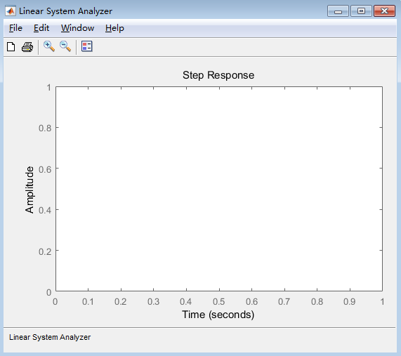
The method of open the app
1. On the Apps tab, under Control System Design and Analysis, click the app icon.
2.MATLAB command prompt: Enter ltiview

Slide 5
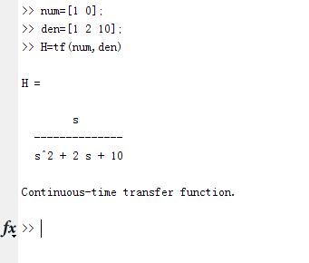
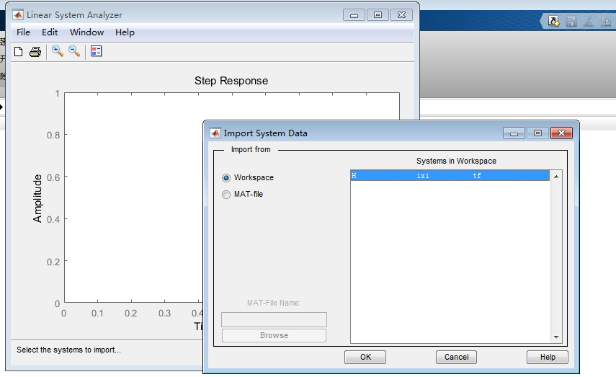
Related Examples
1.Build a transfer function model
2.Import H to the linear system analysis

Slide 6
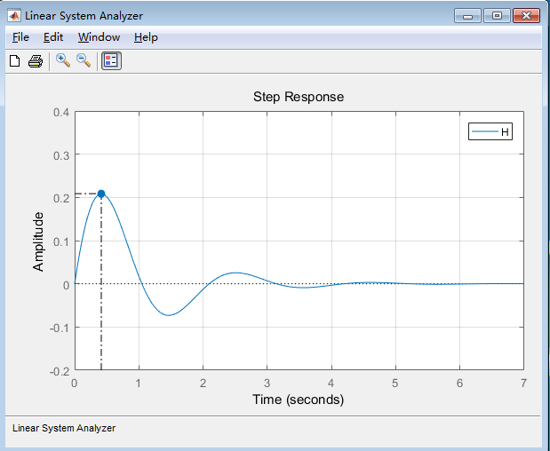
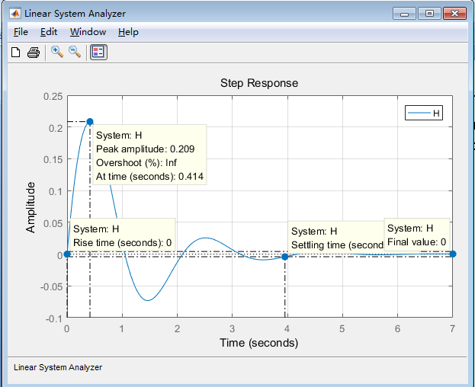
Related Examples
From this step response,you can set characteristics to get peak response、setting time 、rise time and stead state.

Slide 7
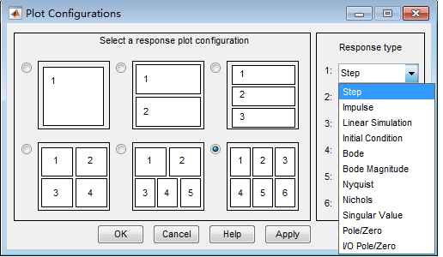
Related Examples
3.You can add more plots to the Linear System Analyzer:
Select Edit > Plot Configurations.
In the Plot Configurations dialog box, select the number of plots to open.

Slide 8
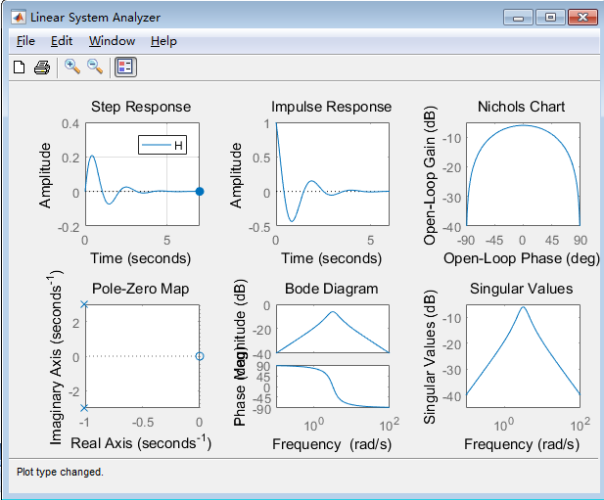
Related Examples
From those pictures.we can get Nichols chart、bode diagram 、pole-zoro map and the like.based on this ,we can judged the stability of the system.

