Slide 1
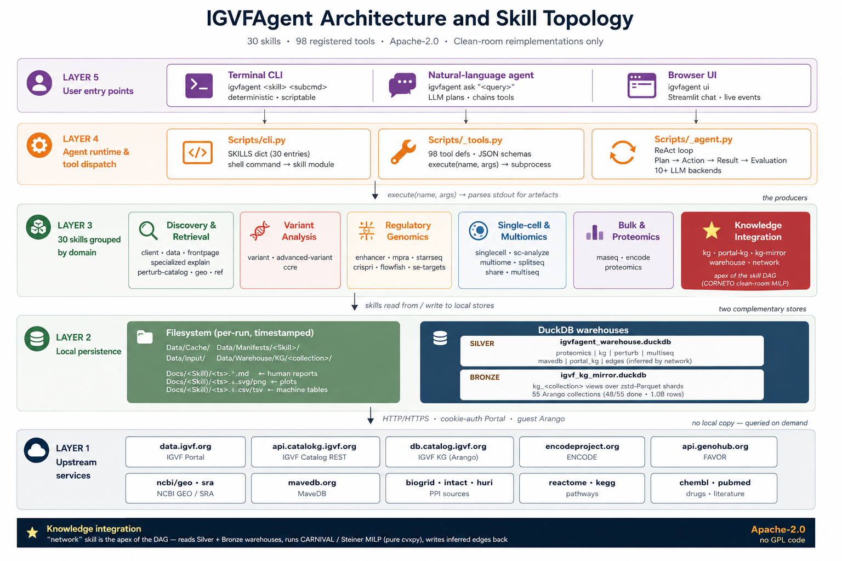
IGVF Agent
An auditable, locally deployable research agent for analysis across federated functional-genomics resources
Hufeng Zhou¹, Yichun He², Daofeng Li³, Junhao Zhu¹, Xihao Li⁴, Xingxin Pan⁵, Alvin Zhang¹, Vineet Verma¹, Ting Wang³, Zhiping Weng⁶, Tianxi Cai⁷, Jesse Engreitz⁸, William H. Majoros⁹, S. Stephen Yi⁵, Xihong Lin¹²
¹Harvard T.H. Chan School of Public Health · ²Broad Institute · ³Washington University · ⁴UNC Chapel Hill · ⁵UT Austin / Baylor · ⁶UMass Chan · ⁷Harvard Medical School · ⁸Stanford · ⁹Duke
52
158
21
77
6
analysis skills
typed LLM tools
benchmarked studies
machine-checked criteria
federated archives
The problem
Capabilities
Variant-to-function research now spans IGVF, ENCODE, GEO, CELLxGENE, HCA and Zenodo — archives that differ in schema, identifiers, metadata standards and access mechanisms.
The rate-limiting step has shifted from the availability of data to the labour of integrating it: even a focused question — which enhancers regulate PCSK9 in hepatocytes — needs custom scripts to search, harmonise, retrieve and track provenance across several repositories.
LLM agents are a credible response, but most are bound to one vendor, route credentials through opaque cloud services, or expose a single archive. None of those is usable for controlled-access data.
Discovery and retrieval · variant interpretation · regulatory genomics · single-cell and multiome · bulk and proteomic analysis · cross-resource integration
Assay-aware reimplementations
Clean-room implementations of the canonical published pipeline for each major assay — MPRA, STARR-seq, CRISPRi Flow-FISH, SHARE-seq, VAMP-seq deep mutational scanning, MULTI-seq — written to one provenance and plotting framework under a single permissive licence.
Network integration
CARNIVAL signed MILP and prize-collecting Steiner tree, reimplemented from the published formulations, composing the outputs of several skills into one mechanistic inference.
Design
1. Explicit commands, not generated code
Every agent action is a typed, recorded command drawn from a fixed repertoire — never free-form code. A session therefore reduces without loss to a re-runnable script.
2. Local execution
Tools run as subprocesses in the investigator's environment. Endpoints and credentials resolve at runtime, so the released code is the deployed code.
3. Two-way drivability
Each capability is simultaneously a shell command and an LLM-callable tool with identical semantics, so exploration and the archived pipeline execute the same code.
4. Backend agnosticism
One routing layer drives hosted APIs, self-hosted open-weight models, or an external coding CLI without touching analysis code.
Evaluated in three tiers
An agent fails in three independent ways, and one aggregate score conceals which occurred.
Tier 1 — skill correctness. 21 studies, 77 machine-checked criteria. Fixed command sequences with no model in the loop: this establishes that the implementations are right, not that the agent would select them.
Tier 2 — planning. Tool selection, argument binding and ordering scored against a gold plan, with deliberate tool failures to test recovery.
Tier 3 — conclusion validity. An independent verifier judges each claim supported, unsupported or contradicted by the artefacts — without seeing the reasoning that produced it.
Reported honestly: of 21 benchmarks, 7 assert a derived scientific quantity; the rest establish retrieval or artefact generation. Calling them all “reproductions” would overstate the weakest.
Result: the multiome corpus
A cross-archive survey resolved 401 datasets / 3,837 files / 14.19 TB across six archives in ~20 minutes on a workstation.
Of that, ~12.5 TB is raw reads and alignments recoverable from primary data. The analysis-ready fraction — count matrices, fragment files, cell annotations — is ≈1.04 TB.
That the union of publicly available multiome data collapses to a roughly one-terabyte analysis-ready corpus brings assembly of a single-cell foundation-model training set within reach of an individual laboratory.
Reproducibility, stated precisely
Auditability is a property of the record: every action is a typed command, recorded with arguments, artefacts and a consistency fingerprint. This holds in general.
Repeatability is a property of execution: pinned command sequences reproduce artefacts exactly; free-form planning does not, and neither survives an upstream re-release.
Validity is a property of the conclusion, and is the open problem — agreement metrics measure whether two runs concur, which two identically mistaken runs also satisfy.
Five-layer architecture: entry points → agent runtime and tool dispatch → skills by domain → local persistence → upstream archives.
Growing knowledge graph
Every retrieval feeds a local graph. Result tables are parsed and their rows become entity-to-entity edges — variant → gene, element → gene, gene → pathway, protein ↔ protein — carrying score, source and method.
The graph therefore accumulates across sessions rather than resetting: repeat questions are answered locally, and evidence gathered for one analysis is available to the next.
Extensible by its users
New capabilities do not require touching core code. A tool manifest or a Python skill dropped into an extension directory is absorbed into the registry with no restart, appearing simultaneously as a shell command and an LLM-callable tool.
The agent can author these itself: asked for a capability that does not exist, it writes the implementation and registers the matching typed interface in one step, then calls it.
Each skill is described by a machine-readable skill card — identity, version, typed interfaces, upstream archives, and a validation status derived from the benchmark suite rather than asserted — so skills can be version-pinned and consumed by systems other than this agent.
Worked example
“Functionally annotate these variants and add them to the knowledge graph”
25 APOB stop-gain variants, pasted in any notation (chr-pos-ref-alt, rsID, SPDI, HGVS, VCF — mixed freely).
→ annotated against FAVOR and the IGVF Catalog, with live ClinVar taking precedence over FAVOR's snapshot
→ 25 variant nodes, 7 gene edges, 24 disease edges, 6 regulatory-element edges written to the local graph
→ an APOB depth-2 traversal returns 19 nodes and 47 edges spanning variant, gene, disease and regulatory element
Cross-source verification matters: for one variant FAVOR's snapshot reports Benign / hypercholesterolaemia while current ClinVar reports Pathogenic / hypobetalipoproteinaemia — opposite significance and opposite direction of effect.
Deployment and privacy
Three interchangeable interfaces — command line, browser UI, conversational agent — over one shared contract.
Backends span hosted APIs, self-hosted open-weight models (Ollama, vLLM, TGI) and external coding CLIs. Analysis code is identical across all of them.
Stated precisely: tool execution is local, and endpoints and credentials resolve at runtime. Inference is local only when a locally served model is used, and federated data access contacts public archives under every backend — so a local model keeps the prompt local rather than eliminating egress.
github.com/zhouhufeng/IGVFagent · igvfagent.genohub.org · Apache-2.0
IGVFagent v0.2.9 · open source, installable with pip · runs on hosted APIs or entirely on local models

