Slide 1

Use of Connect API in ODT CAAElecConnect

Slide 2

In brief about this Presentation
The further slides show various steps in the Use Case "CAAElecConnect".
The steps show how the APIs ‘Connect’ and ‘Disconnect’ are used on different Devices.
The slides depict snaps of Electrical Devices being connected and disconnected from each other leading to a complete assembly at the end.
Any developer working further on this topic, if finds bugs or adds new APIs which will call for adding new cases, is encouraged to append a snap of that particular( if possible simplified) data in this ppt.
  Ofcourse, he/she has to add that particular Case in the ODT as well.

Slide 3
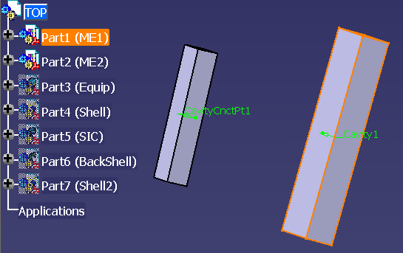
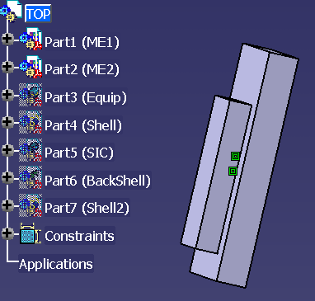
Step 1
(Connect MountingEquipment1 to MountingEquipment2)

Slide 4
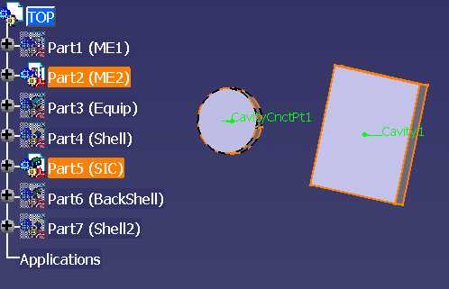
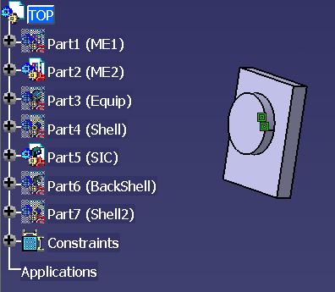
Step 2
(Connect SIC to MountingEquipment2)

Slide 5
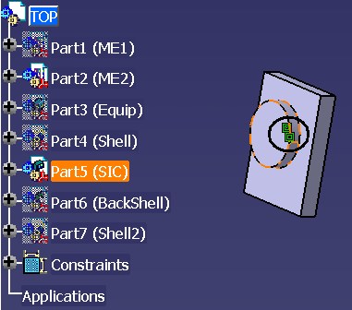
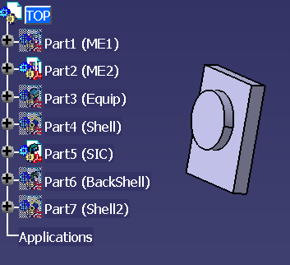
Step 3
(Disconnect SIC from MountingEquipment2)

Slide 6
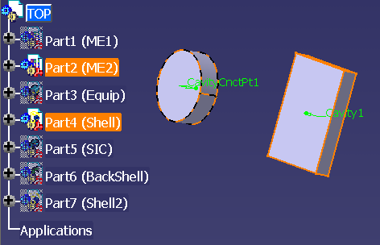
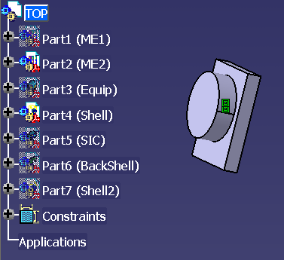
Step 4
(Connect Shell to MountingEquipment2)

Slide 7
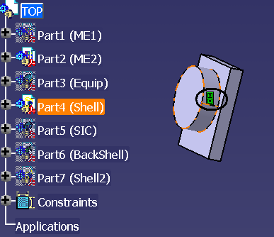
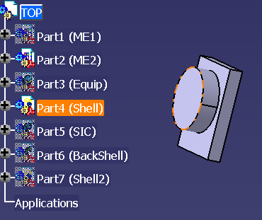
Step 5
(Disconnect Shell from MountingEquipment2)

Slide 8
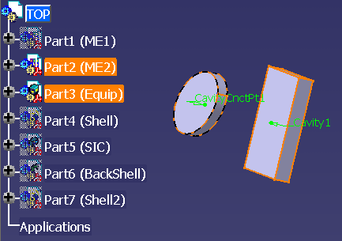
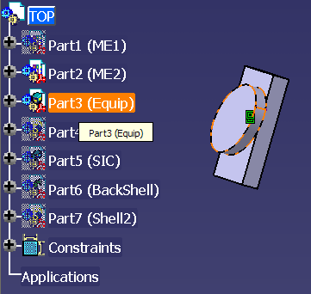
Step 6
(Connect Equipment to MountingEquipment2)

Slide 9
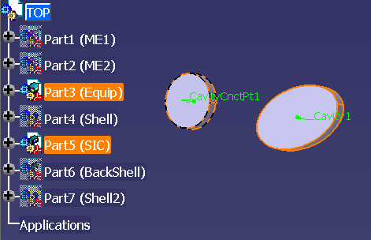
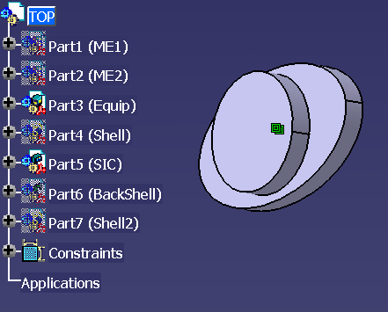
Step 7
(Connect SIC to Equipment)

Slide 10
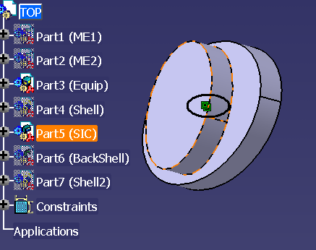
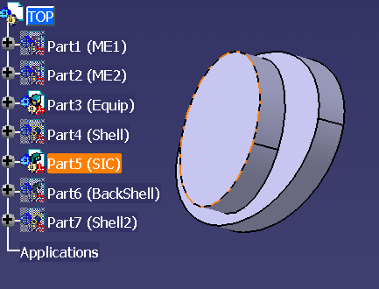
Step 8
(Disconnect SIC from Equipment)

Slide 11
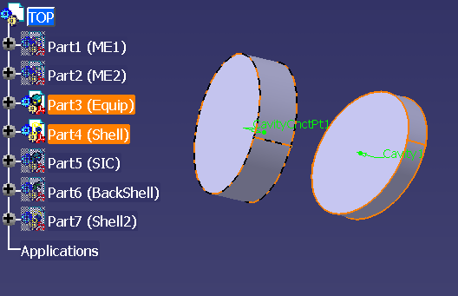
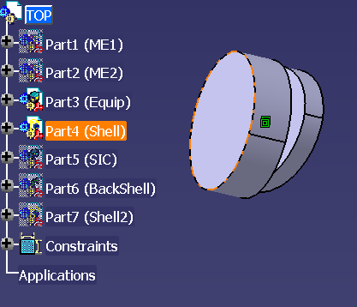
Step 9
(Connect Shell to Equipment)

Slide 12
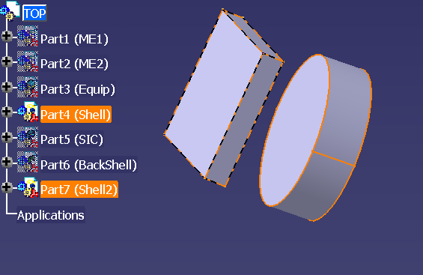
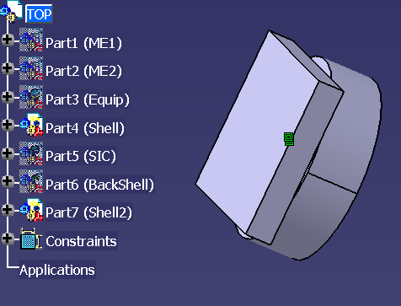
Step 10
(Connect Shell to Shell2)

Slide 13
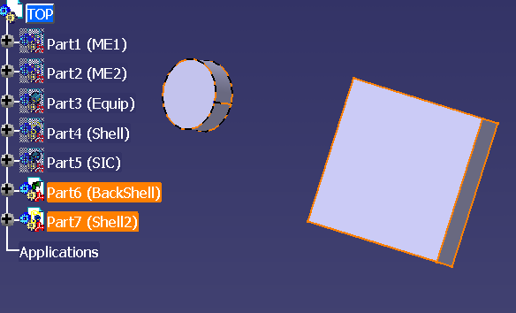
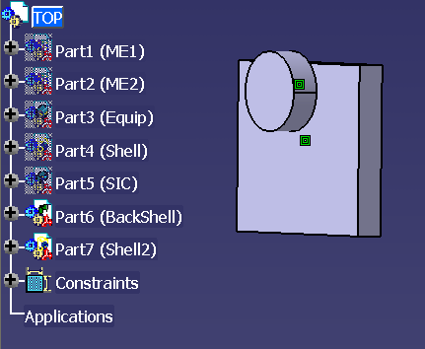
Step 11
(Connect BackShell to Shell2)

Slide 14
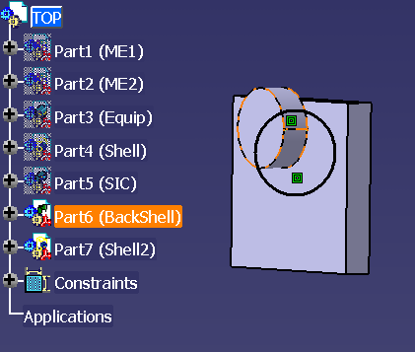
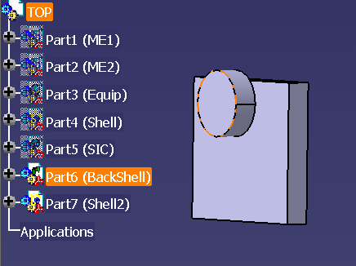
Step 12
(Disconnect BackShell from Shell2)

Slide 15
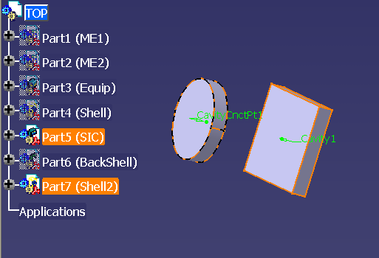
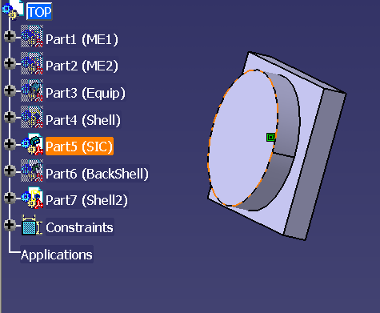
Step 13
(Connect SIC to Shell2)

Slide 16
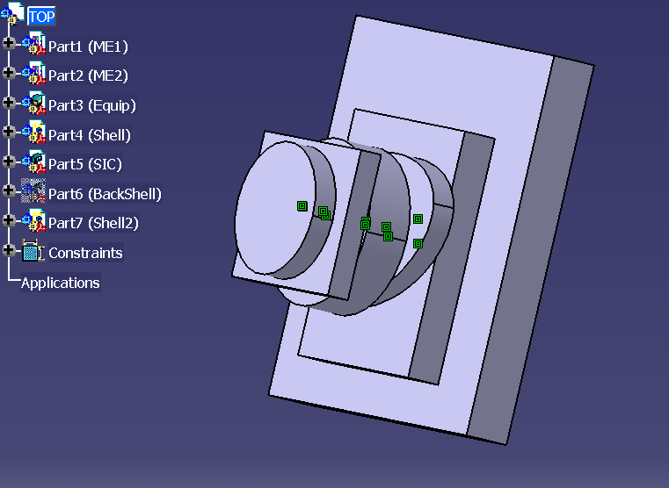
Final Assembly
Devices Connected together using “Connect” APIs

