Slide 1
The Graph-Parallel Abstraction
A user-defined Vertex-Program runs on each vertex
Graph constrains interaction along edges
Using messages (e.g. Pregel [PODC’09, SIGMOD’10])
Through shared state (e.g., GraphLab [UAI’10, VLDB’12])
Parallelism: run multiple vertex programs simultaneously

Slide 2
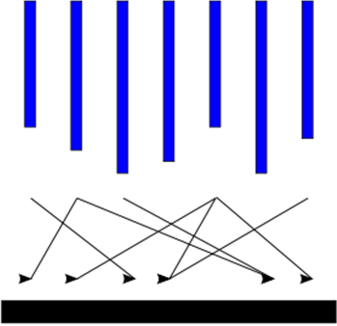
Computation Model (1/4)
Input
Supersteps
(a sequence of iterations)
Output
Source: http://en.wikipedia.org/wiki/Bulk_synchronous_parallel

Slide 3
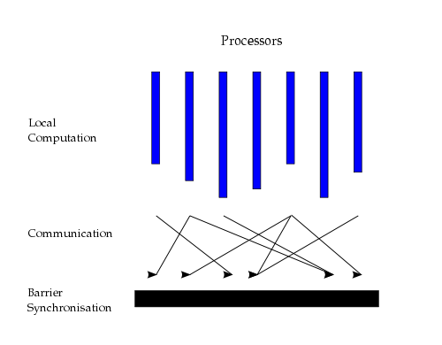
Computation Model (2/4)
Source: http://en.wikipedia.org/wiki/Bulk_synchronous_parallel
Notes:
A BSP computer consists of processors connected by a communication network. Each processor has a fast local memory, and may follow different threads of computation. A BSP computation proceeds in a series of global supersteps. A superstep consists of three components:
Concurrent computation: Several computations take place on every participating processor. Each process only uses values stored in the local memory of the processor. The computations are independent in the sense that they occur asynchronously of all the others.
Communication: The processes exchange data between themselves. This exchange takes the form of one-sided put and get calls, rather than two-sided send andreceive calls.
Barrier synchronisation: When a process reaches this point (the barrier), it waits until all other processes have finished their communication actions.
The computation and communication actions do not have to be ordered in time. The barrier synchronization concludes the superstep.

Slide 4









Example
Depends on the popularity their followers
Depends on popularity of her followers
What’s the popularity
of this user?
Popular?

Slide 5
PageRank Algorithm
Rank of user i
Weighted sum of neighbors’ ranks
Update ranks in parallel
Iterate until convergence

Slide 6
The Pregel Abstraction
Vertex-Programs interact by sending messages.
Pregel_PageRank(i, messages) :
// Receive all the messages
total = 0
foreach( msg in messages) :
total = total + msg
// Update the rank of this vertex
R[i] = 0.15 + total
// Send new messages to neighbors
foreach(j in out_neighbors[i]) :
Send msg(R[i] * w_{ij}) to vertex j
i
Malewicz et al. [PODC’09, SIGMOD’10]

Slide 7
System Architecture
Pregel system also uses the master/worker model
Master
Coordinates worker
Recovers faults of workers
Worker
Processes its task
Communicates with the other workers
Temporary data is stored on local disk
Notes:
Google cluster architecture consists of thousands of commodity PCs organized into racks with high intra-rack bandwidth. Clusters are interconnected but distributed geographically.

Slide 8
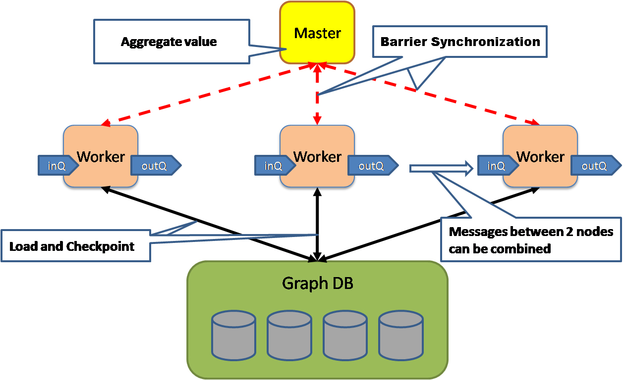
Pregel Execution
http://java.dzone.com/news/google-pregel-graph-processing
Notes:
Messages are sent asynchronously, to enable overlapping of computation, communication and batching.
This step is repeated as long as any vertices are active or any messages are in transit.
After the computation halts, the master may instruct each worker to save its portion of the graph.

Slide 9
Execution of a Pregel Program
Steps of Program Execution:
Copies of the program are distributed across all workers
1.1 One copy is designated as a master
Master partitions the graph and assigns workers their respective partition(s) along with portions of the input
Master coordinates the execution of supersteps and delivers messages among vertices
Each worker may be instructed to save its portion of the graph

Slide 10
分布式系统课程作业
演示：显示数据是存储在多机，显示两个节点在并发运算，关掉程序重启，可以看出数据恢复到内存，而且系统可以在checkpoint基础上继续执行，最后输出节点的PageRank和入度值。

Slide 11
具体要求
（1）利用链接里给的真实图数据 Dataset （2）把数据load到至少两台机器上 （3）实现两个机器上的并行pagerank，每个机器负责算自己内存中的节点，然后两个机器同步数据，再算下一轮节点的rank值 （4）每次节点同步完成，再算下一轮值前，把内存中节点rank值存储到两台机器的磁盘上（checkpoint），然后挂掉一台机器，再重启起来，把重启机器中的内存数据从checkpoint中读出来，然后继续计算

