Slide 1








Where Are My Feet?!
Proposal
Group6: Technology
周家葳 李天乐 王禹骁 张帆远航 李佳睿
Notes:
更多资源请加qq群 626648181

Slide 2
Introduction
Contents
Frame
Challenge
Goal
Notes:
更多资源请加qq群 626648181

Slide 3

1
Introduction
Notes:
更多资源请加qq群 626648181

Slide 4
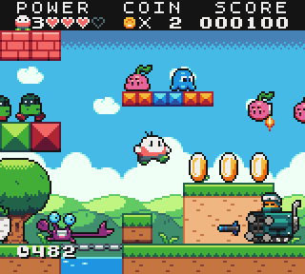
Introduction
1
Name：Where Are My Feet?!
2
Goal：Find his missing feet
Notes:
更多资源请加qq群 626648181

Slide 5
Introduction
An overweight boy ate tons of burgers
One day he could not see his feet anymore when looking down
He was shocked and decided to find his feet at any cost
Will he reunite with his feet ultimately?
Varieties of enemies will attack him
In the adventure he will go through forest and climb snow mountain

Slide 6
Control
AD:RUN
SPACE:JUMP
HOLD ON SPACE:STICK TO THE WALL

Slide 7
2
FRAME
Notes:
更多资源请加qq群 626648181

Slide 8
Frame
Essential Elements
action
obstacle
enemy
terrain
music

Slide 9
Frame
level
components
background
hero and action
obstacle and enemy
props
map design
texture and music
plot
3 levels with
3 scene
01
02
03
Notes:
更多资源请加哈工大资源分享qq群 626648181

Slide 10
3
Challenge
汇报人：

Slide 11
Challenge
Different
Enemies
Control
Of
Difficulty
Smooth
actions
Team
Work
1
2
3
4
Different enemies need different behaviours
Make proper difficulty for the game
How to make all the object
action smooth
Teammates together try out best

Slide 12


Slide 13
4
Goal
Make proper difficulty for the game
Notes:
更多资源请加哈工大资源分享qq群 626648181

Slide 14

Goal
1.Keep working and adding interesting function
2.master the team work model
3.Make a beautiful and relaxing game
4.Try our best

Slide 15
THANK YOU
presenter：
Notes:
更多资源请加qq群 626648181

