Slide 1
Component Diagrams
Notes:
© Dr. Jim Arlow 2000 v1.0

Slide 2
Content
Overview
Concepts
Methods
Notes:
© Dr. Jim Arlow 2000 v1.0

Slide 3
Content
Overview
Concepts
Methods
Notes:
© Dr. Jim Arlow 2000 v1.0

Slide 4
Overview
Component diagrams show the organization of and dependencies among a set of components
Component diagrams address the static implementation view of a system

Slide 5
Overview
Use component diagrams when you are dividing your system into components and want to show their interrelationships through interfaces or the breakdown of components into a lower-level structure.

Slide 6
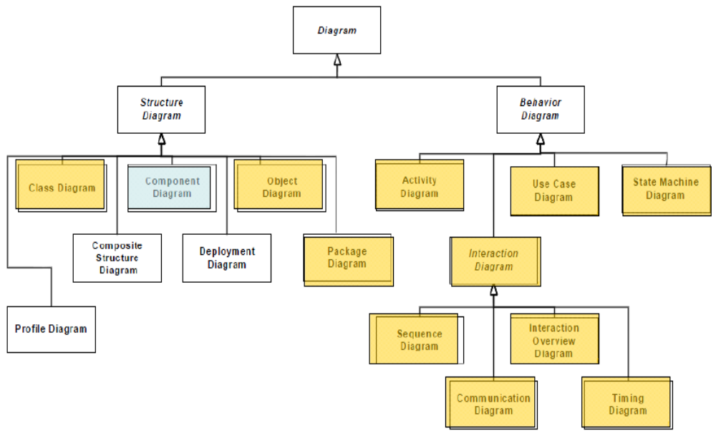
Overview

Slide 7
Content
Overview
Concepts
Methods
Notes:
© Dr. Jim Arlow 2000 v1.0

Slide 8
What is an interface?
design by
contract
An interface specifies a named set of public features
It separates the specification of functionality from its implementation
An interface defines a contract that all realizing classifiers must conform to
Notes:
© Dr. Jim Arlow 2000 v1.0

Slide 9
Provided interface syntax
A provided interface indicates that a classifier implements the services defined in an interface
«interface»
Borrow
borrow()
return()
isOverdue()
interface
Borrow
realization
relationship
Book
CD
Book
CD
“Class” style notation
“Lollipop” style notation
(note: you can’t show the interface operations or attributes with this shorthand style of notation)
Notes:
© Dr. Jim Arlow 2000 v1.0

Slide 10
Required interface syntax
A required interface indicates that a classifier uses the services defined by the interface
class style notation
lollipop style notation
Library
Library
Library
«interface»
Borrow
Borrow
Borrow
required interface
Notes:
© Dr. Jim Arlow 2000 v1.0

Slide 11
Assembly connectors
You can connect provided and required interfaces using an assembly connector
Library
assembly
connector
Borrow
Book
CD
Notes:
© Dr. Jim Arlow 2000 v1.0

Slide 12
Ports: organizing interfaces
A port specifies an interaction point between a classifier and its environment
port
Viewer
DisplayMedium
Book
presentation
presentation
Book
Print, Display
Notes:
© Dr. Jim Arlow 2000 v1.0

Slide 13
Interfaces and CBD
Interfaces are the key to component based development (CBD)
This is constructing software from replaceable, plug-in parts
Interfaces define a contract so classifiers that realise the interface agree to abide by the contract and can be used interchangeably
Notes:
© Dr. Jim Arlow 2000 v1.0

Slide 14
Components
A component is a replaceable part of a system that conforms to and provides the realization of a set of interfaces

Slide 15
Components
The UML 2.0 specification states that, "A component represents a modular part of a system that encapsulates its contents and whose manifestation is replaceable within its environment"
  A black-box whose external behaviour is completely defined by its provided and required interfaces
  May be substituted for by other components provided they all support the same protocol
Notes:
© Dr. Jim Arlow 2000 v1.0

Slide 16
Component syntax
Components may have provided and required interfaces, ports, internal structure
  Provided and required interfaces usually delegate to internal parts
  You can show the parts nested inside the component icon or externally, connected to it by dependency relationships
black box notation
white box notation
«component»
component
part
A
provided
interface
required
interface
B
C
«component»
I1
I2
A
«delegate»
«delegate»
I1
I2
I1
I2
Notes:
© Dr. Jim Arlow 2000 v1.0

Slide 17
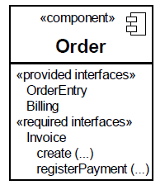
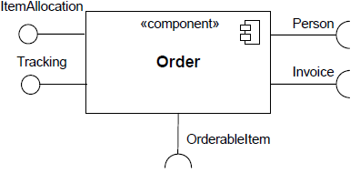
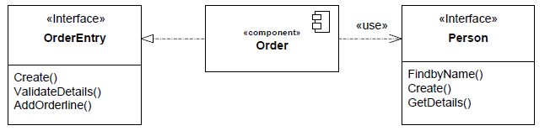
Component syntax

Slide 18
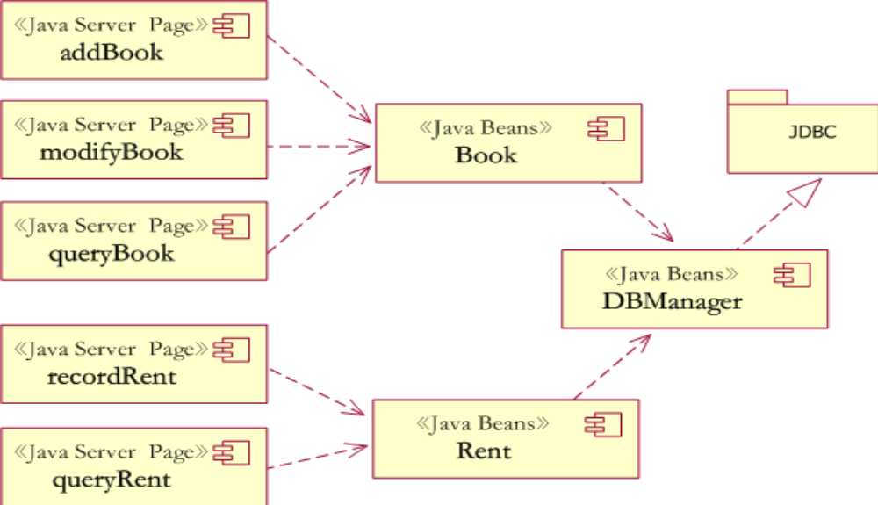
Basic component diagram

Slide 19
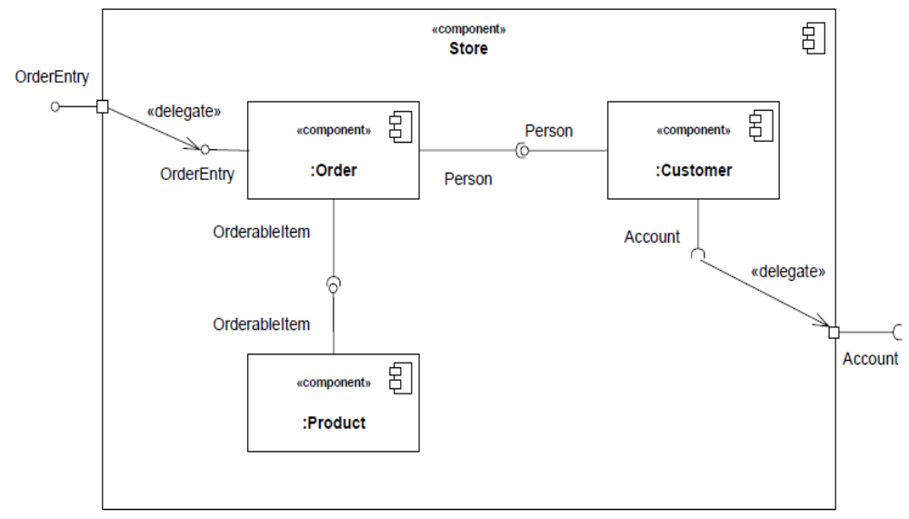
Nested component diagram

Slide 20
Physical architecture
Subsystems and interfaces comprise the physical architecture of our model
We must now organise this collection of interfaces and subsystems to create a coherent architectural picture:
We can apply the "layering" architectural pattern
  Subsystems are arranged into layers
  Each layer contains design subsystems which are semantically cohesive e.g. Presentation layer, Business logic layer, Utility layer
  Dependencies between layers are very carefully managed
  Dependencies go one way
  Dependencies are mediated by interfaces
Notes:
© Dr. Jim Arlow 2000 v1.0

Slide 21
Example layered architecture
«subsystem»
GUI
presentation
OrderManager
Customer
Manager
Product
Manager
domain
«subsystem»
Customer
«subsystem»
Order
«subsystem»
Product
business
logic
Account
Manager
services
«subsystem»
Accounts
utility
«subsystem»
{global}
java.util
«subsystem»
javax.swing
«subsystem»
java.sql
Notes:
© Dr. Jim Arlow 2000 v1.0

Slide 22
Using interfaces
Advantages:
  When we design with classes, we are designing to specific implementations
  When we design with interfaces, we are instead designing to contracts which may be realised by many different implementations (classes)
  Designing to contracts frees our model from implementation dependencies and thereby increases its flexibility and extensibility
Disadvantages:
  Interfaces can add flexibility to systems BUT flexibility may lead to complexity
  Too many interfaces can make a system too flexible!
  Too many interfaces can make a system hard to understand
Keep it simple!
Notes:
© Dr. Jim Arlow 2000 v1.0

Slide 23
Content
Overview
Concepts
Methods
Notes:
© Dr. Jim Arlow 2000 v1.0

Slide 24
Usage of component diagrams
The Component Diagram helps to model the physical aspect of an Object-Oriented software system
It illustrates the architectures of the software components and the dependencies between them
Those software components including run-time components, executable components also the source code components.

Slide 25
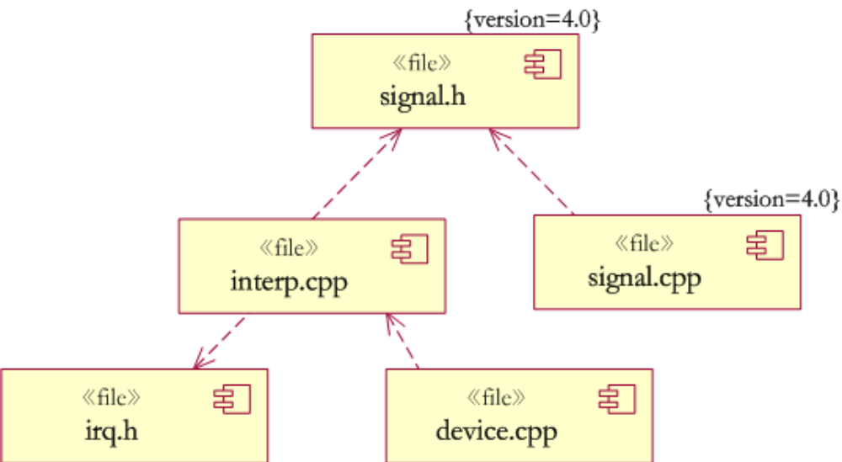
Example: source code

Slide 26
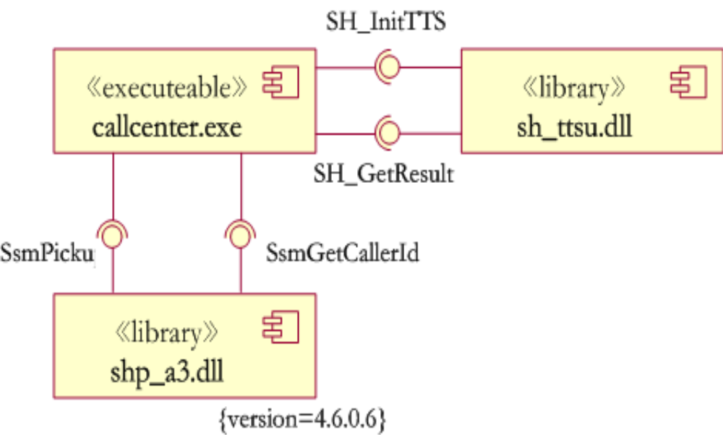
Example: executables of an application

Slide 27
Style of UML Component Diagram
Apply One Component Stereotype Consistently
Choose either the <<component>> or the bandage-box symbol and apply it consistently
Show Only Relevant Interfaces
Depict only the interfaces that are applicable to the goals of your diagram
Make Components Dependent Only on Interfaces
By making components dependent on the interfaces of other components, instead of on the other components themselves

