Slide 1
Deployment Diagrams
Notes:
© Dr. Jim Arlow 2000 v1.0

Slide 2
Content
Overview
Concepts
Methods
Notes:
© Dr. Jim Arlow 2000 v1.0

Slide 3
Content
Overview
Concepts
Methods
Notes:
© Dr. Jim Arlow 2000 v1.0

Slide 4
Overview
A deployment diagram shows the configuration of run time processing nodes and the artifacts that live on them.
It models the mapping between the software architecture and the physical system architecture

Slide 5
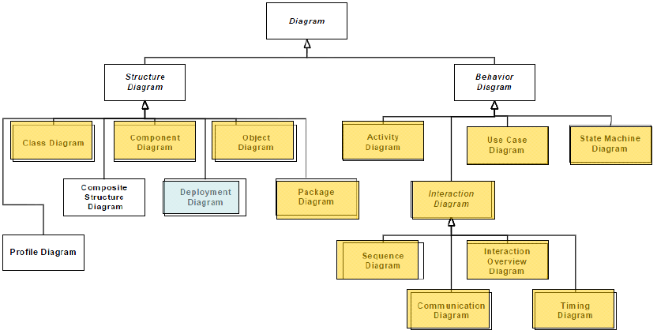
Overview

Slide 6
Content
Overview
Concepts
Methods
Notes:
© Dr. Jim Arlow 2000 v1.0

Slide 7
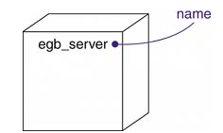
Nodes
A node is a physical element that exists at run time and represents a computational resource, generally having at least some memory and, often, processing capability
Graphically, a node is rendered as a cube

Slide 8
Nodes – descriptor form
«device»
WindowsPC
«device»
LinuxPC
0..*
«http»
0..*
«execution environment»
IE6
«execution environment»
Apache
association
node
A node represents a type of computational resource
  e.g. a WindowsPC
Standard stereotypes are «device» and «execution environment»
Notes:
© Dr. Jim Arlow 2000 v1.0

Slide 9
Nodes – instance form
A node instance represents an actual physical resource
  e.g. JimsPC:WindowsPC - node instances have underlined names
«device»
JimsPC:WindowsPC
«execution environment»
:IE6
«device»
WebServer1:LinuxPC
«http»
«execution environment»
:Apache
«device»
IlasPC:WindowsPC
«execution environment»
:IE6
node instance
Notes:
© Dr. Jim Arlow 2000 v1.0

Slide 10
Stereotyping nodes
It’s very useful to use lots of stereotyping on the deployment diagram to make it as clear and readable as possible
Notes:
© Dr. Jim Arlow 2000 v1.0

Slide 11
Nodes
Modeling Processors and Devices
Processors
A processor is a node that has processing capability, meaning that it can execute a artifact
Devices
A device is a node that has no processing capability (at least, none that are modeled at this level of abstraction) and, in general, represents something that interfaces to the real world

Slide 12
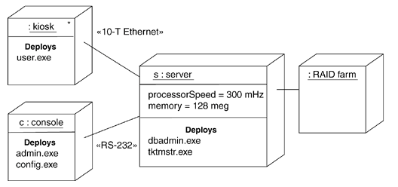
Nodes
Modeling the Distribution of Artifacts
When you model the topology of a system, it's often useful to visualize or specify the physical distribution of its artifacts across the processors and devices that make up the system.

Slide 13
Artifacts
Artifacts are the physical manifestations of software
An artifact represents a type of concrete, real-world thing such as a file
  Can be deployed on nodes
Artifact instances represent particular copies of artifacts
  Can be deployed on node instances
An artifact can manifest one or more components
Notes:
© Dr. Jim Arlow 2000 v1.0

Slide 14
Connections
The most common kind of relationship you'll use among nodes is an association
In this context, an association represents a physical connection among nodes, such as an Ethernet connection, a serial line, or a shared bus
You can even use associations to model indirect connections, such as a satellite link between distant processors

Slide 15
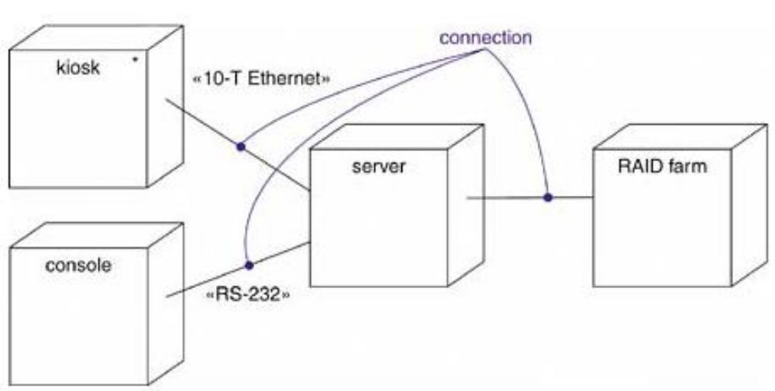
Connections

Slide 16
Deployment
Artifacts are deployed on nodes, artifact instances are deployed on node instances
«device»
server:WindowsPC
«device»
client:WindowsPC
«RMI»
«execution environment»
:J2EE Server
«JAR»
:ConverterClient.jar
«JAR»
:ConverterApp.ear
«deployment spec»
converterDeploymentSpecification
EnterpriseBeanClass: ConverterBean
EnterpriseBeanName: ConverterBean
EnterpriseBeanType: StatelessSession
deployment descriptor
artifact instance
Notes:
© Dr. Jim Arlow 2000 v1.0

Slide 17
Content
Overview
Concepts
Methods
Notes:
© Dr. Jim Arlow 2000 v1.0

Slide 18
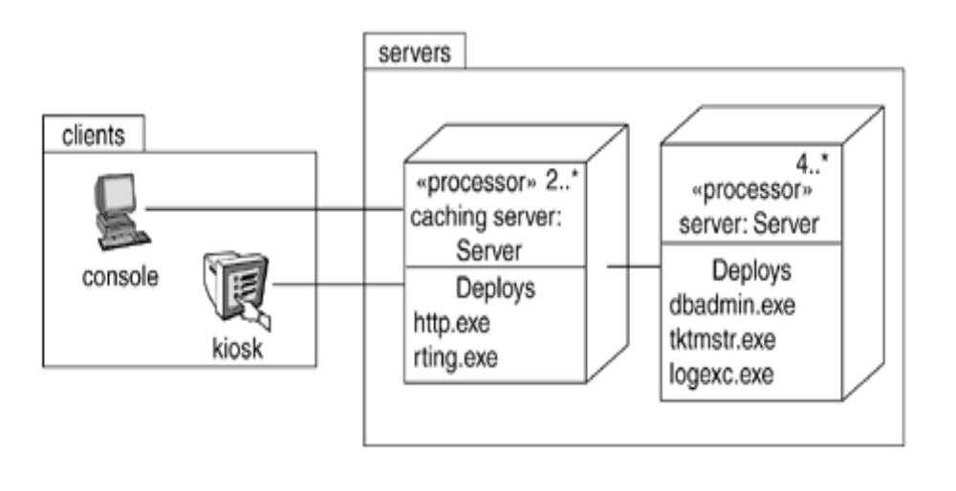
Usage of Deployment Diagram
Modeling a Client/Server System

Slide 19
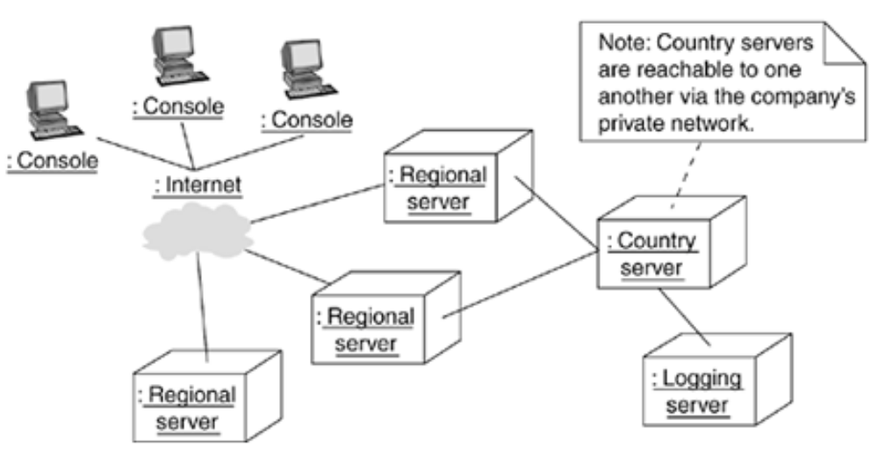
Usage of Deployment Diagram
Modeling a Fully Distributed System

Slide 20
Style of UML Deployment Diagram
Model Only Vital Software Component
Apply Visual Stereotypes to Nodes
Indicate Communication Protocols via Stereotypes

