Slide 1
Use case modeling
Notes:
© Dr. Jim Arlow 2000 v1.0

Slide 2
Content
Overview
Use case diagram
Use case specification
Methods
Notes:
© Dr. Jim Arlow 2000 v1.0

Slide 3
Content
Overview
Use case diagram
Use case specification
Methods
Notes:
© Dr. Jim Arlow 2000 v1.0

Slide 4
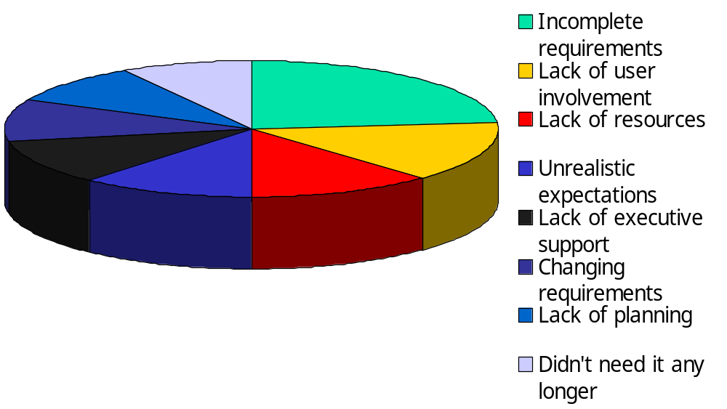
The importance of requirements
Project Failures
Incomplete requirements are the primary
reason that projects fail!
The Standish Group, "The CHAOS Report (1994) "
Notes:
© Dr. Jim Arlow 2000 v1.0

Slide 5
Overview
Use case modelling is a form of requirements engineering.
Use cases are a technique for capturing the functional requirements of a system.
Notes:
© Dr. Jim Arlow 2000 v1.0

Slide 6
Overview
Use case models :
Describe how users use the system;
Describe how actors interact with the system;
Capture the system requirements from the perspective of users;
Are easy to understand;
…

Slide 7
Overview
A Use case Diagram:
Describes actors, use cases and relationships between them.
Describes who or what uses which function of a system.

Slide 8
Overview
A use case specification:
Describe the typical interactions between the users of a system and the system itself, providing a narrative of how a system is used.
Brings together all of the behavior relevant to a slice of system functionality.

Slide 9
Content
Introduction
Use case diagram
Use case specification
Methods
Notes:
© Dr. Jim Arlow 2000 v1.0

Slide 10
Use Case Diagrams
The use case diagram shows the system boundary and the interactions with the outside world.
The use case diagram shows the actors, the use cases, and the relationships between them.

Slide 11
Use case modelling
Use case modelling proceeds as follows:
  Find the system boundary
  Find actors
  Find use cases
  …
It lets us identify the system boundary, who or what uses the system, and what functions the system should offer
Notes:
© Dr. Jim Arlow 2000 v1.0

Slide 12
The subject
Before we can build anything, we need to know:
  Where the boundary of the system lies
  Who or what uses the system
  What functions the system should offer to its users
We create a Use Case model containing:
  Subject – the edge of the system
    also known as the system boundary
  Actors – who or what uses the system
  Use Cases – things actors do with the system
  Relationships - between actors and use cases
subject
SystemName
Notes:
© Dr. Jim Arlow 2000 v1.0

Slide 13
What are actors?
An actor is anything that interacts directly with the system
  Actors identify who or what uses the system and so indicate where the system boundary lies
Actors are external to the system
An Actor specifies a role that some external entity adopts when interacting with the system
«actor»
Customer
Customer
Notes:
© Dr. Jim Arlow 2000 v1.0

Slide 14
Identifying Actors
When identifying actors ask:
  Who or what uses the system?
  What roles do they play in the interaction?
  Who installs the system?
  Who starts and shuts down the system?
  Who maintains the system?
  What other systems use this system?
  Who gets and provides information to the system?
  Does anything happen at a fixed time?
  …
Time
Notes:
© Dr. Jim Arlow 2000 v1.0

Slide 15
What are use cases?
A use case is something an actor needs the system to do. It is a “case of use” of the system by a specific actor
Use cases are always started by an actor
  The primary actor triggers the use case
  Zero or more secondary actors interact with the use case in some way
Use cases are always written from the point of view of the actors
PlaceOrder
GetStatusOnOrder
Notes:
© Dr. Jim Arlow 2000 v1.0

Slide 16
Identifying use cases
Start with the list of actors that interact with the system
When identifying use cases ask:
  What functions will a specific actor want from the system?
  Does the system store and retrieve information? If so, which actors trigger this behaviour?
  What happens when the system changes state (e.g. system start and stop)? Are any actors notified?
  Are there any external events that affect the system? What notifies the system about those events?
  Does the system interact with any external system?
  Does the system generate any reports?
Notes:
© Dr. Jim Arlow 2000 v1.0

Slide 17
Naming use cases
Use cases describe something that happens
They are named using verbs or verb phrases
Notes:
© Dr. Jim Arlow 2000 v1.0

Slide 18
The use case diagram
Mail Order System use case diagram
Mail Order System
subject name
communication relationship
system boundary
PlaceOrder
CancelOrder
ShipProduct
ShippingCompany
CheckOrderStatus
Customer
RequestCatalogue
actor
use case
Dispatcher
Notes:
© Dr. Jim Arlow 2000 v1.0

Slide 19
More relationships…
We have studied basic use case analysis, but there are relationships that we have still to explore:
  Actor generalisation
  Use case generalisation
  «include» – between use cases
  «extend» – between use cases
Notes:
© Dr. Jim Arlow 2000 v1.0

Slide 20
Actor generalization - example
The Customer and the Sales Agent actors are very similar
They both interact with List products, Order products, Accept payment
Additionally, the Sales Agent interacts with Calculate commission
Our diagram is a mess – can we simplify it?
Sales system
ListProducts
Customer
OrderProducts
AcceptPayment
CalculateCommission
SalesAgent
Notes:
© Dr. Jim Arlow 2000 v1.0

Slide 21
Actor generalisation
abstract actor
If two actors communicate with the same set of use cases in the same way, then we can express this as a generalisation to another (possibly abstract) actor
The descendent actors inherit the roles and relationships to use cases held by the ancestor actor
We can substitute a descendent actor anywhere the ancestor actor is expected. This is the substitutability principle
Sales system
ancestor
or parent
ListProducts
generalisation
Purchaser
OrderProducts
AcceptPayment
CalculateCommission
Customer
SalesAgent
descendents or children
Use actor generalization when it simplifies the model
Notes:
© Dr. Jim Arlow 2000 v1.0

Slide 22
Use case generalisation
The ancestor use case must be a more general case of one or more descendant use cases
Child use cases are more specific forms of their parent
They can inherit, add and override features of their parent
Sales system
FindProduct
Customer
FindBook
FindCD
Notes:
© Dr. Jim Arlow 2000 v1.0

Slide 23
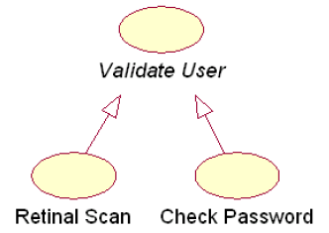
Use case generalisation

Slide 24
«include»
Personnel System
base use case
The base use case executes until the point of inclusion:
include(InclusionUseCase)
  Control passes to the inclusion use case which executes
  When the inclusion use case is finished, control passes back to the base use case which finishes execution
Note:
  Base use cases are not complete without the included use cases
  Inclusion use cases may be complete use cases, or they may just specify a fragment of behaviour for inclusion elsewhere
ChangeEmployeeDetails
«include»
ViewEmployeeDetails
«include»
FindEmployeeDetails
Manager
«include»
DeleteEmployeeDetails
inclusion
use case
include relationship
When use cases share common behaviour we can factor this out into a separate inclusion use case and «include» it in base use cases
Notes:
© Dr. Jim Arlow 2000 v1.0

Slide 25
«include» example
Use case: ChangeEmployeeDetails
Use case: FindEmployeeDetails
ID: 1
ID: 4
Brief description:
The Manager changes the employee details.
Brief description:
The Manager finds the employee details.
Primary actors:
Manager
Primary actors:
Manager
Seconday actors:
None
Seconday actors:
None
Preconditions:
1. The Manager is logged on to the system.
Preconditions:
1. The Manager is logged on to the system.
Main flow:
Main flow:
1.
2.
3.
include( FindEmployeeDetails ).
The system displays the employee details.
The Manager changes the employee details.
…
1.
2.
The Manager enters the employee's ID.
The system finds the employee details.
Postconditions:
1. The system has found the employee details.
Postconditions:
1. The employee details have been changed.
Alternative flows:
None.
Alternative flows:
None.
Notes:
© Dr. Jim Arlow 2000 v1.0

Slide 26
«extend»
Library system
«extend» is a way of adding new behaviour into the base use case by inserting behaviour from one or more extension use cases
  The base use case specifies one or more extension points in its flow of events
The extension use case may contain several insertion segments
The «extend» relationship may specify which of the base use case extension points it is extending
base use case
ReturnBook
«extend»
BorrowBook
IssueFine
Librarian
extend relationship
FindBook
extension use case
The extension use case inserts behaviour into the base use case.
The base use case provides extension points, but does not know about the extensions.
Notes:
© Dr. Jim Arlow 2000 v1.0

Slide 27
Base use case
Use case: ReturnBook
ID: 9
base use case
Brief description:
The Librarian returns a borrowed book.
ReturnBook
Primary actors:
Librarian
extension points
overdueBook
Secondary actors:
None.
Preconditions:
1. The Librarian is logged on to the system.
«extend»
(overdueBook)
Main flow:
1.
2.
3.
4.
The Librarian enters the borrower's ID number.
The system displays the borrower's details including the list of borrowed books.
The Librarian finds the book to be returned in the list of books.
The Librarian returns the book.
…
extension
point
extension
point name
extension point: overdueBook
IssueFine
Postconditions:
1. The book has been returned.
Alternative flows:
None.
extension use case
There is an extension point overdueBook just before step 4 of the flow of events
Extension points are not numbered, as they are not part of the flow
Notes:
© Dr. Jim Arlow 2000 v1.0

Slide 28
Extension use case
Extension Use case: IssueFine
ReturnBook
ID: 10
extension points
overdueBook
Brief description:
Segment 1: The Librarian records and prints out a fine.
Primary actors:
Librarian
«extend»
(overdueBook)
Secondary actors:
None.
Segment 1 preconditions:
1. The returned book is overdue.
the single insertion segment
in IssueFine is inserted at the overdueBook insertion point in the ReturnBook use case
Segment 1 flow:
1.
2.
The Librarian enters details of the fine into the system.
The system prints out the fine.
IssueFine
Segment 1 postconditions:
1. The fine has been recorded in the system.
2. The system has printed out the fine.
Extension use cases have one or more insertion segments which are behaviour fragments that will be inserted at the specified extension points in the base use case
Notes:
© Dr. Jim Arlow 2000 v1.0

Slide 29
Multiple insertion points
Extension Use case: IssueFine
ReturnBook
ID: 10
extension points
overdueBook
payFine
Brief description:
Segment 1: The Librarian records and prints out a fine.
Segment 2: The Librarian accepts payment for a fine.
Primary actors:
Librarian
«extend»
(overdueBook, payFine)
Secondary actors:
None.
Segment 1 preconditions:
1. The returned book is overdue.
the first segment in IssueFine is inserted at overdueBook and the second segment at payFine
Segment 1 flow:
1.
2.
The Librarian enters details of the fine into the system.
The system prints out the fine.
Segment 1 postconditions:
1. The fine has been recorded in the system.
2. The system has printed out the fine.
IssueFine
Segment 2 preconditions:
1. A fine is due from the borrower.
Segment 2 flow:
1.
2.
3.
If more than one extension point is specified in the «extend» relationship then the extension use case must have the same number of insertion segments
The Librarian accepts payment for the fine from the borrower.
The Librarian enters the paid fine in the system.
The system prints out a receipt for the paid fine.
Segment 2 postconditions:
1. The fine is recorded as paid.
2. The system has printed a receipt for the fine.
Notes:
© Dr. Jim Arlow 2000 v1.0

Slide 30
Conditional extensions
ReturnBook
extension points
overdueBook
payFine
«extend»
(overdueBook)
[first offence]
«extend»
(overdueBook)
[!first offence]
IssueWarning
IssueFine
condition
We can specify conditions on «extend» relationships
  Conditions are Boolean expressions
  The insertion is made if and only if the condition evaluates to true
Notes:
© Dr. Jim Arlow 2000 v1.0

Slide 31
Content
Overview
Use case diagram
Use case specification
Methods
Notes:
© Dr. Jim Arlow 2000 v1.0

Slide 32
Use case specification
use case name
Use case: PaySalesTax
use case identifier
ID: 1
brief description
Brief description:
Pay Sales Tax to the Tax Authority at the end of the business quarter.
the actors involved in the use case
Primary actors:
Time
Secondary actors:
TaxAuthority
the system state before the use case can begin
Preconditions:
1. It is the end of the business quarter.
Main flow:
implicit time actor
the actual steps of the use case
1.
2.
3.
The use case starts when it is the end of the business quarter.
The system determines the amount of Sales Tax owed to the Tax Authority.
The system sends an electronic payment to the Tax Authority.
the system state when the use case has finished
Postconditions:
1. The Tax Authority receives the correct amount of Sales Tax.
alternative flows
Alternative flows:
None.
Notes:
© Dr. Jim Arlow 2000 v1.0

Slide 33
Pre and postconditions
Preconditions and postconditions are constraints
Preconditions constrain the state of the system before the use case can start
Postconditions constrain the state of the system after the use case has executed
If there are no preconditions or postconditions write "None" under the heading
Use case: PlaceOrder
Preconditions:
1. A valid user has logged on to the system
Postconditions:
1. The order has been marked confirmed and is saved by the system
Notes:
© Dr. Jim Arlow 2000 v1.0

Slide 34

Main flow
<number> The <something> <some action>
The flow of events lists the steps in a use case
It always begins by an actor doing something
  A good way to start a flow of events is:
  1) The use case starts when an <actor> <function>
The flow of events should be a sequence of short steps that are:
  Declarative
  Numbered,
  Time ordered
The main flow is always the happy day or perfect world scenario
  Everything goes as expected and desired, and there are no errors, deviations, interrupts, or branches
  Alternatives can be shown by branching or by listing under Alternative flows (see later)
Notes:
© Dr. Jim Arlow 2000 v1.0

Slide 35
Branching within a flow: If
Use the keyword if to indicate alternatives within the flow of events
  There must be a Boolean expression immediately after if
Use indentation and numbering to indicate the conditional part of the flow
Use else to indicate what happens if the condition is false (see next slide)
Use case: ManageBasket
ID: 2
Brief description:
The Customer changes the quantity of an item in the basket.
Primary actors:
Customer
Secondary actors:
None.
Preconditions:
1. The shopping basket contents are visible.
Main flow:
1.
2.
3.
The use case starts when the Customer selects an item in the basket.
If the Customer selects "delete item"
If the Customer types in a new quantity
2.1
The system removes the item from the basket.
3.1
The system updates the quantity of the item in the basket.
Postconditions:
None.
Alternative flows:
None.
Notes:
© Dr. Jim Arlow 2000 v1.0

Slide 36
Repetition within a flow: For
We can use the keyword For to indicate the start of a repetition within the flow of events
The iteration expression immediately after the For statement indicates the number of repetitions of the indented text beneath the For statement.
Use case: FindProduct
ID: 3
Brief description:
The system finds some products based on Customer search criteria and displays them to the Customer.
Actors:
Customer
Preconditions:
None.
Main flow:
1. The use case starts when the Customer selects "find product".
2. The system asks the Customer for search criteria.
3. The Customer enters the requested criteria.
4. The system searches for products that match the Customer's criteria.
5. For each product found
5.1. The system displays a thumbnail sketch of the product.
5.2. The system displays a summary of the product details.
5.3. The system displays the product price.
Postconditions:
None.
Alternative flows:
NoProductsFound
Notes:
© Dr. Jim Arlow 2000 v1.0
a

Slide 37
Repetition within a flow: While
We can use the keyword while to indicate that something repeats while some Boolean condition is true
Use case: ShowCompanyDetails
ID: 4
Brief description:
The system displays the company details to the Customer.
Primary actors:
Customer
Secondary actors:
None
Preconditions:
None.
Main flow:
1. The use case starts when the Customer selects "show company details".
2. The system displays a web page showing the company details.
3. While the Customer is browsing the company details
4. The system searches for products that match the Customer's criteria.
4.1. The system plays some background music.
4.2. The system displays special offers in a banner ad.
Postconditions:
1. The system has displayed the company details.
2. The system has played some background music.
3. The systems has displayed special offers.
Alternative flows:
None.
Notes:
© Dr. Jim Arlow 2000 v1.0

Slide 38
Branching: Alternative flows
We may specify one or more alternative flows through the flow of events:
  Alternative flows capture errors, branches, and interrupts
Potentially very many alternative flows! You need to manage this:
  Pick the most important alternative flows and document those.
  If there are groups of similar alternative flows - document one member of the group as an exemplar and (if necessary) add notes to this explaining how the others differ from it.
Use case
alternative flows
main flow
Only document enough alternative flows to clarify the requirements!
Notes:
© Dr. Jim Arlow 2000 v1.0

Slide 39
Referencing alternative flows
Use case: CreateNewCustomerAccount
ID: 5
List the names of the alternative flows at the end of the use case
Find alternative flows by examining each step in the main flow and looking for:
  Alternatives
  Exceptions
  Interrupts
Brief description:
The system creates a new account for the Customer.
Primary actors:
Customer
Secondary actors:
None.
Preconditions:
None.
Main flow:
1.
2.
3.
The use case begins when the Customer selects "create new customer account".
While the Customer details are invalid
The system creates a new account for the Customer.
2.1.
2.2
The system asks the Customer to enter his or her details comprising email address, password and password again for confirmation.
The system validates the Customer details.
Postconditions:
1. A new account has been created for the Customer.
Alternative flows:
InvalidEmailAddress
InvalidPassword
Cancel
alternative flows
Notes:
© Dr. Jim Arlow 2000 v1.0

Slide 40
An alternative flow example
notice how we name and number
alternative flows
Alternative flow: CreateNewCustomerAccount:InvalidEmailAddress
ID: 5.1
Brief description:
The system informs the Customer that they have entered an invalid email address.
Primary actors:
Customer
Secondary actors:
None.
Preconditions:
1. The Customer has entered an invalid email address
always indicate how the alternative flow begins.
In this case it starts after step 2.2 in the main flow
Alternative flow:
1.
2.
The alternative flow begins after step 2.2. of the main flow.
The system informs the Customer that he or she entered an invalid email address.
Postconditions:
None.
The alternative flow may be triggered instead of the main flow - started by an actor
The alternative flow may be triggered after a particular step in the main flow - after
The alternative flow may be triggered at any time during the main flow - at any time
Notes:
© Dr. Jim Arlow 2000 v1.0

Slide 41
Content
Overview
Use case diagram
Use case specification
Methods
Notes:
© Dr. Jim Arlow 2000 v1.0

Slide 42
Modeling Methods
Establish the context of the system by identifying the actors that surround it.
For each actor, consider the behavior that each expects or requires the system to provide.
Name these behaviors as use cases.
Factor common behavior into new use cases that are used by others; factor variant behavior into new use cases that extend more main line flows.
For each use case, describe the typical interactions between the actors and the system.
Model these use cases, actors, and their relationships in a use case diagram.
Adorn these use cases with notes or constraints that assert nonfunctional requirements.

Slide 43
When to use use case analysis
Use cases describe system behaviour from the point of view of one or more actors. They are the best choice when:
  The system is dominated by functional requirements
  The system has many types of user to which it delivers different functionality
  The system has many interfaces
Use cases are designed to capture functional requirements. They are a poor choice when:
  The system is dominated by non-functional requirements
  The system has few users
  The system has few interfaces
Notes:
© Dr. Jim Arlow 2000 v1.0

Slide 44
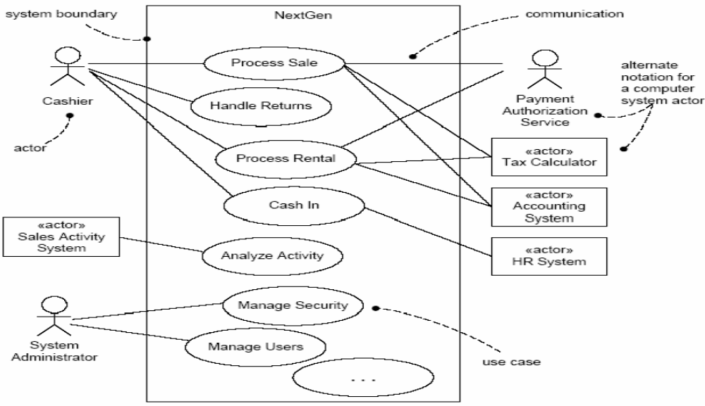
POS - use case diagram

Slide 45
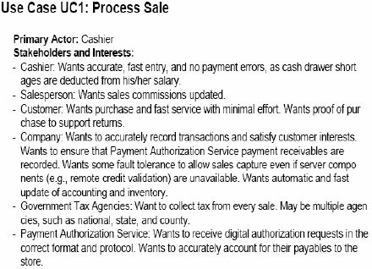
POS - use case specification

Slide 46
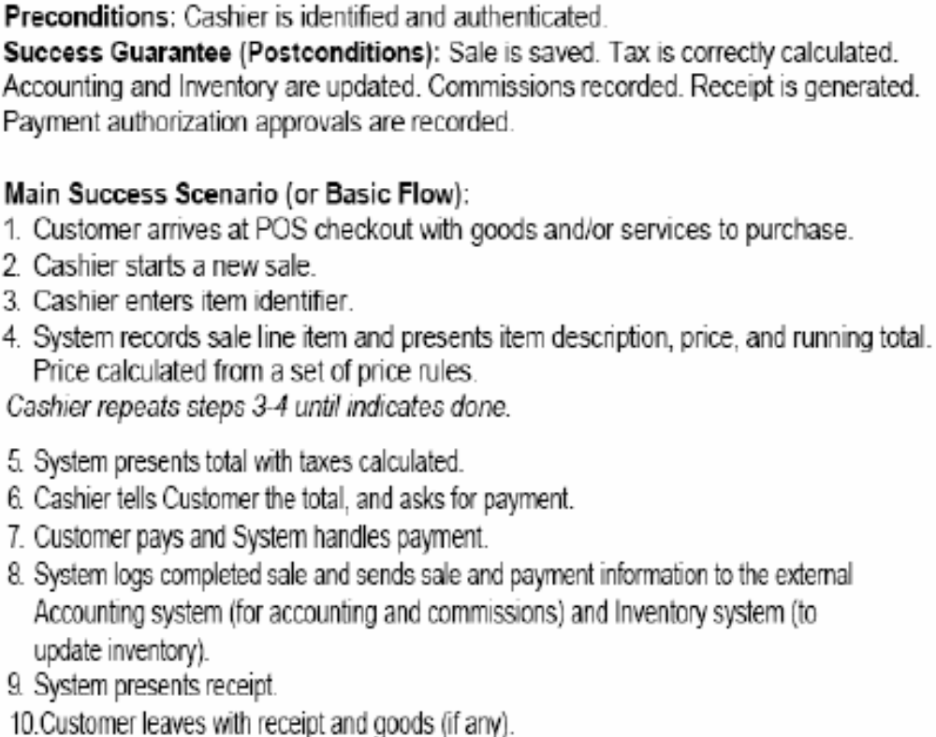

Slide 47
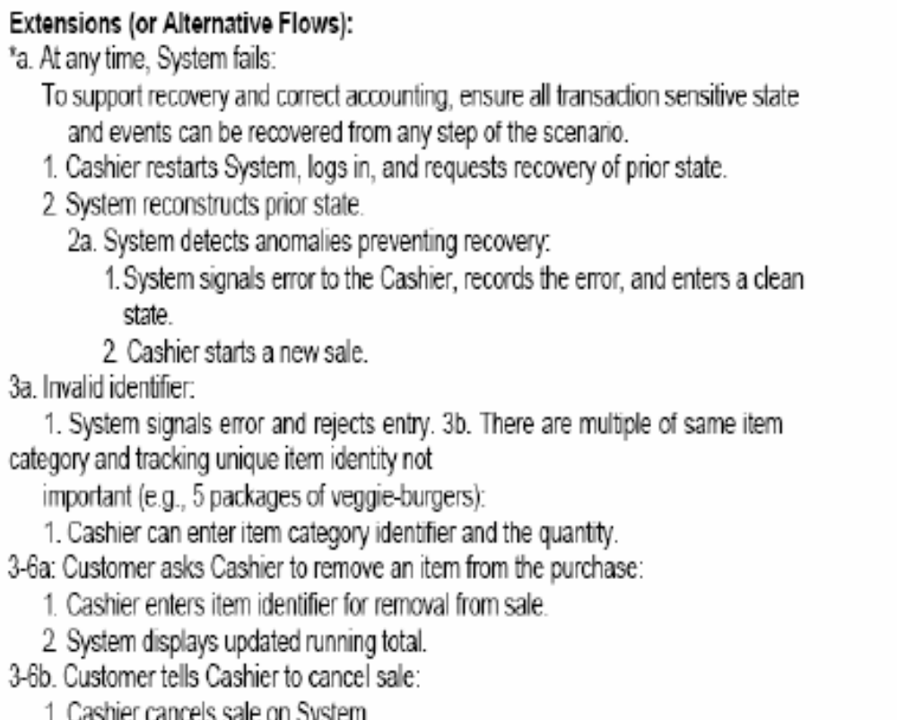

Slide 48
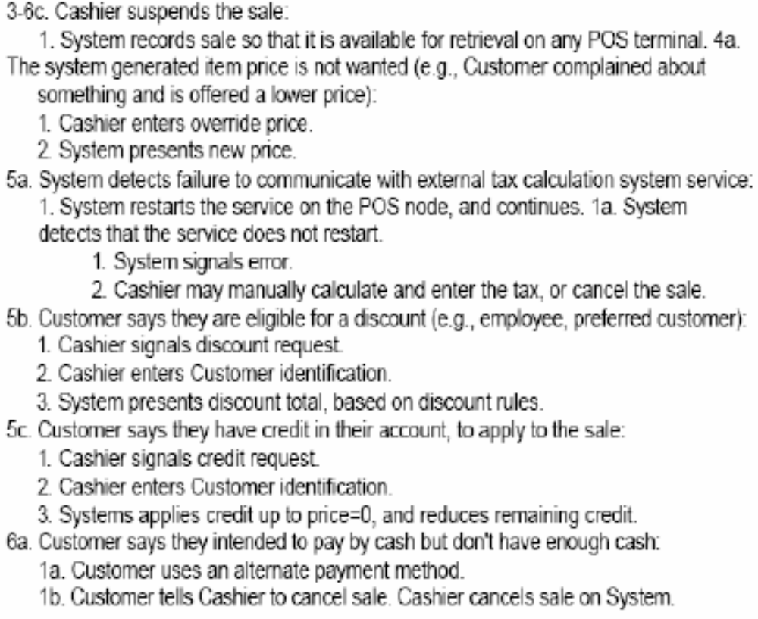

Slide 49
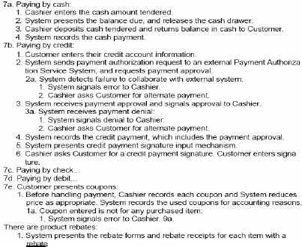

Slide 50
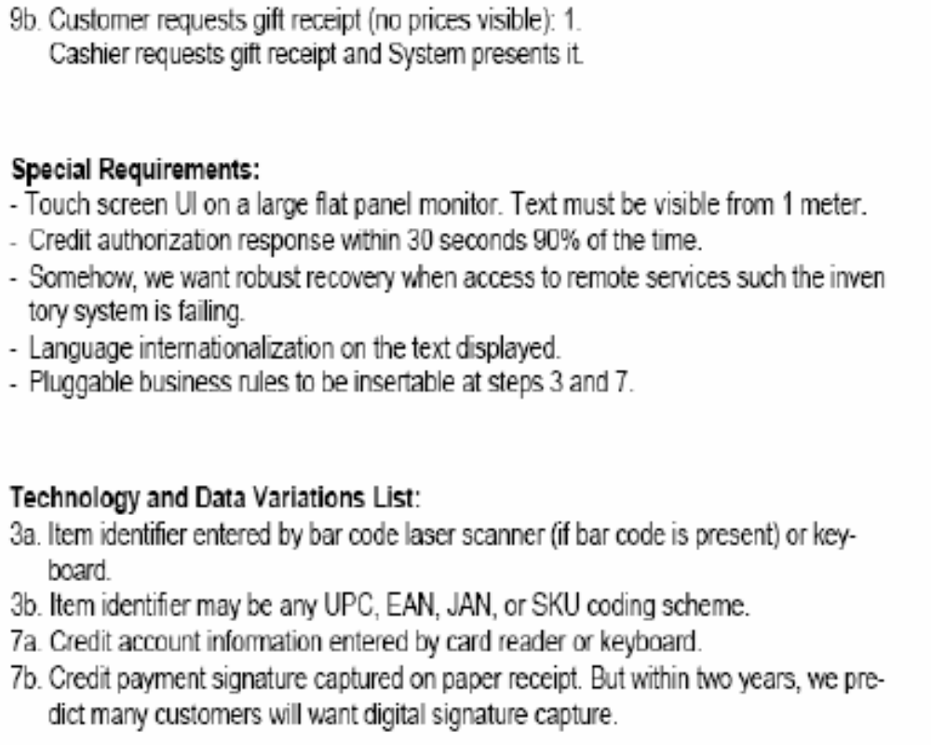

Slide 51
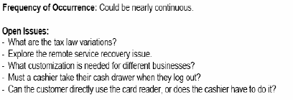

Slide 52
Project
A Library System
similar to SEU library
…

Slide 53
Report
Use case diagram
Use case specification ( Borrow Book )

