Slide 1
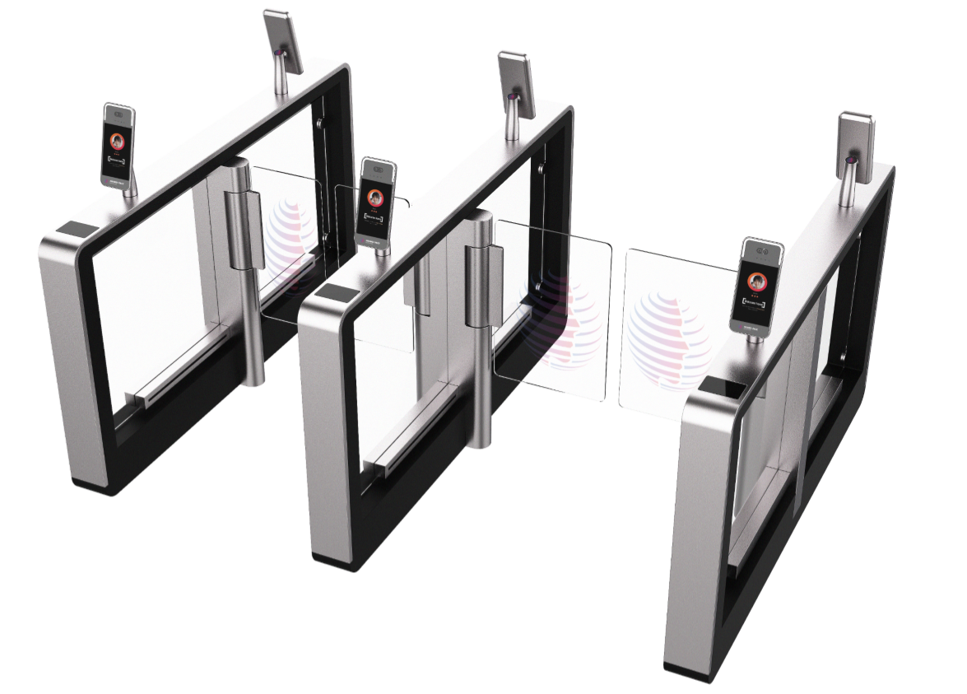
Intelligent Access Control Solution Architecture
Application
Pedestrian and vehicle access
Visitor management
Smart attendance
Parking guidance
IoT service
AI and video services
Integration service
Operations support
Development enablement
...
Digital
platform
Converged communications
Location service
Statistics and analysis
User management
O&M support
Huawei clouds (public cloud/private cloud/hybrid cloud)
Wi-Fi/Wi-Fi 6
Campus network
Connectivity
Frontend
sensing
Vehicle management
All-in-one card system
Access control
Visitor management
Third-party payment system
Turnstile
Camera
CN
Notes:
合作伙伴提供：有源RFID标签、智能电源RFID标签、RFID接收插卡 ； 资产应用
华为提供：物联网AP，园区网络、数字平台

Slide 2
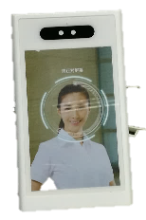
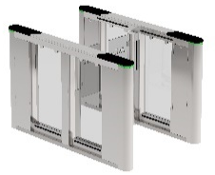
Intelligent Access Control Based on Facial Recognition Improves Personnel Rights Management Accuracy and Efficiency
Ultra-large face library
Face library with a maximum capacity of 200,000 images, suitable for campuses of all sizes.
AI-powered facial recognition algorithm with a recognition accuracy higher than 98%.
Tablet management system
IVS
Highly efficient video-based intelligence
Searches tens of millions of records and provides matches within one second.
Ensures efficient access in large campuses during peak hours and high concurrency periods (up to 200 turnstiles).
Facial recognition Tablet
Openness and pre-integration
Supports interconnection with professional integration security applications.
Lightweight solution featuring easy deployment and simplified O&M.
Turnstile
CN

Slide 3
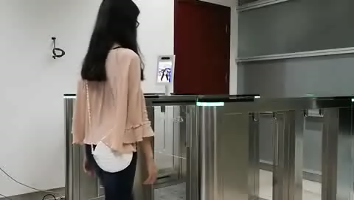
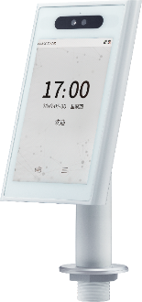
FacePad: Facial Recognition Tablet
Embedded HiSilicon AI chip
Supports live person detection.
Photos and videos cannot be used to fake permissions.
Goes into sleep mode when not accessed, and automatically wakes up after detecting persons (1.5 m away).
Visible light-based and infrared-based technologies enable all-day facial recognition.
IP66-rated ingress protection
Operating temperature: -30℃ to +60℃
FacePad
CN

Slide 4
便捷通行解决方案架构
应用
人车通行
访客管理
智慧考勤
停车指引
物联服务
AI和视频服务
集成服务
运营支持
开发使能
……
数字
平台
融合通信
位置服务
统计与分析
用户管理
运维支持
华为云（公有云/私有云/混合云 ）
WiFi/WiFi6
园区网络
联接
前端
感知
车辆系统
一卡通系统
门禁系统
访客系统
第三方支付系统
闸机
摄像机
EN
Notes:
合作伙伴提供：有源RFID标签、智能电源RFID标签、RFID接收插卡 ； 资产应用
华为提供：物联网AP，园区网络、数字平台

Slide 5
刷脸便捷通行，提升人员权限管理准确率与通行效率
超大人脸底库
最大支持20万人脸底库，适用于各种规模园区
AI人脸识别算法，识别准确率>98%
平板网管
智能视频云平台
高效视频智能
千万数据1秒内响应，自然行走无感通行
200闸机高并发，大型园区高峰时段高效通行
人脸识别平板一体机
闸机
开放预集成
开放预集成，对接专业的综合安防应用
轻量化方案，易部署，易运维
EN

Slide 6
FacePad，人脸识别平板一体机
搭载海思AI芯片
真人检测，杜绝通过激光照片，彩色照片，黑白照片，视频等方式伪造权限
休眠唤醒，人行1.5米自然唤醒
可见光+红外，全天候人脸识别
IP66防护等级
工作温度⁃30℃~+60℃
FacePad
EN

