Slide 1
Deep AutoEncoder Neural Network Based Book Recommendation System
Jing Zhou
Jun Wang
Xiaowen Ding
Yu Zheng

Slide 2
OVERVIEW
Introduction
Review of task of recommendation system
ALS based Recommendation System (Baseline)
Theory and practice
Challenges
Deep AutoEncoder based Recommendation System
Motivation
Approach
Experimental Results
Dataset
Result
Future Work

Slide 3
INTRODUCTION
Taxonomy of Recommendation Systems
Content Based Recommendation System
Collaborative Filtering Based Recommendation System
ALS
SVD
Neural Network Based Model
Hybrid Model

Slide 4
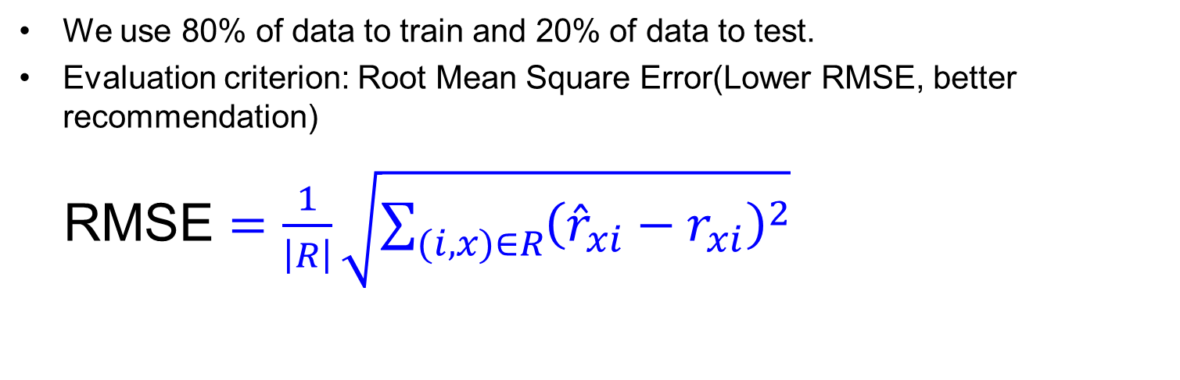
ALS
ALS Based CF
ALS(Alternating Least Squares) collaborative filtering
We use 80% of data to train and 20% of data to test.
Evaluation criterion: Root Mean Square Error(Lower RMSE, better recommendation)
RMSE $=\frac{1}{\left|R\right|}\sqrt{\sum_{(i,x)∈R}{{\left({\hat{r}}_{xi}−r_{xi}\right)}^{2}}}$

Slide 5

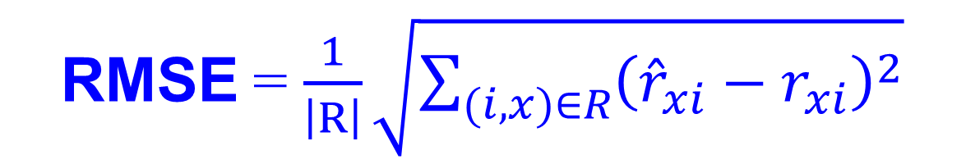
ALS
387,859 users
Matrix R
1 | 3 | 4
 | 3 | 5 |  |  | 5
 |  | 4 | 5 |  | 5
 |  | 3
 |  | 3
2 |  |  | ? |  | ?
 |  |  |  | ?
 | 2 | 1 |  |  | ?
 | 3 |  |  | ?
1
$$r_{3,6}$$
23,684
books
Training Data Set
Test Data Set
True rating of user x on item i
RMSE = $\frac{1}{\left|R\right|}\sqrt{\sum_{(i,x)∈R}{{\left({\hat{r}}_{xi}−r_{xi}\right)}^{2}}}$
Predicted rating

Slide 6
ALS
Users
factors
 | 4 |  | 5 |  |  | 5 |  |  | 3 |  | 1
3 | 1 | 2 |  |  | 4 |  |  | 4 | 5
 | 5 | 3 | 4 |  | 3 |  | 2 | 1 |  | 4 | 2
 | 2 |  |  | 4 |  |  | 5 |  | 4 | 2
5 | 2 |  |  |  |  | 2 | 4 | 3 | 4
 | 4 |  |  | 2 |  |  | 3 |  | 3 |  | 1
.2 | -.4 | .1
.5 | .6 | -.5
.5 | .3 | -.2
.3 | 2.1 | 1.1
-2 | 2.1 | -.7
.3 | .7 | -1
Users
-.9 | 2.4 | 1.4 | .3 | -.4 | .8 | -.5 | -2 | .5 | .3 | -.2 | 1.1
1.3 | -.1 | 1.2 | -.7 | 2.9 | 1.4 | -1 | .3 | 1.4 | .5 | .7 | -.8
.1 | -.6 | .7 | .8 | .4 | -.3 | .9 | 2.4 | 1.7 | .6 | -.4 | 2.1
Books
Books
≈
factors

Slide 7

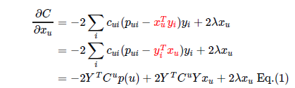

ALS Equation

Slide 8
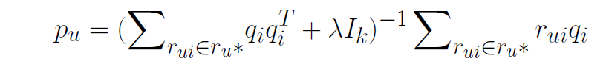

ALS for Matrix Completion
Initialize P,Q
repeat
for u = 1...n do
end for
for i= 1..m do
end for
Until convergence

Slide 9
Challenge
Challenges of CL
Linear model can’t capture the non-linear pattern of the latent structure of data.
Collaborative filtering approach finds similar users and books by usage data, which leads to popular items that will be easier to be recommended than unpopular items.
It is difficult for collaborative filtering to recommend any new movies to users since there are no many usage data associated with these movies.
As my computer only has 6G memory, it crash when I set large rank and bigger iteration number.

Slide 10
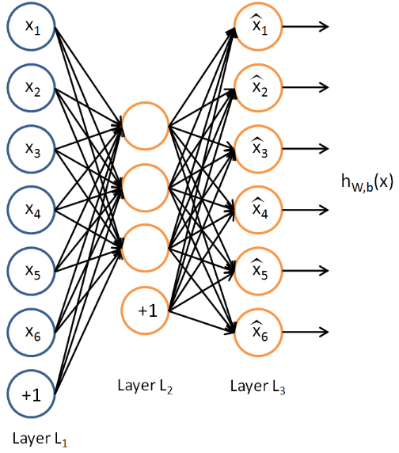
AutoEncoder NN
Advantages
Map the output to the input: finding the latent structure of data (PCA application etc.)
Unsupervised Approach
Able to learn the non-linear latent structure of data

Slide 11
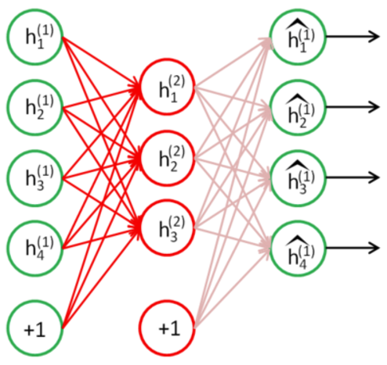
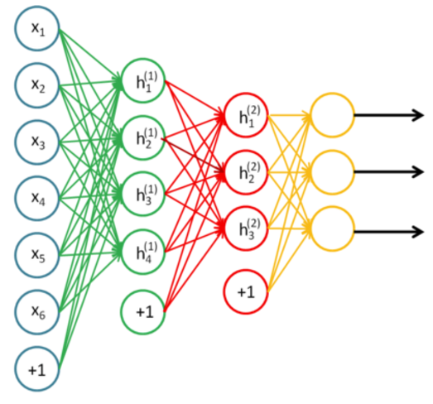
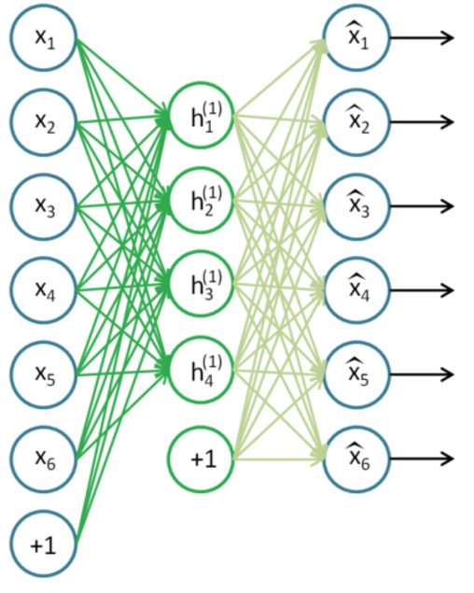
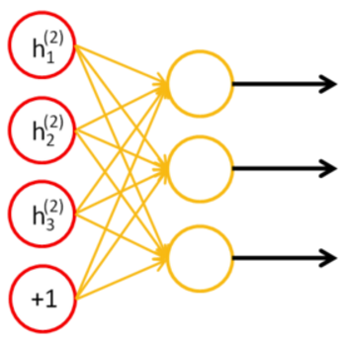
Stacked AutoEncoder NN
The greedy layer-wise approach for pretraining a deep network works by training each layer in turn.
A stacked autoencoder enjoys all the benefits of any deep network of greater expressive power.
It often captures a useful "hierarchical grouping" or "part-whole decomposition" of the input.

Slide 12
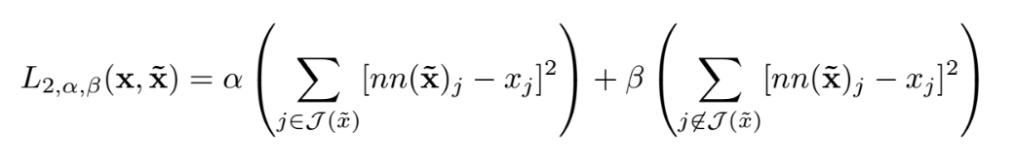
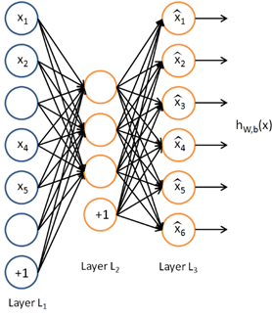
Stacked Denoising AutoEncoder
Intentionally corrupt the input data so as to learn robust representation of data.
Convert the object function to make the model to rebalance between denoising and reconstructing.

Slide 13
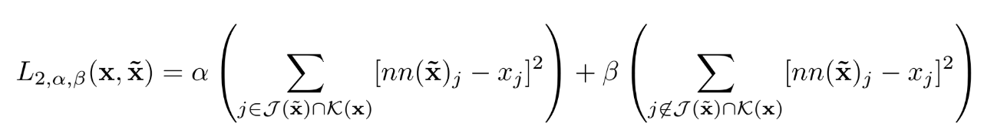
Denoising AutoEncoder for RS
Modify the object function so that the model can predict some invisible input
For user-vector input learns user-network
For item-vector input learns item-network

Slide 14
EXPERIMENTS
Dataset
Amazon Book Dataset.
Experiments have been conducted on two databases:
20Mb data
Number of user = 387,859
Number of item = 23,684
Number of rating = 515742
Data is very sparse with sparsity of about 95%.

Slide 15
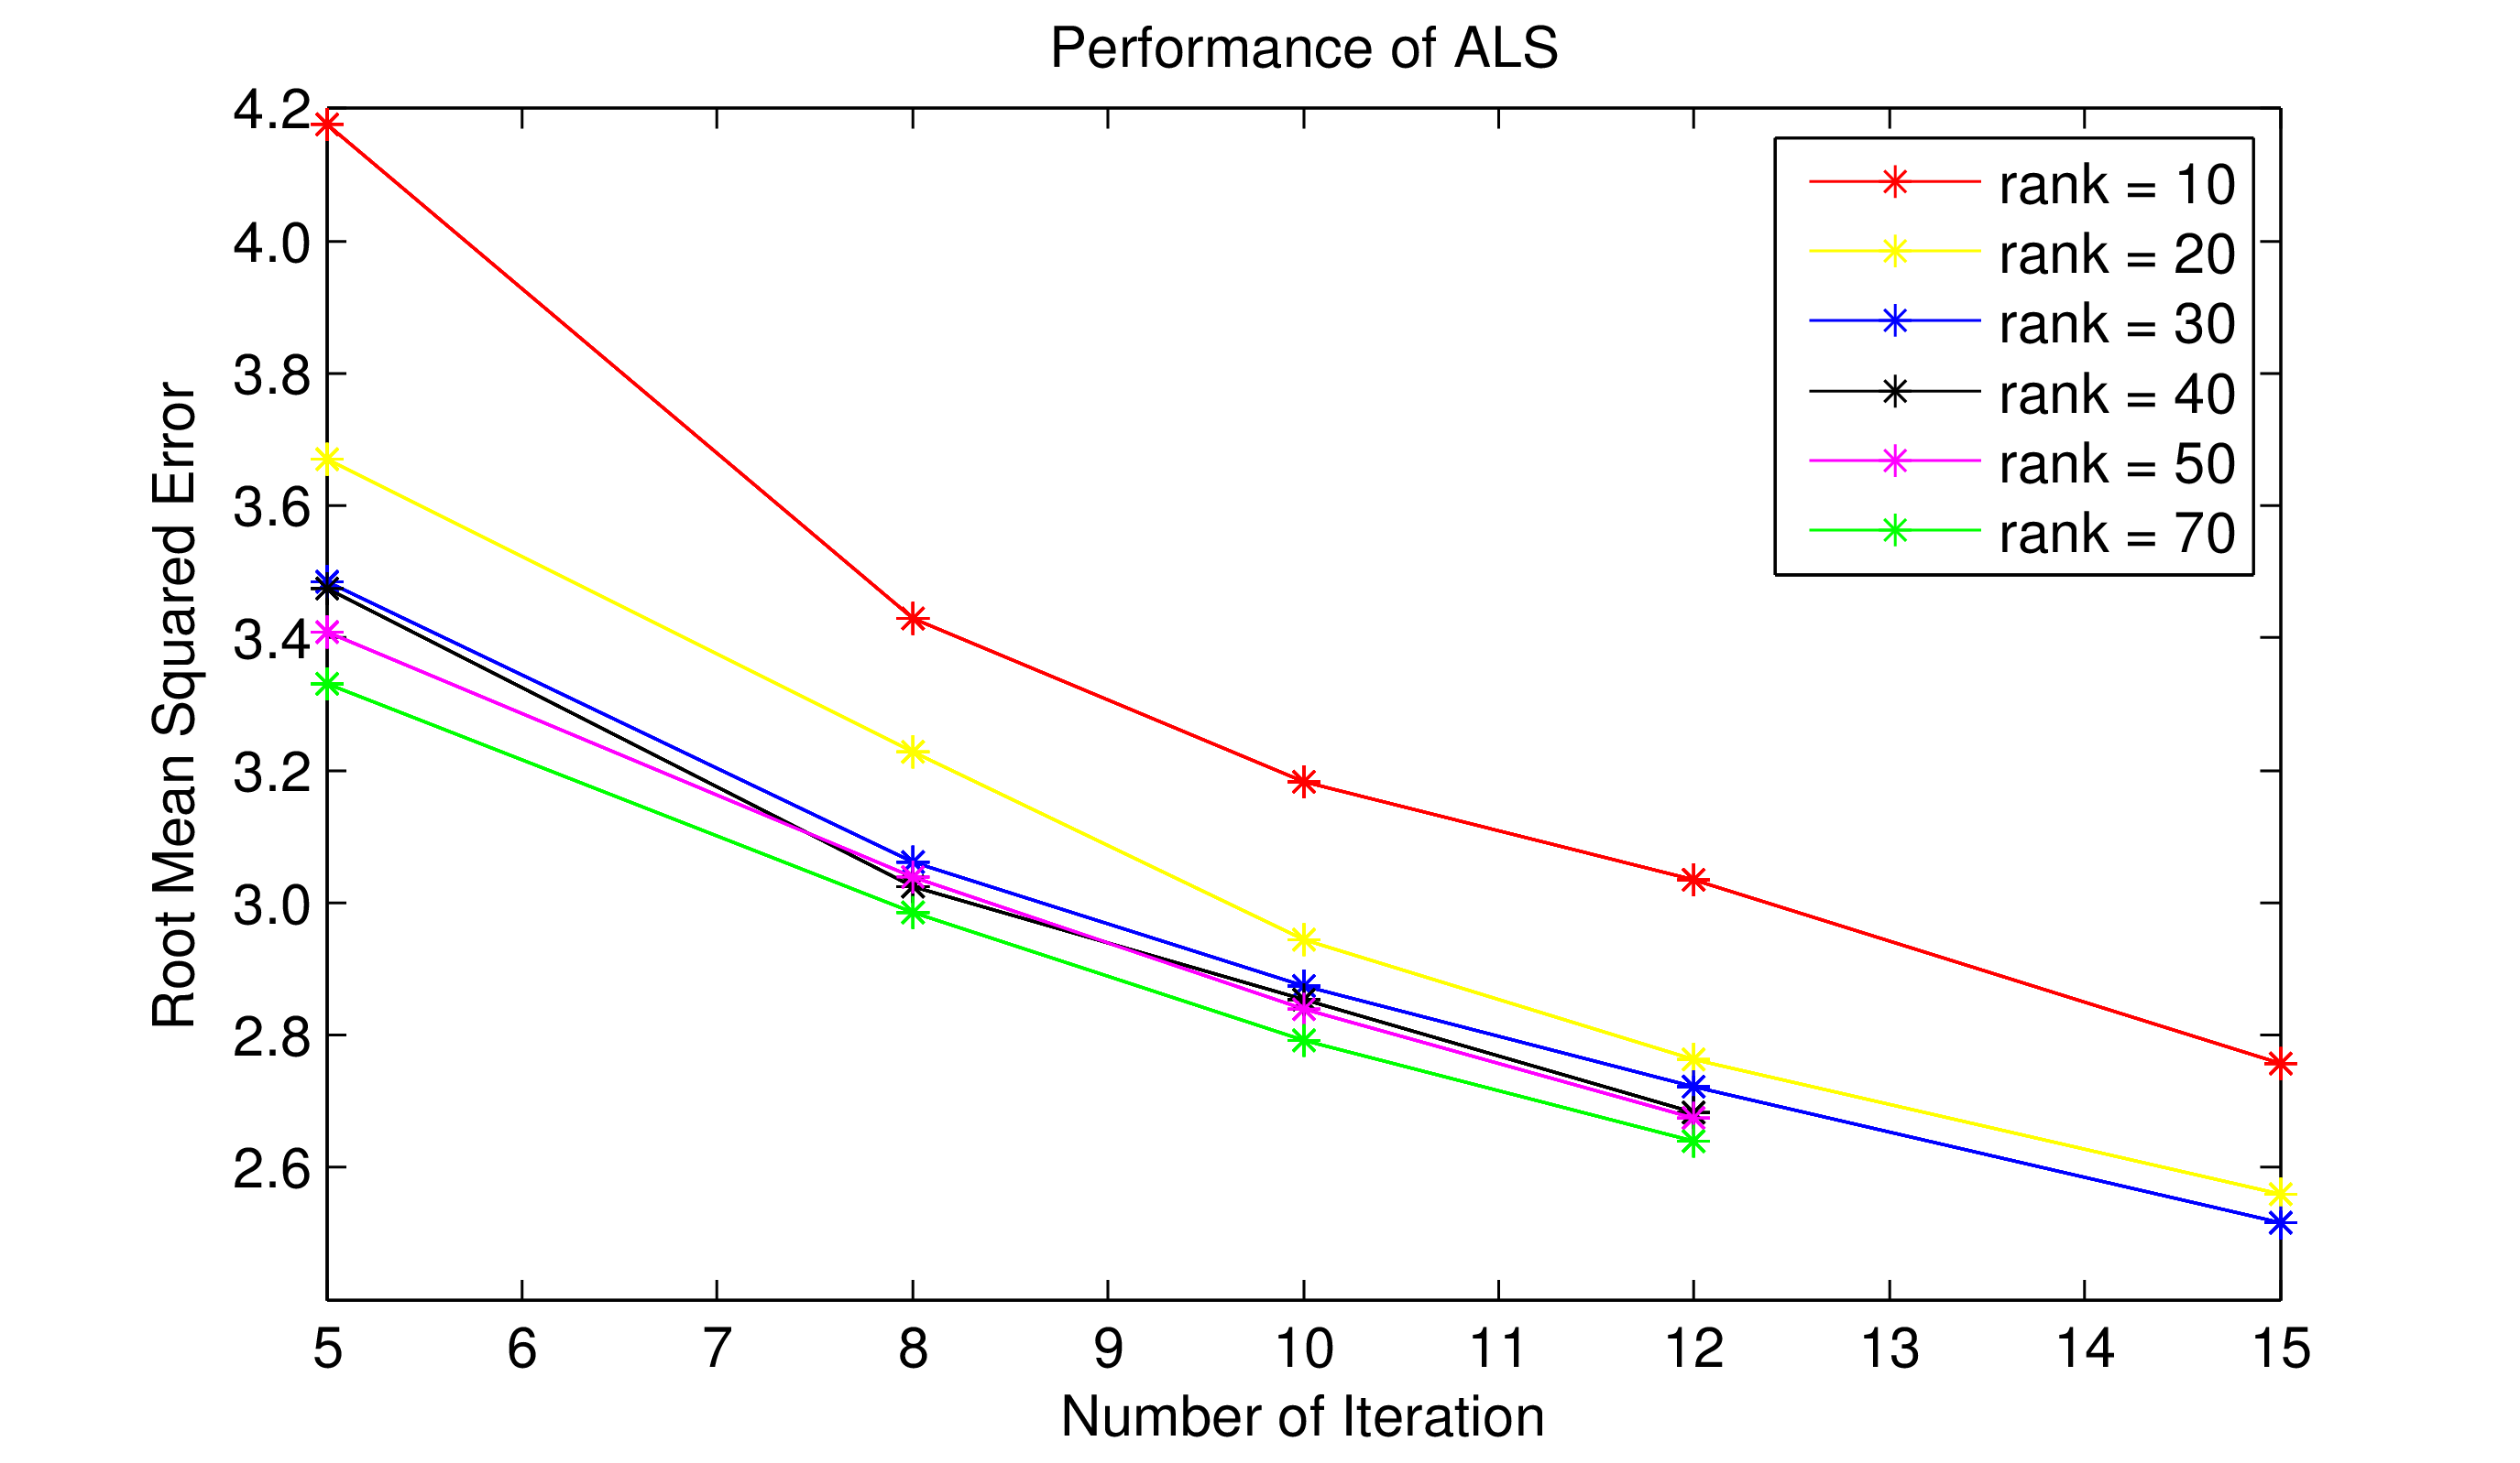
Result
ALS Performance

Slide 16
Result
AutoEncoder Performance
RMSE min around 1.12

Slide 17
Conclusion
ALS:
As my computer only have 6G memory. The least RMSE we can get is around 2.55.(from the chart I give, We find that the bigger the rank and numIter, the better performance the ALS algorithm is.)
AutoEncoder :
With personal computer, RMSE min around 1.12.(From the chart I supply, the bigger the Epoch, the better performance the AutoEncoder algorithm is)
With the same computer, AutoEncoder works much better than ALS collaborative filtering.

Slide 18
Future Work
Train the deep neural network and ALS collaborative filtering on cluster in a distributed mode.

Slide 19
Question?

