Slide 1
Object Detection In The Picture Stream
CE7454: Deep Learning for Data Science
2:43-2:52: Group 02 (3)
Liu Yanling
Zhou Jingzhe
Shi Qibin

Slide 2
Motivation and Description
National Highway Traffic Safety Administration (NHTSA) report:
10% of fatal crashes, 15% of injury crashes, and 14% of all police-reported motor vehicle traffic crashes in 2015 were reported as distraction-affected crashes.
In 2015, there were 3,477 people killed and an estimated additional 391,000 injured in motor vehicle crashes involving distracted drivers.
The distracted driving includes cell phone use, texting, eating, talking to other passengers, adjusting the radio or climate controls, and other activities.¹
The project is aimed at training a model to recognize 10 labeled activities. The model is to be used to improve the detection of driver distractions in video stream.

Slide 3
Data Acquisition, Exploration
Kaggle: State Farm Distracted Driver Detection
API: kaggle competitions download -c state-farm-distracted-driver-detection
Dataset Description
Images are taken from video clips.
Image has dimension 640×480.
Training images come with proper labels.
c0: safe driving
c1: texting - right
c2: talking on the phone - right
c3: texting - left
c4: talking on the phone - left
c5: operating the radio
c6: drinking
c7: reaching behind
c8: hair and makeup
c9: talking to passenger

Slide 4
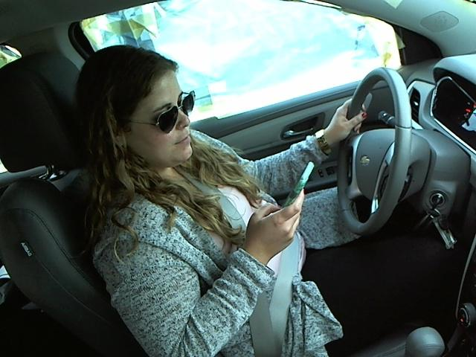
Data Pre-Processing
Use YOLOV3 to detect objects in the images. Localize the class “person”. Clean images without proper location information.
+ Bounding Box
+ Classes
•

Slide 5
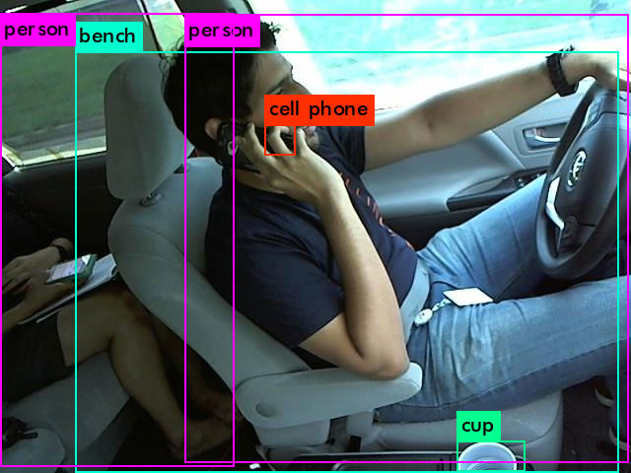
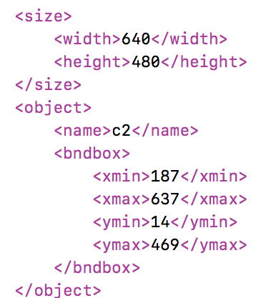
Data Pre-Processing
Get “person” bounding box as (187, 14), (637, 469). Location information is written to xml file.
Class: person, Box: 187 637 14 469, Probability: 98%
Class: person, Box: 0 237 13 473, Probability: 71%
Class: cell phone, Box: 268 299 126 157, Probability: 61%
Class: cup, Box: 463 532 447 478, Probability: 55%
Class: bench, Box: 76 627 52 479, Probability: 67%

Slide 6
Data Pre-Processing
Choose at random from processed images.
20,000 images as training data set
2,000 images as testing data set
Kaggle: Location Information
API: kaggle datasets download -d liuy0156/location-information

Slide 7
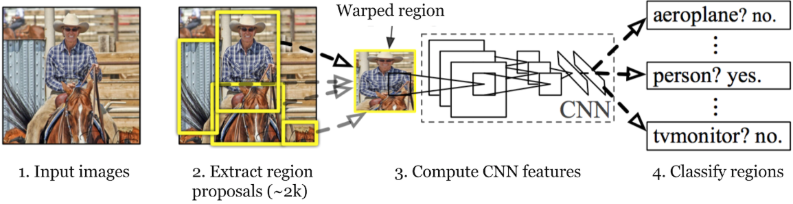
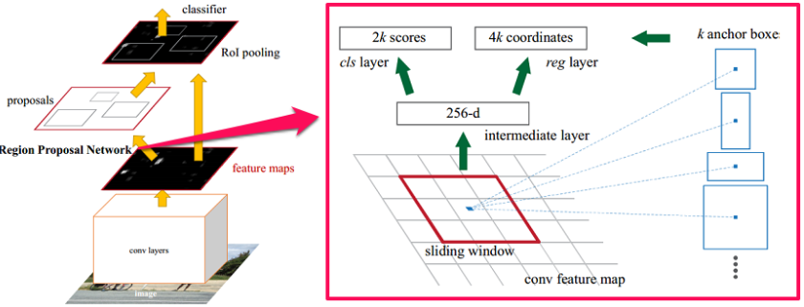
Object detection Algorithm
One-Stage model
Faster, more potential
Acceptable result
Two-Stage model
Better performance
But more computation burden
https://adeshpande3.github.io/The-9-Deep-Learning-Papers-You-Need-To-Know-About.html

Slide 8
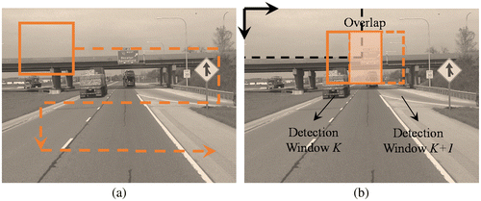
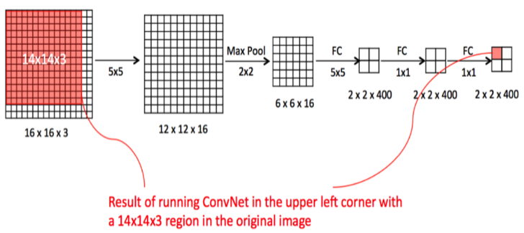
Object detection Algorithm
Sliding windows detection
https://medium.com/machine-learning-bites/

Slide 9
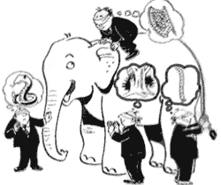
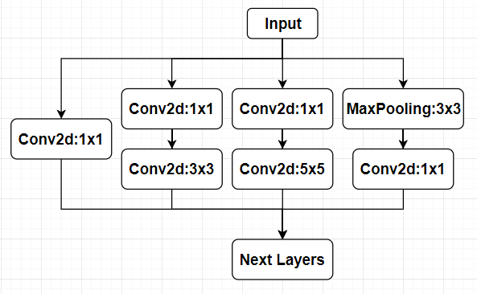
Intuition behind Inception Block
The different views on a same picture
https://fo.ifeng.com

Slide 10


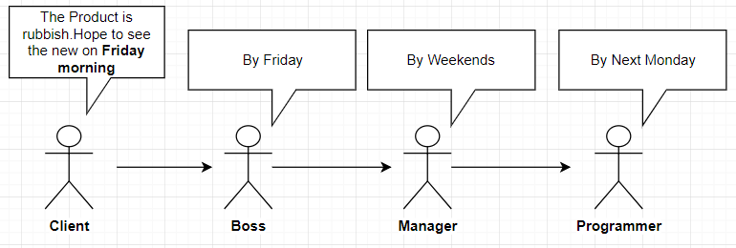
Intuition behind ResNet block
The all blocks can make a big stride due to shortcuts

Slide 11
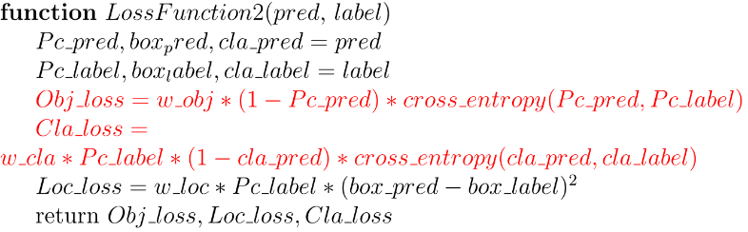
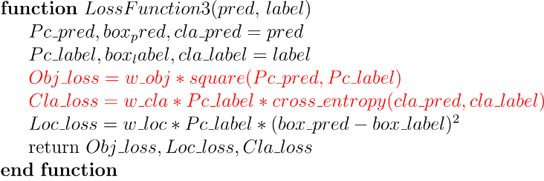
Loss_v2 and Loss_v3

Slide 12
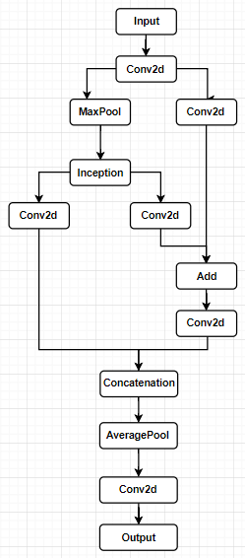
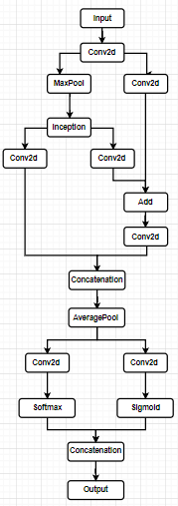
Proposed Deep Learning Solution
Net_1
Net_2

Slide 13
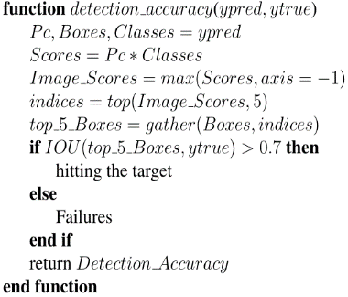
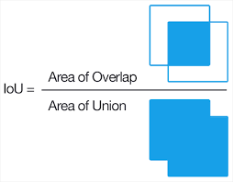
Evaluation
https://www.pyimagesearch.com/2016/11/07/intersection-over-union-iou-for-object-detection/

Slide 14
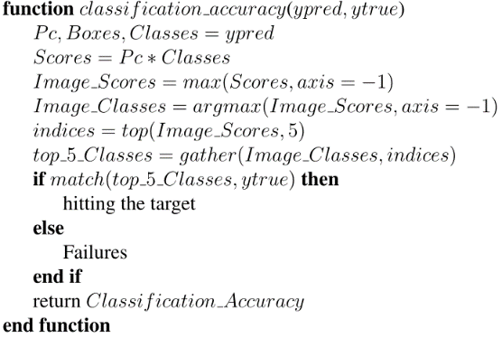
Evaluation

Slide 15
Proposed Deep Learning Solution
✔
Net_2

Slide 16

Training Methodology
Loss_v2
Decay every Epoch
Loss_V2
Decay every Epoch
Loss_V2
Decay every Batch
2,000 pictures for tuning architecture and hyper parameters
20,000 pictures for training and validation
Loss_v3
Decay every Epoch
Loss_v3
Decay every Epoch
Loss_v3
Decay every Batch
https://seeklogo.net/world-cup-trophy-vector-49551.html

Slide 17
Comparing two ways of lr decay
lr decay every epoch:
The upper scenario have the capability to overfit, and
the validation losses are also lower than using ‘decay every batch’
lr decay every batch:

Slide 18

Training Methodology
Loss_v2
Decay every Epoch
Loss_V2
Decay every Epoch
Loss_V2
Decay every Batch
2,000 pictures for tuning architecture and hyper parameters
20,000 pictures for training and validation
Loss_v3
Decay every Epoch
Loss_v3
Decay every Epoch
Loss_v3
Decay every Batch
https://seeklogo.net/world-cup-trophy-vector-49551.html

Slide 19
Choose the better loss calculation and suitable decay rate
Loss v2
is better than Loss v3
decay = 0.1 decay too fast
decay = 0.001 almost no decay

Slide 20
Analysis of Results
Best model
Validation_split = 0.20
Validation_split = 0.35
training loss
validation loss

Slide 21
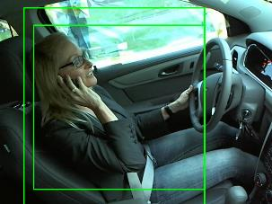
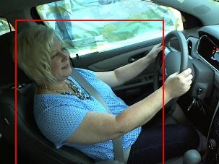
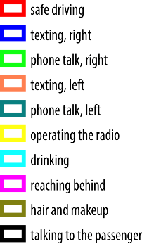
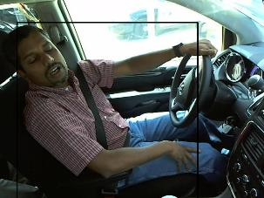
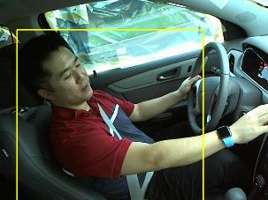
Prediction

Slide 22
Notebook Description for Reproducibility
Please refer to readme.txt in the package and project description in jupyter notebook files.
Github
https://github.com/yanyan1liu/group2ce7454

Slide 23
Contribution Table
Name | Major Work
Liu Yanling | Project Design, Dataset Processing
Zhou Jingzhe | Design Networks, Result Analysis
Shi Qibin | Design Experiments, Result Analysis
All the work is collaborated by all members.

Slide 24
References
1. National Center for Statistics and Analysis. Distracted Driving: 2015, in Traffic Safety Research Notes. DOT HS 812 381. March 2017, National Highway Traffic Safety Administration: Washington, D.C.

Slide 25
Thank you!

