Slide 1
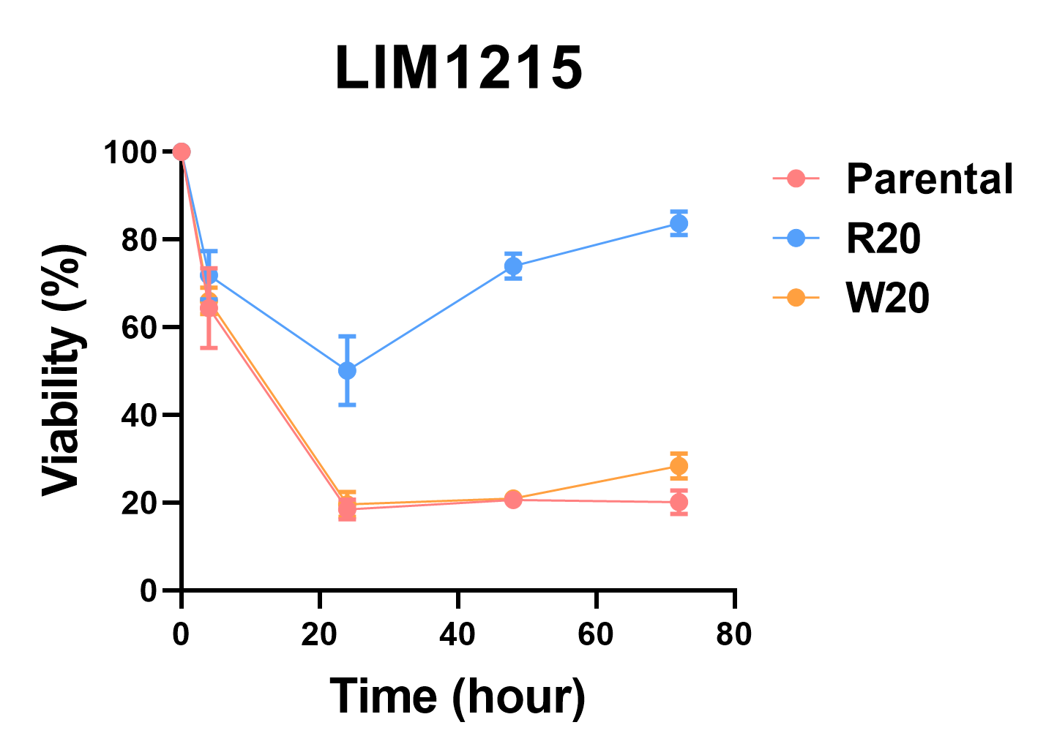
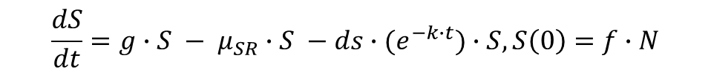

Modeling data: Cell ADCC viability, Know: initial R and S fraction, R and S growth rate
g
g
µ_{SR}
S
R
µ_{RS}
ds(t)
dr(t)
When the drug is on, only S will switch to R. When the drug is off, R will switch to S.
Since the ADCC viability were all measured after 3 days of drug treatment, parameters µ_{sr}, ds, dr, k will be estimated using ADCC viability data.(averaged by each cycle). K represents the drug efficacy decay with time. Growth rate g is calculated by average doubling time of parental, R20, W20 cells. Initial composition of S and R ratio f is from scRNA data (subpopulation figure).
µ_{RS} will be estimated separately using the reverse cycle 10, 20 data.
$$\frac{dS}{dt}=g∙S − μ_{SR}∙S −ds∙(e^{−k∙t})∙S, S\left(0\right)=f∙N$$
$$\frac{dR}{dt}=g∙R+ μ_{SR}∙R −dr∙(e^{−k∙t})∙R, R\left(0\right)=(1−f)∙N$$
$$ADCC viability\%=100\%∙{(S\left(t\right)+R\left(t\right))}/{N∙e^{g∙t}}$$

Slide 2
F (S and R fraction) from scRNA data
From bulk RNA sequence, we know the resistant cells are up-regulated in CD74, CCL3, HRA-DRA genes (slide 3)
scRNA data have 5 clusters (slide 4)
Cluster 2 and 4 are low in CD74, CCL3, HRA-DRA, so cluster 2 and 4 represent “S” subpopulation, cluster 0, 1, 3 represet “R” population. (slide 4)
Calculate the “S” and “R” fraction for parental, R20, and C20 cells as the initial conditions. (slide 5)

Slide 3
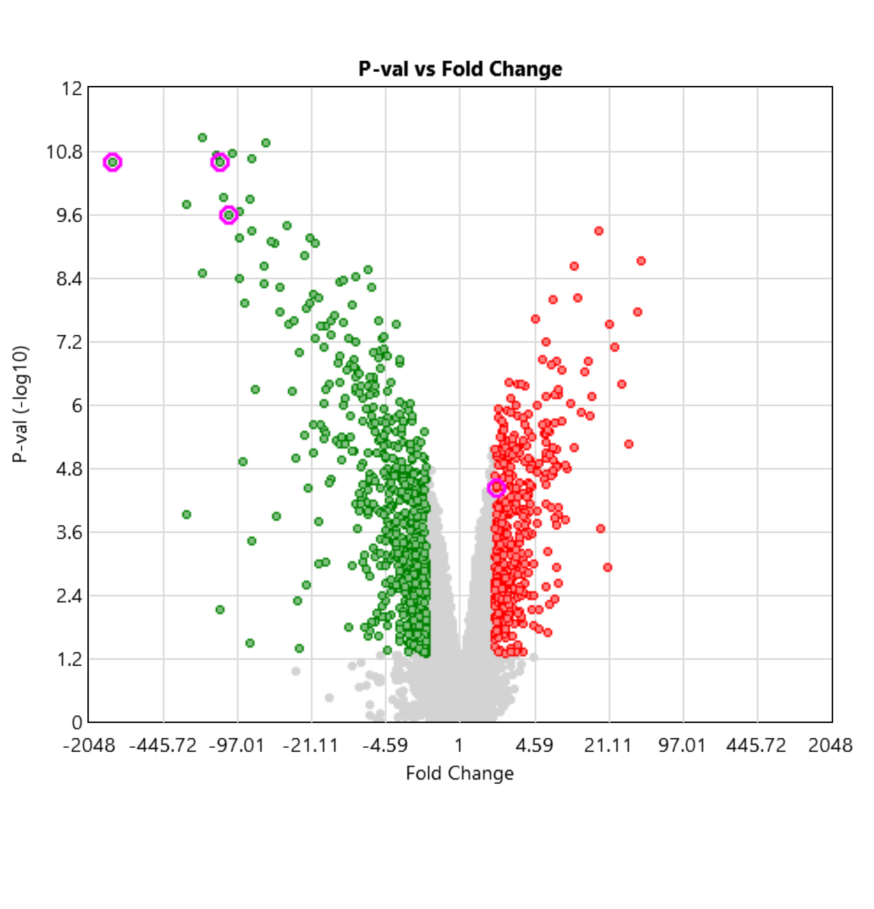
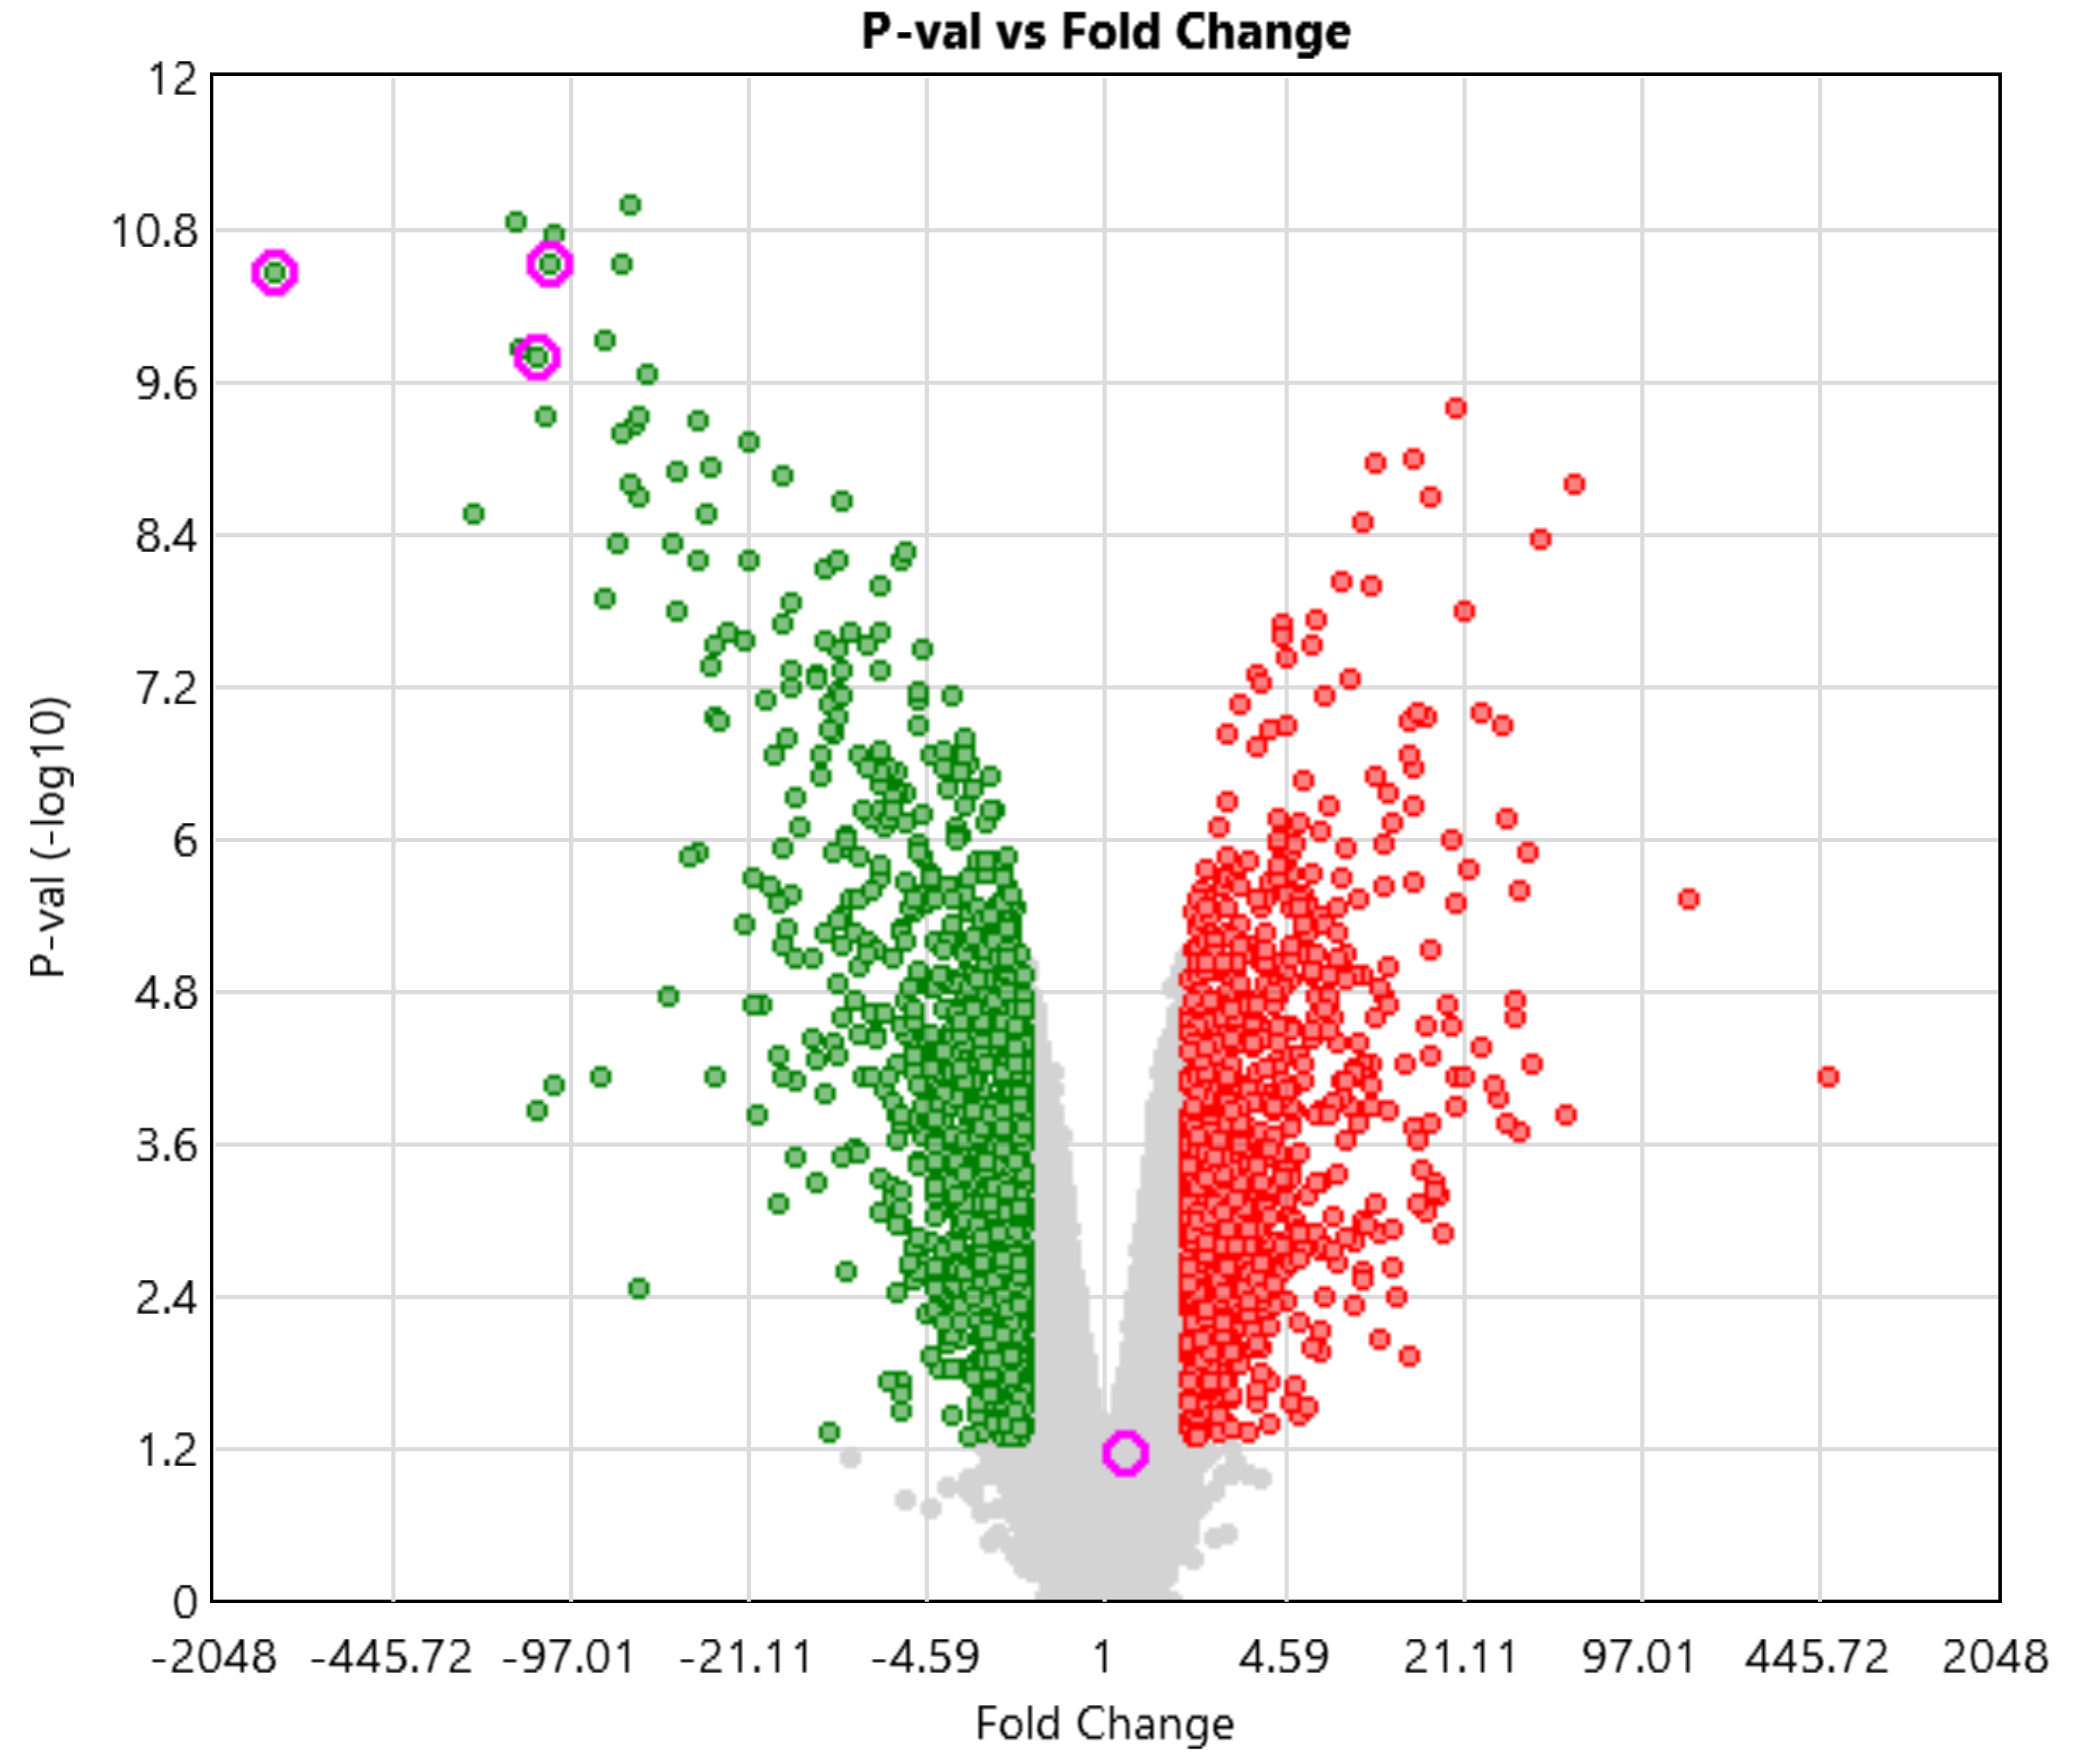
LIM1215 bulk RNA sequence
Parental vs. R20
W20 vs. R20
HLA-DRA
CD74
CD74
CCL3
HLA-DRA
CCL3
HSPB1
HSPB1

Slide 4
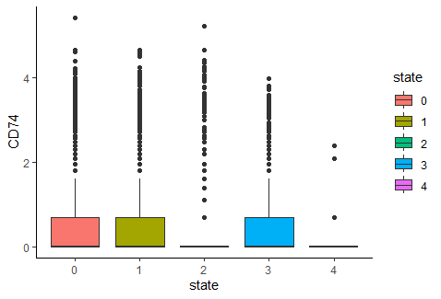
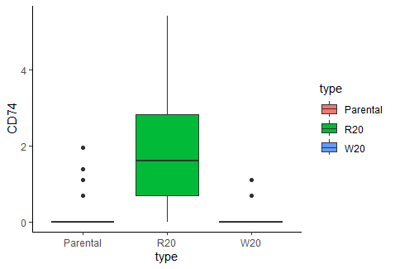
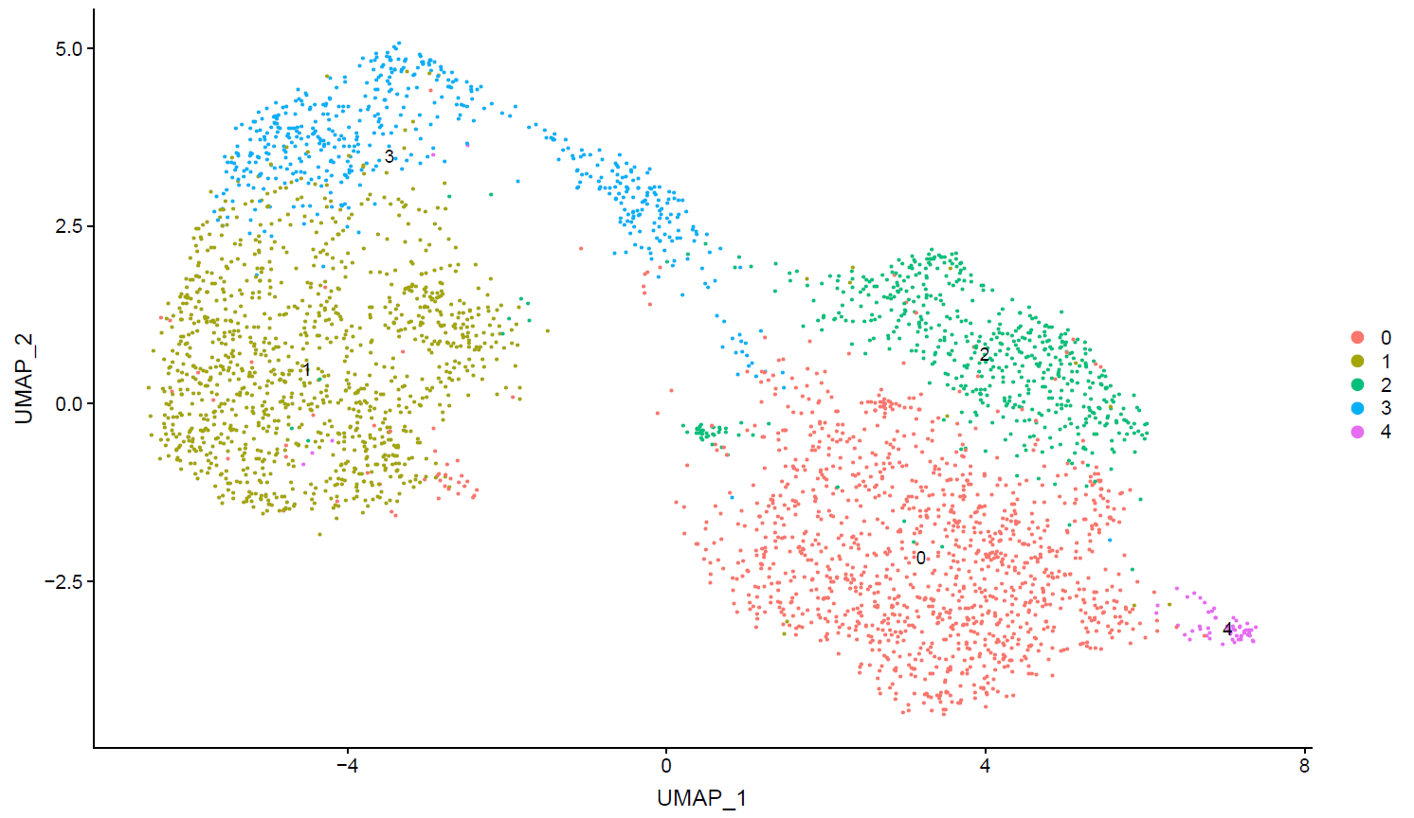
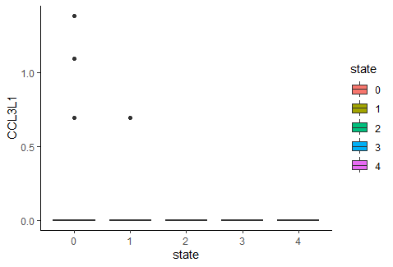
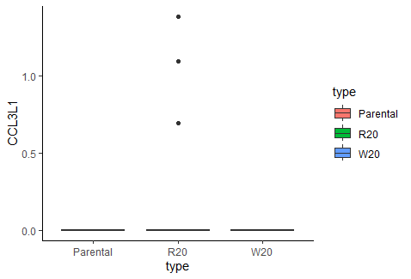
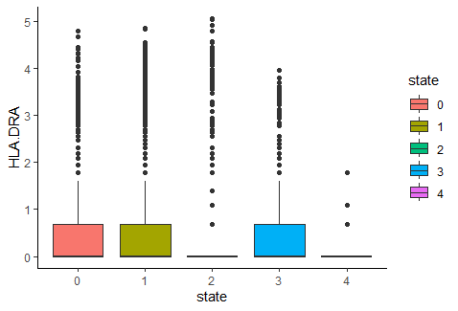
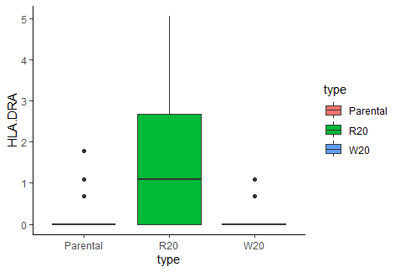

Slide 5
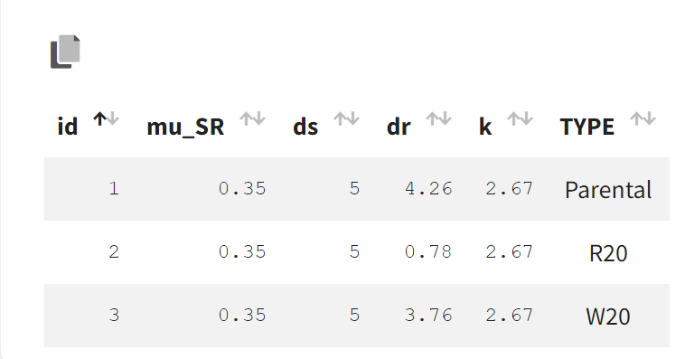
Estimate with Monolix SAEM, each experiment sample is an ID, random effects on parameters, proportional error.
Individual parameters
Parameter | Definition (Unit) | Estimate | RSE%
mu_SR | Transition rate from S to R (1/day) | 0.347 | 944
ds | S death rate under drug (1/day) | 5 | Fix
dr | R death rate under drug (1/day) | 4.26 | 21.1
k | Drug efficacy decay rate (1/day) | 2.67 | 17.7
dr for Parental: 4.26; R20: 0.78; W20: 3.76

Slide 6
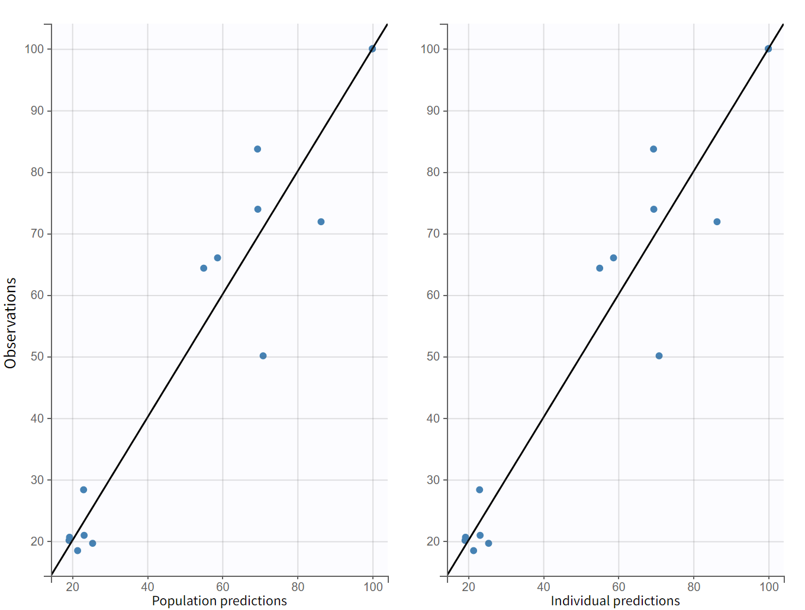
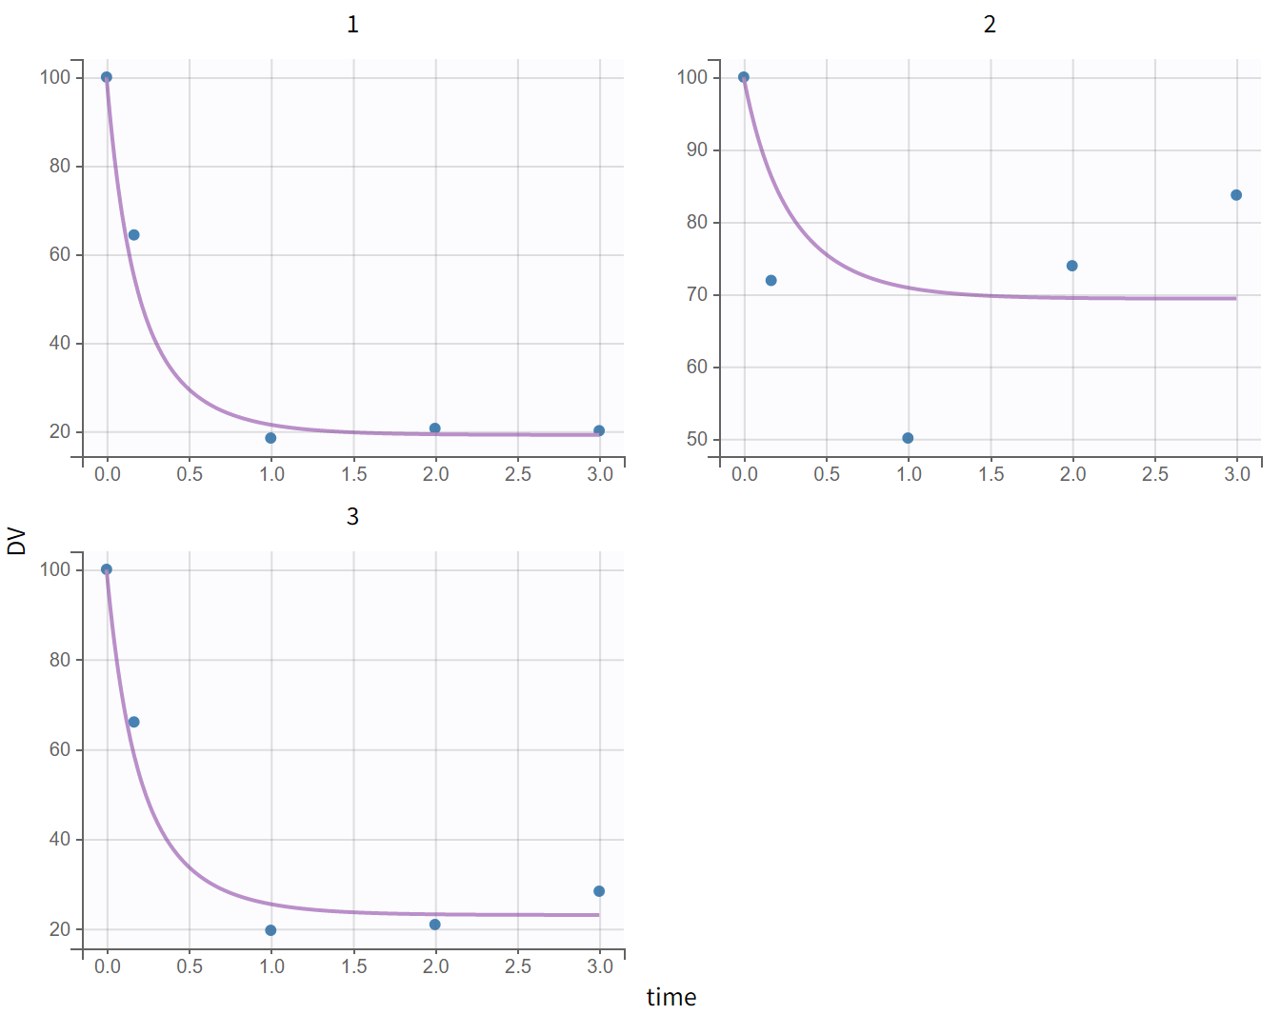
Model diagnostic plots test1

Slide 7
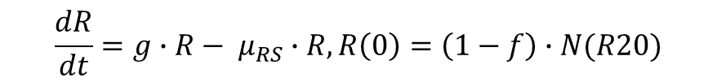
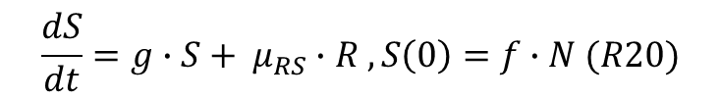

Calculate mu_RS
g
g
S
R
µ_{RS}
$$\frac{dS}{dt}=g∙S+ μ_{RS}∙R , S\left(0\right)=f∙N (R20)$$
$$\frac{dR}{dt}=g∙R− μ_{RS}∙R, R\left(0\right)=\left(1−f\right)∙N(R20)$$
Monolix estimate
Mu_RS = 0.0014 1/day
$$frac_W20={S(60 days)}/{S\left(60 days\right)+R(60 days)}$$

Slide 8
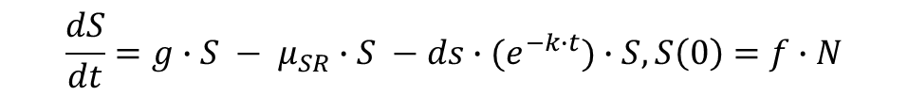
Updated model for simulations
g
g
µ_{SR}
S
R
µ_{RS}
ds(t)
dr(t)
$$\frac{dS}{dt}=g∙S − μ_{SR}∙S −ds∙(e^{−k∙t})∙S, S\left(0\right)=f∙N$$
$$\frac{dR}{dt}=g∙R+ μ_{SR}∙R −dr∙\left(e^{−wt}\right)∙(e^{−k∙t})∙R, R\left(0\right)=(1−f)∙N$$
$$dr\left(60 days\right)=dr\left(0 days\right)∙\left(e^{−wt}\right)$$
$$0.78=4.26∙\left(e^{−wt}\right), w=0.028 per day$$

Slide 9

Simulations with on/off dosing
Assume once the treatment is off, R switch back to S, and resistance doesn’t accumulate, change back to initial state ( $\left(e^{−wt}\right)$, t start from 0), this came from the dr drops back in W20 compared to R20)

