Slide 1
Label Printer & Stock Finder
A very brief overview
Alain Garcia
Zhou Lab

Slide 2
Main purposes
Find stocks faster
Find by genotype, responsible person, project, etc.
Print labels without having to type genotype manually

Slide 3
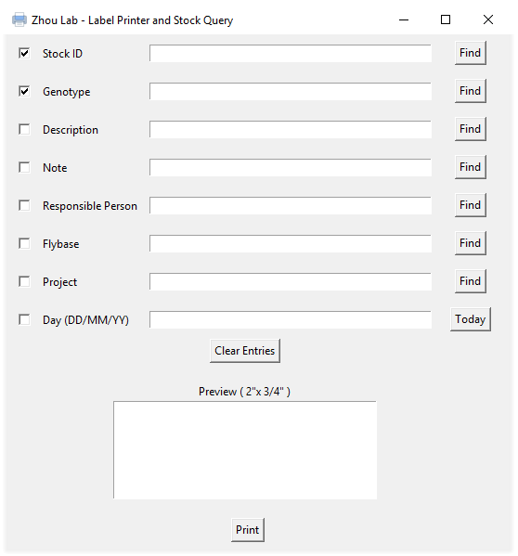
Graphical user interface
Checkboxes to select what will be displayed on the label preview
Find with respect to current row
Day entry if you want to specify creation date
All entries and textboxes are editable
A rough estimate of what the label will look like

Slide 4
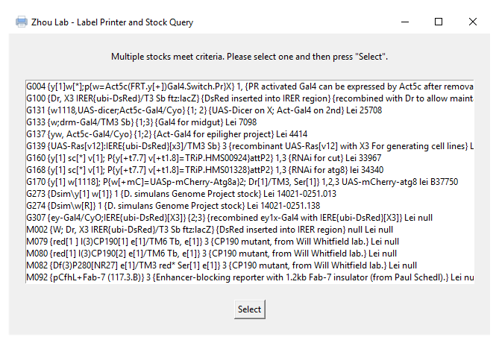
When not selecting from Stock ID
Multiple stocks may match the search criteria
One must be selected
Click on one and then press “Select”
Example: “Lei Zhou” was searched under the “Responsible Person” entry

