Slide 1
Fly Stock Program
A very brief overview
Alain Garcia
Zhou Lab

Slide 2
Main purposes
FINDER
Find stocks faster
Find by genotype, responsible person, project, etc.
Print labels without having to type genotype manually
ADDER
Show empty stock numbers
Add stocks from Bloomington .csv files

Slide 3
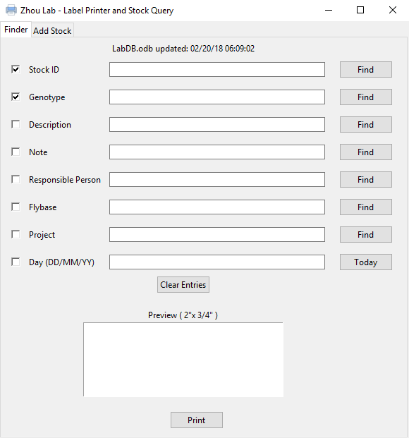
Graphical user interface
Checkboxes to select what will be displayed on the label preview
Find with respect to current row
Day entry if you want to specify creation date
All entries and textboxes are editable
A rough estimate of what the label will look like

Slide 4
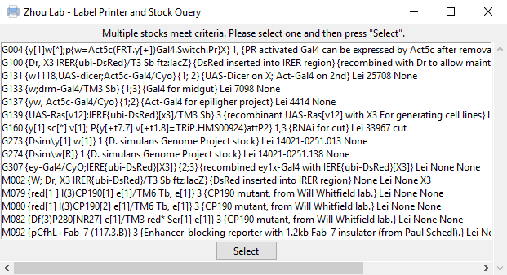
When not selecting from Stock ID
Multiple stocks may match the search criteria
One must be selected
Click on one and then press “Select”
Example: “Lei” was searched under the “Responsible Person” entry

Slide 5
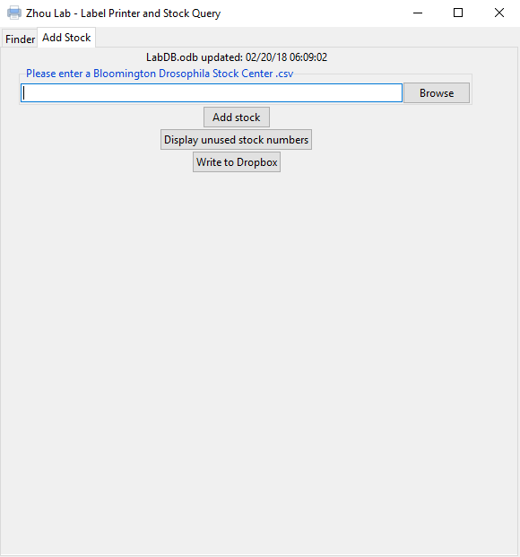
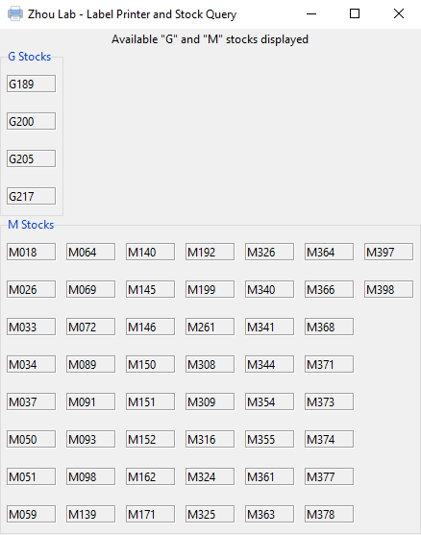
Add Stock
Enter Bloomington .csv file location in the textbox, then press ‘Add Stock’ to add Bloomington stocks
Display unused stock numbers simply displays numbers that are currently unused (shown below)
Write to Dropbox currently does nothing (for safety purposes).

Slide 6
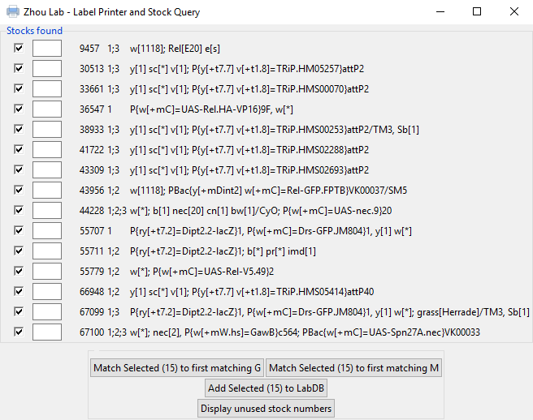
ADD STOCK (Continued)
All Bloomington stock will be displayed.
Select which ones you want added (all of them by default)
Use the Match buttons to automatically assign the stocks to the first empty position.
Once all stocks have been assigned a stock number (Note: Make sure you have not entered an existing stock number), press the ‘Add Selected…’ button
Display unused stock numbers is displayed for convenience
Stocks are currently added to …/Resources/Lab.odb

