Slide 1
Vision-Centric Autonomous Driving
Guided by Ph.D Liguo Zhou
Presented by Hao Yang

Slide 2
Content
Motivation
Structure of Project
Preprocess of input images
Resnet
Yolov5
Object detection and Distance detection
Issue
Discussion

Slide 3
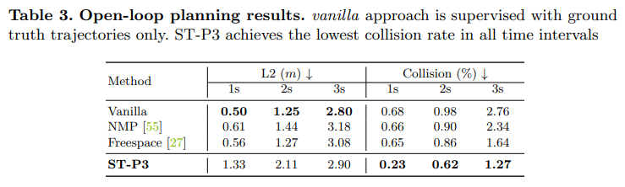
Motivation
End-to-end trajectory prediction
Only ground truth trajectory provided
Or
Ground truth trajectory + camera
How does the vision-centric autonomous driving perform?

Slide 4
Structure of Project
Collection of datasets: Nuscenes Dataset
Preprocess of images and coordinates in different frames
Networks: Resnet50, LSTM
Train: get weights for networks
Tune:
L1 or L2 as Loss function
Calculation of loss = prediction - ground truth
Calculation of loss = prediction – (ground truth of first node + prediction of displacements)
Input: Images + Coordinates or only coordinates
Network: LSTM or simply fc layer

Slide 5
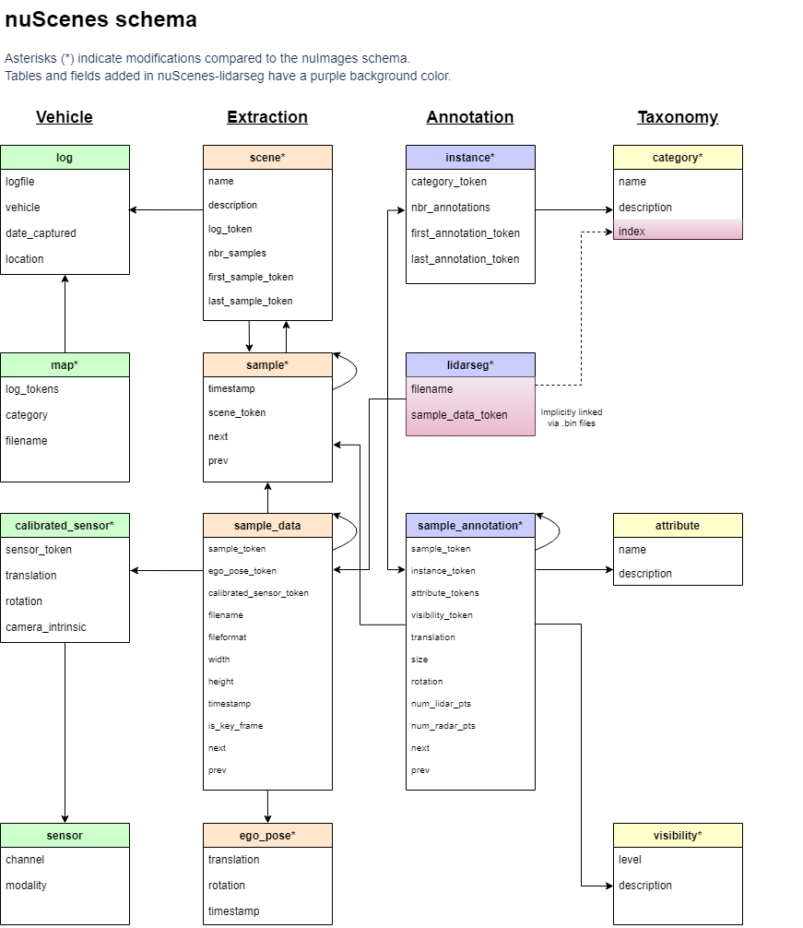
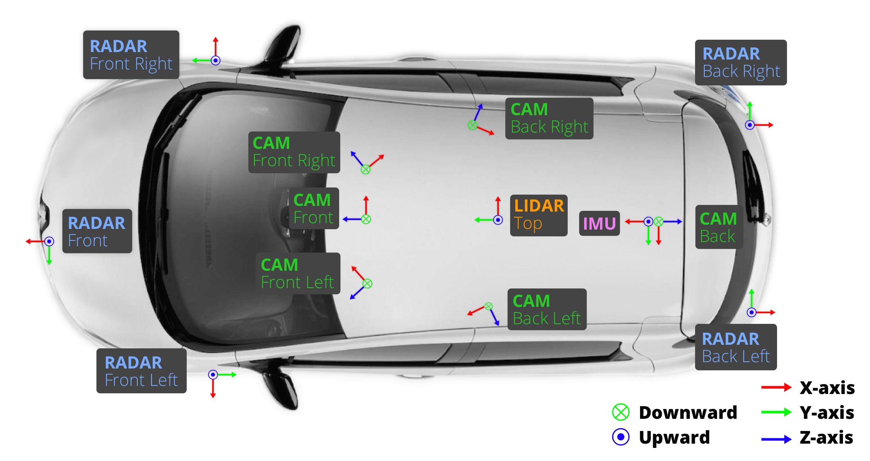
Nuscenes Datasets
Ego pose from IMU
Ego pose from LIDAR at top of vehicle
Images from the camera at top front of vehicle

Slide 6
Preprocess of Images and Coordinates
Images:
Random crop
Color jitter (Brightness, Contrast, Saturation, Hue….)
normalization
Coordinates:
Use rotation and transformation parameters to construct extrinsic and intrinsic matrix
Transform all points' coordinates from the world coordinate system to coordinates established based on the current frame's car pose
Output the displacement between two adjacent time points
Output the displacement between current time point and other time points

Slide 7
Network
Image
Coordinates
Resnet:
Extract features from images
LSTM:
Process the coordinates sequences
Model 1: predict 6 points at once
Model 2: Predict one point at a time, inputting the previous prediction result and the previous three frames of data
Combination of features:
Image features : coordinate features = 1 : 1
Image features : coordinate features = 12 : 96
Resnet
LSTM
FC-Layer
Output

Slide 8
Results of test
 | criterial | L2 |  |  | collision rate (%)
 | time | 1s | 2s | 3s | 1s | 2s | 3s
with image | one lstm + dx + 12-96 | 0.316 | 0.598 | 1 | 0.5187 | 0.6485 | 0.9926
 | one lstm + dx + 1-1 | 0.53 | 1.179 | 2.1 | 0.28 | 1.87 | 5.1
 | one lstm + original + 12-96 | 1.38 | 6.6 | 15.38 | 0.6 | 3.69 | 5.43
 | multi lstm + original + 12-96 | 1.37 | 6.545 | 15.208 | 0.55 | 3.69 | 5.537
 | multi lstm + dx + 12-96 | 0.314 | 0.621 | 1.06 | 0.332 | 0.519 | 1.01
coo | multi lstm + original | 1.53 | 7 | 16.3 | 0.228 | 3.6 | 4.93
 | multi lstm + dx | 0.336 | 0.655 | 1.09 | 0.322 | 0.467 | 0.809
 | one lstm + dx | 0.254 | 0.563 | 1.01 | 0.342 | 0.493 | 0.8266
 | one lstm + original | 1.45 | 6.816 | 15.77 | 0.4565 | 3.6366 | 5.236
STP3 |  | 1.33 | 2.11 | 2.9 | 0.23 | 0.62 | 1.27

Slide 9
Conclusion
Image don’t help with performance optimization
Multi-lstm model doesn’t help much
Modified L2 loss calculation makes performance of models much better

Slide 10
Discussion
The resnet50 model works not good with feature extraction in this project, more complicated and powerful model like Transformer should be applied.
Too small batch size makes loss curve redundant and not converge
Too huge batch size makes training trapped in local minima easily
The modified L2 loss calculation works well, it can be used in other projects

Slide 11
Thanks for your attention!

Slide 12
Reference
https://link.zhihu.com/?target=https%3A//arxiv.org/pdf/1911.11929.pdf

