Slide 1

Choose a few files as sample to run normal CNMF-E individually. Each file will get some neurons that are common to all sample files as well as some unique neurons that file only in that file.
Sample folder
Generate a common spatial footprint of neuron (A): merge common ones and keep unique ones.
Use this A to extract neuron temporal C in all data you are interested in.
data folder

Slide 2
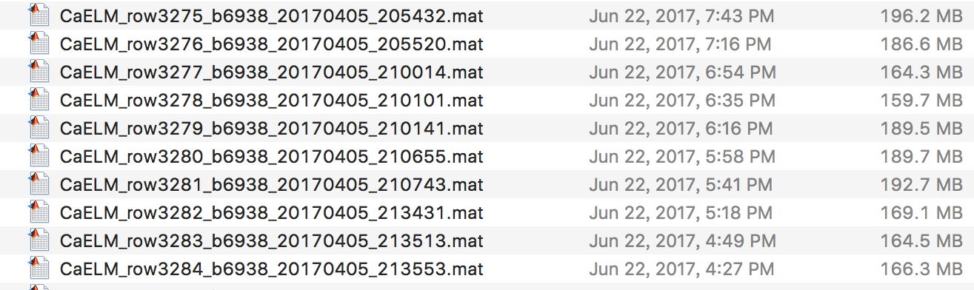
A
A
A
A0s
A
delete samples with empty A
A
{1}
{2}
{3}
{4}
{5}
{6}
Sample folder
A
A0s’ mask
①Normal CNMF-E for each sample file i individually
Output: A0s{i}, File(i)
③ Similar neurons extracted in different files should have similar spatial footprint as well as similar temporal traces across files. User-specified correlation threshold is used in this step.
Merge their A. See MergeAC() for detailed merging strategy. Output: ACS’s updated A and STD field. (some neuron’s A and STD deleted, while those merged have the same A and STD in each file’s ACS)
② For each sample data
For each A0 mask cell element, use it on background subtracted sample data to extract C (Each mask cell starts with fresh data). After extraction of one neuron, re-estimate its A and peel the signal (A*C) off.
The result is put in structure ACS. ACS(i) has file i’s BigC, its STD, and BigA. See A2C2A() for details.
Sample data 1’s BigC
data 2’s
data 3’s
1
2
3
2
ACS
K
1
2
3
4
5
6
Sample data 1’s A0s
④ Those neurons that cannot be merged will have A’s (Each sample file’s BigA) weighted and summed based on standard deviation of each A column’s corresponding C trace. See weightedA=ReducingA(…) for detailed method.
{1}
2
3
4
5
6
Each sample file has a BigC
Sample data 2’s A0s
{1}
2
3
4
5
6
Sample data 3’s A0s
1
2
3
4
5
6
Each sample file has a BigA
Afinal
⑤ Use this A to extract neuron temporal C in all data you are interested in. No initiation and iteration for data. Use background subtraction strategy in the normal cnmf-e to subtract background, then use regression to find C corresponding to A. Save results in neuron_batch.neuron. See more in “Input and Output” in “Getting Started” section.
data folder

Slide 3
Key Variables | Description
A0s | Cell array. A0s{i} contains the A for sample data i.
File | Structure. Length of sample number. Containing two fields, 'options','Ysignal'. Options keeps the neuron.options. Ysignal keeps the background subtracted and de-noised data, which is essentially A*C after iteration.
Mode | String, either 'initiation’or ‘massive’, which means sampling and extracting all data respectively.
ACS | Structure. Length of sample number. Three fields. 'Ain','Cin','STD'. ‘Ain’and ‘Cin’is the BigA and BigC in Figure2(ReadMe). ‘STD’is the standard deviation of each temporal traces(Cin).
ind_del | There are two ind_del in different scopes in this BatchVer. ind_del of the output of mergeAC is an intermediate variable, indicating that these neuron(ind_del) are involved in merging. Users would not need to care about this one too much. The other one is in the output of final result, neuron_batch. ind_del here is an index for neurons that have temporal traces not deconcolved successfully or have all zeros. Looking at all files’ind_del, In output log file of each running, “First x neurons are successfully deconvolved in each files” is printed to prompt you this. The number of x is sum(~ind_del_final).
Afinal | The final A used to extract all file’s C.
neuron_batch | Structure, length of data file number. Each row of neuron_batch stands for each data file, which has information/data in 4 fields, 'ind_del','signal','FileOrigin','neuron'. Ind_del, see above. signal is a matrix where each row is the neuron’s background subtracted and denoised signal: median(jA(jA>0)*jC). FileOrigin is a structure, essentially a row of dir(Datadir). neuron is the result of CNMF-E using Afinal. This neuron does not contain full information as a normal CNMF-E due to the steps it skips. See section Summary of differences between CNMF-E (basic) and CNMF-E (BatchVer) in ReadMe for more information.

