Slide 1
QPModel⁺ Meeting #2
Qingqing Zhou
09/2020

Slide 2
Code of Conduct for Open Source Meetings
Should preferably conduct meetings in English language.
Prior to the meeting, publicly publish the meeting Calendar & Agenda (in English using GoogleDocs) with link on the main page of github repo.
After the meeting, publicly publish the meeting Minutes (in English using GoogleDocs) & Recordings with link on the main page of github repo.
Discussion during the meeting shall primarily focus towards project related technical considerations and information shared during the meeting should be non-proprietary.
Meeting shall be conducted in compliance with the applicable Export Control laws.

Slide 3
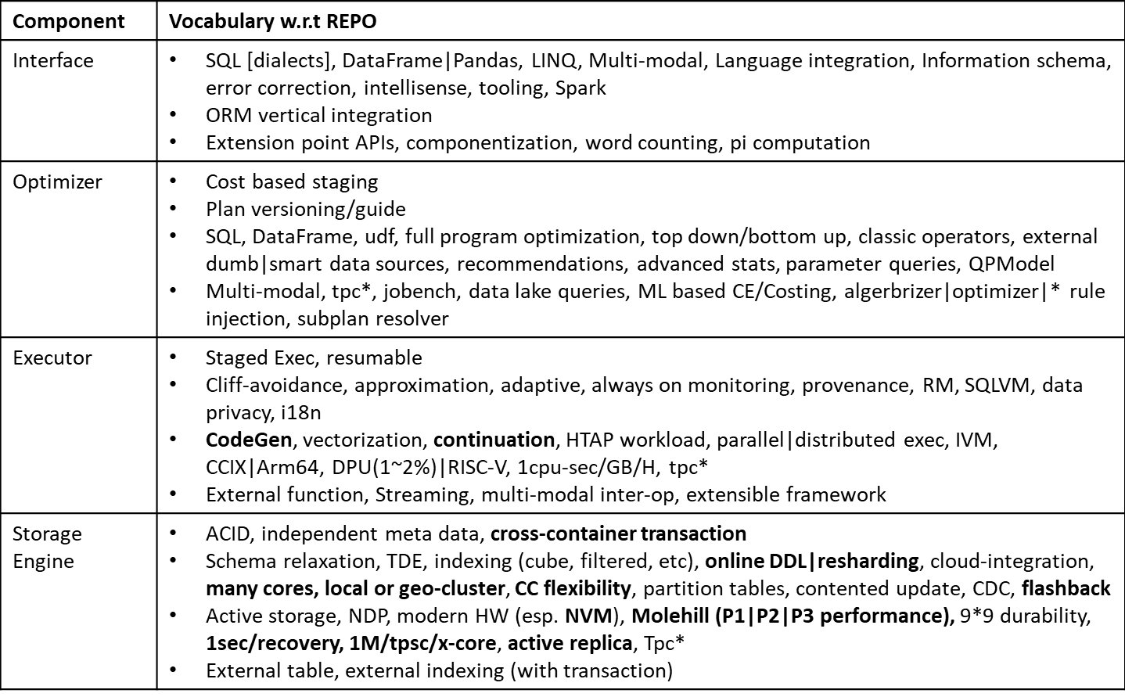
Review of Technologies (see meeting#1 notes)
Notes:
- Bold are OLTP highlights

Slide 4
QPModel Status
Academic Collaborations
Query Optimizer research based on QPModel
[PAPER] Working on optimizer benchmark paper (target EOY): cardinality estimation (CE) is one of the core problems of optimizers. There are many proposed statistical or machine learning based methods try to improve the CE precision. However, there is no clear standard or benchmarks to measure their efficiency and correctness. This paper is try to introduce such standard, implements a benchmark based on real or synthetic dataset and evaluates multiple popular CE algorithms.
[PAPER] Working on a DL based optimizer improvement (target EOY): This innovative CE estimation improvement introduces graph model capture the query structure, merging with data based deep learning CE model and improve join, group by and predicate precision and inference performance.
Storage Engine research based on Ermia
Working on query execution re-architecture (target MOY-2021)

Slide 5
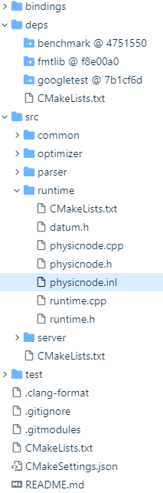
QPModel Status (cont.)
QPModel Native Implementation (target EOY)
Working on native framework
C0 System: Architecture, C++ style error handling, memory management etc
Shared memory single machine, shared nothing cluster
Transaction level exception handling / C++ pmr based memory management
C1 Interface: Enhance SQL, DataFrame, Extension API/Python bindings
Algorithm borrow from QPModel
C2 Optimizer: Porting QPModel
Algorithm borrow from QPModel but pay more attention to coding efficiency
C3 Executor: HTAP engine, streaming, parallel/distributed
Coroutine based, Combine Open source OpenGauss work and QPModel’s codeGen model
Support multi-modal execution model
C4 Storage Engine: integration only
Integrate with Ermia open source
Used as a basis for query execution re-architecture collaboration
QPModel generate and serialize plan

Slide 6
Mile Stones (before 12/21)
Milestone | Deliverables
10/21 | Experimental code exercising different design options, including all major components Overall System Design doc
12/21 | Native database engine framework with focus on query optimizer + execution layer, runnable with some representative queries from TPCH and short stroke TPCC like queries Two papers submitted on optimizers

