Slide 1
qpmodel
Design Introduction

Slide 2
Hybrid SQL Compiler and Optimizer
qpmodel架构如下：
User
SQL Query
Parser
Abstract Syntax Tree
AST
Builder
Executor
Unresolved Logic Plan
Native Code
Binder
Catalog
Cost Estimates
Compiler
Resolved Logic Plan
Source Code
Logic Optimizer
Optimizer
Code Generator
Optimized Logic Plan
Physical Plan

Slide 3
Binder
Binder通过Catalog对SQL Query进行校验和解析，包括关系，属性，数据类型等。
Catalog以寻找查询的关系，从而从中解析出这个关系的属性。
Catalog
Binder
SELECT sum(v)
FROM (
SELECT
t1.id, 1 + 2 + t1.value as v
FROM t1 JOIN t2
WHERE
t1.id = t2.id AND t2.id > 50 * 1000) tmp
Aggregate
sum(v)
Project
t1.id, 1 + 2 + t1.value as v
Filter
t1.id = t2.id
t2.id > 50 * 1000
Join
Scan(t1)
Scan(t2)

Slide 4
Binder
当引用的关系在物理上shading，在Resolved Logic Plan中插入Exchange Plan，记录关系的shading节点信息。
SELECT a1,a2 FROM ad where a1 < 100
a1 isn’t distributed
a1 is distributed
Project
ad.a1, ad.a2
Project
Filter
ad.a1 < 100
Filter
insert Exchange
With node id of shading
Exchange
ScanTable
ad
ScanTable

Slide 5
Logic Optimizer
通过关系代数的局部等价变换，使得变换前后返回的结果不变但执行成本不同。通过寻找执行成本最低的关系代数表示，将查询优化为更高效的logic plan。这些包括常量折叠，谓词下推，投影修剪，空传播，布尔表达式简化和其他规则。
Rules
Logic Optimizer
Aggregate
sum(v)
Aggregate
sum(v)
Project
t1.id, 1 + 2 + t1.value as v
Project
t1.id, 1 + 2 + t1.value as v
Filter
t1.id = t2.id
t2.id > 50 * 1000
Join
t1.id = t2.id
Join
Filter
t2.id > 50000
Scan(t1)
Scan(t2)
t1.id, t1.value
Project
Project
t2.id
Scan(t1)
Scan(t2)

Slide 6
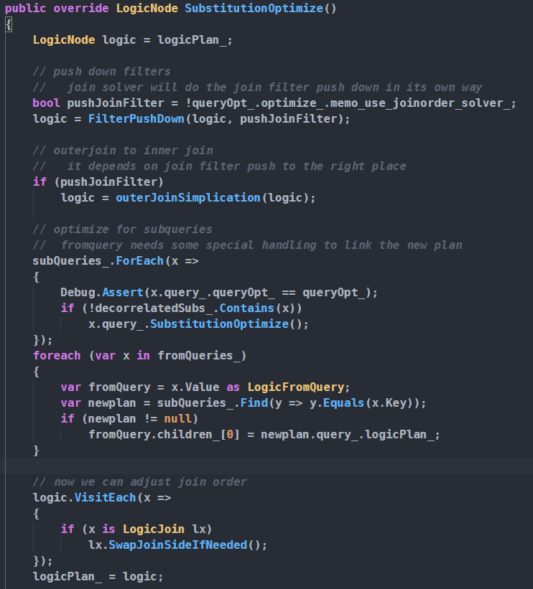
Logic Optimizer
Logic Optimizer基于规则的优化算法实现，在关系代数结构上匹配一部分局部结构，再根据结果的特点进行变换或替换操作。
qpmodel中的规则如下：
Resolved Logic Plan
FilterPushDown
OuterJoinSimplication
Subquery
SwapJoinSide
Optimized Logic Plan

Slide 7
Logic Optimizer
SELECT A.name FROM A, B, C WHERE A.id = B.aid AND B.cid = C.id AND A.value > 100 AND C.value > 100
PROJECT
A.name
A.id=B.id
B.id=C.id
C.value > 100
PROJECT
A.name
FILTER
JOIN
JOIN
C.id=B.cid
JOIN
PROJECT
A.name,
B.cid
PROJECT
id
A
B
C
JOIN
A.id=B.aid
FILTER
C.value > 100
id, name
PROJECT
PROJECT
aid, cid
A
B
C
通过拆分连接谓词，谓词下推，投影修剪完成逻辑优化。由关系代数和逻辑代数的转换规则转换后的Logic Plan的性能必然高于优化之前。

Slide 8
Thank you

