Slide 1
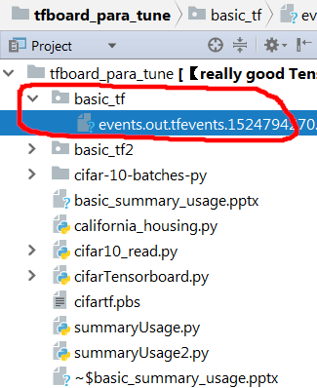
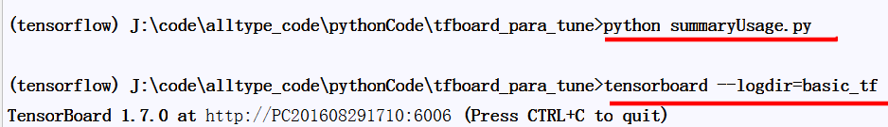
summaryUsage.py
import tensorflow as tf x = tf.Variable(1.0) xnew = tf.assign(x,x+0.2) x_summary = tf.summary.scalar('x_trace',xnew) writer= tf.summary.FileWriter('basic_tf',graph=tf.get_default_graph())
with tf.Session() as sess: sess.run(tf.global_variables_initializer()) for i in range(20): _,x_smy = sess.run([xnew,x_summary]) writer.add_summary(x_smy,global_step=i)
writer.close()

Slide 2
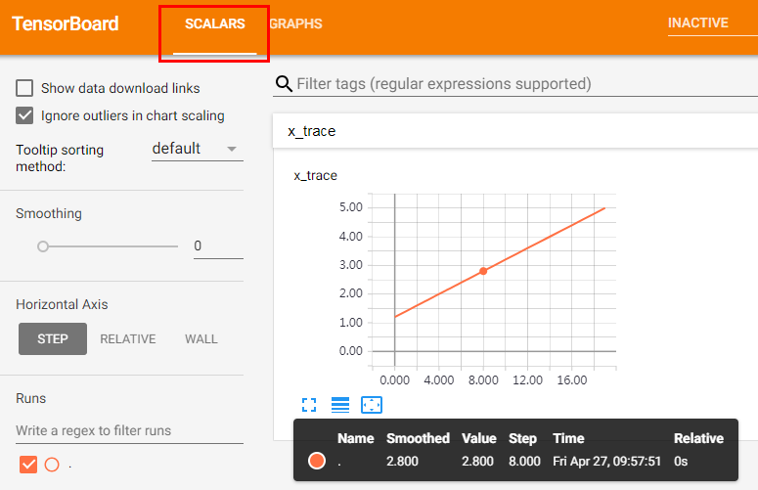
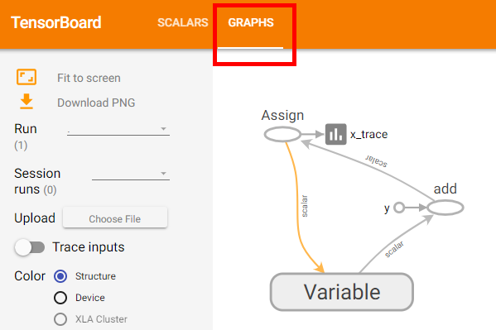
summaryUsage.py
import tensorflow as tf x = tf.Variable(1.0) xnew = tf.assign(x,x+0.2) x_summary = tf.summary.scalar('x_trace',xnew) writer= tf.summary.FileWriter('basic_tf',graph=tf.get_default_graph())
with tf.Session() as sess: sess.run(tf.global_variables_initializer()) for i in range(20): _,x_smy = sess.run([xnew,x_summary]) writer.add_summary(x_smy,global_step=i)
writer.close()

Slide 3
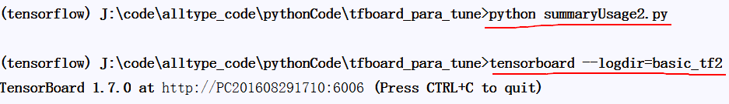
summaryUsage2.py
import tensorflow as tf x = tf.Variable(1.0) xnew = tf.assign(x,x+0.2) x_summary = tf.summary.scalar('x_trace',xnew) y = tf.Variable(tf.ones([28,28]),name='2d_value') ynew = tf.assign(y,tf.add(y,tf.random_normal([28,28]))) y_summary = tf.summary.histogram('2d_value',ynew) merged_summary = tf.summary.merge_all() writer= tf.summary.FileWriter('basic_tf2',graph=tf.get_default_graph()) with tf.Session() as sess: sess.run(tf.global_variables_initializer()) for i in range(20): _,merged_smy = sess.run([xnew,merged_summary]) writer.add_summary(merged_smy,global_step=i) writer.close()

Slide 4
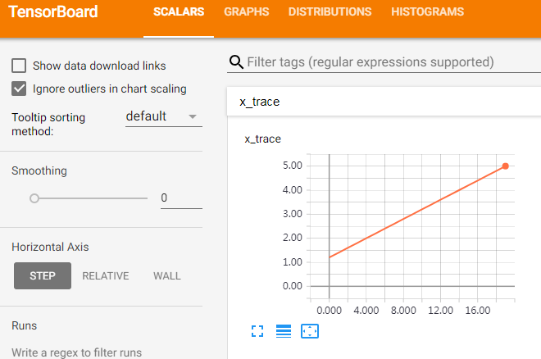
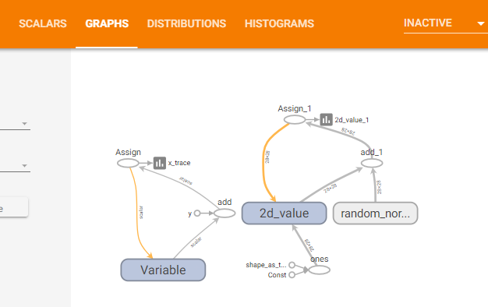
summaryUsage2.py
import tensorflow as tf x = tf.Variable(1.0) xnew = tf.assign(x,x+0.2) x_summary = tf.summary.scalar('x_trace',xnew) y = tf.Variable(tf.ones([28,28]),name='2d_value') ynew = tf.assign(y,tf.add(y,tf.random_normal([28,28]))) y_summary = tf.summary.histogram('2d_value',ynew) merged_summary = tf.summary.merge_all() writer= tf.summary.FileWriter('basic_tf2',graph=tf.get_default_graph()) with tf.Session() as sess: sess.run(tf.global_variables_initializer()) for i in range(20): _,merged_smy = sess.run([xnew,merged_summary]) writer.add_summary(merged_smy,global_step=i) writer.close()

Slide 5
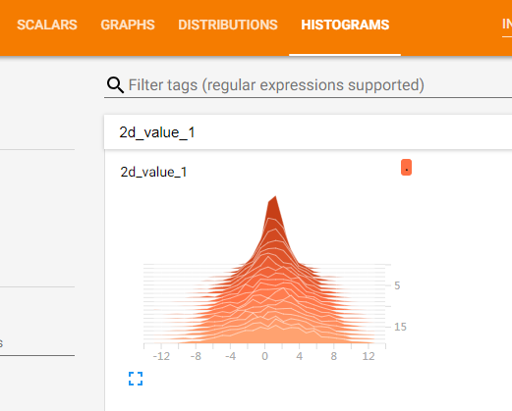
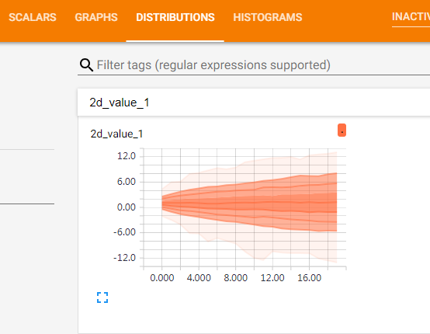
summaryUsage2.py
import tensorflow as tf x = tf.Variable(1.0) xnew = tf.assign(x,x+0.2) x_summary = tf.summary.scalar('x_trace',xnew) y = tf.Variable(tf.ones([28,28]),name='2d_value') ynew = tf.assign(y,tf.add(y,tf.random_normal([28,28]))) y_summary = tf.summary.histogram('2d_value',ynew) merged_summary = tf.summary.merge_all() writer= tf.summary.FileWriter('basic_tf2',graph=tf.get_default_graph()) with tf.Session() as sess: sess.run(tf.global_variables_initializer()) for i in range(20): _,merged_smy = sess.run([xnew,merged_summary]) writer.add_summary(merged_smy,global_step=i) writer.close()
从从上到下的折现分别表示权重分布的不同分位数：
[maximum, 93%, 84%, 69%, 50%, 31%, 16%, 7%, minimum]

