Slide 1
BRI Random Forest Approach
By:Richard Zhou

Slide 2

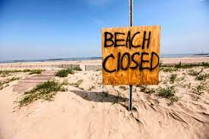


Project Description
Customers cancel and that loses the company thousands of dollars
Find a way to predict cancellations before they happen
People book Vacation
People cancel Vacation
Offer incentives to “at-risk” customers
35% stay

Slide 3
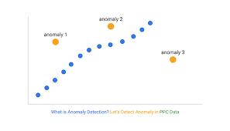
The Dataset
Rows in the Dataset
Which rows have most prominence?
“previous_cancellations” and “is_repeating_guest” correlation
Anomalies, Null data, and repeats
Interesting correlations
Figure 1: p-value chart

Slide 4

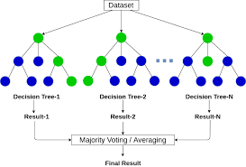
Random Forest Classifier Analysis
What parts of the data did I keep?
Creating the classifier(0.3 test size)
Finding the optimal amount of estimators
Dropping ‘is_canceled’ columns
Figure 2: Train-test split

Slide 5
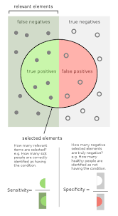
Results of Random Forest Classifier
What are the downsides of Random Forest Classifier?
97.61% accurate
Cost to implement($1,177,065)
What this means for future outlook of cancellations
Other data that could improve classifier practicality

Slide 6
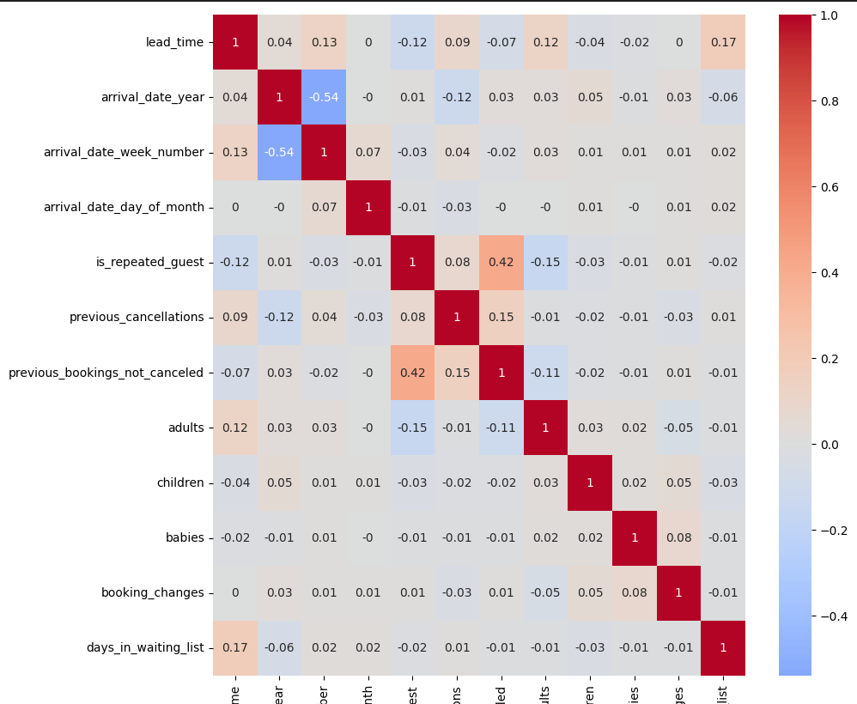
Random Forest Approach Discussion
How does the approach interact with the cost model?
What happens with correlated data in a Random Forest approach?
High correlations within data
How to deal with sensitive data
Figure 3: Correlation Chart

Slide 7


Personal Recommendation
What does the data say about saved costs and accuracy?
How this benefits the company in the long run
Use of quarterly analysis to track success and checkpoints

Slide 8

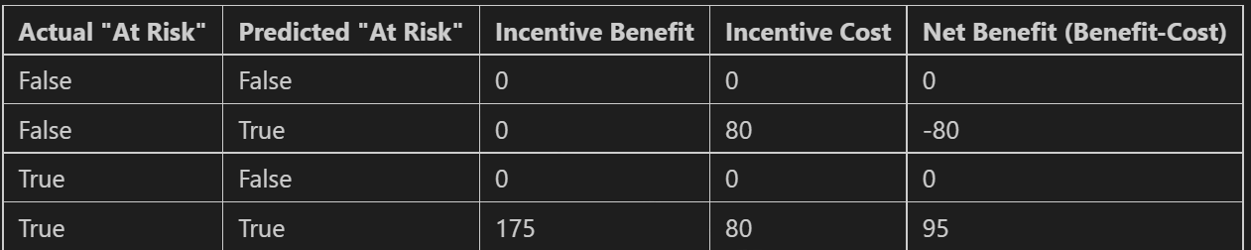
Future Steps
Notable to data to collect to optimize classifying
Maybe looking at other habits, analyzing holidays, and salary
Setting up checkups to make sure approach is achieving expectations
Test other discounts to see which has more success instead of $80
Figure 4: Cost Function Chart

Slide 9

Conclusion
Why is the Random Forest Approach so good?
What is the fiscal data behind the implementation
Immediate steps to take

Slide 10
Questions?

Slide 11
Appendix
Figure 1
P-value Chart, Slide 3
From the p-value being so low you can see that the correlation is extremely high thus resulting in some cloudy classification from the Random Forest approach

Slide 12
Appendix
Figure 2
Train-test split, slide 4
The test was split into 70% used for training and 30% for testing. This produced the highest accuracy and the best results

Slide 13
Appendix
Figure 3
Correlation Chart, slide 6

Slide 14
Appendix
Figure 4
Cost Function Chart, slide 8

