Slide 1
BRI Presentation
By:Richard Zhou

Slide 2
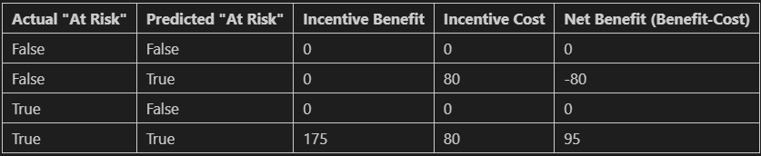
Project Description
Loss of Revenue due to Cancellation- $500
Intervention Idea of offering a financial incentive
$80 discount to “at-risk” people
Intervention Idea is 35% effective
How to determine “at-risk” people
Cost saves the company $1177065
Figure 1: Cost matrix

Slide 3
The Dataset
Rows in the Dataset
Which rows have most prominence?
“previous_cancellations” and “is_repeating_guest” correlation
Anomalies, Null data, and repeats
Interesting correlations
Figure 2: p-value chart

Slide 4

Random Forest Classifier Analysis
What parts of the data did I keep?
Creating the classifier(0.3 test size)
Finding the optimal amount of estimators
Dropping ‘is_canceled’ columns
Figure 3: Train-test split

Slide 5
Results of Random Forest Classifier
What are the downsides of Random Forest Classifier?
97.61% accurate
Cost to implement($1,177,065)
What this means for future outlook of cancellations
Other data that could improve classifier practicality

Slide 6
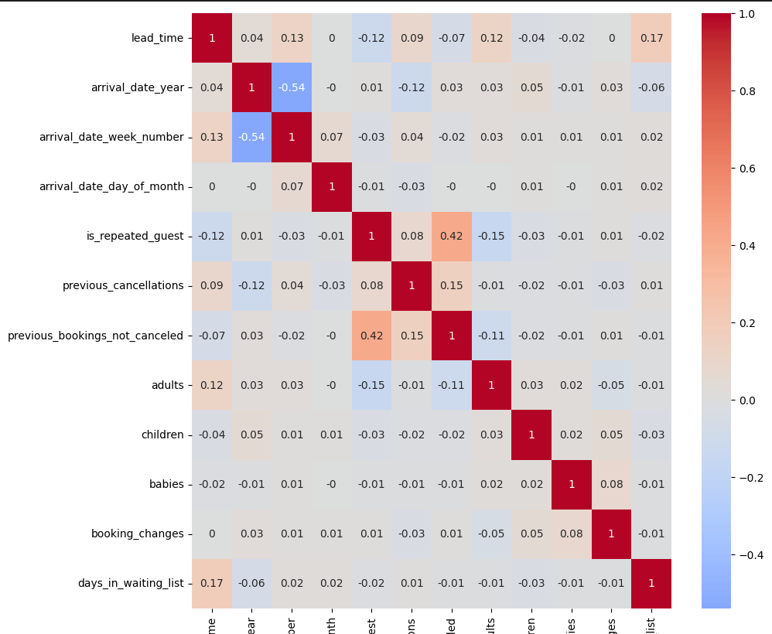
Random Forest Approach Discussion
How does the approach interact with the cost model?
What happens with correlated data in a Random Forest approach?
High correlations within data
How to deal with sensitive data
Figure 4: Correlation Chart

Slide 7
Personal Recommendation
What does the data say about saved costs and accuracy?
How this benefits the company in the long run
Use of quarterly analysis to track success and checkpoints
Comparing data of present to how the classifier “should” work

Slide 8
Future Steps
Notable to data to collect to optimize classifying
Ensuring data is clean and only tracking what is relevant
Setting up checkups to make sure approach is achieving expectations
Test other discounts to see which has more success instead of $80

Slide 9
Conclusion
Why is the Random Forest Approach so good?
What is the fiscal data behind the implementation
Immediate steps to take

Slide 10
Questions?

Slide 11
Appendix
Figure 1
Cost Matrix, Slide 2

Slide 12
Appendix
Figure 2
P-value Chart, Slide 3

Slide 13
Appendix
Figure 3
Train-test split, slide 4

Slide 14
Appendix
Figure 4
Correlation Chart, slide 6

