Slide 1
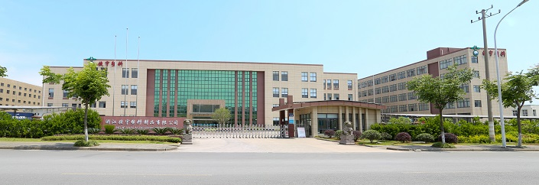

Corncomp Alliance
遇米生物集团简介
2024年1月 V5.0

Slide 2

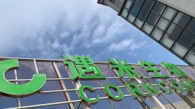
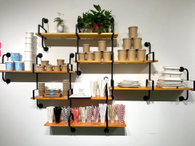
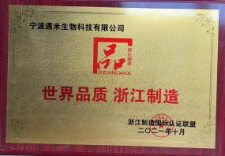
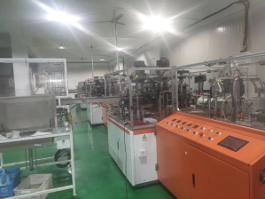
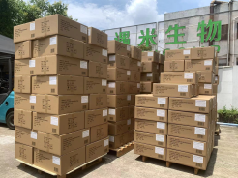
Enterprise Profile
发展历程
Enterprise Profile
2024年
New Facility
2023年
纸盘生产线
Paper Plate
2022年
专利申请8项
8 Patents
2021年10月
浙江制造品字标认证
Zhejiang Branded
2020年5月
纸碗生产线Salad Bowl
2019年9月
迪士尼全球供应商 Disney Partnership
2018.9.25
Found Corncomp

Slide 3

Our Vision
Make Tableware
Bio-degradable, Eco-Friendly
We Do everything we can to support Green Earth

Slide 4
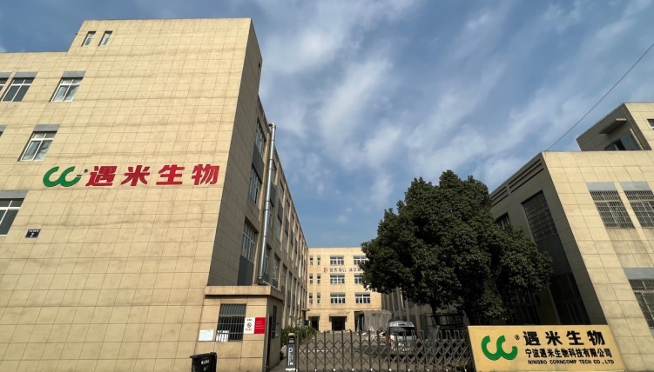
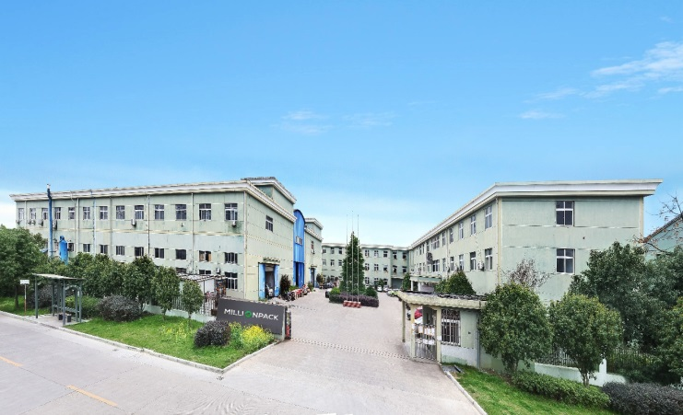
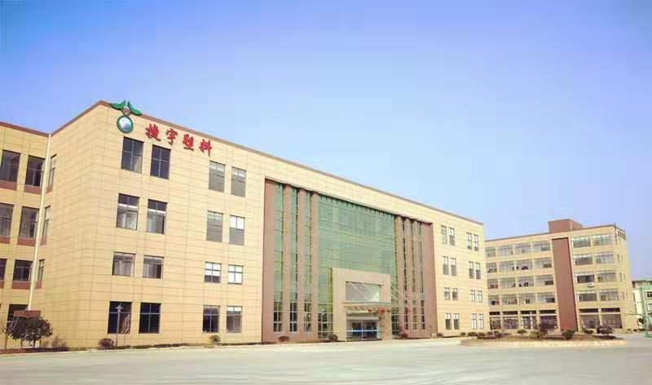
Our Alliance (3 Factories）
Millionpack
(Paper Container)
Plastik(Jieyu）
PLA/PP Tableware
Corncomp
（ Straws/Salad Bowl/Plate）
8000M2
Since 2018
11000M2
Since 2009
36000 M2
Since 2009

Slide 5

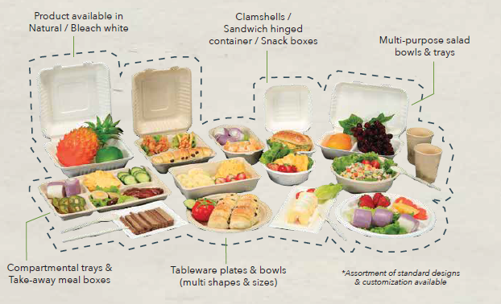

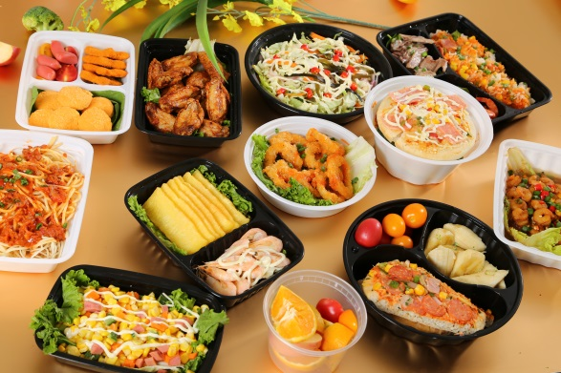

Main Product Line /Brands
Biodegradable Containers
(Straws,Bowls, Plates,cutlery)
Paper Containers
(Lunch Box, Sushi, Bagasse)
PLA/PP Tableware
(PLA cultery, PP Bowl)

Slide 6
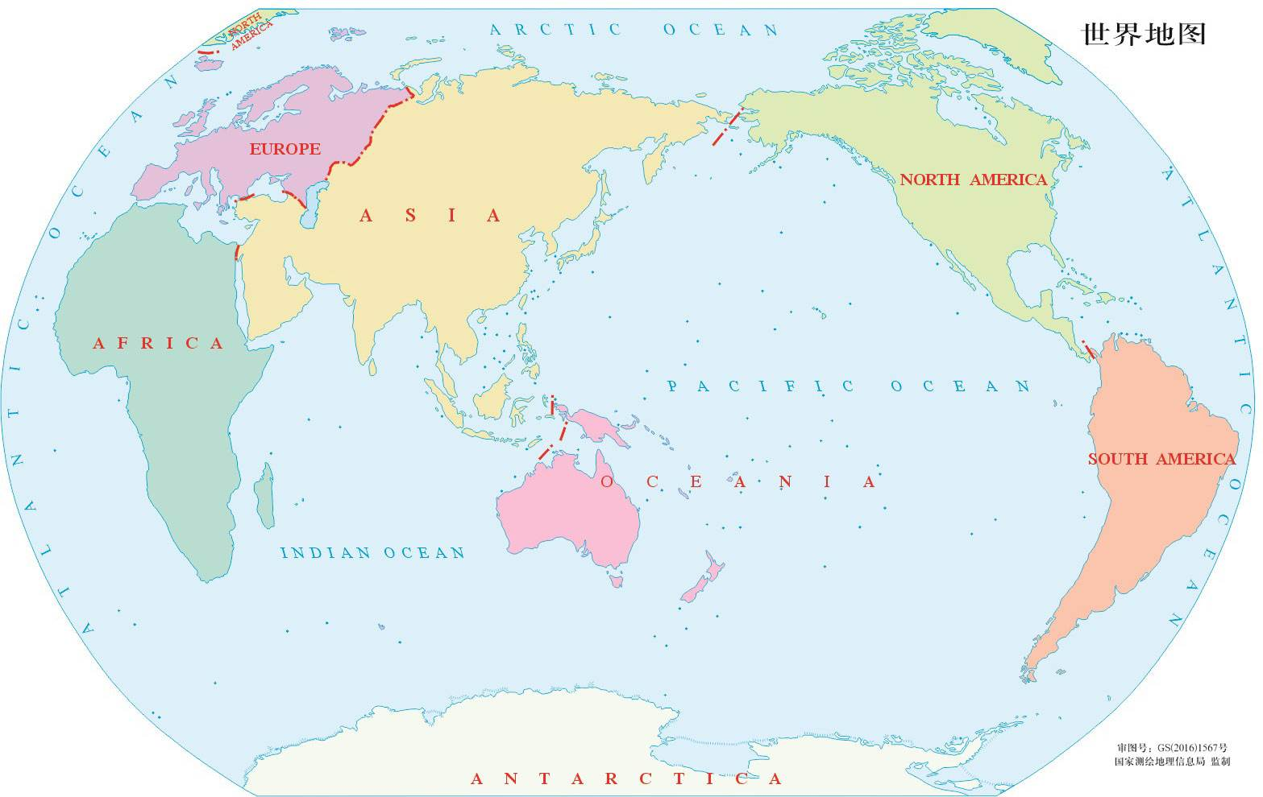
Worldwide Direct Presence
Europe Office:
Rue de wavre 33, Bevekom,Belgium
USA Office: Meadow Woods Rd . NY ,11020
(1200m2 Warehouse)
(10000m2 Warehouse)
Factory
Jieyu
Millionpack
Corncomp
Ningbo, China

Slide 7

Key Competitive Advantage
Excellence in Product Development:
  in-house made machineries made by industrial leading R&D team;
  Newly developing Biodegradable tableware, PLA containers;
Capacity and Efficiency
  Mass Production and automation ,with less labor involved ;
  Lean management applied ,with High rotation;
Quality Always Prevails
  Dust-free facility ,with Food Grade certified material;
  3rd party(SGS)audited production process control ;
  BRC, FSC certified and FDA /LFGB test passed.

Slide 8
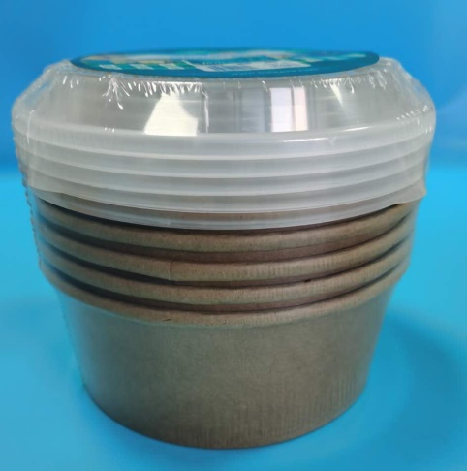
Newly Products Updates
BBQ Combo
PLA laminated Category (Paper Cup, Paper Tray)
Compostable Cutlery (CPLA spoon and forks)
Bamboo Spoon and forks
Plastic-Free coated paper Cup( Tray)
Paper Plate

Slide 9
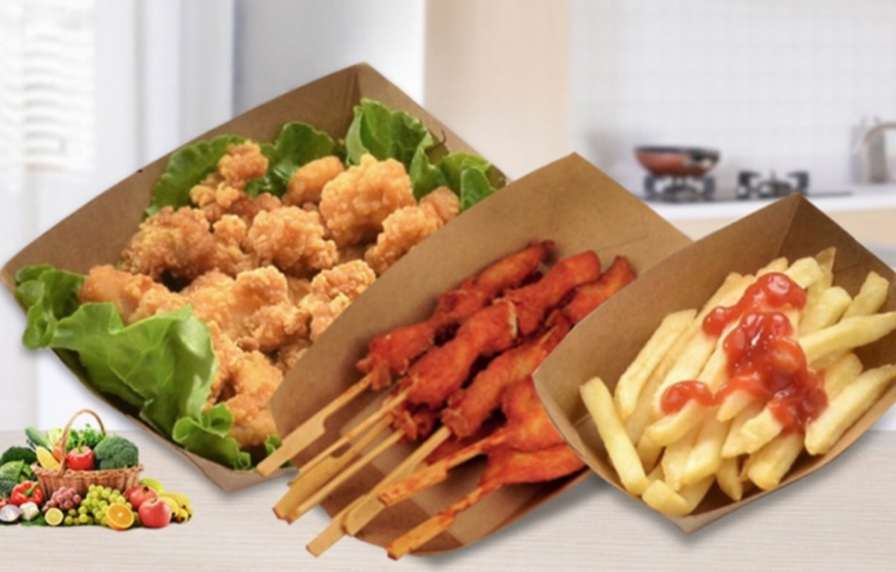
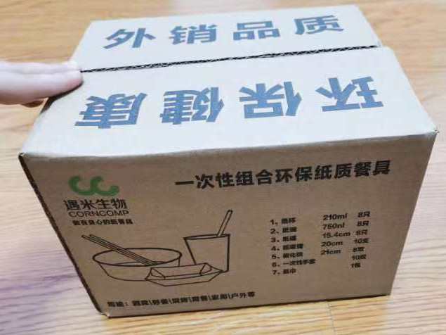
BBQ Combo
BBQ Combo
Fork、Knifes；
Paper Cups
Paper Tray；
Bamboo Sticks
Napkins；

Slide 10
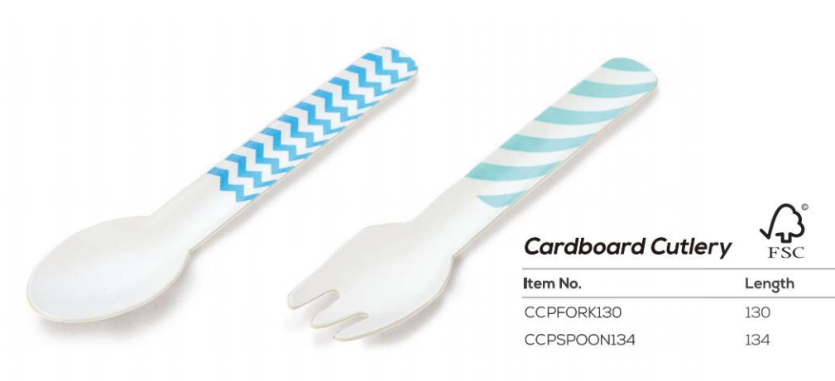
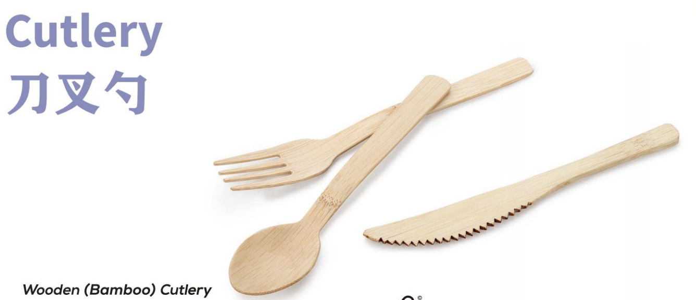
Compostable Cutlery
Bamboo Cutlery
Paper Cutlery

Slide 11
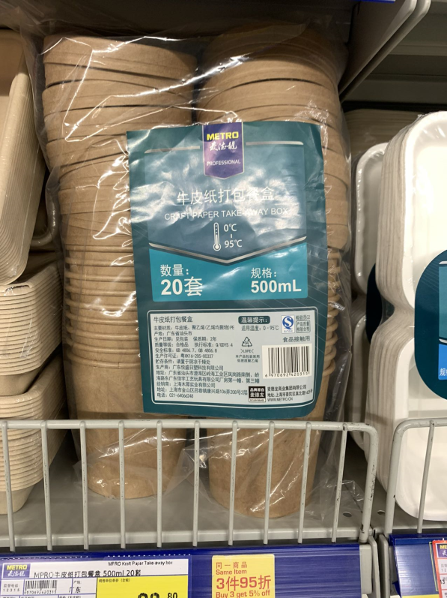
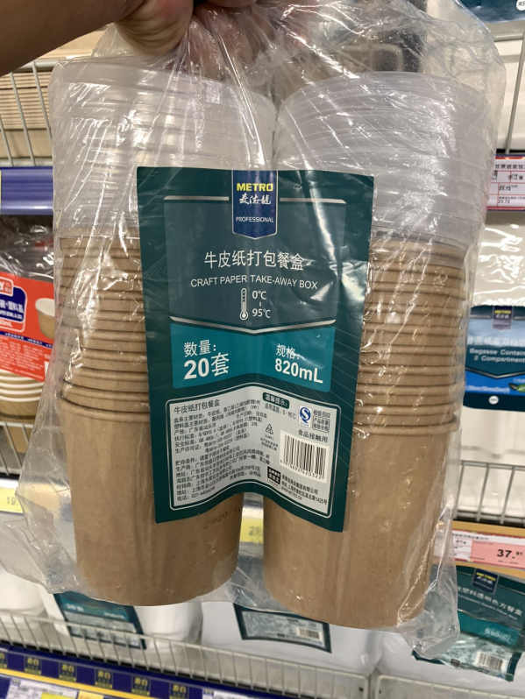
Retails Sets Compostable Bowls
Retails Sets Bowls ；
PE or PLA laminated

Slide 12
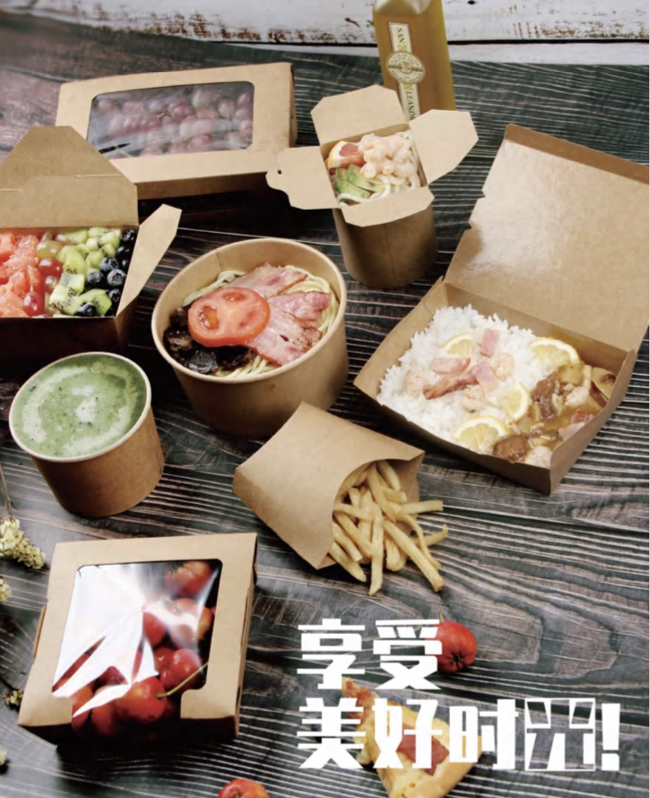
PLA laminating Products
Salad Bowl
Paper Tray
Lunch Box
Salad Box

Slide 13
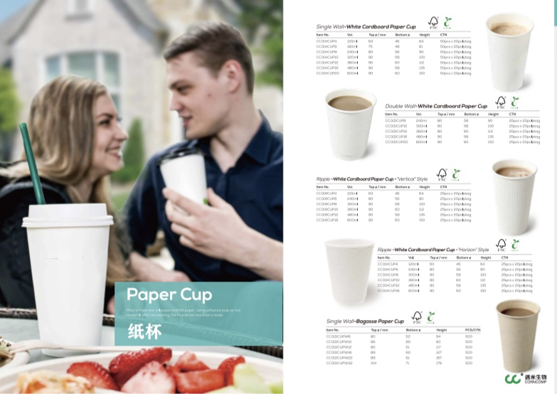
Plastic-free Coated Cups

Slide 14

Key Management Team
Managing Director
Steven Zhu
Canadian CPA
Chairman
Wilson Wang
15+ year paper tableware industry
Tableware Key seller in European market
Chief Engineer
Sheng Chen
Paper Container Machineries Provider
R&D Driver
15+ years Experience in European Manufacturer Operating
Certified PMP
Running several paper material factories.
20+ years in paper industry.
Sales Director
Shawn Qu
30+ years in tableware industry.
Several Tableware factories owner
Key Sales in US market

Slide 15
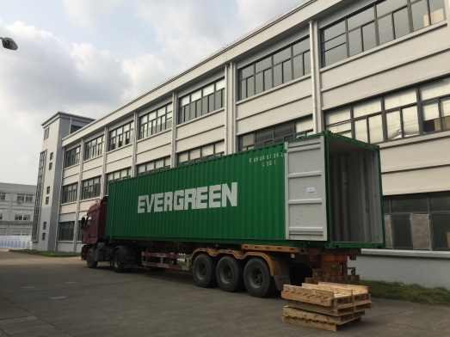
Factory Highlights--Corncomp
Newly Equipped with 6000m2 Plant (dusty-free) , and 80 workers; 30 production lines of Straws ,Cutleries, Cups/ Bowls .
Equipped with leading industrial machineries
  1 Printing Machineries
  3 Slitting Machineries and 1 Die Cutting machine,
  30 Tube Rolling Machineries ,
  10 Individual packaging Machineries
  2 Drying & Sanitizing Machineries

Slide 16
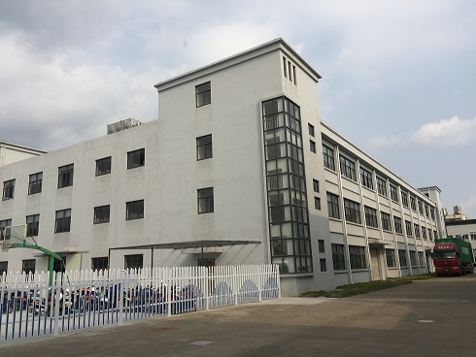
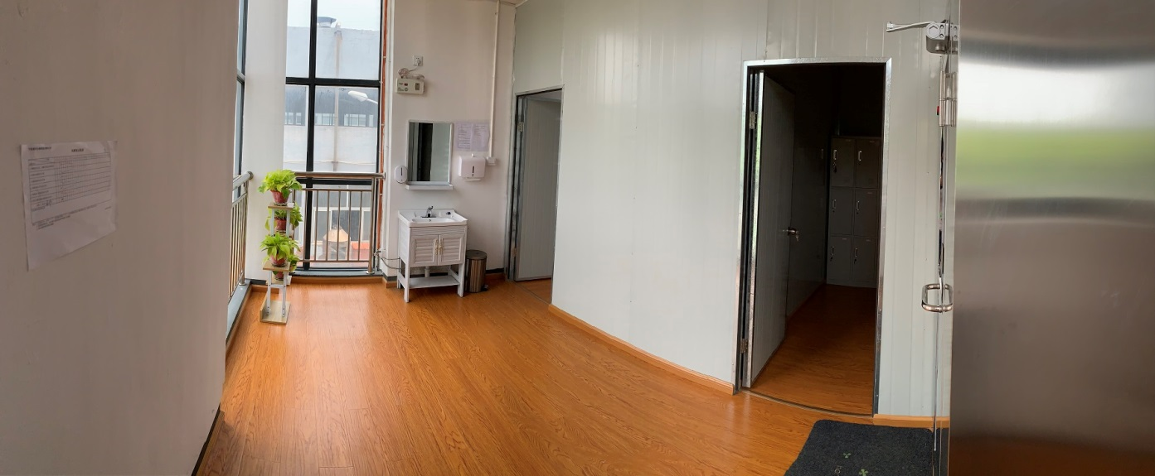
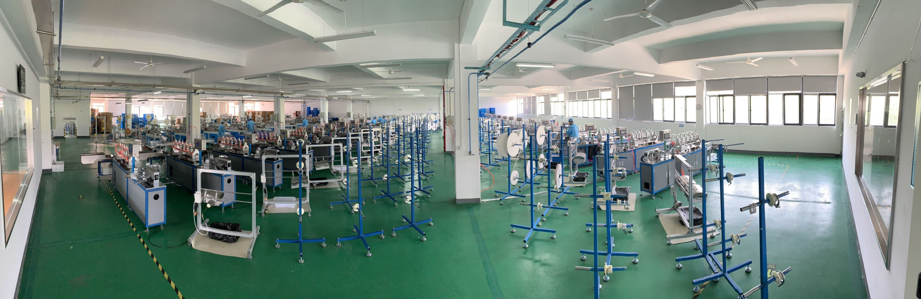
Corncomp Overview

Slide 17
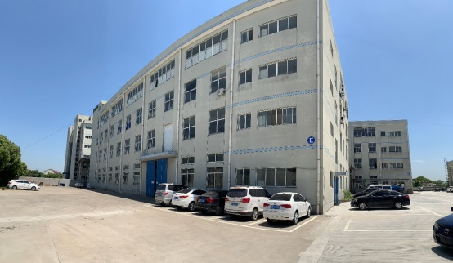
Factory Highlights--
Established in 2009, 10 years experience in Food packaging industry;
Sales turnover 15M+ USD ,with 11,000m2 Plant and 110 workers;
Annual 5000tons of Paper Tray, Lunch box
Equipped with leading industrial machineries
  1 Printer Machine, 1 PLA/PE Laminating machine.
  4 Die CuttingMachineries
  35 production lines with Sleeve Production,
  3 packaging Machineries

Slide 18
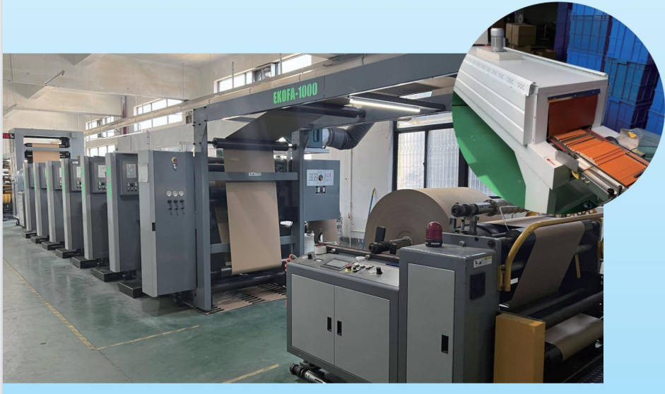
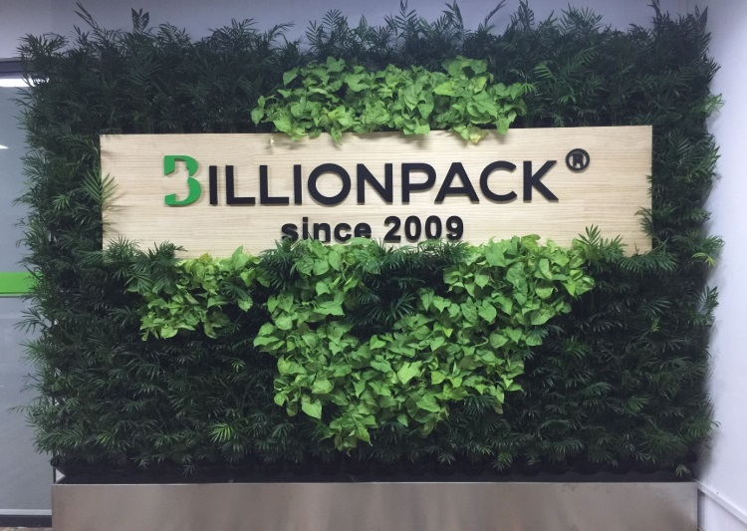
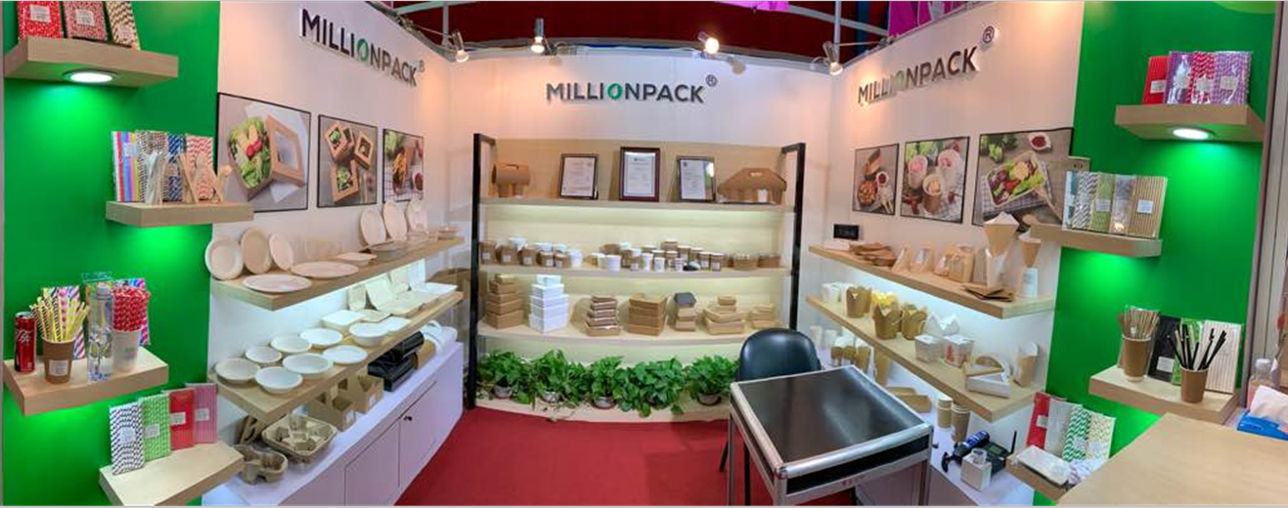
Company Overview-

Slide 19

Factory Highlights--Plastik
Established in 2009 , with 35M+ USD turnover
Self-owned 36,500m2 Plant and 120 workers;
Annual consumption of 20000tons of PP/PLA material ;
Equipped with leading industrial Facilities
  Self-owned Molding workshop with R&D center
  68 injection machineries
  2 CNC processing machinery
  Auto material feeding system
  Automatic packing system

Slide 20
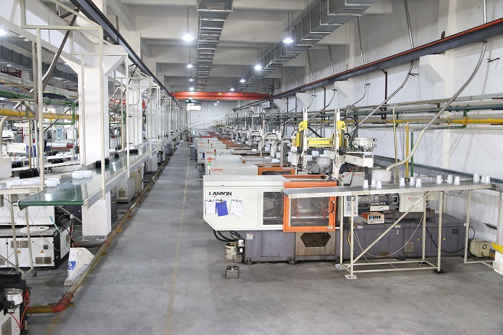
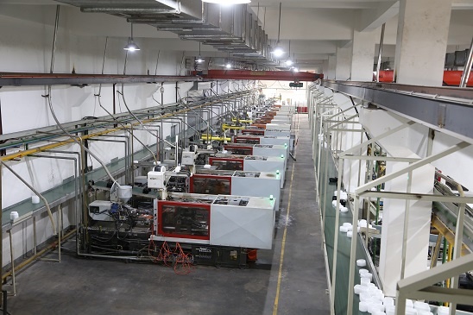
Main Facility Overview

Slide 21
Factory’s Video
Excellence brings value to Each Customer

Slide 22











Strategic Business Partners

Slide 23
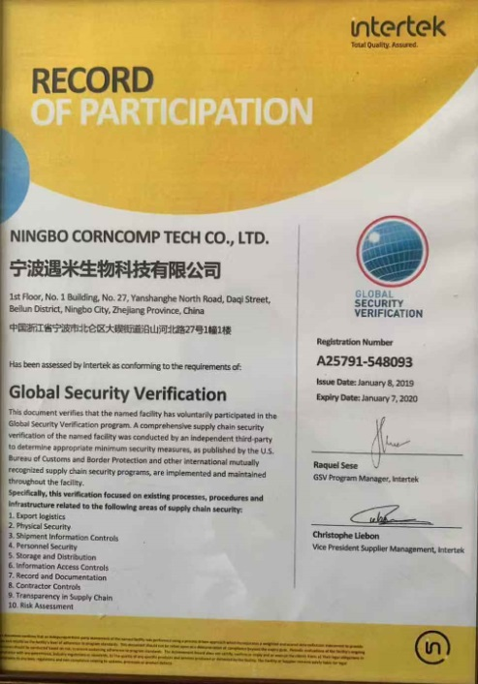
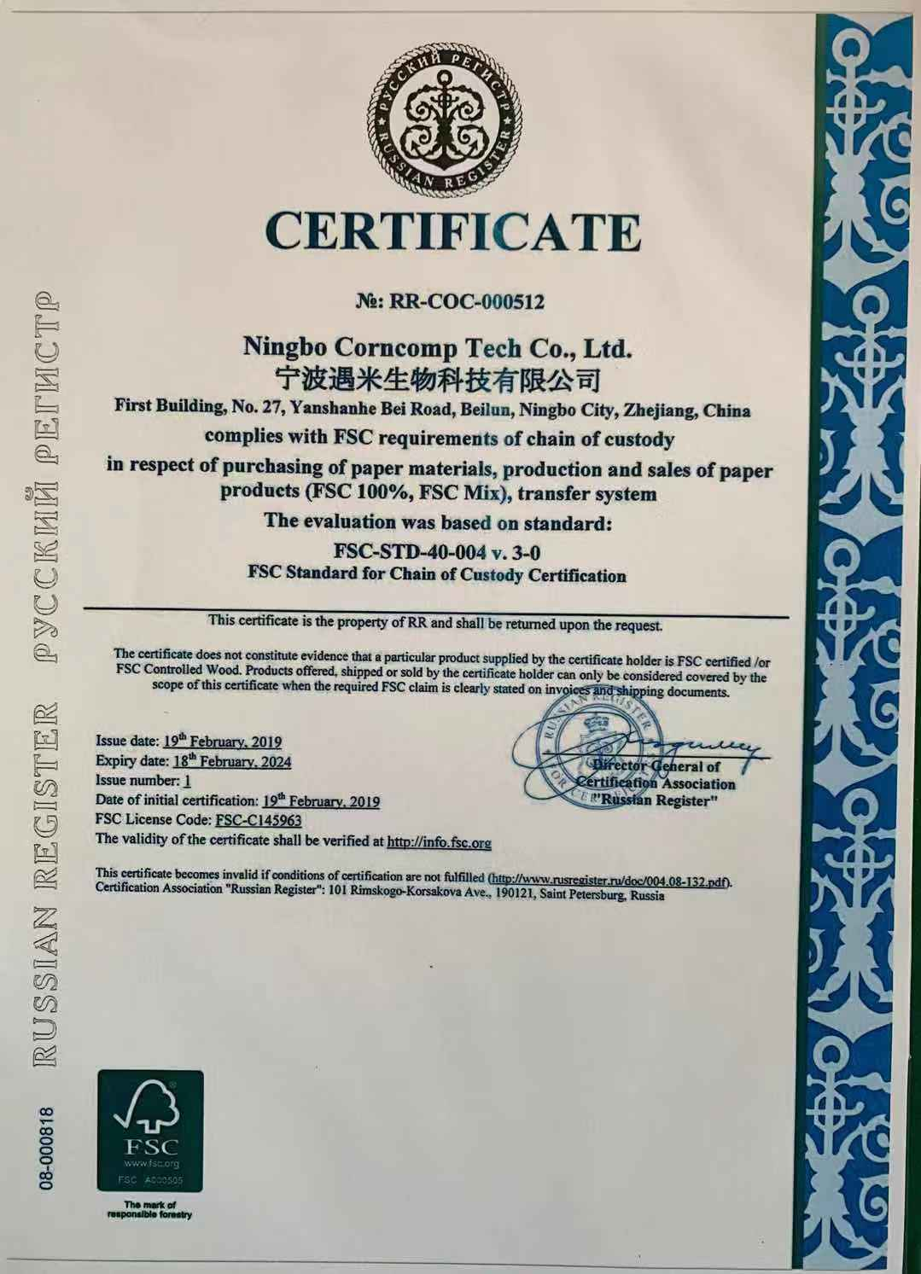
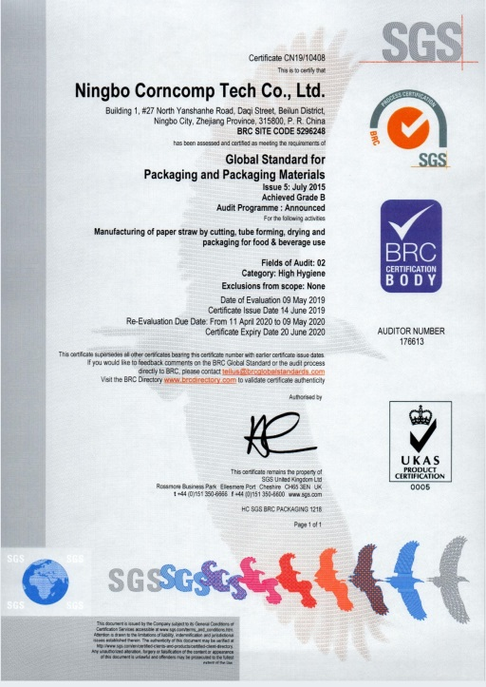
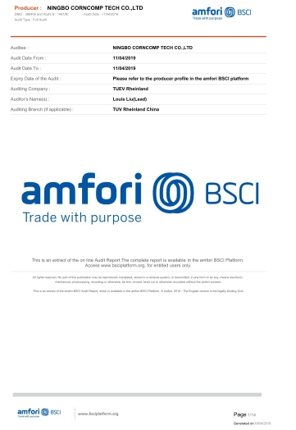




Certificates and Credentials
GSV. Certificates
FSC. Certificates
BRC certified
BSCI audit

Slide 24
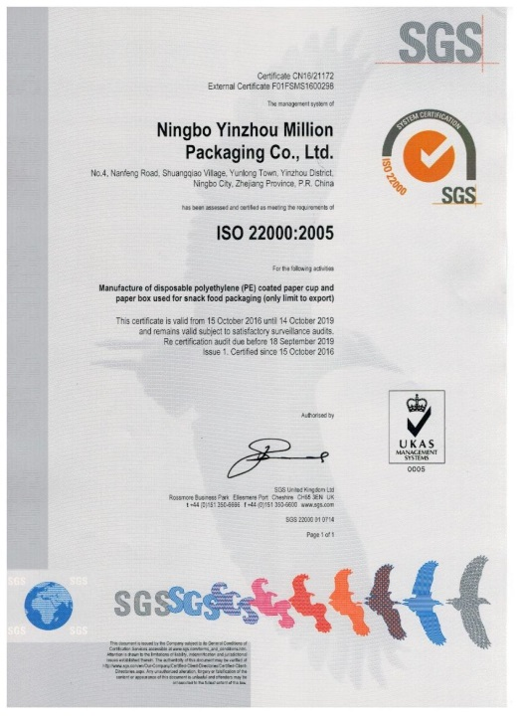
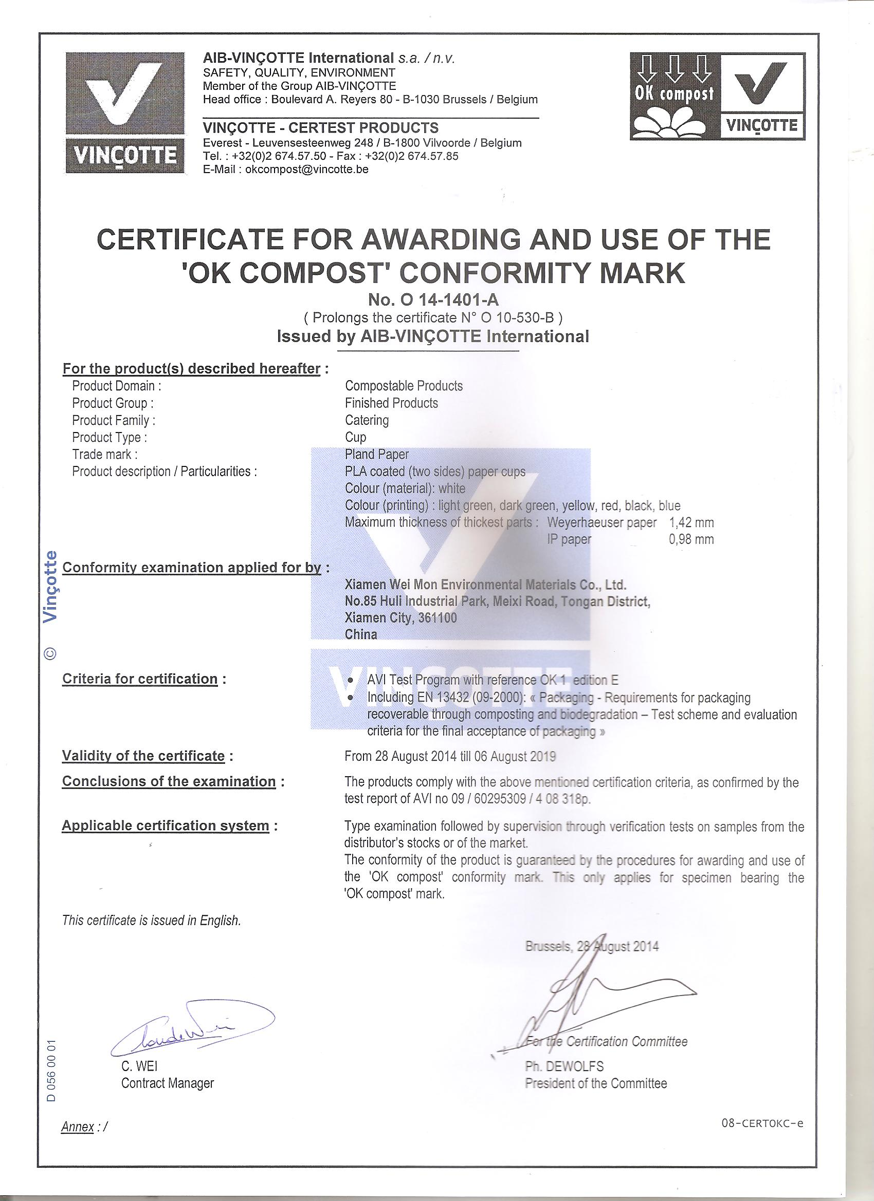
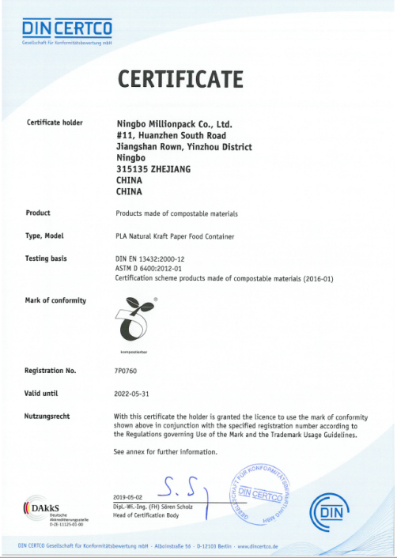

Certificates and Credentials
ISO 9001
FSC. Certificates
Compostable Certificate
DIN Certco

Slide 25
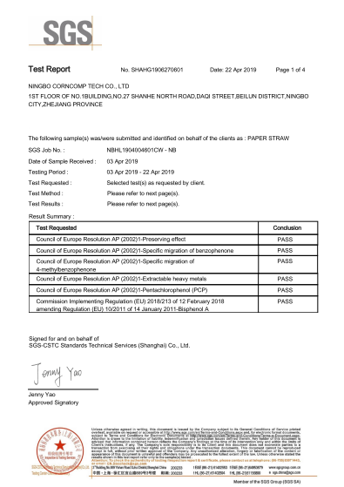
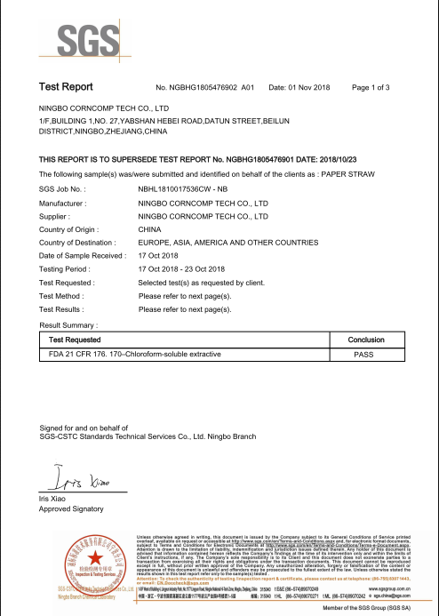

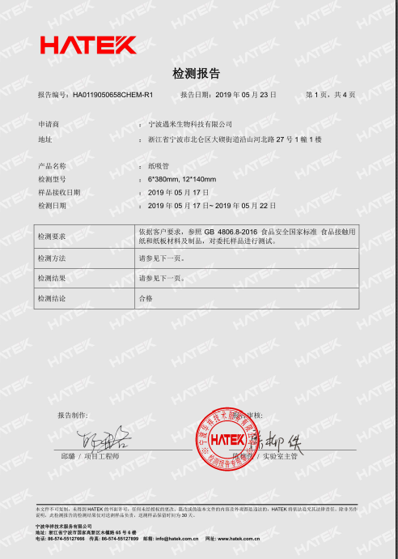
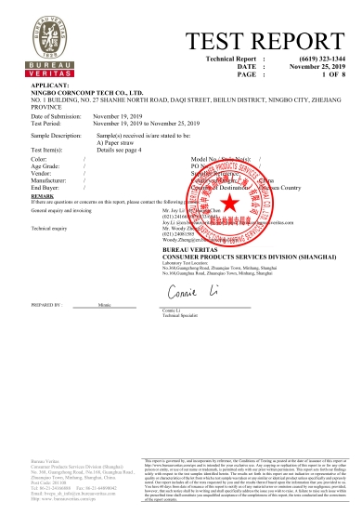
Products’ Testing Reports
Europe AP 2002
FDA 21 CFR 176
GB 4806.8&31604
Germany LFGB

Slide 26
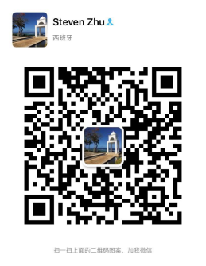
Thanks For Listening
Any Comments welcomed
Contact : Steven Zhu
Steven.zhu@corncomp.com
0086-13806632002

