Slide 1
End to end data science
Isabel Zimmerman
Software Engineer
Artificial Intelligence Center of Excellence, Red Hat

Slide 2
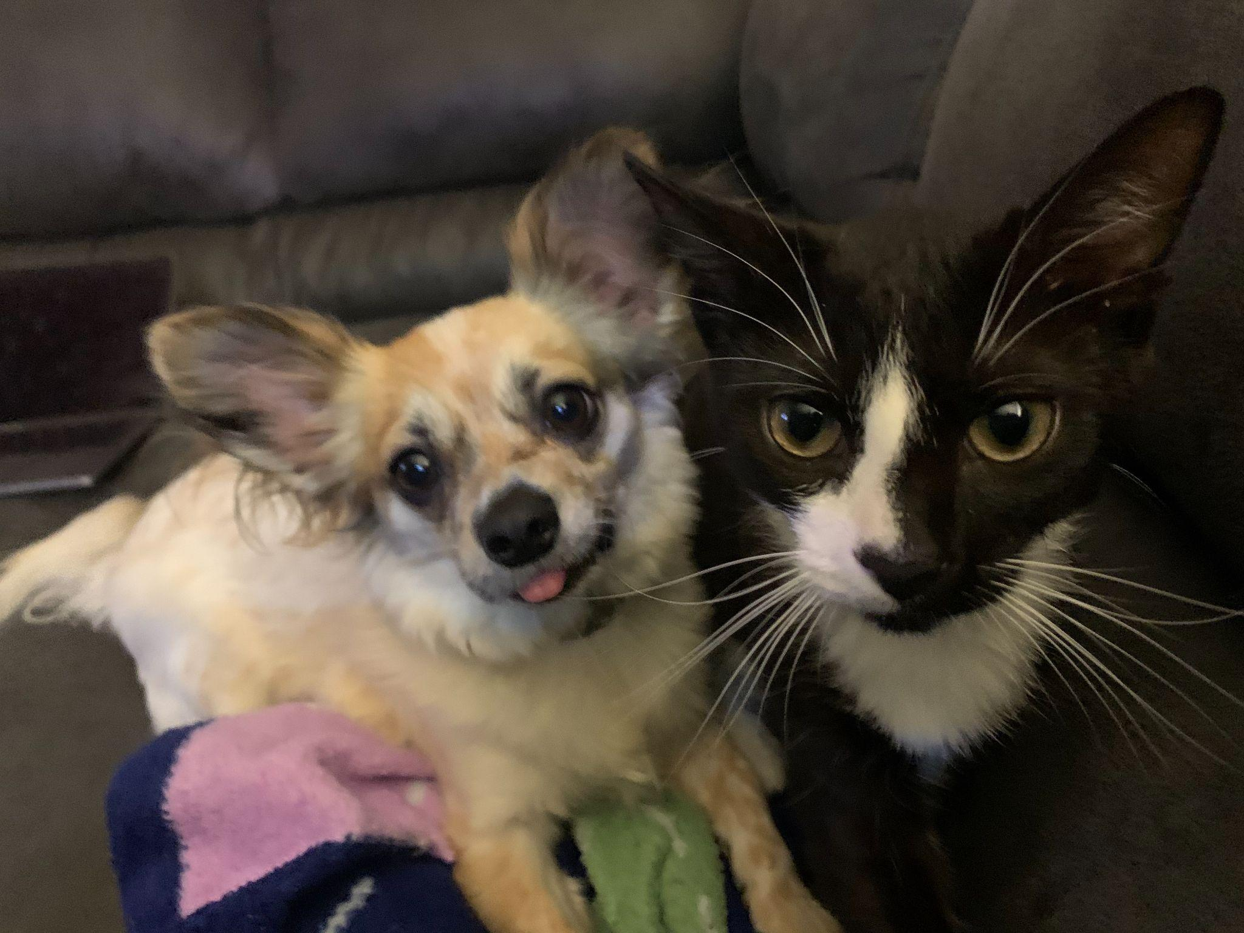
Undergraduate > Intern > Graduated > Full time + Graduate student

Slide 3


What is the data science lifecycle?
Notes:
We first need to understand exactly what data scientists are doing

Slide 4
DATA SCIENCE LIFECYCLE
codifying problem and metrics
data collection and cleaning
feature engineering
model training
and tuning
model
validation
model
deployment
monitoring,
validation

Slide 5
DATA SCIENCE LIFECYCLE
codifying problem and metrics
data collection and cleaning
feature engineering
model training
and tuning
model
validation
model
deployment
monitoring,
validation

Slide 6
DATA SCIENCE LIFECYCLE
codifying problem and metrics
data collection and cleaning
feature engineering
model training
and tuning
model
validation
model
deployment
monitoring,
validation
What are we trying to accomplish?

Slide 7

DATA SCIENCE LIFECYCLE
codifying problem and metrics
data collection and cleaning
feature engineering
model training
and tuning
model
validation
model
deployment
monitoring,
validation
What are we trying to accomplish?

Slide 8
DATA SCIENCE LIFECYCLE
codifying problem and metrics
data collection and cleaning
feature engineering
model training
and tuning
model
validation
model
deployment
monitoring,
validation

Slide 9
DATA SCIENCE LIFECYCLE
codifying problem and metrics
data collection and cleaning
feature engineering
model training
and tuning
model
validation
model
deployment
monitoring,
validation
Where can we get the information to solve the problem?

Slide 10
DATA SCIENCE LIFECYCLE
codifying problem and metrics
data collection and cleaning
feature engineering
model training
and tuning
model
validation
model
deployment
monitoring,
validation
Where can we get the information to solve the problem?
How will this data be handled?

Slide 11

DATA SCIENCE LIFECYCLE
codifying problem and metrics
data collection and cleaning
feature engineering
model training
and tuning
model
validation
model
deployment
monitoring,
validation
Where can we get the information to solve the problem?
How will this data be handled?

Slide 12
DATA SCIENCE LIFECYCLE
codifying problem and metrics
data collection and cleaning
feature engineering
model training
and tuning
model
validation
model
deployment
monitoring,
validation

Slide 13
DATA SCIENCE LIFECYCLE
codifying problem and metrics
data collection and cleaning
feature engineering
model training
and tuning
model
validation
model
deployment
monitoring,
validation
What do we know from our data now?

Slide 14
DATA SCIENCE LIFECYCLE
codifying problem and metrics
data collection and cleaning
feature engineering
model training
and tuning
model
validation
model
deployment
monitoring,
validation
What do we know from our data now?
What other information do we need to glean from the data for it to be useful?

Slide 15

DATA SCIENCE LIFECYCLE
codifying problem and metrics
data collection and cleaning
feature engineering
model training
and tuning
model
validation
model
deployment
monitoring,
validation
What do we know from our data now?
What other information do we need to glean from the data for it to be useful?

Slide 16
DATA SCIENCE LIFECYCLE
codifying problem and metrics
data collection and cleaning
feature engineering
model training
and tuning
model
validation
model
deployment
monitoring,
validation

Slide 17
DATA SCIENCE LIFECYCLE
codifying problem and metrics
data collection and cleaning
feature engineering
model training
and tuning
model
validation
model
deployment
monitoring,
validation
What type of problem are we solving (classification? regression? supervised learning? unsupervised?)?

Slide 18
DATA SCIENCE LIFECYCLE
codifying problem and metrics
data collection and cleaning
feature engineering
model training
and tuning
model
validation
model
deployment
monitoring,
validation
What type of problem are we solving (classification? regression? supervised learning? unsupervised?)?
Do we need machine learning?

Slide 19
DATA SCIENCE LIFECYCLE
codifying problem and metrics
data collection and cleaning
feature engineering
model training
and tuning
model
validation
model
deployment
monitoring,
validation
What type of problem are we solving (classification? regression? supervised learning? unsupervised?)?
Do we need machine learning?

Slide 20
DATA SCIENCE LIFECYCLE
codifying problem and metrics
data collection and cleaning
feature engineering
model training
and tuning
model
validation
model
deployment
monitoring,
validation

Slide 21
DATA SCIENCE LIFECYCLE
codifying problem and metrics
data collection and cleaning
feature engineering
model training
and tuning
model
validation
model
deployment
monitoring,
validation
How is our model performing (precision, recall, accuracy, etc)?

Slide 22
DATA SCIENCE LIFECYCLE
codifying problem and metrics
data collection and cleaning
feature engineering
model training
and tuning
model
validation
model
deployment
monitoring,
validation
How is our model performing (precision, recall, accuracy, etc)?
What unintended consequences could we have built in our model?

Slide 23
DATA SCIENCE LIFECYCLE
codifying problem and metrics
data collection and cleaning
feature engineering
model training
and tuning
model
validation
model
deployment
monitoring,
validation
How is our model performing (precision, recall, accuracy, etc)?
What unintended consequences could we have built in our model?

Slide 24
DATA SCIENCE LIFECYCLE
codifying problem and metrics
data collection and cleaning
feature engineering
model training
and tuning
model
validation
model
deployment
monitoring,
validation

Slide 25
DATA SCIENCE LIFECYCLE
codifying problem and metrics
data collection and cleaning
feature engineering
model training
and tuning
model
validation
model
deployment
monitoring,
validation
How will people interact with our models?

Slide 26
DATA SCIENCE LIFECYCLE
codifying problem and metrics
data collection and cleaning
feature engineering
model training
and tuning
model
validation
model
deployment
monitoring,
validation
How will people interact with our models?
How will this interaction change with updates?

Slide 27

DATA SCIENCE LIFECYCLE
codifying problem and metrics
data collection and cleaning
feature engineering
model training
and tuning
model
validation
model
deployment
monitoring,
validation
How will people interact with our models?
How will this interaction change with updates?

Slide 28
DATA SCIENCE LIFECYCLE
codifying problem and metrics
data collection and cleaning
feature engineering
model training
and tuning
model
validation
model
deployment
monitoring,
validation

Slide 29
DATA SCIENCE LIFECYCLE
codifying problem and metrics
data collection and cleaning
feature engineering
model training
and tuning
model
validation
model
deployment
monitoring,
validation
Is our application healthy?

Slide 30
DATA SCIENCE LIFECYCLE
codifying problem and metrics
data collection and cleaning
feature engineering
model training
and tuning
model
validation
model
deployment
monitoring,
validation
Is our application healthy?
Is our model performing as expected?

Slide 31
DATA SCIENCE LIFECYCLE
codifying problem and metrics
data collection and cleaning
feature engineering
model training
and tuning
model
validation
model
deployment
monitoring,
validation
Is our application healthy?
Has the data changed?
Is our model performing as expected?

Slide 32


DATA SCIENCE LIFECYCLE
codifying problem and metrics
data collection and cleaning
feature engineering
model training
and tuning
model
validation
model
deployment
monitoring,
validation
Is our application healthy?
Has the data changed?
Is our model performing as expected?

Slide 33
Why should we do data science in the cloud?
Notes:
So what is the open data hub and how does it help?

Slide 34
WHAT IS OPEN DATA HUB?
AI as a service platform on Red Hat's Kubernetes-based OpenShift® Container Platform and Ceph Object Storage.
Notes:
Platform for data scientists
AI as a service platform
integrates many different open source projects into one operator
In the cloud? whaaaat?

Slide 35

WHAT IS OPEN DATA HUB?
AI as a service platform on Red Hat's Kubernetes-based OpenShift® Container Platform and Ceph Object Storage.

Slide 36
WHAT IS OPEN DATA HUB?
AI as a service platform on Red Hat's Kubernetes-based OpenShift® Container Platform and Ceph Object Storage.
Notes:
By migrating data scientists into the cloud, they are able to take advantage of all the benefits of a cloud native environment

Slide 37
WHAT IS OPEN DATA HUB?
Scalability
Flexibility
Reproducibility

Slide 38
What does it look like with all these pieces put together?
Notes:
So what is the open data hub and how does it help?

Slide 39
store model
Google cloud storage
S3
Azure Blob storage
PersistentVolume
Notes:
When new data is acquired, Seldon will use it to make a prediction, and send results to Prometheus, a times series database that stores all the streamed information from Seldon. From there, Prometheus forwards the data to Grafana so I can build dashboards to easily monitor the model’s health and performance.
Grafana is where we are able to visualize what is happening under the hood. Engineers are often more interested in the model-user interaction, so they are able to monitor the deployed model, even while the data scientist works on Machine learning does not break loudly; code will keep running with gradual, often unseen, model degradation. This can be difficult to diagnose, but Grafana allows us to measure model health. In this dashboard, we can see requests being sent to the model and how it is responding. If there was a distinct change in model health -- whether that be API latency, global success rates, or any other custom metrics you choose to build -- you could clearly see that the model is not performing as expected.

Slide 40
store model
deploy model

Slide 41
explore model
store model
deploy model

Slide 42
explore model
store model
deploy model
explore metrics
visualize

Slide 43

explore model
store model
deploy model
explore metrics
visualize

Slide 44
How can I try this out?
Notes:
So what is the open data hub and how does it help?

Slide 45
DATA SCIENCE LIFECYCLE
codifying problem and metrics
data collection and cleaning
feature engineering
model training
and tuning
model
validation
model
deployment
monitoring,
validation

Slide 46
DATA SCIENCE LIFECYCLE
codifying problem and metrics
data collection and cleaning
feature engineering
model training
and tuning
model
validation
model
deployment
monitoring,
validation

Slide 47
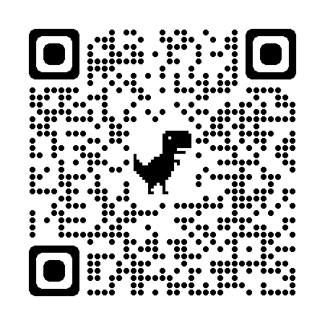
DATA SCIENCE LIFECYCLE
codifying problem and metrics
data collection and cleaning
feature engineering
model training
and tuning
model
validation
model
deployment
monitoring,
validation
Notes:
Mailing list analysis--regex, messy data

Slide 48
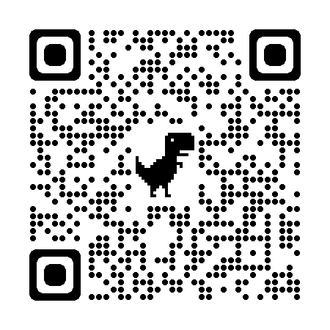
DATA SCIENCE LIFECYCLE
codifying problem and metrics
data collection and cleaning
feature engineering
model training
and tuning
model
validation
model
deployment
monitoring,
validation
Notes:
Ai-4-ci

Slide 49
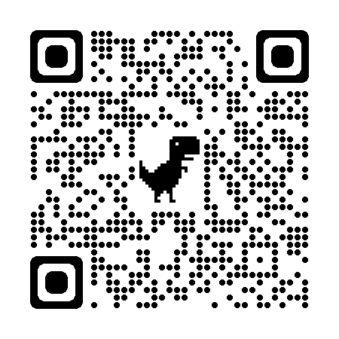
DATA SCIENCE LIFECYCLE
codifying problem and metrics
data collection and cleaning
feature engineering
model training
and tuning
model
validation
model
deployment
monitoring,
validation
Notes:
Pet image detection demo

Slide 50

DATA SCIENCE LIFECYCLE
codifying problem and metrics
data collection and cleaning
feature engineering
model training
and tuning
model
validation
model
deployment
monitoring,
validation
Notes:
sre-practices

Slide 51
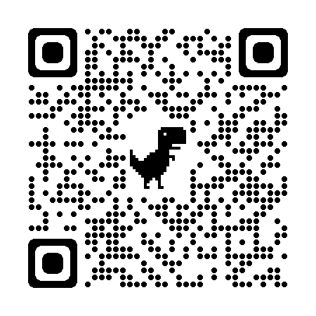
Stay Connected.
Notes:
Thank you for joining! and I look forward to chatting with you and answering your questions.

