Slide 1
Network Analysis
Boston University CS 506 - Lance Galletti

Slide 2
Example Networks
Internet:
What will internet traffic through Belgium look like today?
Anomalous traffic patterns
Model of the internet
Biology:
Are certain patterns of interactions among genes more common than expected?
Which regions of the brain communicate for a given task?
Social:
Who is friends with whom?
Who are the influencers?
What social groups are present?
How does information flow through the network?

Slide 3
Graphs
We use Graphs and Graph Theory to model / represent and analyse Networks.
A Graph is comprised of Nodes / Vertices connected by Edges. These Edges can be undirected (where edges are symmetrical connections between Nodes - A is connected to B then B is connected to A) or directed.
Node
Undirected Edge
Directed Edge

Slide 4
Graphs
Formally, a graph G is an ordered pair of sets (V, E) where:
V is the set of all Nodes / Vertices
E is the set of all Edges
Let G = (V, E) be undirected where V = {1, 2, 3} and E = {(1,2), (1,3), (2,3)}. What does G look like?
1
3
2

Slide 5
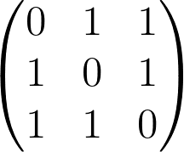
Graphs
How can we efficiently store a graph?
Adjacency Matrix
Adjacency List
1 : {2, 3}
2 : {1, 3}
3 : {1, 2}

Slide 6
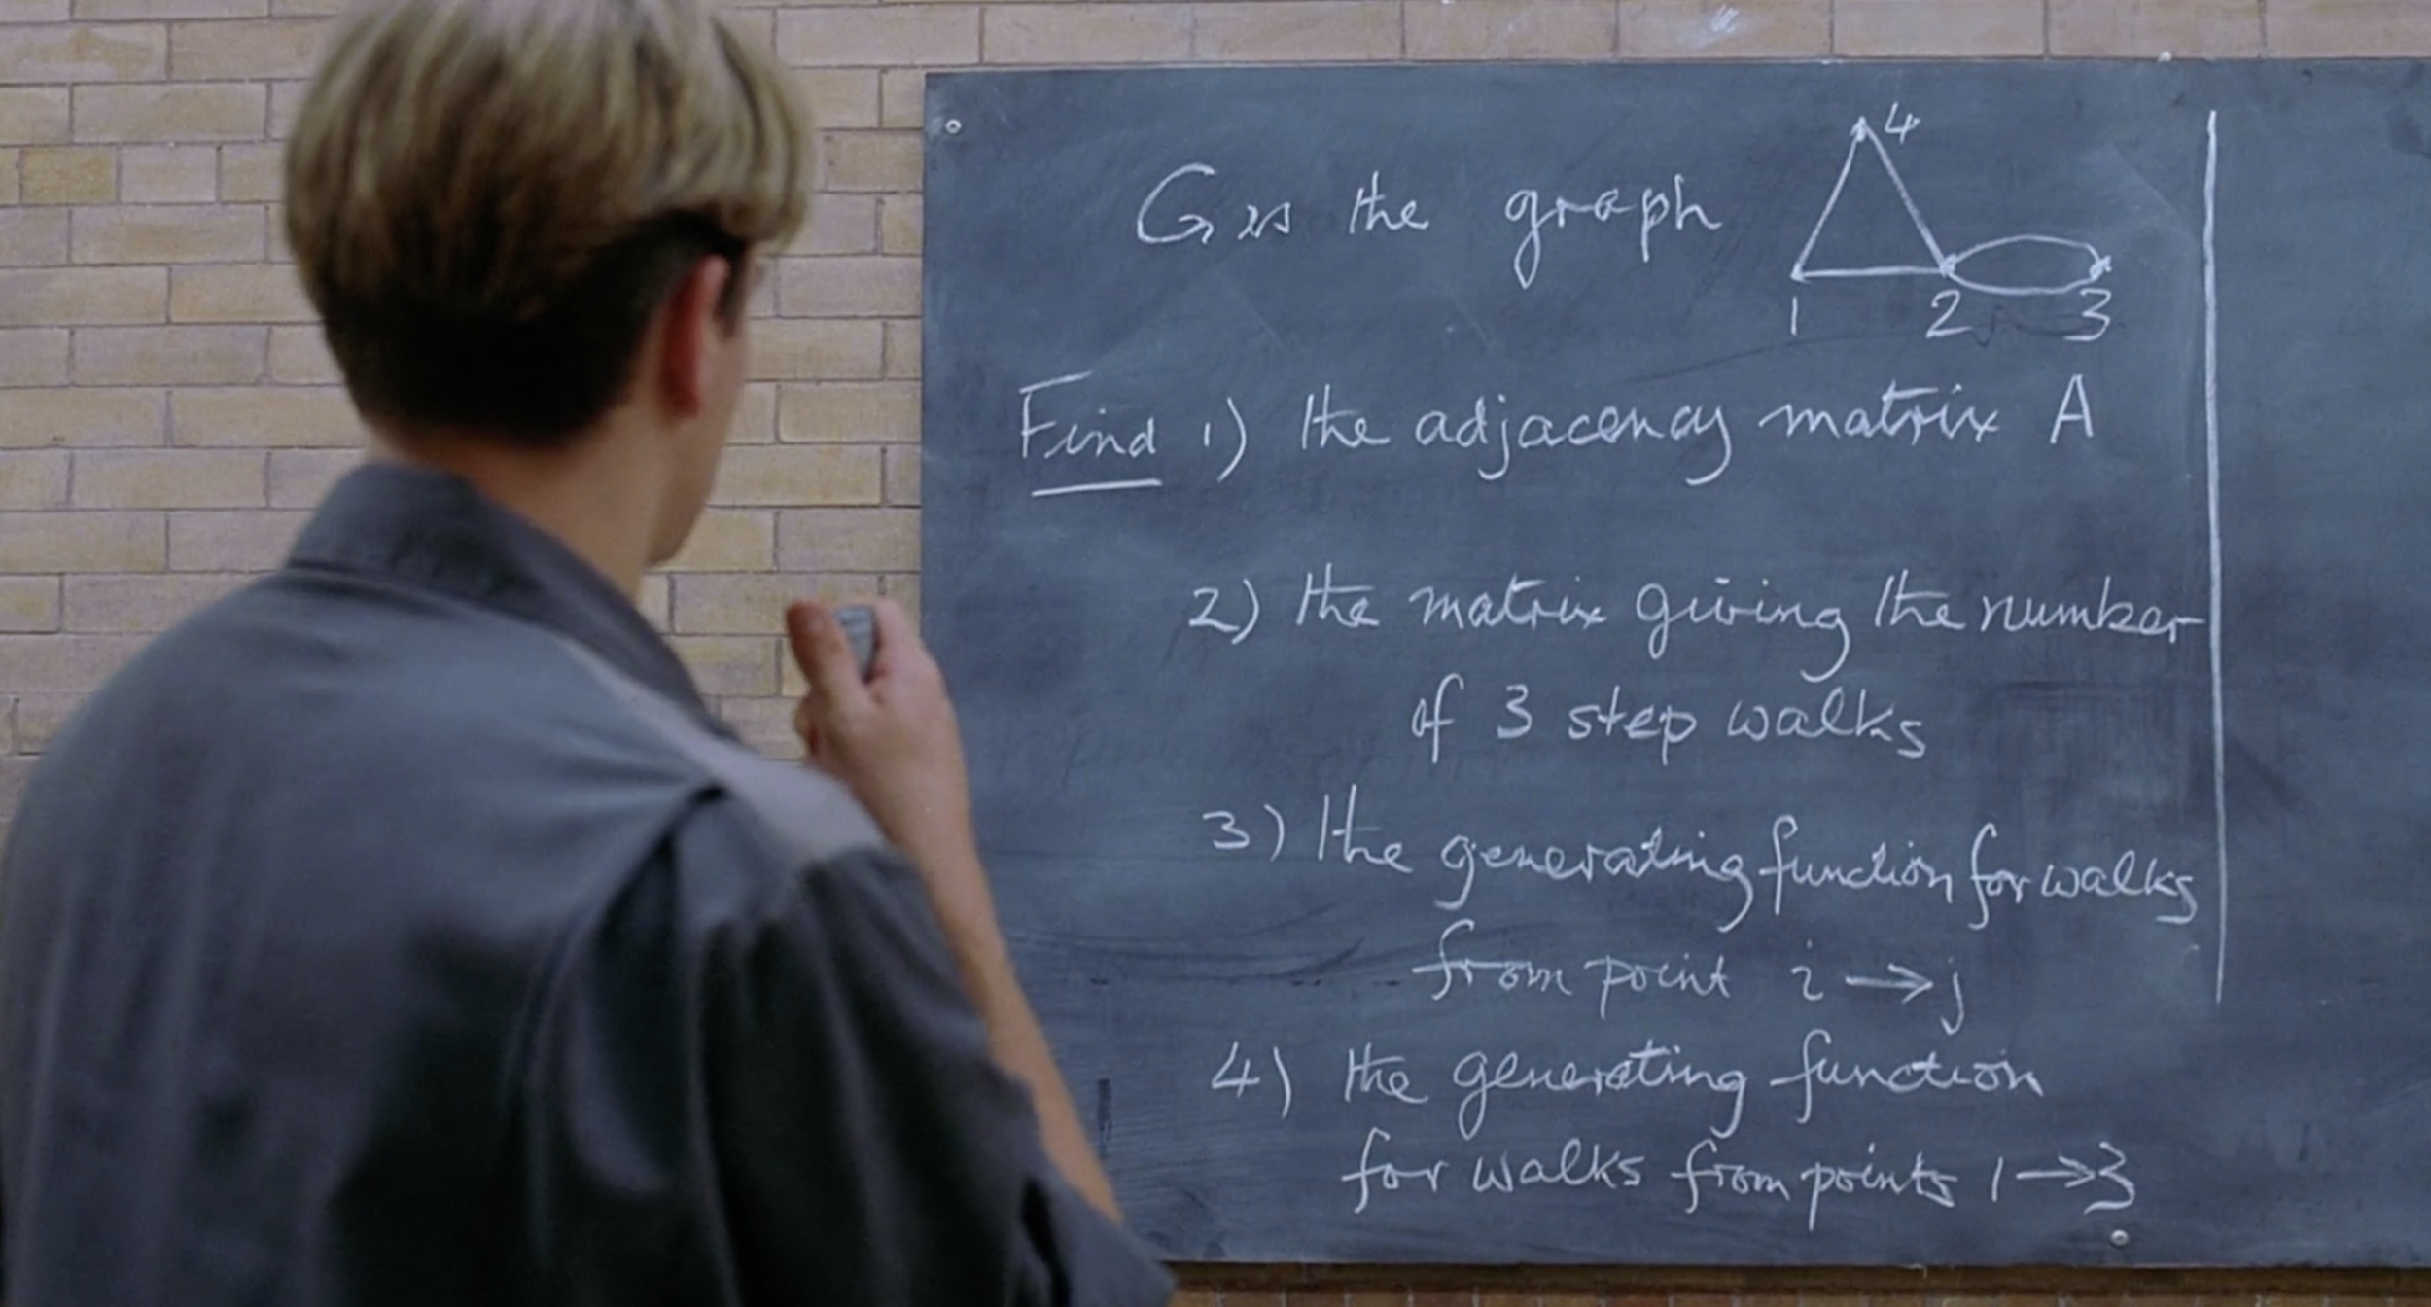
Graphs
Notes:
Good Will Hunting math problem

Slide 7
Graphs Characteristics
The degree of a Node is the number of edges connected to it.
A path between two Nodes is a sequence of edges that joins these two Nodes.
A graph is called complete if there is an edge between every pair of Nodes.
Questions:
What is the sum of the degrees of all Nodes in a Graph as a function of N_{E} (the number of Edges)?
2 * N_{E}
How many Edges are in a complete Graph as a function of N_{V} (the number of Nodes)
N_{V}(N_{V} - 1) / 2

Slide 8
Graph Problems
Clique Problem (find largest complete subgraph)
Coloring Problem (Color a graph with a given a number of colors s.t no two adjacent vertices share a color - or other conditions)
Travelling Salesman Problem (Given a list of cities and distances between cities, find the shortest path that goes through all cities and returns to its origin)
Shortest Path (given weights on edges, find the shortest path between two nodes)
Vertex Cover (When you pick a node, all its adjacent edges get removed. Find the min number of nodes needed to remove all edges from the graph)
Which one do you think is the easiest to solve?

Slide 9
Network Characteristics
Distribution of edges / node degrees:
Anomaly detection
Ranking / Recommendation
Describe flow through the network
Centrality of a node:
Identify influencers
Discover groups / clusterings
How nodes affect connectivity / flow

Slide 10
Network Analysis
Networks / Graphs are generated by processes or functions on its nodes / edges. For example: creating a new account (adding a node), making friends / following / connecting (adding an edge), etc.
The state of a Network / Graph at a given point in time is the stochastic result of these processes.
One way we can model the characteristics from the previous slide is by modeling the state of the Graph (i.e. finding the random process that generated the given Graph)

Slide 11
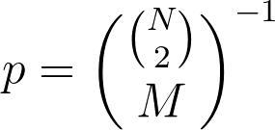

Random Graph Model
1. Let G(N, M) = {G = (V, E) | |V| = N, |E| = M} = the set of all graphs with N nodes and M edges. Pick uniformly from G(N,M).
Ex: G(3,2) = { , , } pick each with probability 1 / 3
In general, what is the probability with which you pick a graph from G(N, M)?
2. Let G(N, p) be generated by randomly connecting nodes with probability p, independently. What is the probability distribution of G(N, p) as a function of a number of edges M?
Hint: we are performing N(N-1) / 2 Bernoulli trials inserting edges independently with probability p.

Slide 12
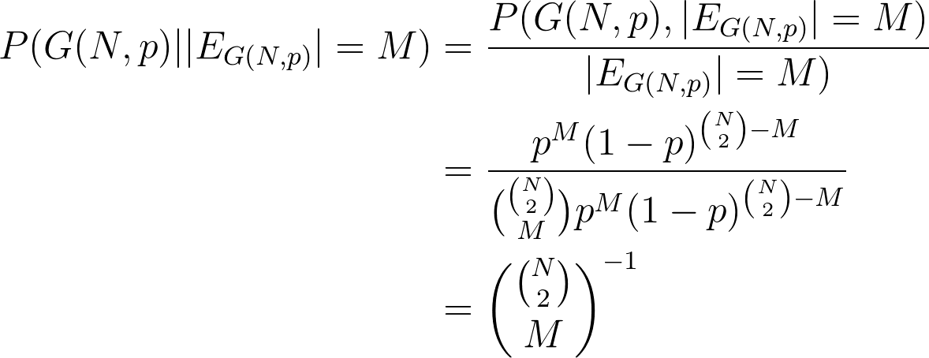
Random Graph Model
Both methods are related in that: G(N,p) conditioned on the event that it has M edges, is equal in distribution to G(N, M).
Proof:
P(

Slide 13
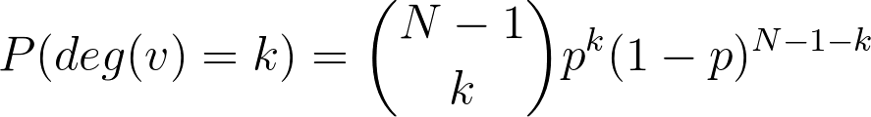
Random Graph Model
What is the distribution of the degree of Nodes?
Note: As N goes to infinity while Np remains constant (i.e. p goes to zero at a comparable rate), the above Binomial distribution converges to a Poisson Distribution
Q: What is the expected number of connections / degree for nodes in this Graph?
~ Np
Q: Is this realistic for say social networks?
This means on average we all have similar number of connections and that the probability of a high degree node is exponentially small. Probably not realistic.

Slide 14
Power Law
Most real-life social networks follow have a degree distribution following a power law of the form
P(k) = Ck^{-𝛼} for some constants C & 𝛼
What does this mean?
Random Graph
Power Law
freq
freq
deg
deg

Slide 15
Describing / Comparing Graphs
In order to compare graphs, we can define metrics that represent characteristics of the graphs and compare these.
We can talk about metrics that characterize the graph as a whole or characterize a specific node, edge, or set of nodes or edges.

Slide 16
Metrics on Graphs
Diameter
Let d_{ij} be the shortest path between node i and node j. The diameter of G is defined as
Diam(G) = max_{ij} d_{ij}
This captures what we refer to as the small world phenomenon.
Q: What is the Diameter of

Slide 17
Metrics on Graphs
Clustering Coefficient
C = # triangles / # triplets
A triangle is a closed triplet. A triplet consists of 3 nodes connected by 2 edges. Triangles and triplets are defined as being centered on a node.
Ex: What is the clustering coefficient of
1
3
5
C = (1 + 1 + 1 + 0 + 0) / (1 + 1 + 6 + 0 + 0)
= 3 / 8
2
4

Slide 18
Metrics on Graphs
Density
Let N = # Nodes, M = # Edges
Density = 2M / N(N-1)
Q: what is the density of a complete graph?
A: 1

Slide 19
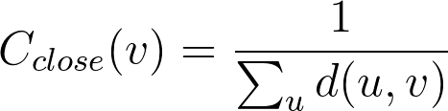
Metrics on Nodes
Degree Centrality
The more central a node is, the higher its number of connections
C_{deg}(v) = Deg(v)
Closeness Centrality
The more central a node is, the closer it is to all other nodes

Slide 20
Metrics on Nodes
For the following Graph
1
5
3
2
4
Q: Which node has the highest degree centrality?
A: 3
Q: What is the closeness centrality (where d(u,v) = # edges on the shortest path between u & v) of Node 3?
A: 1/4
Q: What is the closeness centrality of Node 5?
A: 1/7

Slide 21
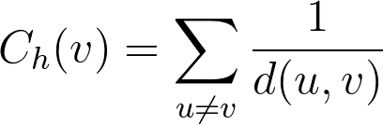
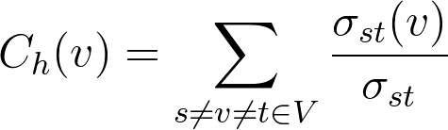
Metrics on Nodes
Harmonic Centrality
Where d⁻¹(u,v) = 0 if there is no path between u & v
Betweenness Centrality
Quantifies the number of times the node acts like a bridge along the shortest path between 2 other nodes
Where 𝞂_{st} is the total number of shortest paths from s to t and 𝞂_{st}(v) is the number of those shortest paths that go through v

Slide 22
Metrics on Nodes
For the following Graph
1
5
3
2
4
Q: What is the harmonic centrality of Node 3?
A: 4
Q: What is the betweenness centrality of Node 3?
A: 10

Slide 23
Recommendation
In homework 3 you will encounter the following problem:
Given a graph and a node v, how can we recommend nodes that v is not connected to?
We can rank all other nodes that v is not connected to from most recommended to least recommended. What scoring function can we use to produce such an ordering?
Common Neighbors
Jaccard’s Index
Adamic / Adar Index

Slide 24
Ranking Aggregation
Each of these scoring functions / metrics can generate an ordered list of nodes. We’ll refer to this ordered list as a ranking.
Q: How can we compare rankings?
Suppose we have two rankings w₁ , w₂. Can we use a distance function to compare these?
If we have access to the score, we could take the sum of the square differences in scores.
Problem is that different scores are not directly comparable.

Slide 25
Ranking Aggregation
We need a distance function on the ordering itself. Does this remind you of anything?
Disagreement distance?
Let’s count the number of inversions / disagreements between the rankings for all pairs of Nodes!

Slide 26
Ranking Aggregation
Kendall 𝜏 distance
d_{𝜏}(w₁ , w₂) = # pairs ranked in different order / # pairs
Pair | Agree
AB | ✓
AC | ✗
AD | ✗
BC | ✗
BD | ✗
CD | ✓
Node | A | B | C | D
w₁ | 1 | 2 | 3 | 4
w₂ | 3 | 4 | 1 | 2
d_{𝜏}(w₁ , w₂) = 4 / 6

Slide 27
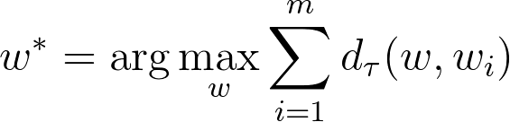
Ranking Aggregation
Given m Rankings w₁, … , w_{m}, we can generate an aggregate ranking w*

