Slide 1
Neural Networks
Boston University CS 506 - Lance Galletti

Slide 2
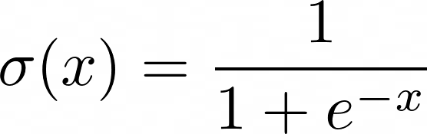
Logistic Regression Re-Revisited
x₁
x₁ | x₂ | y
... | ... | 0
... | ... | 1
... | ... | 1
... | ... | 0
𝝨w_{i}x_{i}
...
𝞂
proba(y)
x_{n}
where

Slide 3
Logistic Regression Re-Revisited
XOR function
x₁ | x₂ | y
0 | 0 | 0
1 | 0 | 1
0 | 1 | 1
1 | 1 | 0

Slide 4
Logistic Regression Re-Revisited
XOR function
x₁ | x₂ | y
0 | 0 | 0
1 | 0 | 1
0 | 1 | 1
1 | 1 | 0

Slide 5
Logistic Regression Re-Revisited
XOR function
x₁ | x₂ | y
0 | 0 | 0
1 | 0 | 1
0 | 1 | 1
1 | 1 | 0

Slide 6
Logistic Regression Re-Revisited
XOR function
x₁ | x₂ | y
0 | 0 | 0
1 | 0 | 1
0 | 1 | 1
1 | 1 | 0

Slide 7
Logistic Regression Re-Revisited
XOR function
x₁ | x₂ | y
0 | 0 | 0
1 | 0 | 1
0 | 1 | 1
1 | 1 | 0
?

Slide 8
Logistic Regression Re-Revisited
Recall, the OR function is linearly separable:
x₁ | x₂ | y
0 | 0 | 0
1 | 0 | 1
0 | 1 | 1
1 | 1 | 1

Slide 9
Logistic Regression Re-Revisited
XOR(x₁, x₂) = OR( AND(x₁ = 0 , x₂ = 1), AND(x₁ = 1 , x₂ = 0))
= (x₁ = 0 ⋀ x₂ = 1) ⋁ (x₁ = 1 ⋀ x₂ = 0)
= h₁ ⋁ h₂
x₁ | x₂ | h₁ | h₂ | y
0 | 0 | 0 | 0 | 0
1 | 0 | 0 | 1 | 1
0 | 1 | 1 | 0 | 1
1 | 1 | 0 | 0 | 0

Slide 10
Logistic Regression Re-Revisited
h₁ | h₂ | y
0 | 0 | 0
0 | 1 | 1
1 | 0 | 1
0 | 0 | 0
h₁
𝝨w_{i}h_{i}
𝞂
proba(y)
h₂
where

Slide 11
Logistic Regression Re-Revisited
But, the AND function is also linearly separable:
x₁ | x₂ | y
0 | 0 | 0
1 | 0 | 0
0 | 1 | 0
1 | 1 | 1

Slide 12
Logistic Regression Re-Revisited
Since we can learn h₁ and h₂ automatically through logistic regression
x₁ | x₂ | h₁
0 | 0 | 0
0 | 1 | 0
1 | 0 | 1
1 | 1 | 0
x₁
𝝨w_{i}x_{i}
𝞂
proba(h₁)
x₂

Slide 13
Logistic Regression Re-Revisited
Since we can learn h₁ and h₂ automatically through logistic regression
x₁ | x₂ | h₂
0 | 0 | 0
0 | 1 | 1
1 | 0 | 0
1 | 1 | 0
x₁
𝝨w_{i}x_{i}
𝞂
proba(h₂)
x₂

Slide 14
Neural Networks
Putting it all together:
x₁
h₁
y
x₂
h₂

Slide 15
Neural Networks
Putting it all together:
x₁
w⁽¹⁾₀₀
h₁
w⁽²⁾₀
w⁽¹⁾₁₀
w⁽¹⁾₀₁
y
x₂
h₂
w⁽²⁾₁
w⁽¹⁾₁₁

Slide 16
Neural Networks
Putting it all together:
x₁
w⁽¹⁾₀₀
h₁
w⁽²⁾₀
w⁽¹⁾₁₀
w⁽¹⁾₀₁
y
x₂
h₂
w⁽²⁾₁
w⁽¹⁾₁₁
Input layer

Slide 17
Neural Networks
Putting it all together:
x₁
w⁽¹⁾₀₀
h₁
w⁽²⁾₀
w⁽¹⁾₁₀
w⁽¹⁾₀₁
y
x₂
h₂
w⁽²⁾₁
w⁽¹⁾₁₁
Hidden layer

Slide 18
Neural Networks
Putting it all together:
x₁
w⁽¹⁾₀₀
h₁
w⁽²⁾₀
w⁽¹⁾₁₀
w⁽¹⁾₀₁
y
x₂
h₂
w⁽²⁾₁
w⁽¹⁾₁₁
Output layer

Slide 19
Neural Networks
We need to define:
How input flows through the network to get the output (forward propagation)
How the weights and biases gets updated (Backpropagation)

Slide 20
Neural Networks - Forward Propagation
x₁
w⁽¹⁾₀₀
h₁
w⁽²⁾₀
w⁽¹⁾₁₀
w⁽¹⁾₀₁
y
x₂
h₂
w⁽²⁾₁
w⁽¹⁾₁₁

Slide 21
Neural Networks - Forward Propagation
x₁
w⁽¹⁾₀₀
h₁
w⁽¹⁾₀₁
y
x₂
h₂
h₁ = 𝞂( w⁽¹⁾₀₀ x₁ + w⁽¹⁾₀₁ x₂ + b⁽¹⁾₁)

Slide 22
Neural Networks - Forward Propagation
x₁
h₁
w⁽¹⁾₁₀
y
x₂
h₂
w⁽¹⁾₁₁
h₂ = 𝞂( w⁽¹⁾₁₀ x₁ + w⁽¹⁾₁₁ x₂ + b⁽¹⁾₂)

Slide 23
Neural Networks - Forward Propagation
x₁
h₁
w⁽²⁾₀
y
x₂
h₂
w⁽²⁾₁
y = 𝞂( w⁽²⁾₀ h₁ + w⁽²⁾₁ h₂ + b⁽²⁾₁)

Slide 24
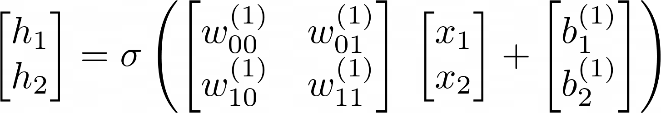
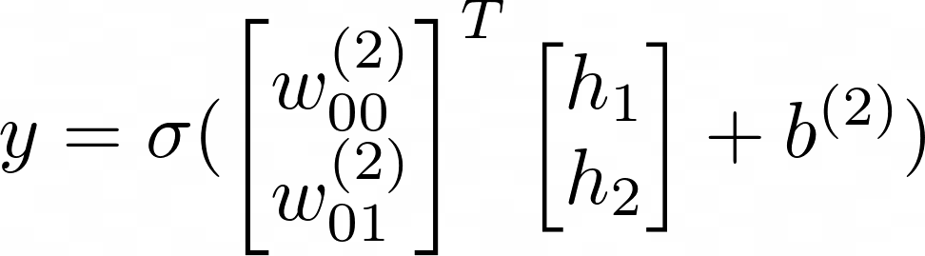
Neural Networks - Forward Propagation
Using matrix notation:

Slide 25
Neural Networks - Forward Propagation
Q: if all the weights and biases are initialized to 0, what will be the output of the network?
x₁
w⁽¹⁾₀₀
h₁
w⁽²⁾₀
w⁽¹⁾₁₀
w⁽¹⁾₀₁
y
x₂
h₂
w⁽²⁾₁
w⁽¹⁾₁₁

Slide 26
Neural Networks - Forward Propagation
Q: why have 𝞂 at all?
𝝨w_{i}a^{(l)}_{i}
𝞂
x₁
w⁽¹⁾₀₀
h₁
w⁽²⁾₀
w⁽¹⁾₁₀
w⁽¹⁾₀₁
y
x₂
h₂
w⁽²⁾₁
w⁽¹⁾₁₁

Slide 27
Neural Networks - Forward Propagation
If we don’t, we just end up with normal logistic regression on x₁ and x₂.
h₁ = w⁽¹⁾₀₀ x₁ + w⁽¹⁾₀₁ x₂ + b⁽¹⁾₁
h₂ = w⁽¹⁾₁₀ x₁ + w⁽¹⁾₁₁ x₂ + b⁽¹⁾₂
Then
y = 𝞂( w⁽²⁾₀ h₁ + w⁽²⁾₁ h₂ + b⁽²⁾₁)
= 𝞂( w⁽²⁾₀(w⁽¹⁾₀₀ x₁ + w⁽¹⁾₀₁ x₂ + b⁽¹⁾₁) + w⁽²⁾₁(w⁽¹⁾₁₀ x₁ + w⁽¹⁾₁₁ x₂ + b⁽¹⁾₂) + b⁽²⁾₁)
= 𝞂( w₁ x₁ + w₂ x₂ + b₂)

Slide 28
Neural Networks - BackPropagation
How do weights and biases get updated?
x₁
w⁽¹⁾₀₀
h₁
w⁽²⁾₀
w⁽¹⁾₁₀
w⁽¹⁾₀₁
y
x₂
h₂
w⁽²⁾₁
w⁽¹⁾₁₁
W⁽²⁾ & b⁽²⁾

Slide 29

Neural Networks - BackPropagation
Recall for logistic regression:
=

Slide 30
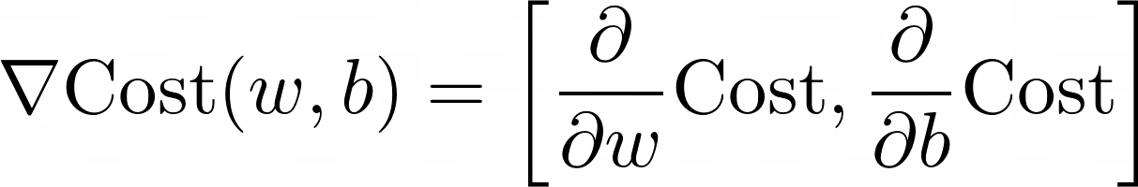
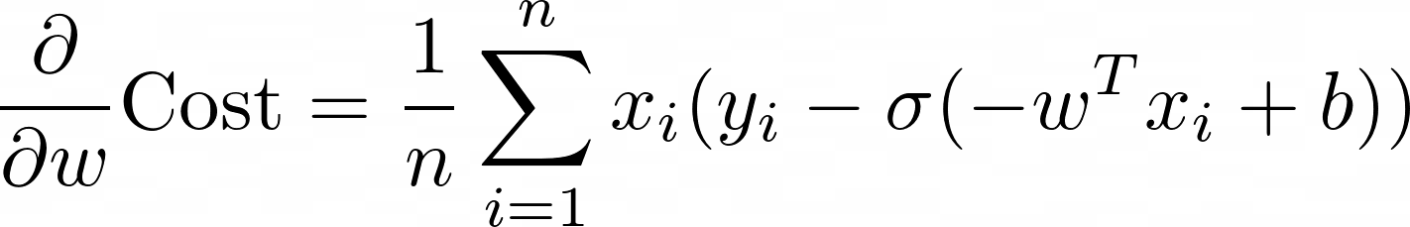
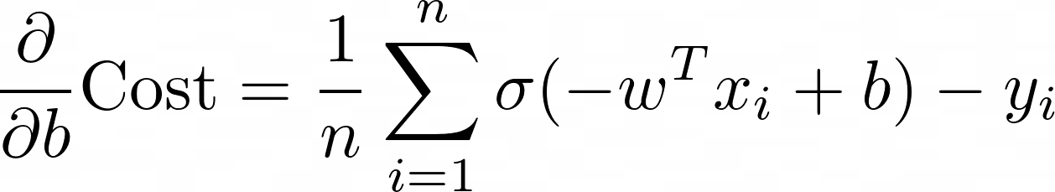
Neural Networks - BackPropagation

Slide 31
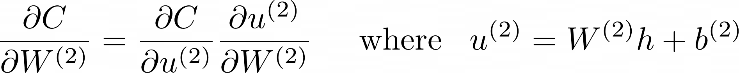
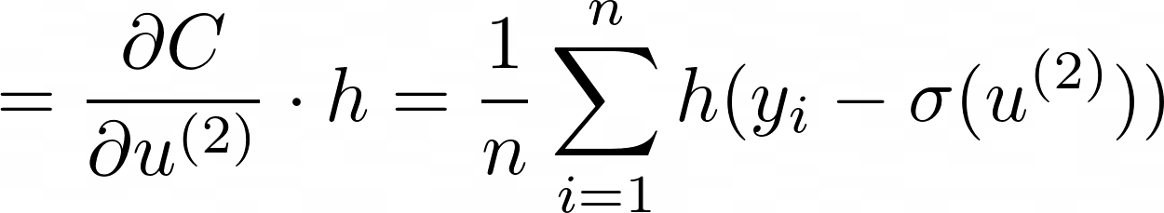
Neural Networks - BackPropagation
Using the chain rule:
h = 𝞂( W⁽¹⁾ X + b⁽¹⁾)

Slide 32
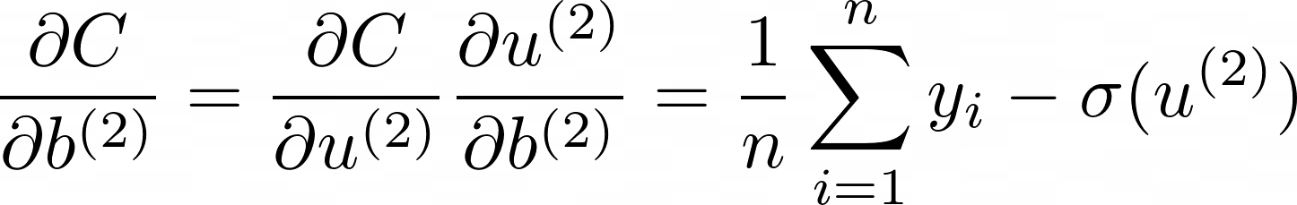
Neural Networks - BackPropagation
Similarly:

Slide 33
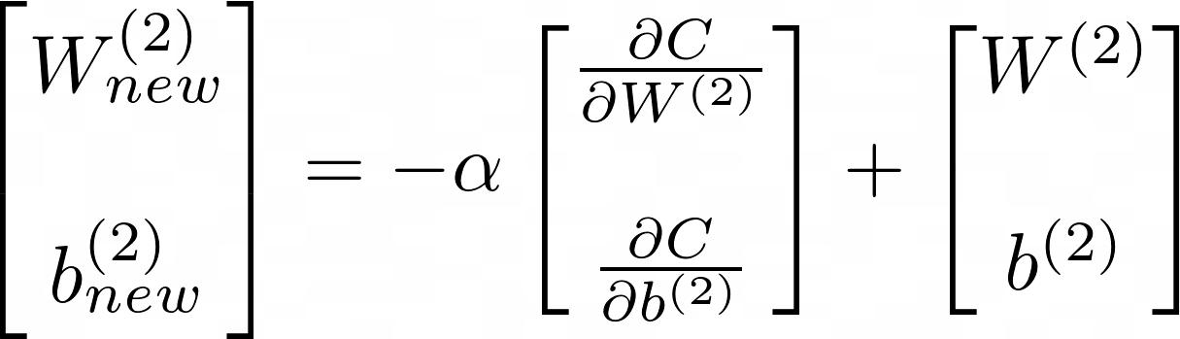
Neural Networks - BackPropagation
So we can update W⁽²⁾ and b⁽²⁾ as follows:
But how do we update W⁽¹⁾ and b⁽¹⁾

Slide 34
Neural Networks - BackPropagation
How do weights and biases get updated?
x₁
w⁽¹⁾₀₀
h₁
w⁽²⁾₀
w⁽¹⁾₁₀
w⁽¹⁾₀₁
y
x₂
h₂
w⁽²⁾₁
w⁽¹⁾₁₁
W⁽¹⁾ & b⁽¹⁾

Slide 35
Neural Networks - BackPropagation
Using the chain rule:
Already computed

Slide 36
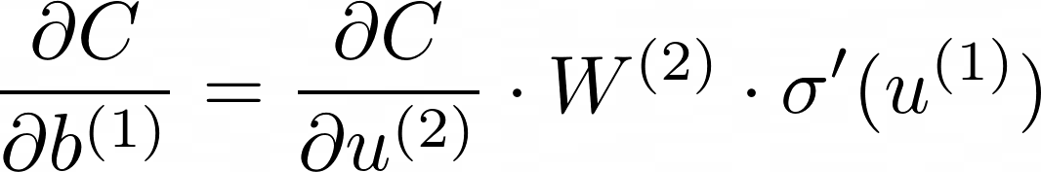
Neural Networks - BackPropagation
Similarly:
Already computed

Slide 37
Neural Networks - BackPropagation
Backpropagation: update W⁽¹⁾ and b⁽¹⁾ without recomputing values that are computed when getting the gradients of the previously updated layer.
http://yann.lecun.com/exdb/publis/pdf/lecun-98b.pdf

Slide 38
Neural Networks - BackPropagation
Important Note:
Depends on both data and weights
Initializing all weights to zero then is not a good idea

Slide 39
Feedforward Neural Networks
In general:
x₁
y
x₂

Slide 40
Feedforward Neural Networks
In general:
x₁
y
x₂
Input layer

Slide 41
Feedforward Neural Networks
In general:
x₁
y
x₂
hidden layers

Slide 42
Feedforward Neural Networks
In general:
x₁
y
x₂
hidden layers

Slide 43
Feedforward Neural Networks
𝝨w_{i}a^{(l)}_{i} + b
In general:
𝞂
x₁
y
Activation function
x₂
hidden layers

Slide 44
Feedforward Neural Networks
In general:
x₁
y
x₂
Output layer

Slide 45
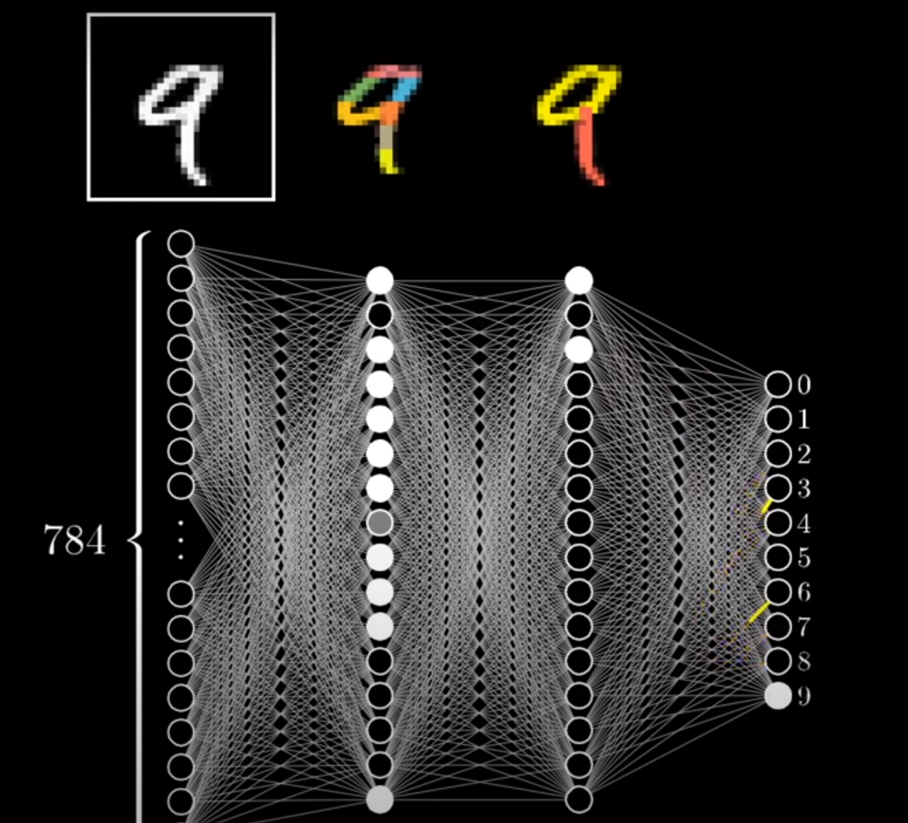
Feedforward Neural Networks
The hope:
Image from 3b1b

Slide 46
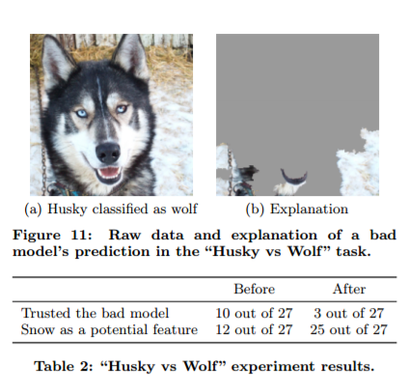
Feedforward Neural Networks
The reality:
Image from "Why Should I Trust You?": Explaining the Predictions of Any Classifier (2016)Marco Tulio Ribeiro, Sameer Singh, Carlos Guestrin

Slide 47
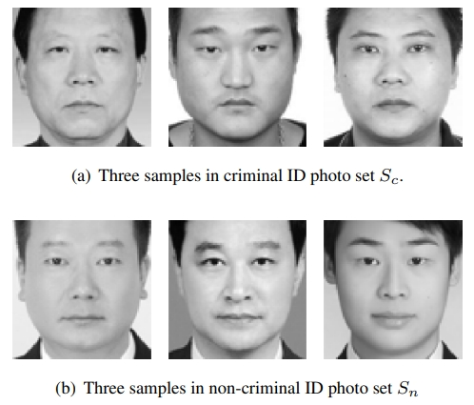
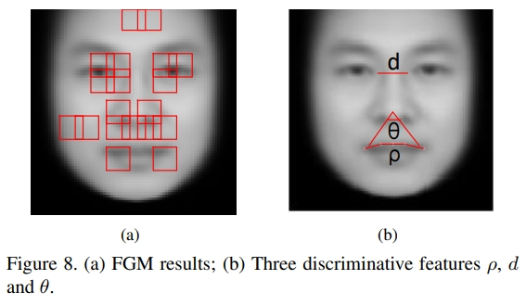
Feedforward Neural Networks
The scary reality:
from "Automated Inference on Criminality using Face Images”, Xiaolin Wu, Xi Zhang
According to this model, if you don’t smile, you’re a criminal

Slide 48
Neural Networks
Can do both Classification and Regression

Slide 49
Neural Networks - Tuning Parameters
Step size 𝛂
Number of BackPropagation iterations
Batch Size
Number of hidden layers
Size of each hidden layer
Activation function used in each layer
Cost function
Regularization (to avoid overfitting)

Slide 50




Activation Functions
Identity -> x
Sigmoid -> 𝞂(x)
Tanh -> tanh(x)
ReLU -> max(0, x)
Note: can use any function you want in order to introduce non-linearity. These are just the popular ones that have been shown to work in practice.
Tuning the activation function is equivalent to feature engineering.

Slide 51
Demo

Slide 52
Neural Networks
First: Normalize your data
https://medium.com/mlearning-ai/tuning-neural-networks-part-i-normalize-your-data-6821a28b2cd8

Slide 53
Neural Networks - Initialization Gotchas
https://medium.com/mlearning-ai/tuning-neural-networks-part-ii-considerations-for-initialization-4f82e525da69

Slide 54
Neural Networks - Challenges
High risk of overfitting as you’re optimizing on the training set.
As the dimensionality of the input increases:
So does the number of weights
The gradients typically get smaller: Vanishing gradient problem
Doesn’t do well for computer vision where the object of detection can be anywhere in the image
Doesn’t handle sequences of inputs (i.e. providing context for data)

Slide 55
Neural Networks - Regularization
Two main ways:
Early termination of weight / bias updates
Dropout - kill neurons (by setting them to 0) randomly
Cost
Stop here
Test
Train
Iterations

Slide 56
Neural Networks - Convolutional Neural Networks
a₀₀
a₀₁
a₀₀ | a₀₁
a₁₀ | a₁₁
y
a₁₀
a₁₁

Slide 57
Neural Networks - Convolutional Neural Networks
a₀₀
a₀₁
...
...
y
...
a₁₀
a₁₁

Slide 58
Neural Networks - Convolutional Neural Networks

Slide 59
Neural Networks - Convolutional Neural Networks

Slide 60
Neural Networks - Convolutional Neural Networks

Slide 61
Neural Networks - Convolutional Neural Networks
w₁ | w₂
w₃ | w₄
Recall: Our network learns weights for each cell

Slide 62
Neural Networks - Convolutional Neural Networks
w₁ | w₂
w₃ | w₄
a₀₀ | a₀₁
a₁₀ | a₁₁
= w₁a₀₀
w₁ | w₂
w₃ | w₄
a₀₀ | a₀₁
a₁₀ | a₁₁
= w₁a₀₀ + w₂a₀₁
w₁ | w₂
w₃ | w₄
a₀₀ | a₀₁
a₁₀ | a₁₁
= w₁a₀₀ + w₂a₀₁ + w₃a₁₀
w₁ | w₂
w₃ | w₄
a₀₀ | a₀₁
a₁₀ | a₁₁
= w₁a₀₀ + w₂a₀₁ + w₃a₁₀ + w₄a₁₁

Slide 63
Neural Networks - Convolutional Neural Networks
Knowing this, what happens if we slide this filter across the larger diagonal?
a₀₀ | a₀₁
a₁₀ | a₁₁
w₁ | w₂
w₃ | w₄
✔
✔

Slide 64
Neural Networks - Convolutional Neural Networks
Knowing this, what happens if we slide this filter across the larger diagonal?
a₀₀ | a₀₁
a₁₀ | a₁₁
w₁ | w₂
w₃ | w₄
✘
✔ | ✘

Slide 65
Neural Networks - Convolutional Neural Networks
Knowing this, what happens if we slide this filter across the larger diagonal?
a₀₀ | a₀₁
a₁₀ | a₁₁
w₁ | w₂
w₃ | w₄
✘
✔ | ✘ | ✘

Slide 66
Neural Networks - Convolutional Neural Networks
Knowing this, what happens if we slide this filter across the larger diagonal?
a₀₀ | a₀₁
a₁₀ | a₁₁
w₁ | w₂
w₃ | w₄
✘
✔ | ✘ | ✘
✘

Slide 67
Neural Networks - Convolutional Neural Networks
Knowing this, what happens if we slide this filter across the larger diagonal?
a₀₀ | a₀₁
a₁₀ | a₁₁
w₁ | w₂
w₃ | w₄
✔
✔ | ✘ | ✘
✘ | ✔

Slide 68
Neural Networks - Convolutional Neural Networks
Knowing this, what happens if we slide this filter across the larger diagonal?
a₀₀ | a₀₁
a₁₀ | a₁₁
w₁ | w₂
w₃ | w₄
✘
✔ | ✘ | ✘
✘ | ✔ | ✘

Slide 69
Neural Networks - Convolutional Neural Networks
Knowing this, what happens if we slide this filter across the larger diagonal?
a₀₀ | a₀₁
a₁₀ | a₁₁
w₁ | w₂
w₃ | w₄
✘
✔ | ✘ | ✘
✘ | ✔ | ✘
✘

Slide 70
Neural Networks - Convolutional Neural Networks
Knowing this, what happens if we slide this filter across the larger diagonal?
a₀₀ | a₀₁
a₁₀ | a₁₁
w₁ | w₂
w₃ | w₄
✘
✔ | ✘ | ✘
✘ | ✔ | ✘
✘ | ✘

Slide 71
Neural Networks - Convolutional Neural Networks
Knowing this, what happens if we slide this filter across the larger diagonal?
a₀₀ | a₀₁
a₁₀ | a₁₁
w₁ | w₂
w₃ | w₄
✔
✔ | ✘ | ✘
✘ | ✔ | ✘
✘ | ✘ | ✔

Slide 72
Neural Networks - Convolutional Neural Networks
Creating such a filter allows us to:
Reduce the number of weights
Capture features all over the image
The process of applying a filter (or kernel) is called a convolution

Slide 73
Neural Networks - Convolutional Neural Networks
To reduce the weights even further, another phase is done after convolution called Pooling:
1 | 1
1 | 1
Max Pooling
✔ | ✘ | ✘
✘ | ✔ | ✘
✘ | ✘ | ✔
1 | .5 | 0
.5 | 1 | .5
0 | .5 | 1
=
.75 | .5
.5 | .75
Average Pooling

Slide 74
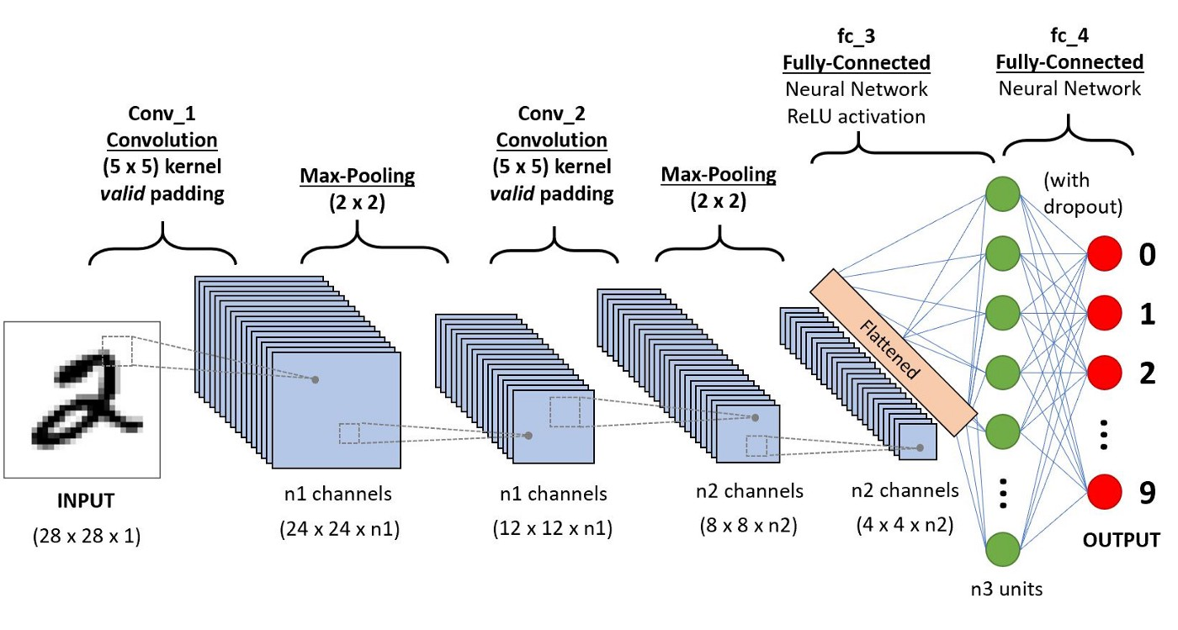
Neural Networks - Convolutional Neural Networks
Image from https://towardsdatascience.com/a-comprehensive-guide-to-convolutional-neural-networks-the-eli5-way-3bd2b1164a53

Slide 75
Neural Networks - Convolutional Neural Networks
Main application: Computer vision

Slide 76
Recurrent Neural Networks
Handling sequences of input.
Intuition: What a word is / might be in a sentence is easier to figure out if you know the words around it.
Applications:
Predicting the next word
Translation
Speech Recognition
Video Tagging

Slide 77
Recurrent Neural Networks
a₀
y
a₁
b₀
y
b₁
c₀
y
c₁

Slide 78
Neural Networks - Auto Encoders
x₁
y₁
A
A^{(k)}
x₂
y₂
...
...
...
x_{n}
y_{n}
k neurons

