Slide 1
A Probabilistic Model with Commonsense Constraints for Pattern-based Temporal Fact Extraction
Yang Zhou, Tong Zhao, Meng Jiang

Slide 2
Temporal Fact Extraction from unstructured text data
w.r.t finding Country‘s President Person at Time Task
“... The former French president Jacques Chirac, a self-styled affable rogue who was head of state from 1995 to 2007 ...” (posted on Sept. 26, 2019 [text gen. time] ) “
2) “... Emmanuel Macron, now President of France, graduated from ENA in 2004...” (posted on Sept. 19, 2019) “
--From news data
Extracted by
Textual Pattern
Pattern 1: former Country president Person
Pattern 2: Person, now president of Country
Time Signal：
temporal tag
text generate time

Slide 3
Temporal Fact Extraction from unstructured text data
“... The former French [Country: France] president Jacques Chirac [Person], a self-styled affable rogue who was head of state from 1995 [temporal tag] to 2007 ...” (posted on Sept. 26, 2019 [text gen. time] ) “
2) “... Emmanuel Macron [Person], now President of France [Country], graduated from ENA in 2004 [temporal tag] ...” (posted on Sept. 19, 2019 [text gen. time]) “
--From news data
Textual Pattern
Pattern 1: former Country president Person
Pattern 2: Person, now president of Country
Time Signal：
temporal tag
text generate time
• ✔ (France, Jacques Chirac, 1995): P1 and temporal tag;
• ✗ (France, Jacques Chirac, 2019): P1 and text gen.time;
• ✗ (France, Emmanuel Macron, 2004): P2 and temporal tag;
• ✔(France,EmmanuelMacron,2019):P2 and textgen.time.
Temporal Fact Extraction

Slide 4
Temporal Fact Extraction from unstructured text data
Here, we have some observations about Temporal Fact Extraction:
O1: Not every pattern is reliable, Patterns have reliability .
pattern such as “Person visited Country” is very likely to be unreliable; and pattern such as “current Country’s president Person” is very likely to be reliable.
O2: There is a dependency between pattern and type of time signal
For temporal fact extraction, different types of time signals might be either reliable or unreliable depending on the pattern.

Slide 5
Method: Probabilistic Graphical Model
What’s Probabilistic Graphical Model?
Why use Probabilistic Graphical Model ?
P
P(B|A)
A
B

Slide 6
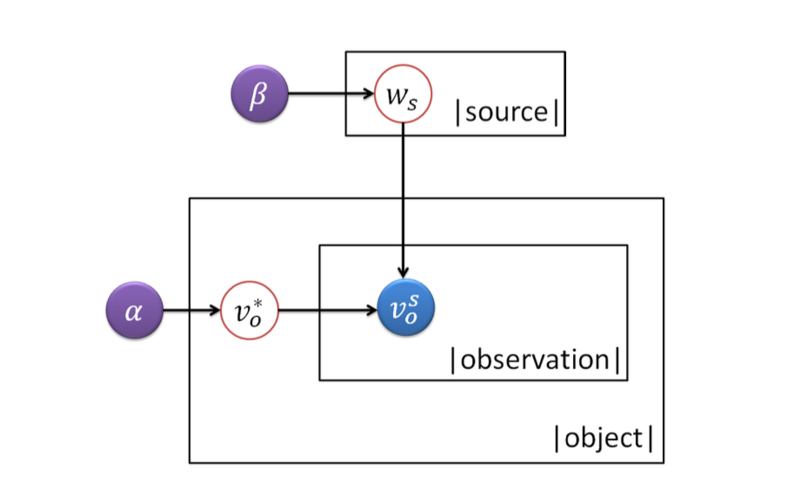
Truth Discovery via PGM
Truth discovery approaches follow two fundamental principles:
If a source provides much trustworthy information, its reliability is high
If an Information is supported by many reliable source, this information is more likely to be true.

Slide 7
Temporal Truth:
Here, we have some commonsense constraint about Temporal Truth:
For country’s president:
one president serves only one country;
one country has only one president at a time;
one country can have multiple presidents in the history (e.g., United States, France).
For sports team’s player:
one player serves only one club at a time;
one club has multiple players and one player can serve multiple clubs in his/her career.
• C1: one value matches with only one entity;
• C2: one entity matches with only one value;
• C3: one value matches with only one entity at a time;
• C4: one entity matches with only one value at a time.
generalize

Slide 8
Temporal Truth:
Commonsense Constraint rules are abstract, While every node in PGM is concrete variable.
it is necessary to model the commonsense for identifying conflicts, estimating pattern reliability, and finding true temporal facts.
• C1: one value matches with only one entity;
• C2: one entity matches with only one value;
• C3: one value matches with only one entity at a time;
• C4: one entity matches with only one value at a time.
generalize

Slide 9
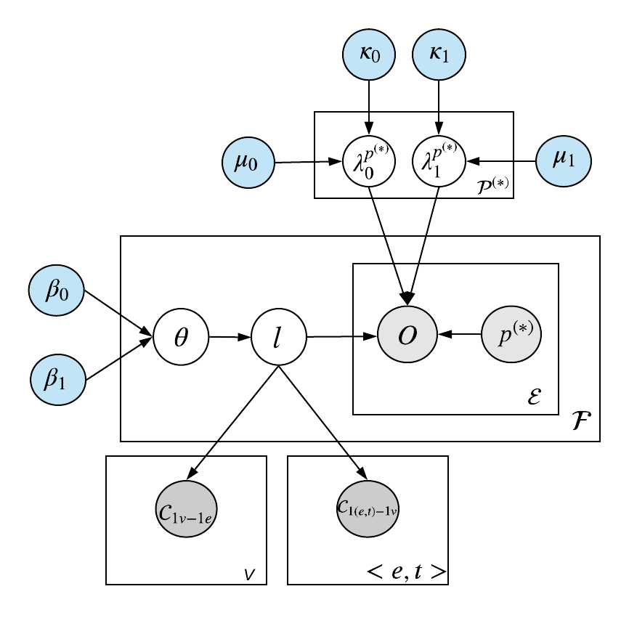
PGM on Temporal Fact Extraction

Slide 10
PGM on Temporal Fact Extraction

